Slide 1


Slide 2
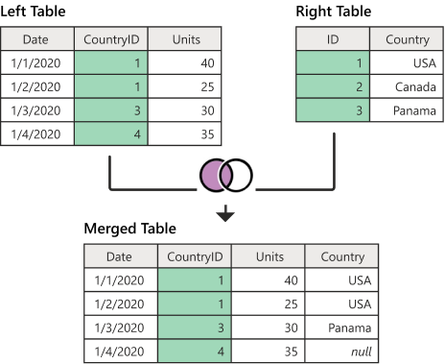
Left Join

Slide 3
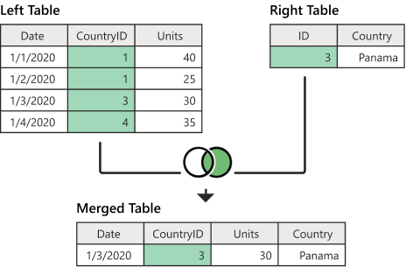
Right Join

Slide 4
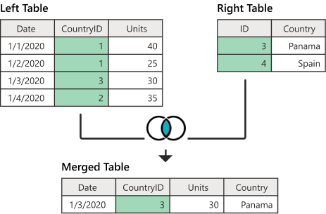
Inner Join

Slide 5
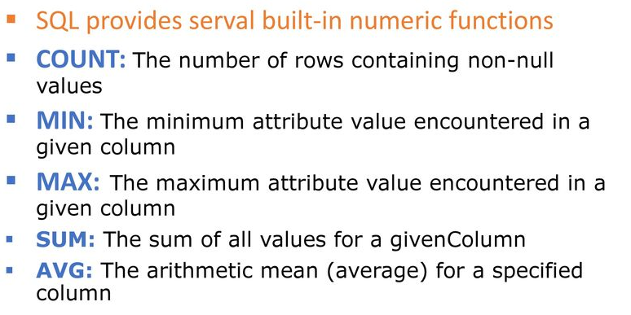
SQL Agregate functions

Slide 6
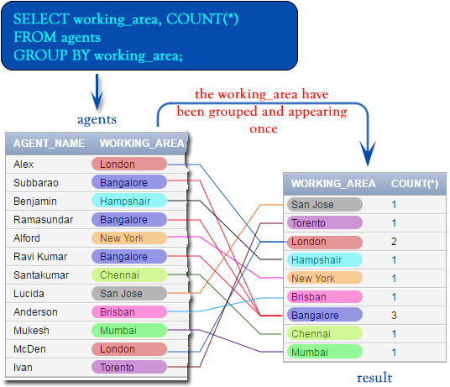
SQL Group by

Slide 7
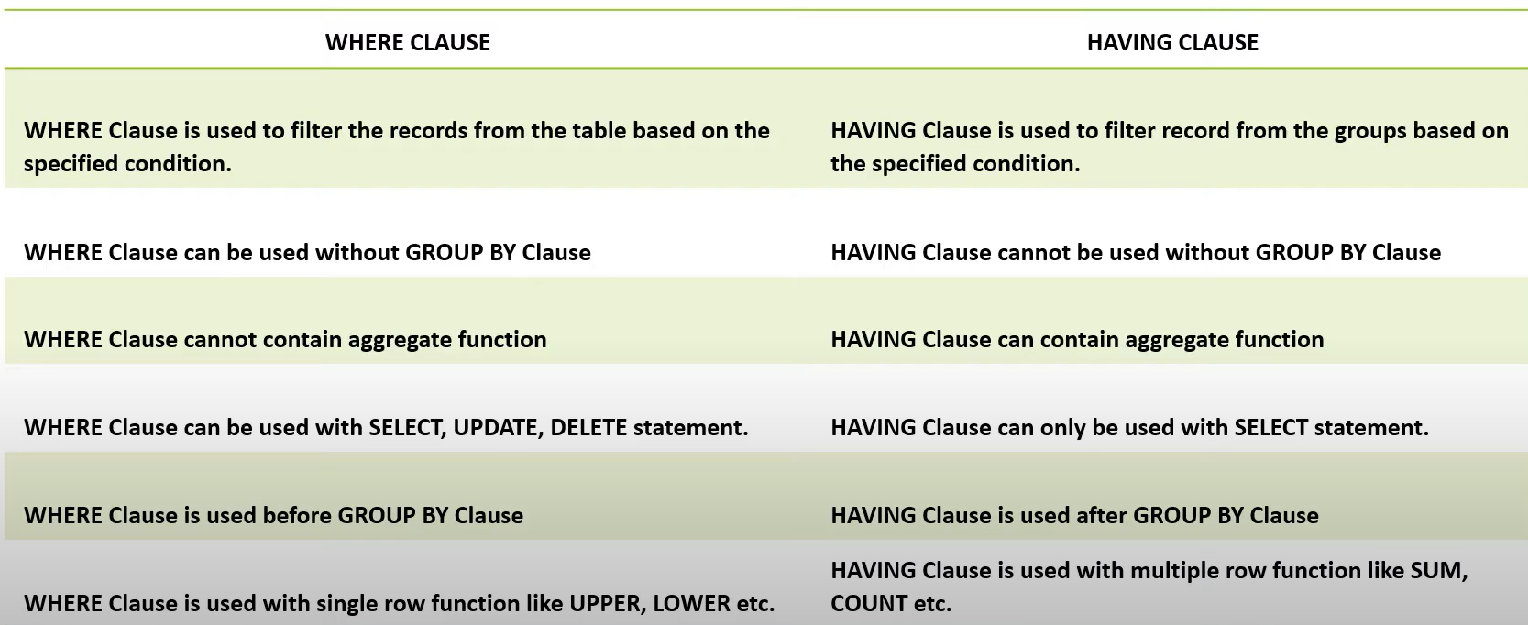
Where VS Having

Slide 8
SELECT statement
INNER JOIN
LEFT JOIN
RIGHT JOIN
Self Join
GROUP BY
HAVING
Subquery
Derived Tables
EXISTS

