Slide 1
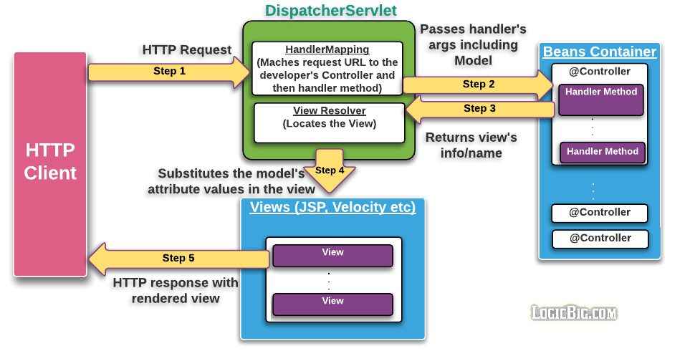
Spring MVC High level

Slide 2
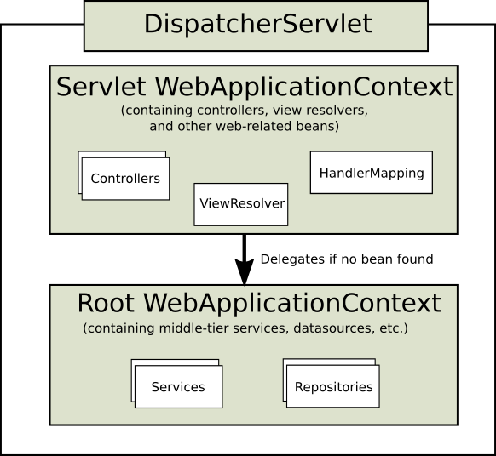
DispatcherServlet

Slide 3
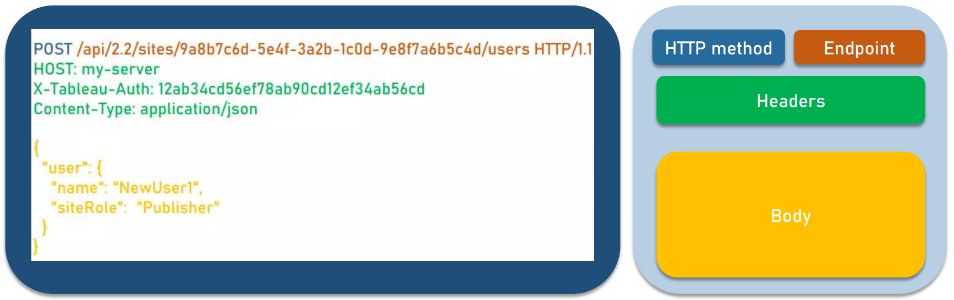

Rest Api Request

Slide 4
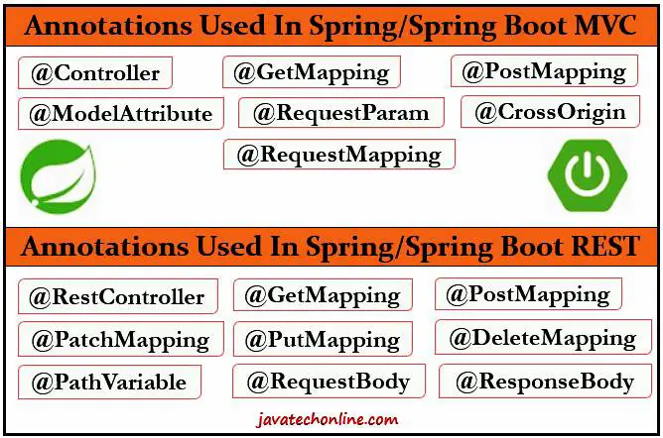
Typical annotations

Slide 5
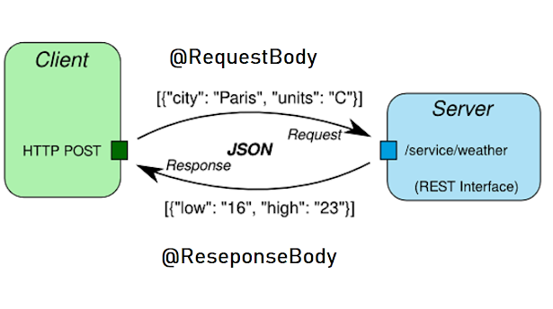
@RequestBody/@ResponseBody

Slide 6
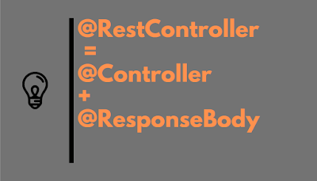
@RestController

Slide 7
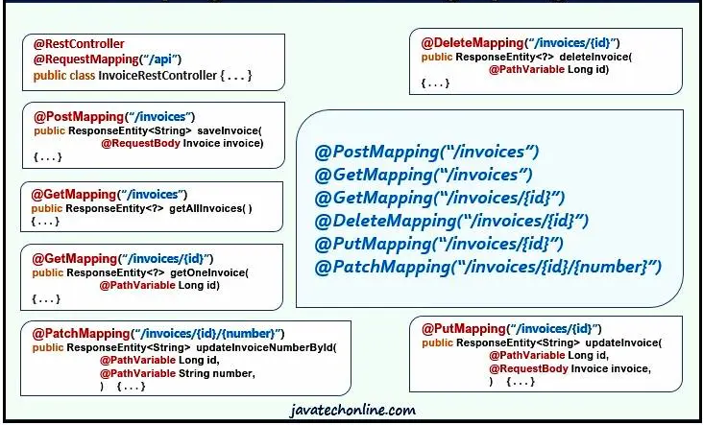
@RequestMapping shortcuts

Slide 8
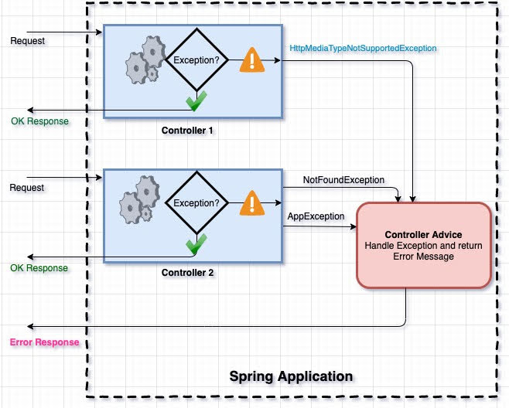
@ControllerAdvice

Slide 9
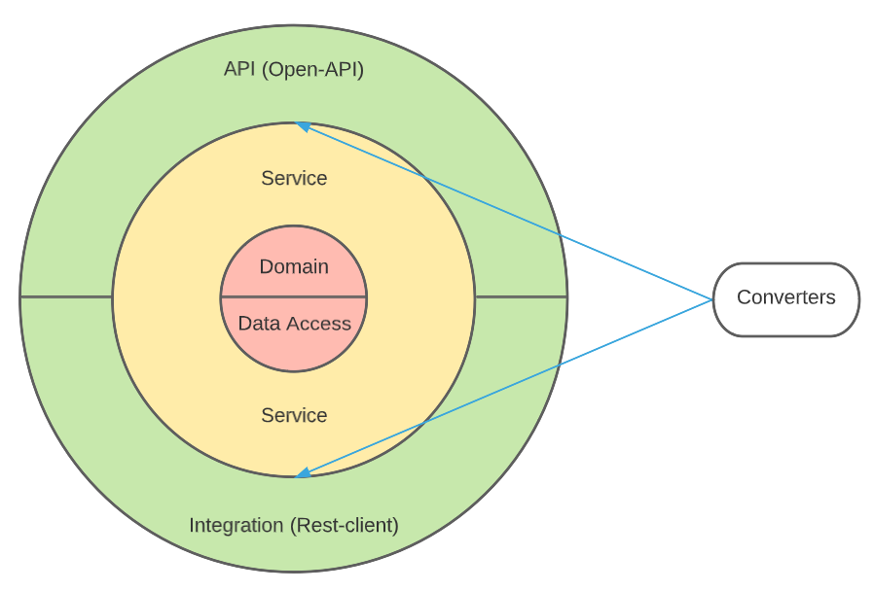
Onion Architecture

