Slide 1
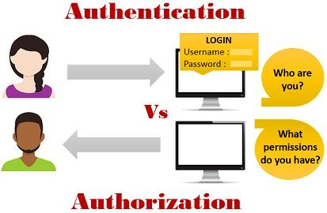
Authentication vs Authorization

Slide 2
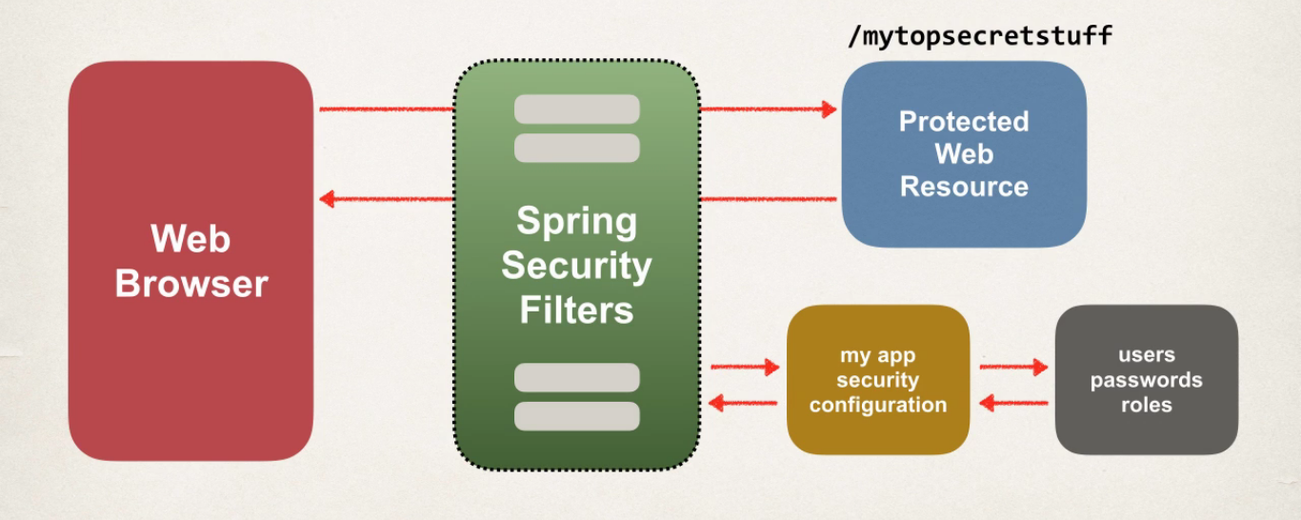
Spring Security overview

Slide 3
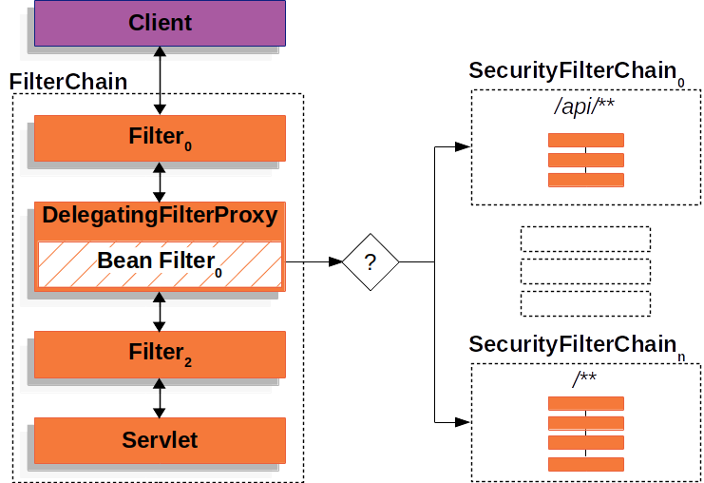
Spring Security concept

Slide 4
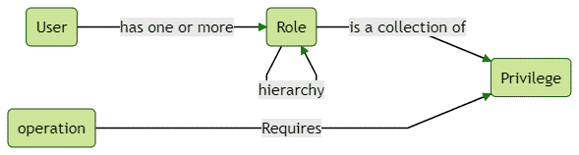
Spring Security Authentication

Slide 5
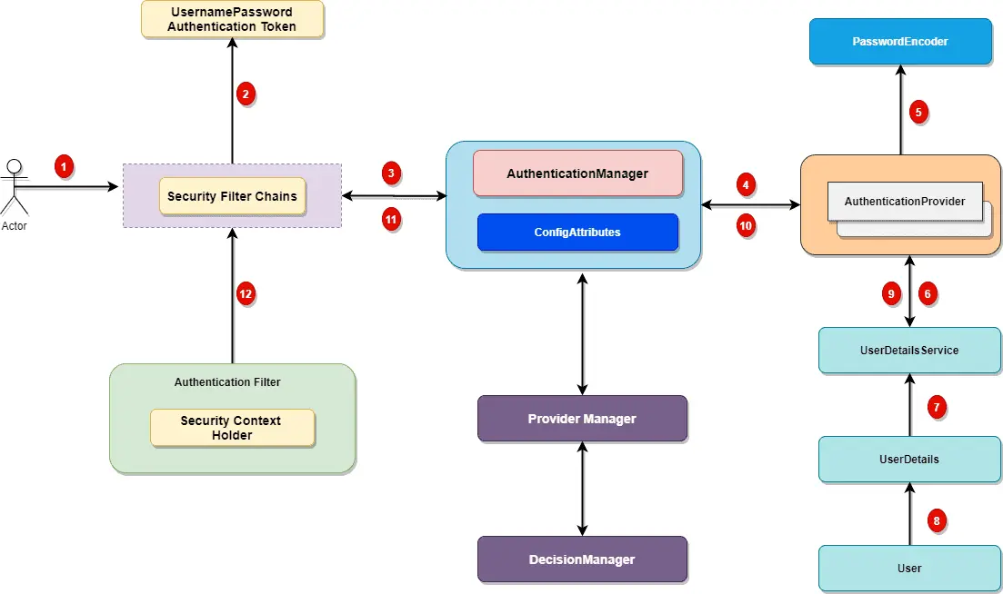
Spring Security Authentication

Slide 6
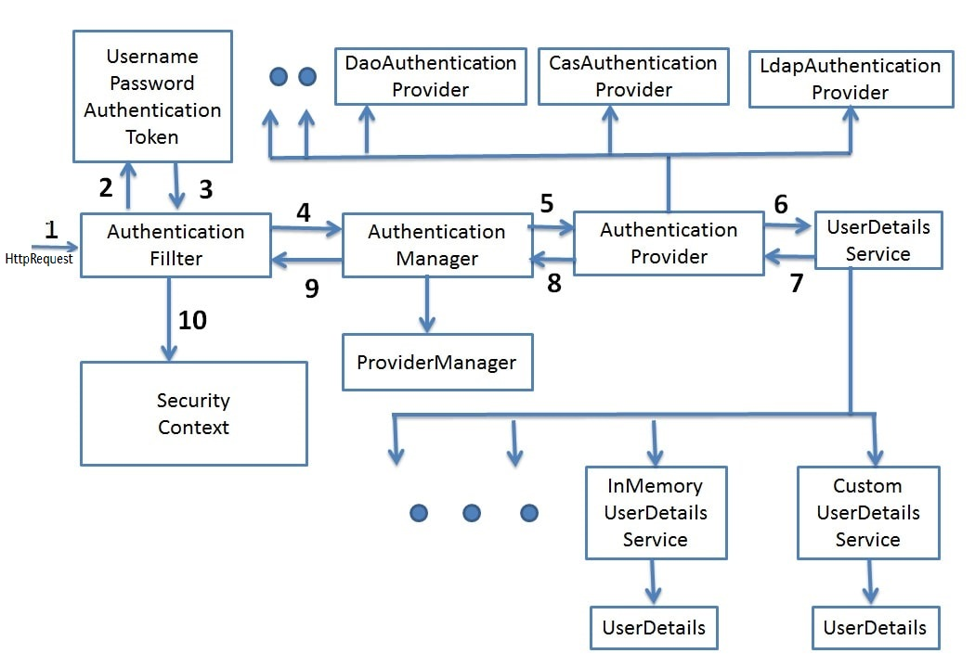
Spring Security Authentication

Slide 7
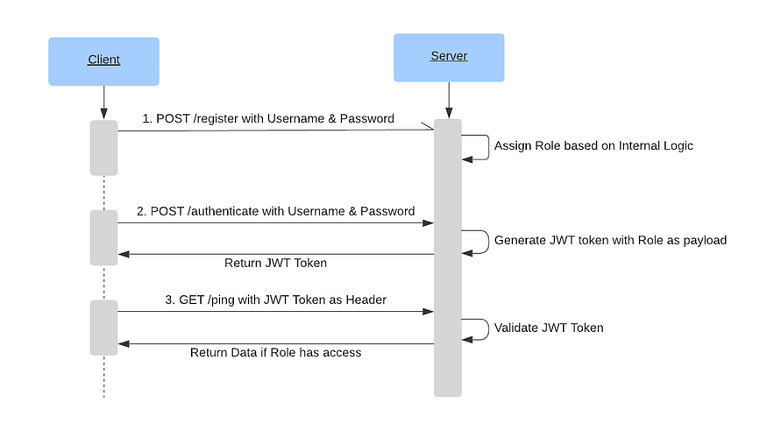
Security process with tokens

Slide 8
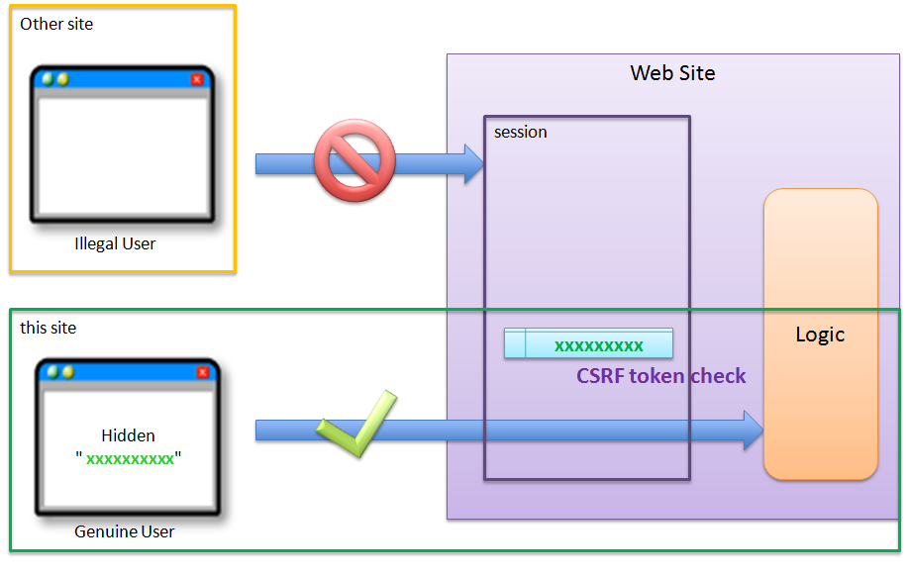
Cross-Site Request Forgery (CSRF)

Slide 9
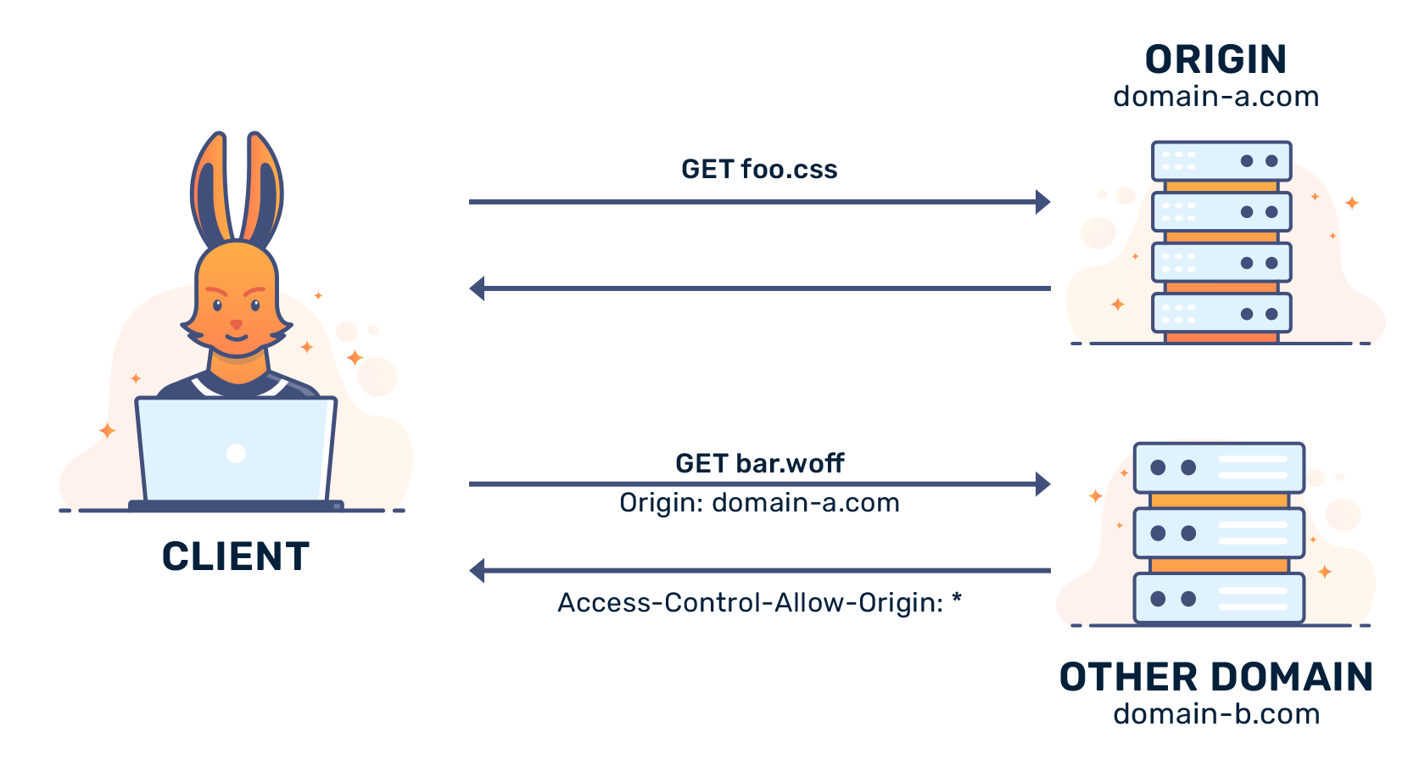
Cross-Origin Resource Sharing (CORS)

