Slide 1

Постановка цілей по SMART

Slide 2
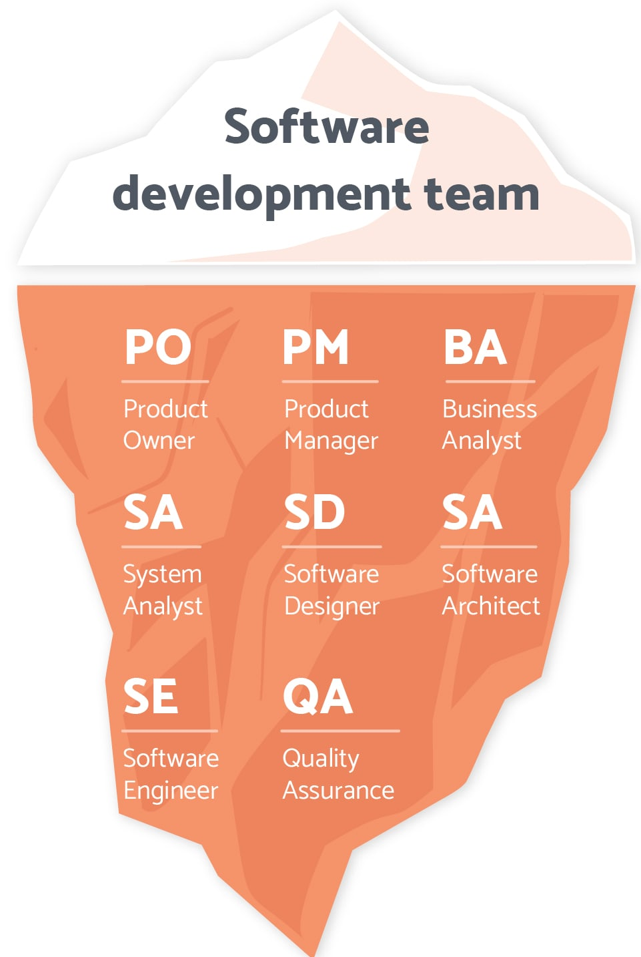
Common team roles

Slide 3


CI/CD process

Slide 4
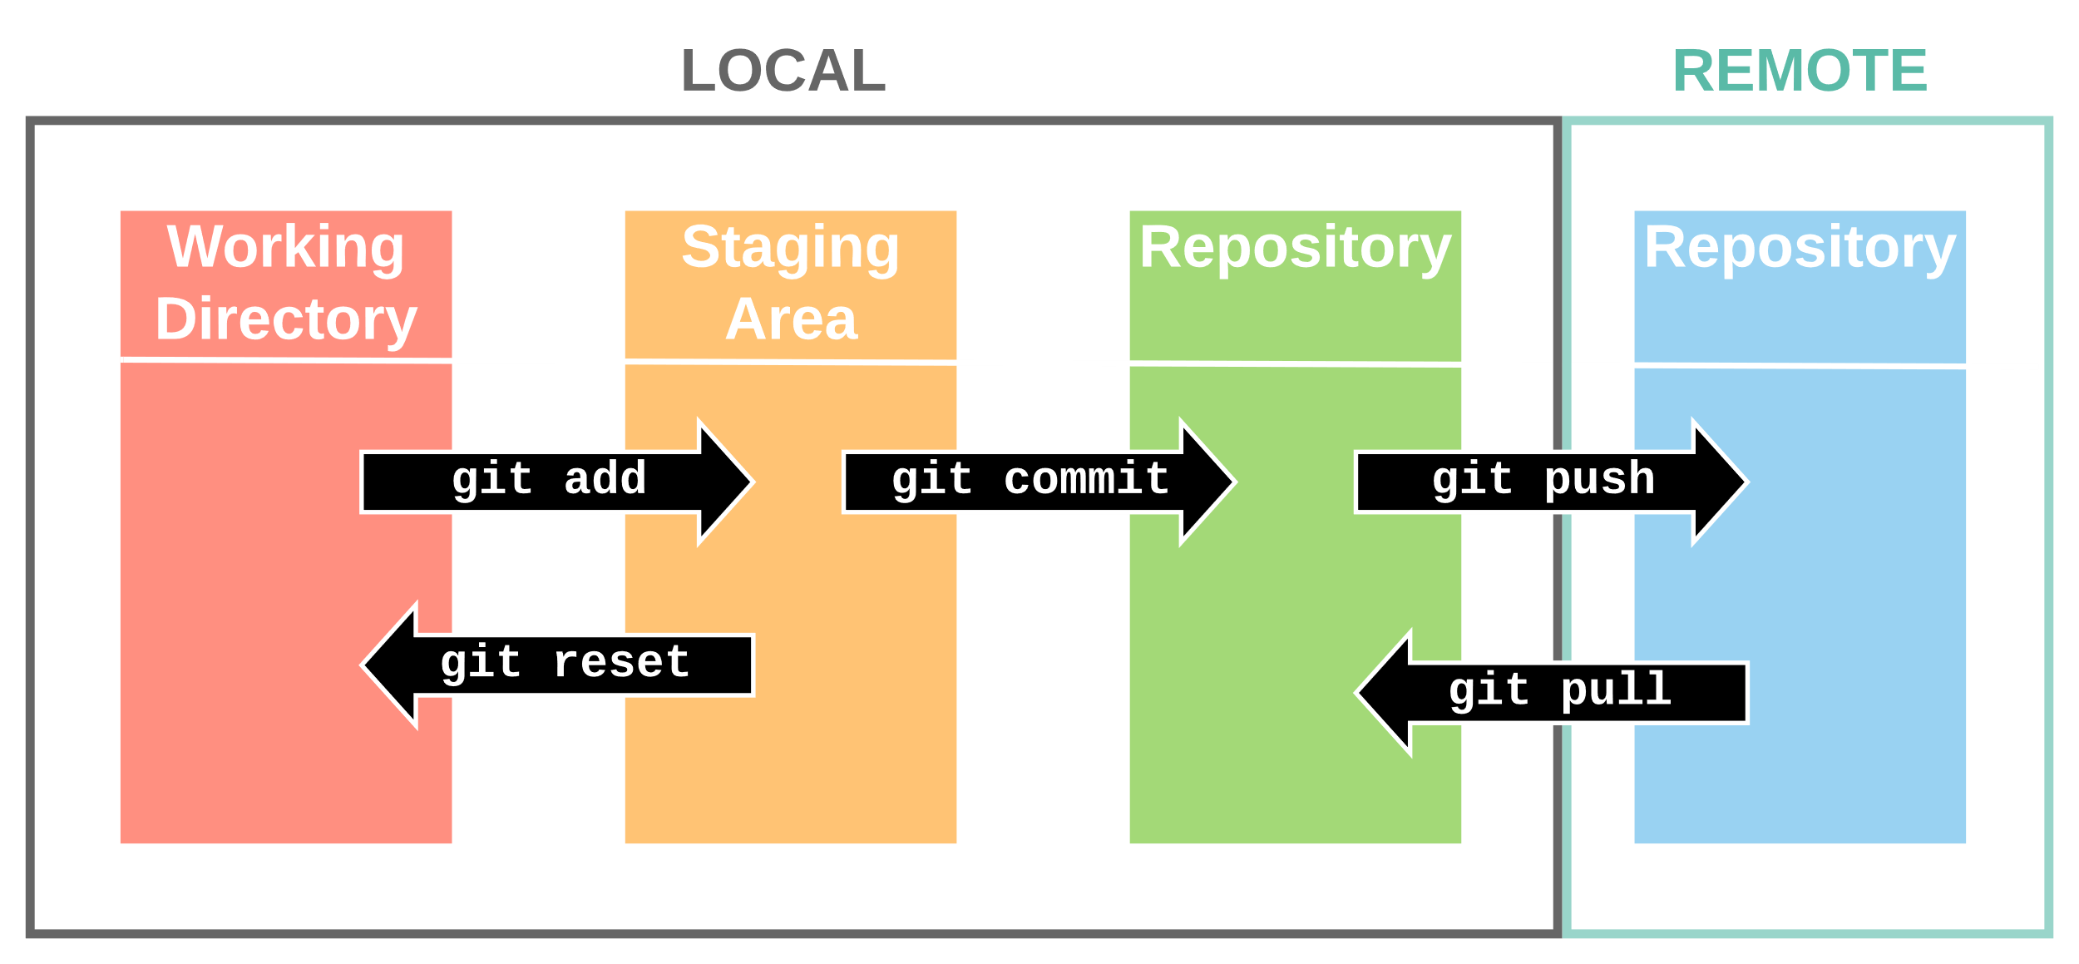
Git helicopter view

