Slide 1
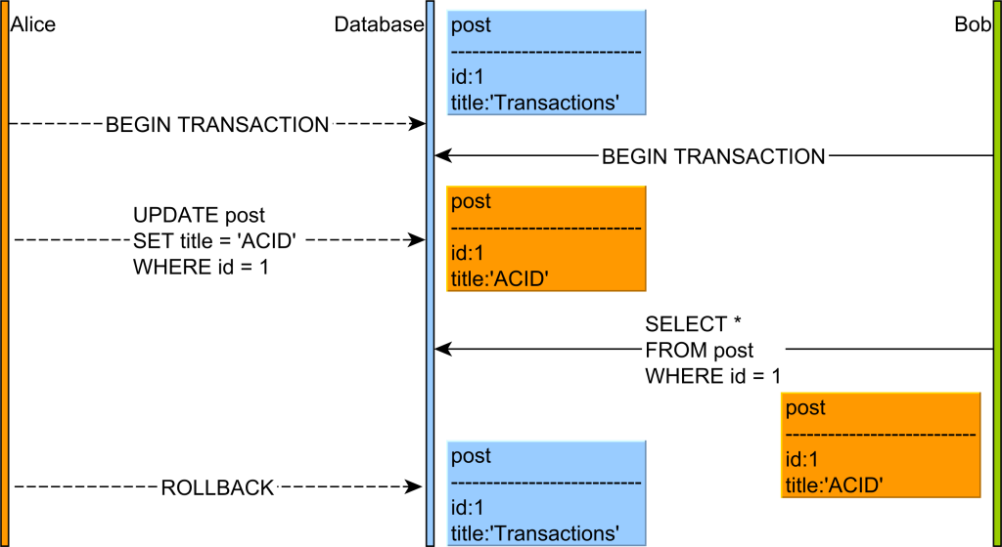
SQL Dirty Read

Slide 2
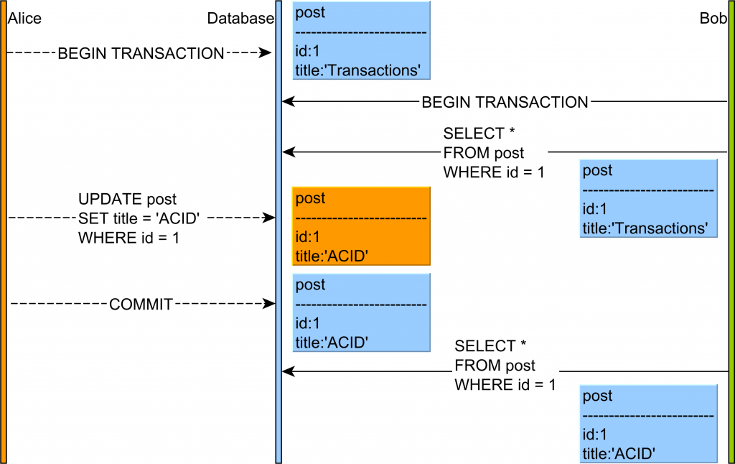
SQL Not repeatable read

Slide 3
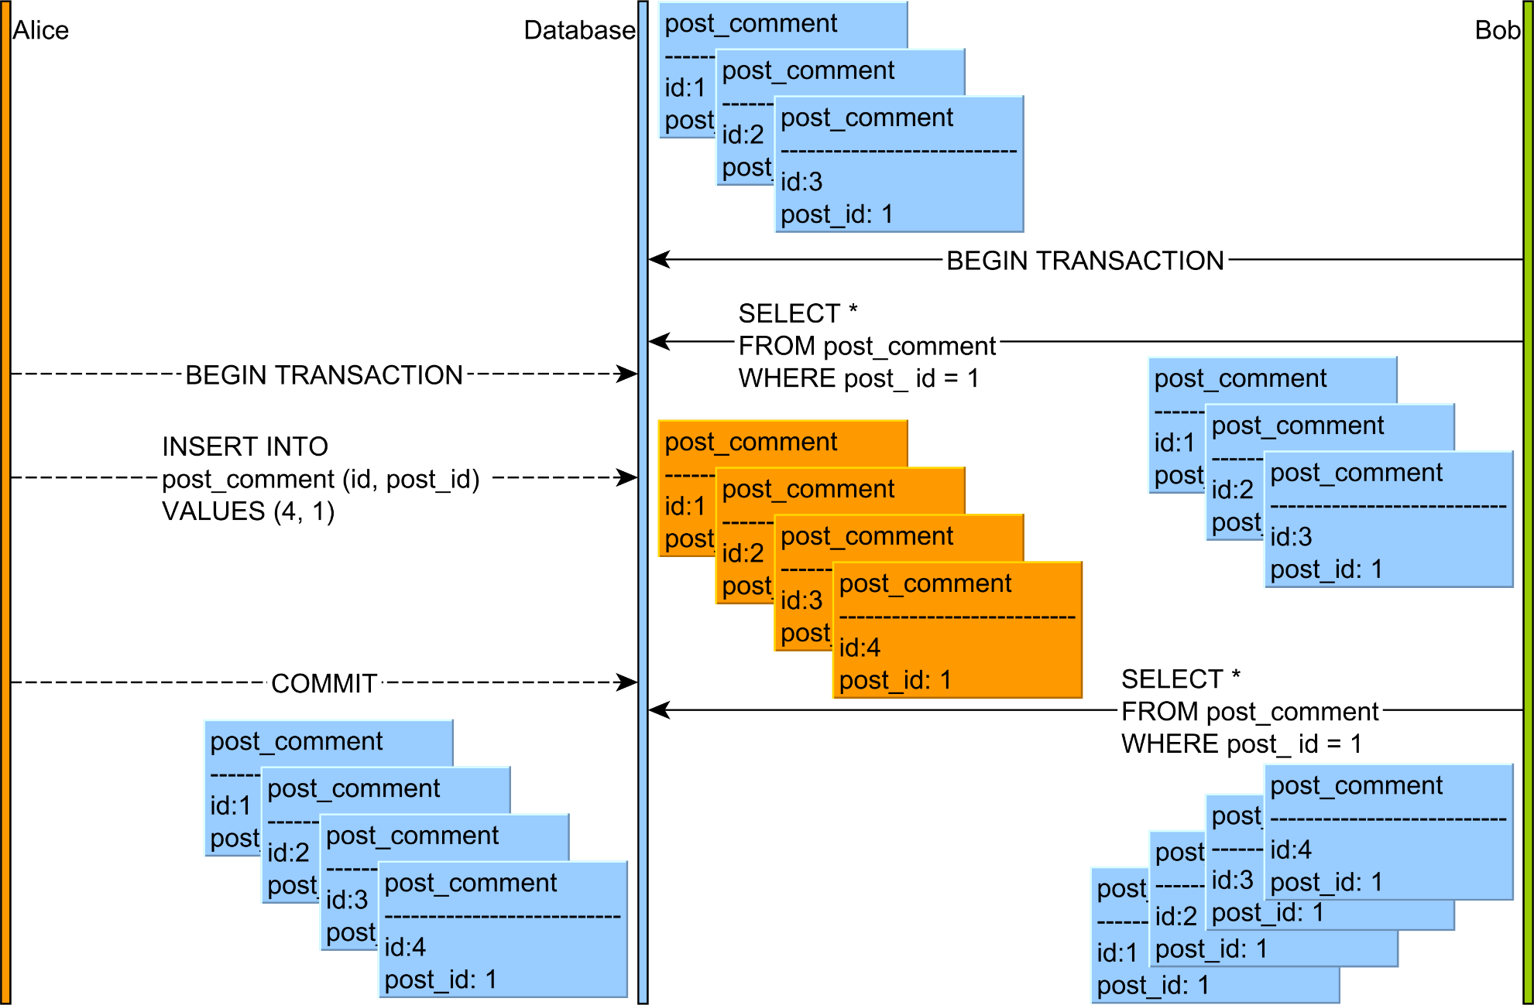
SQL Phantom read

Slide 4
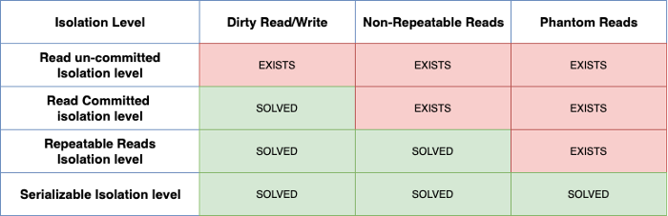
SQL Transactions Isolation level

Slide 5
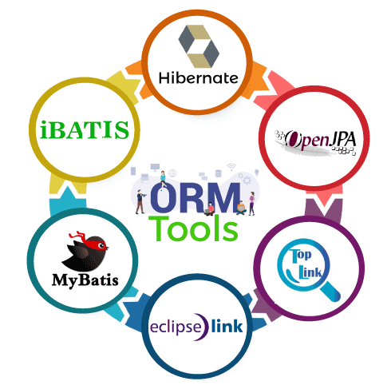
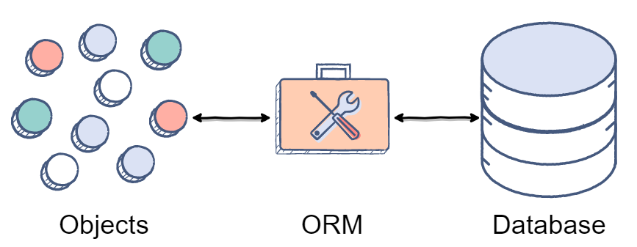
ORM
ORM is a technique for converting data between Java objects and relational databases (table). In simple words, we can say that the ORM implements responsibility of mapping the object to relational model and vice-versa.

Slide 6
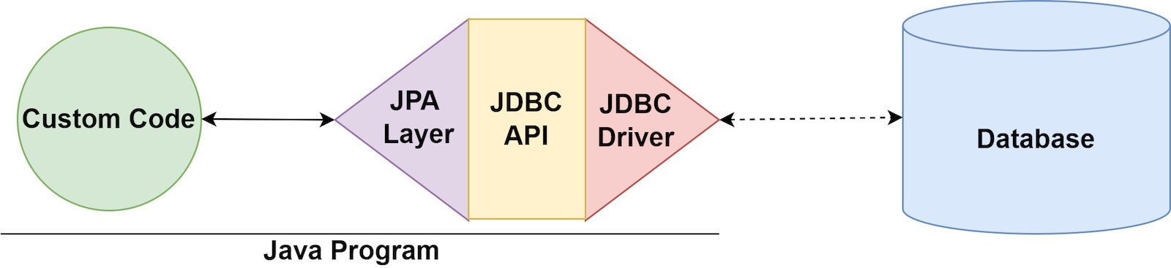
JPA
The Java Persistence API (JPA) is a Java specification for accessing, persisting, and managing data between Java objects / classes and a relational database.

Slide 7
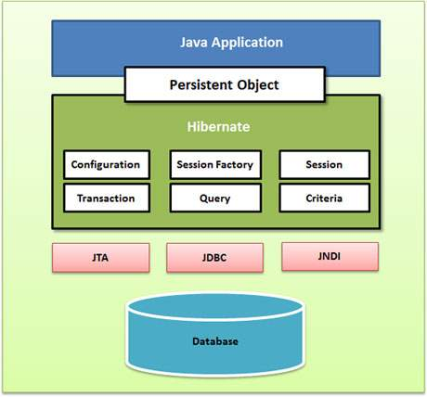
Hibernate architecture

Slide 8
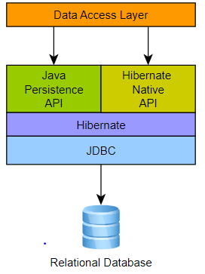
Hibernate VS JPA

Slide 9
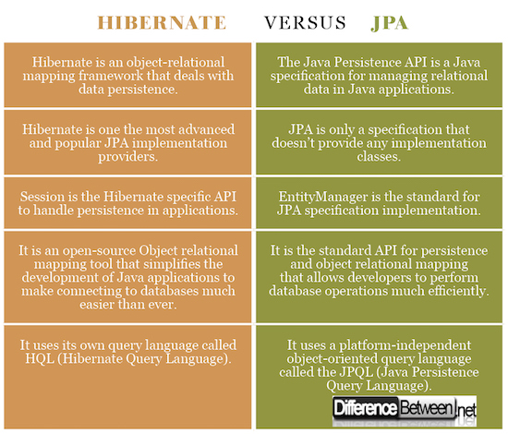
Hibernate VS JPA

Slide 10
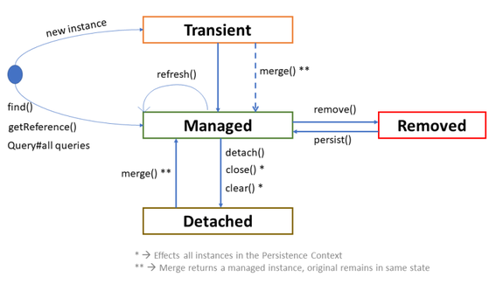
Entity lifecycle

Slide 11
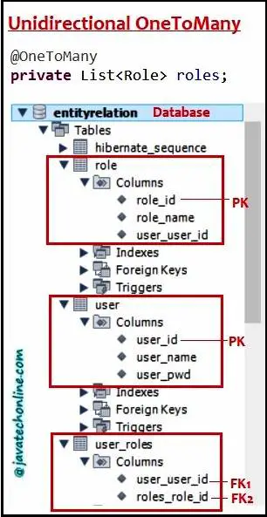
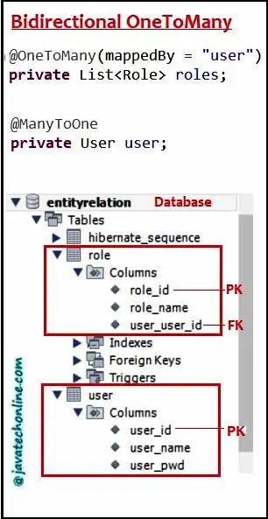
@OneToOne

Slide 12
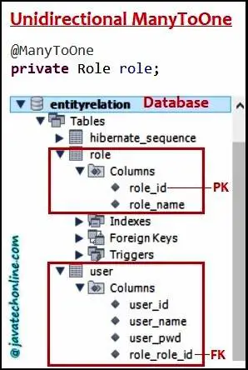
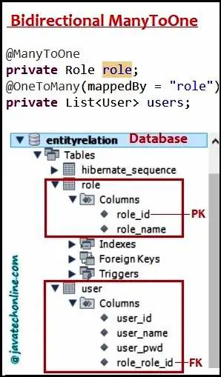
@OneToMany (@ManyToOne)

Slide 13
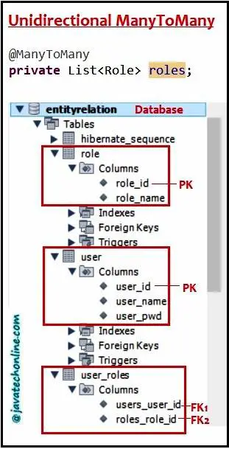
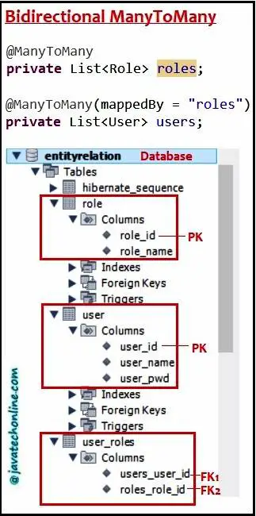
@ManyToMany

Slide 14
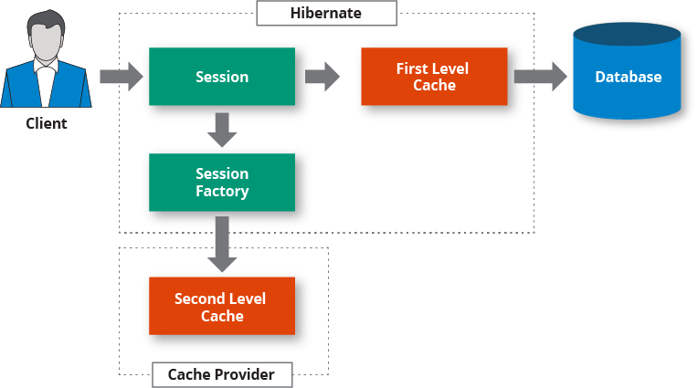
Hibernate cashes

