Slide 1
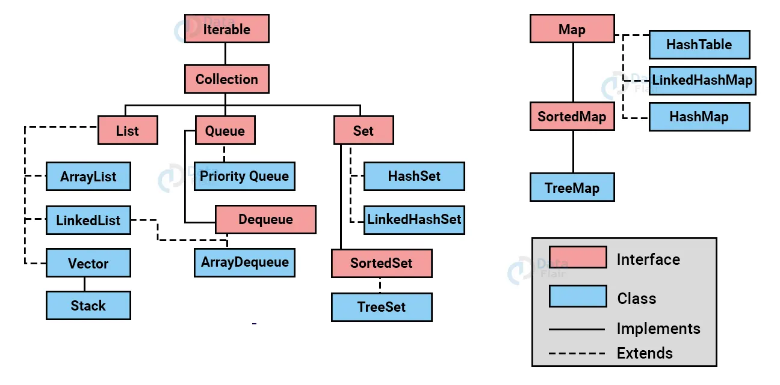
Hierarchy of collection framework

Slide 2
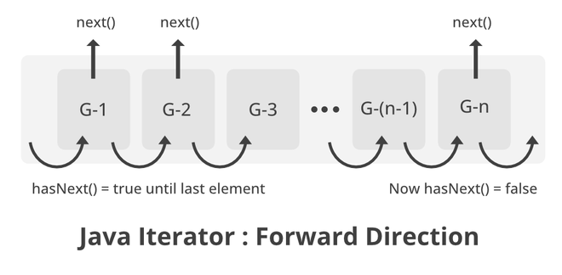
Iterator

Slide 3
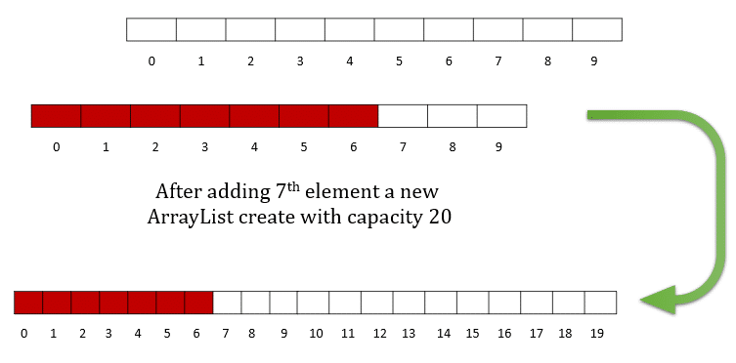
ArrayList load factor

Slide 4
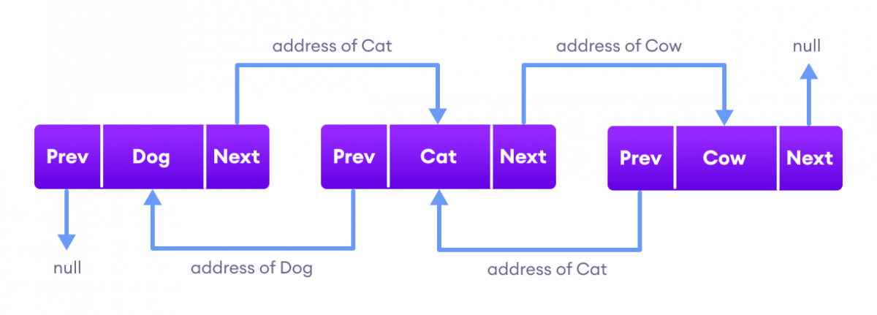
LinkedList structure

Slide 5
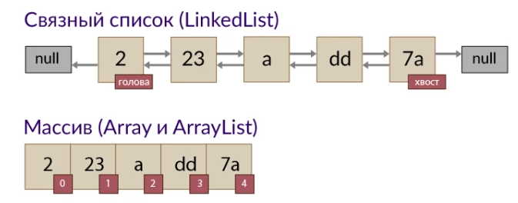
ArrayList VS LinkedList

Slide 6
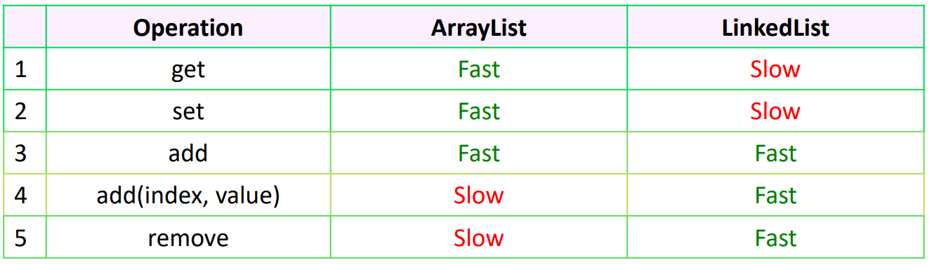
ArrayList VS LinkedList

