Slide 1

Clone

Slide 2
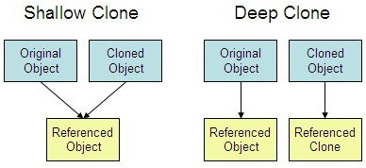
Shallow vs Deep Clone

Slide 3
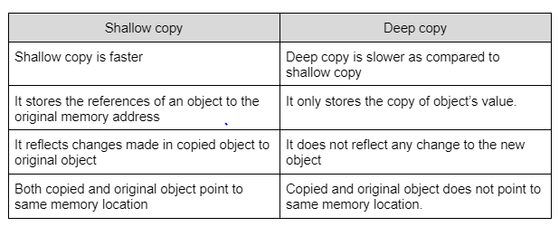
Shallow vs Deep Clone

Slide 4
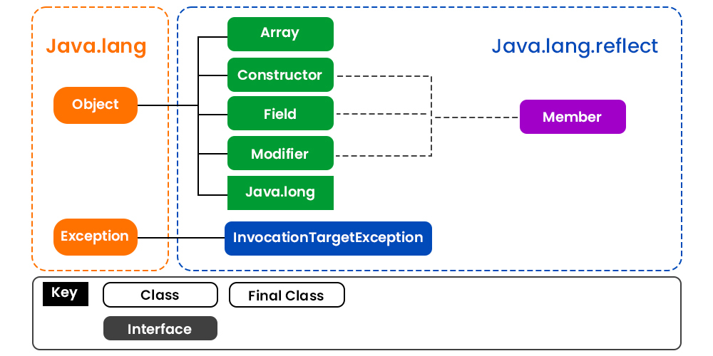
Reflection

Slide 5
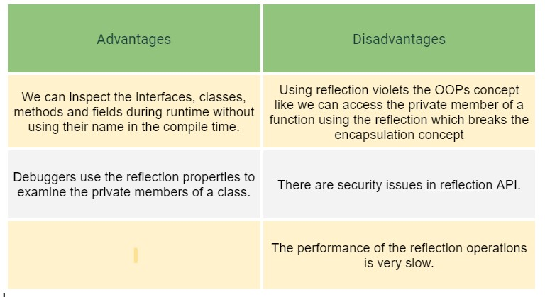
Reflection

Slide 6
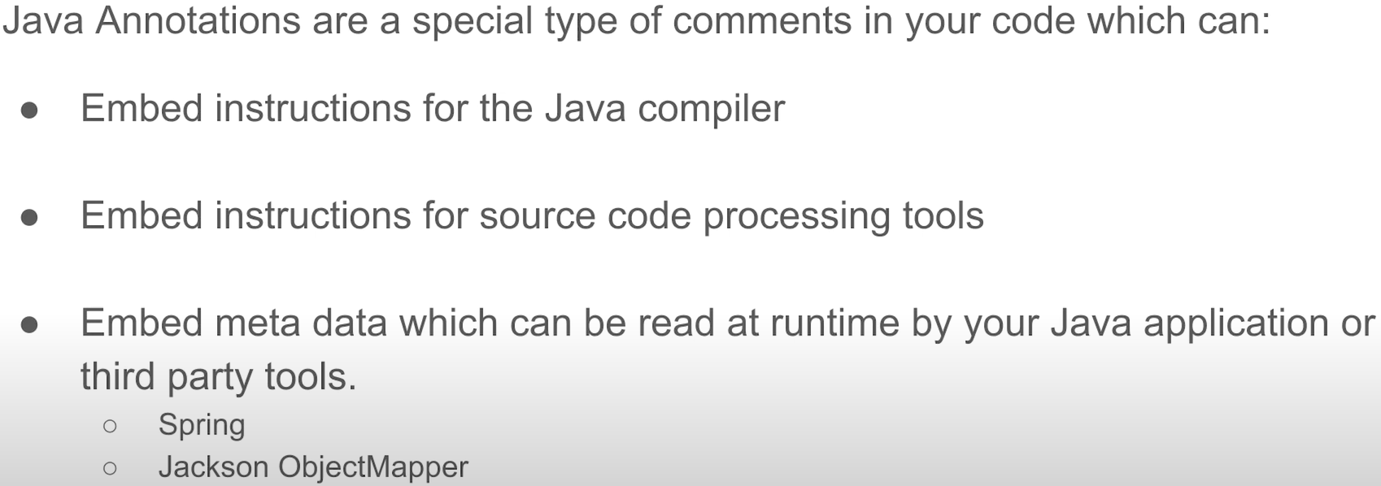
Java annotations

Slide 7
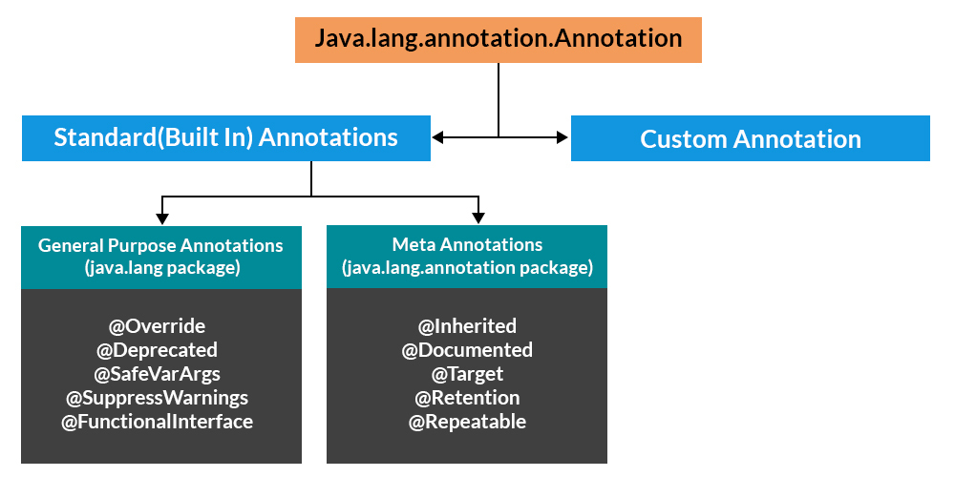
Hierarchy of Annotations in Java

Slide 8
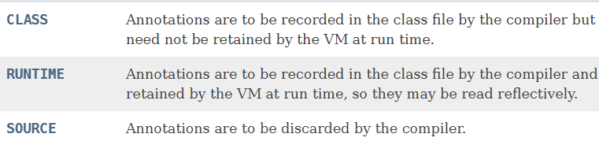
Retention

Slide 9
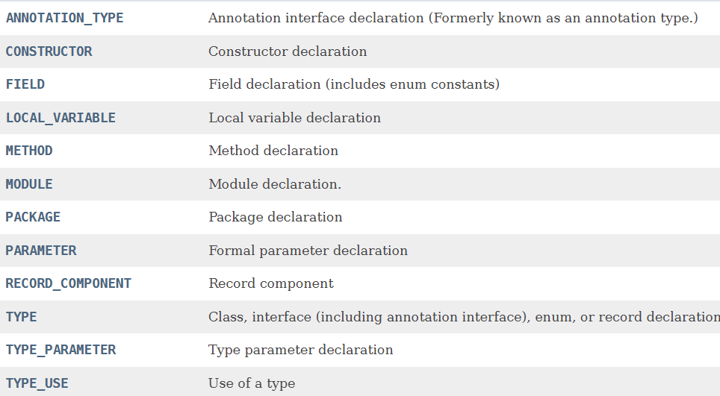
Target

