Slide 1
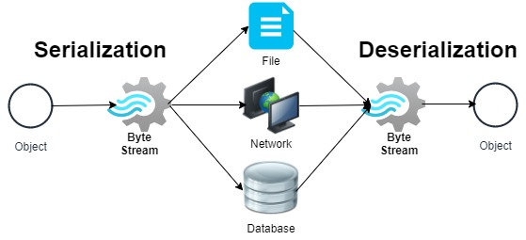
Serialization/Deserialization
Serialization is the process used to convert an object state into stream of bytes so that it can be written into a file, transported through a network or stored into database. De-serialization is just a vice versa.

Slide 2
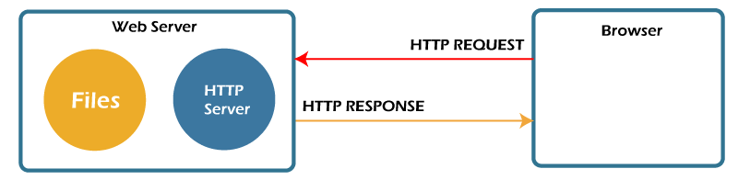
Web Server
A web server is a dedicated computer responsible for running websites sitting out on those computers somewhere on the Internet. They are specialized programs that circulate web pages as summoned by the user. The primary objective of any web server is to collect, process and provide web pages to the users

Slide 3
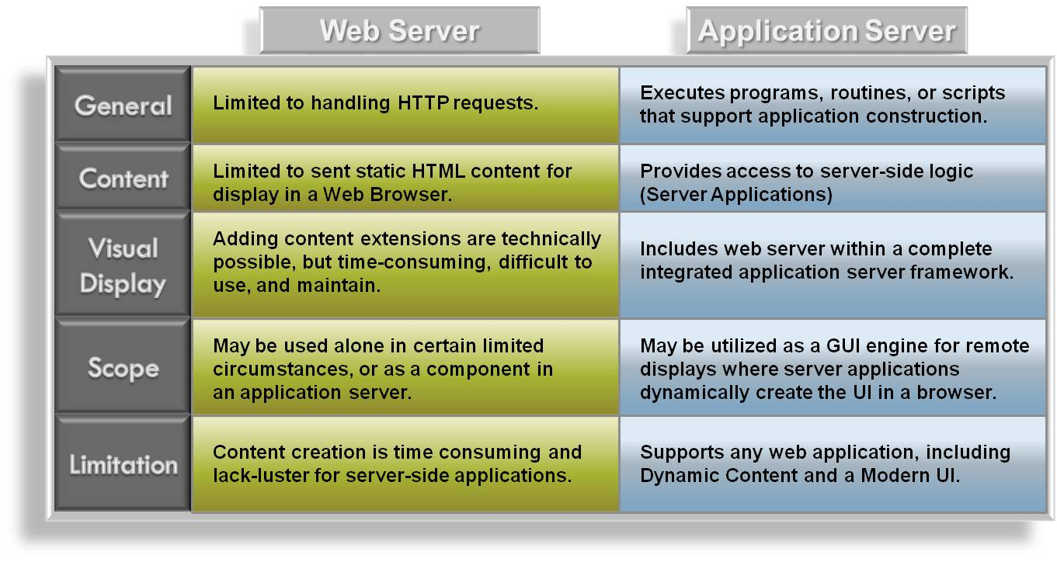
Web VS application server

Slide 4
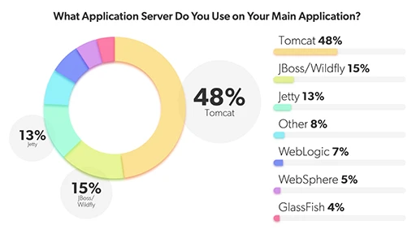
Application Servers popularity

Slide 5
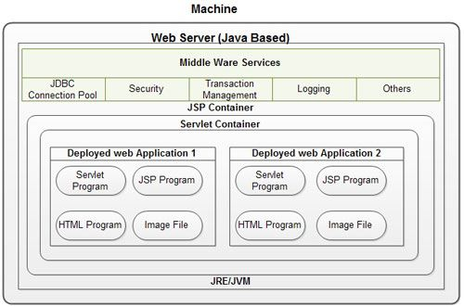
Web Server architecture

Slide 6
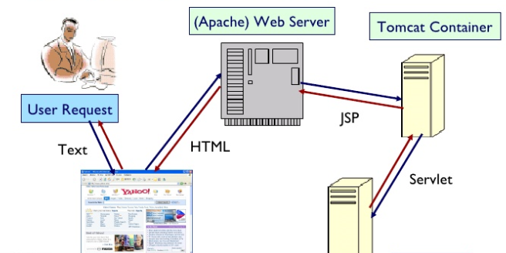
Apache Tomcat Structure

Slide 7
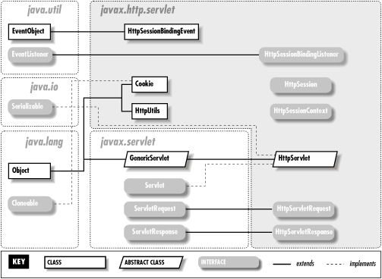
Servlet Api

Slide 8
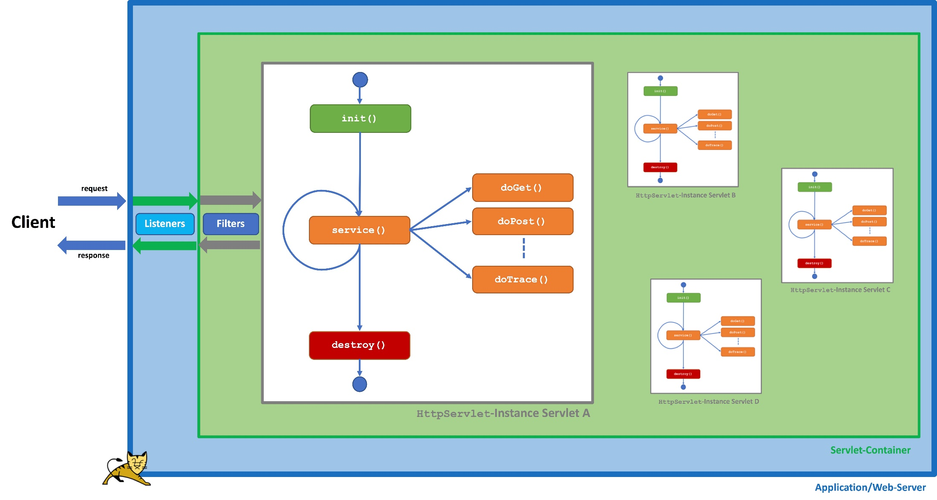
Servlet Api

Slide 9
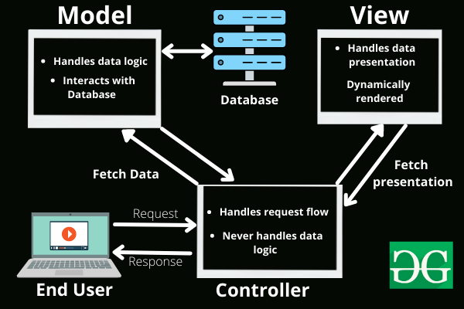
MVC architecture

Slide 10
JSP
A JSP page is a text document. It contains two types of text: static content and dynamic content. Static content can be expressed in any text-based format, say, HTML. Whereas, the dynamic content comprises of the Java code. JSP technology here combines the static content with the Java code, hence making it a dynamic web page.

Slide 11
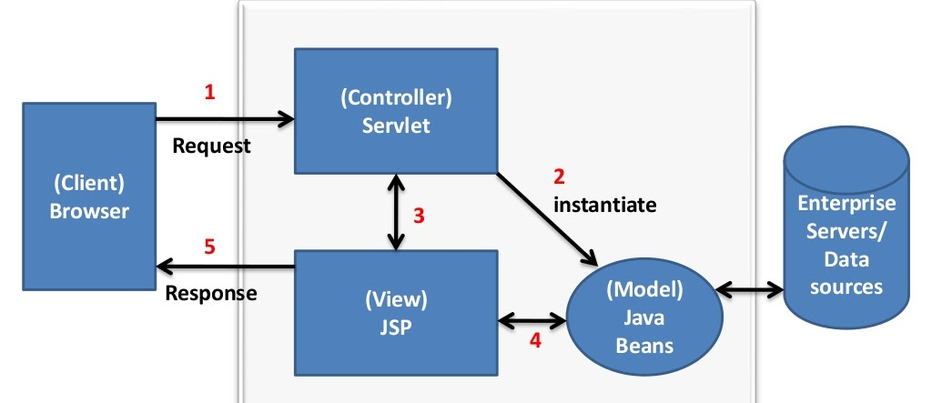
MVC architecture

