Slide 1
OOP principles
Encapsulation
Inheritance
Polymorphism
Abstraction

Slide 2
OOP Concepts
Object as a main logical element
Object is an instance of the certain class
Classes form hierarchy

Slide 3
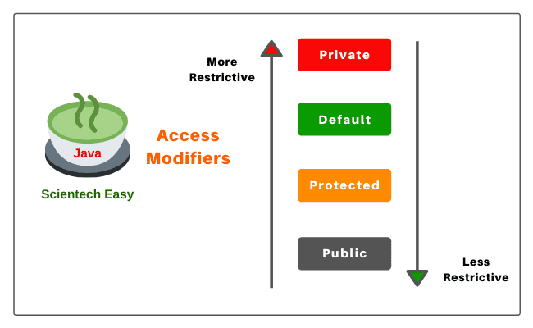
Access modifiers

Slide 4
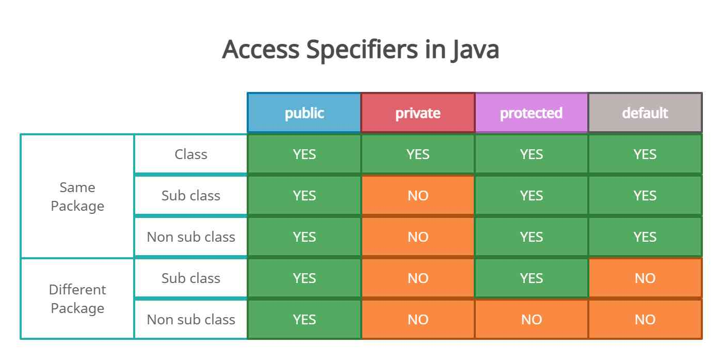
Access modifiers

Slide 5
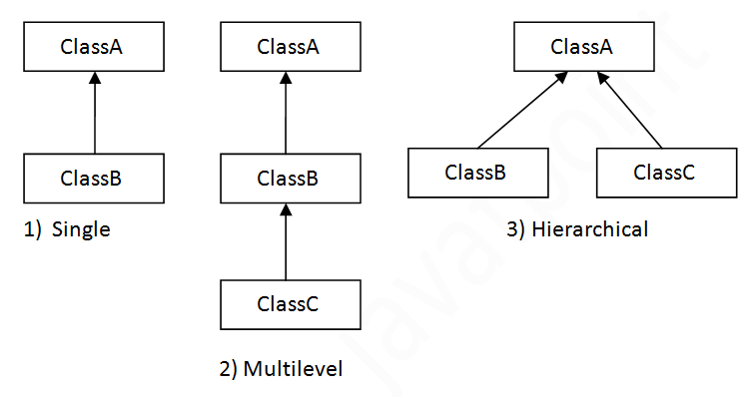
Types of inheritance in java

Slide 6
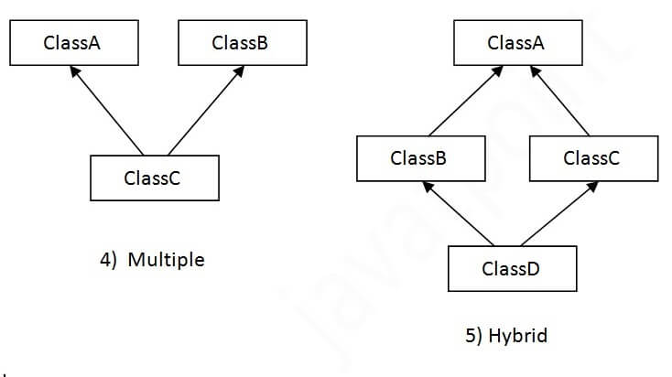
Types of inheritance isn’t in java

