Slide 1
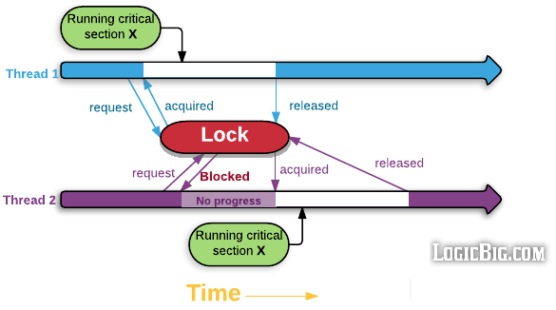
Lock (synchronized on image)

Slide 2
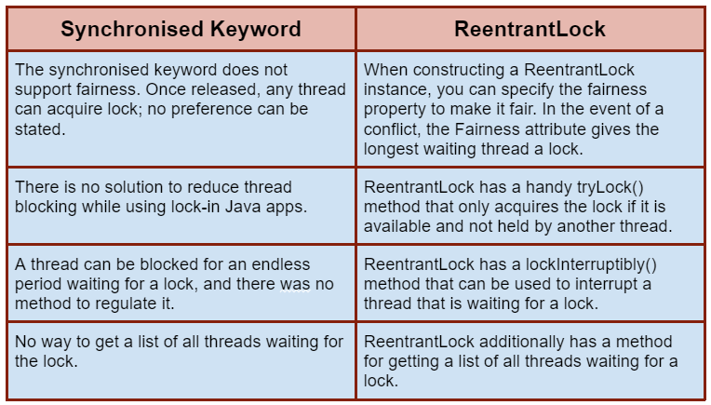
Synchronized vs Lock

Slide 3
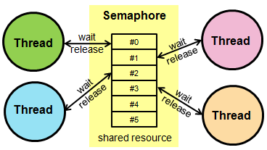
Semaphore

Slide 4
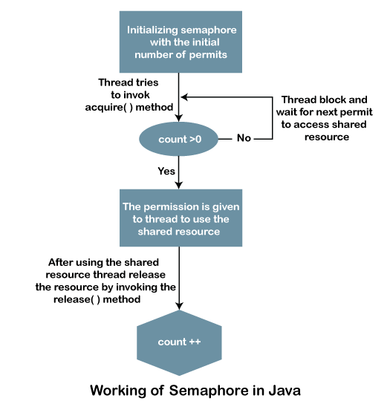
Working of Semaphore

Slide 5
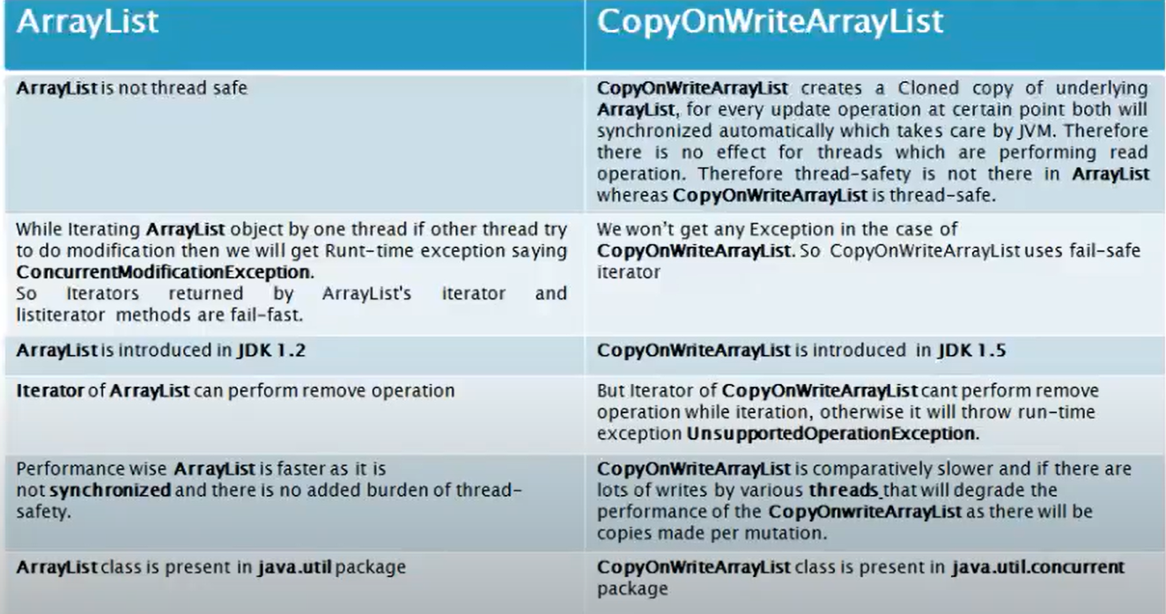
CopyOnWriteArrayList

Slide 6
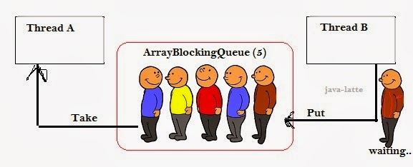
BlockingQueue

