Slide 1
Loggers
Logging is a powerful aid for understanding and debugging program's run-time behavior. Logs capture and persist the important data and make it available for analysis at any point in time.

Slide 2
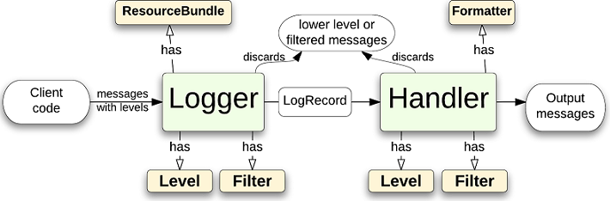
Logging framework

Slide 3
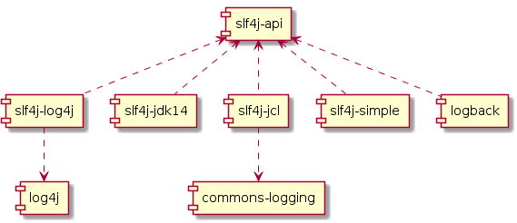
Slf4j

Slide 4
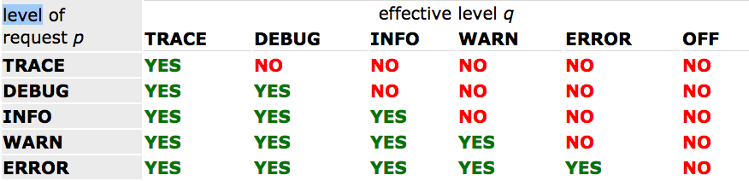
Slf4j logging levels

Slide 5
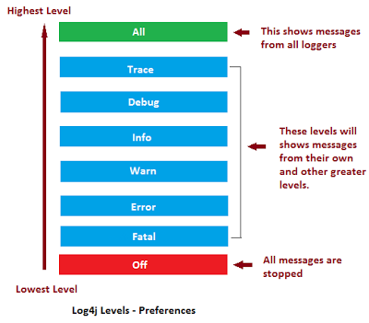
Log4j logging levels

Slide 6
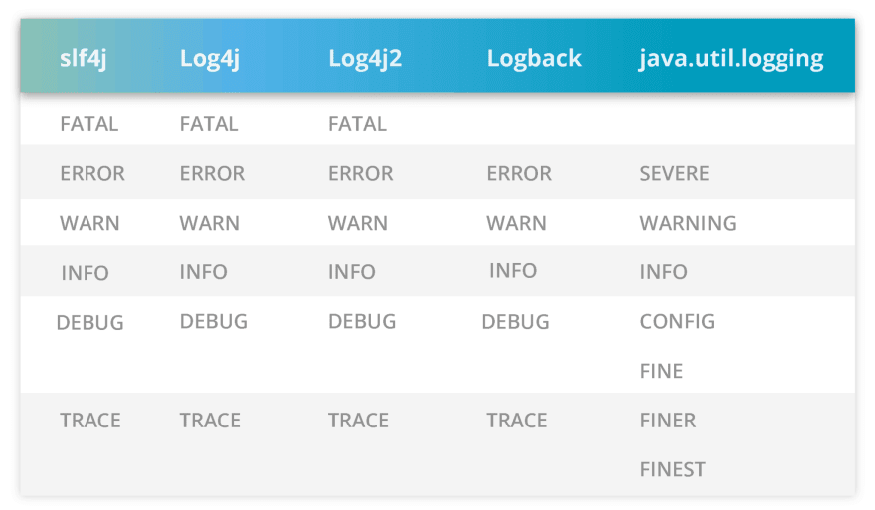
Slf4j logging levels mapping

Slide 7
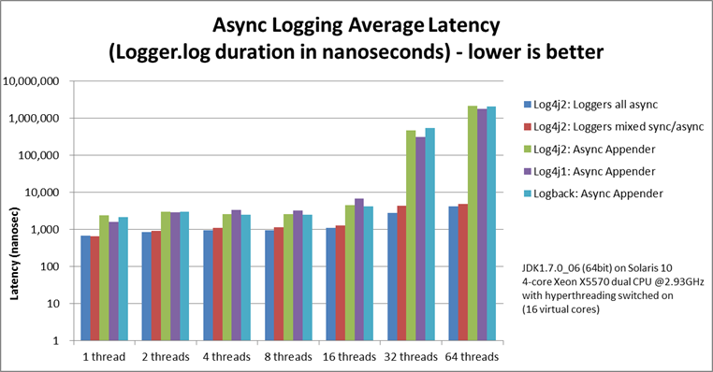
Async logging

Slide 8
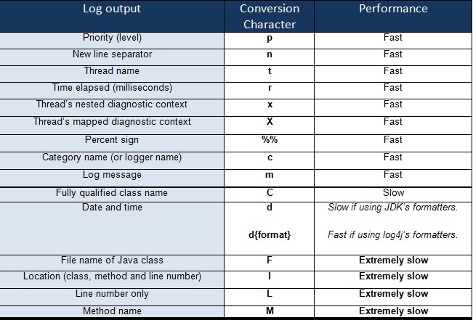
Log4j common patterns

