Slide 1
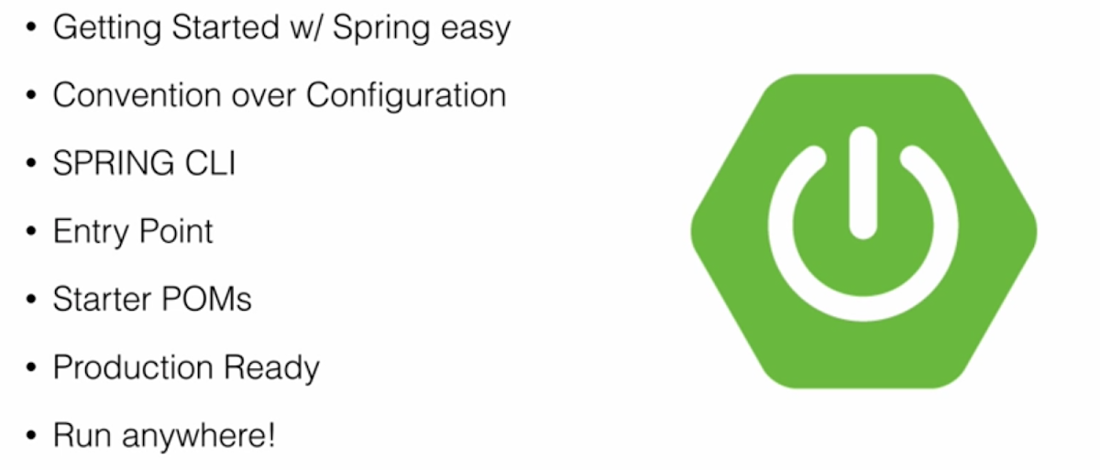

What is SpringBoot

Slide 2
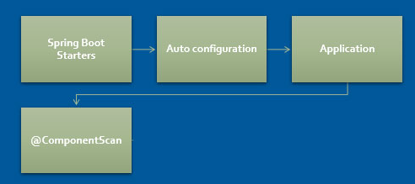
SpringBoot architecture

Slide 3
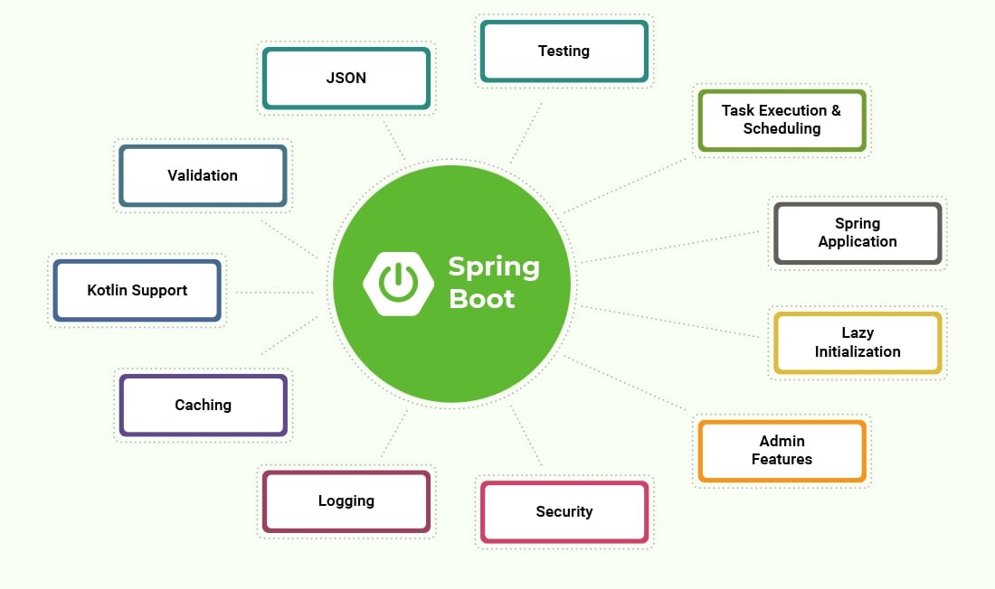
Best features

Slide 4
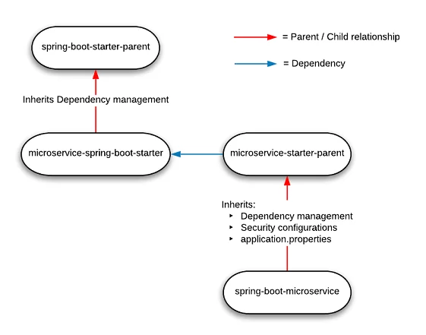
Starters

Slide 5
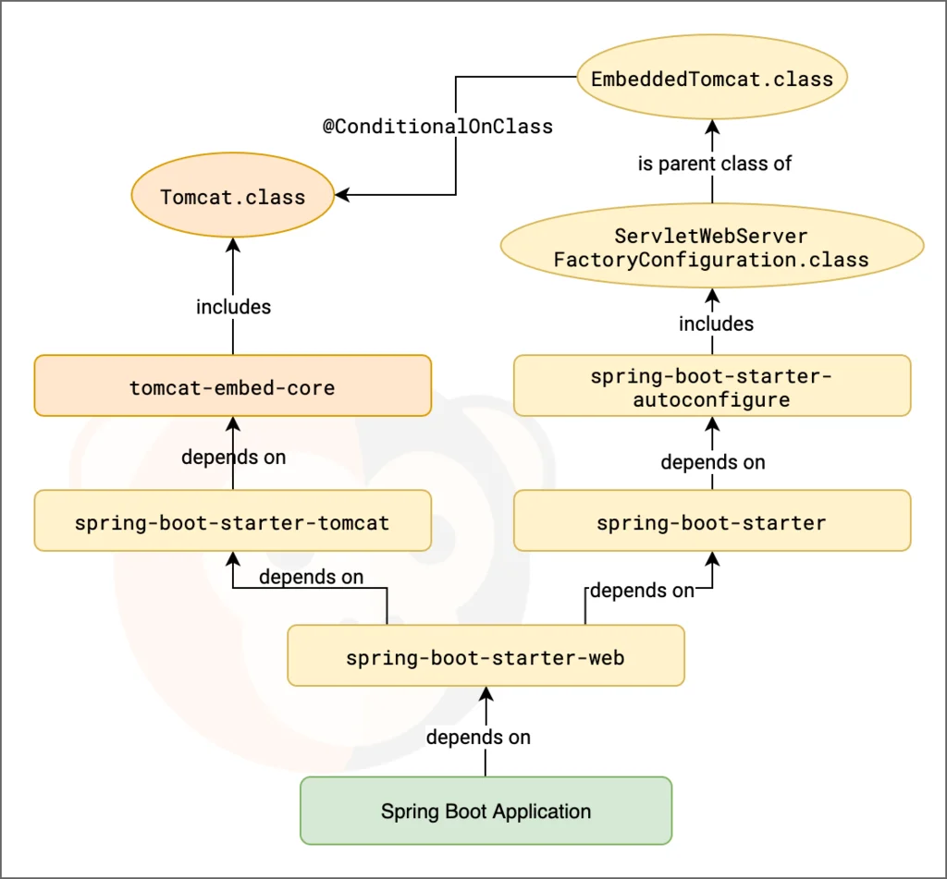
Autoconfiguration example

Slide 6
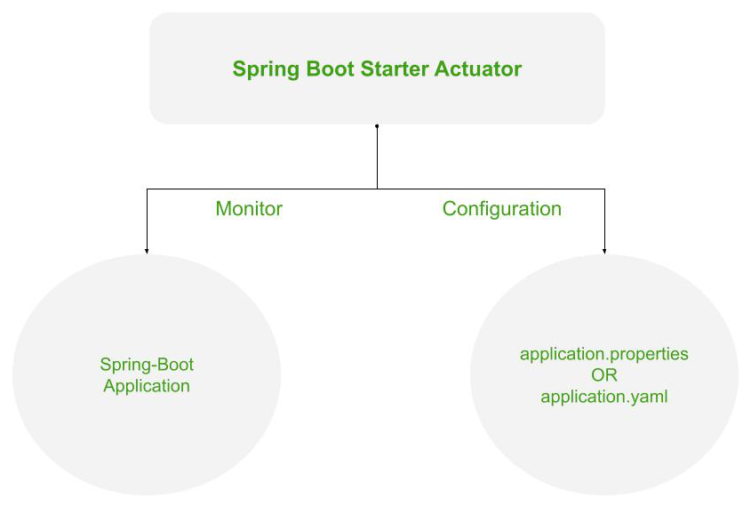
Actuator

Slide 7

Devtools

Slide 8

Advantages

Slide 9

Disadvantages

Slide 10
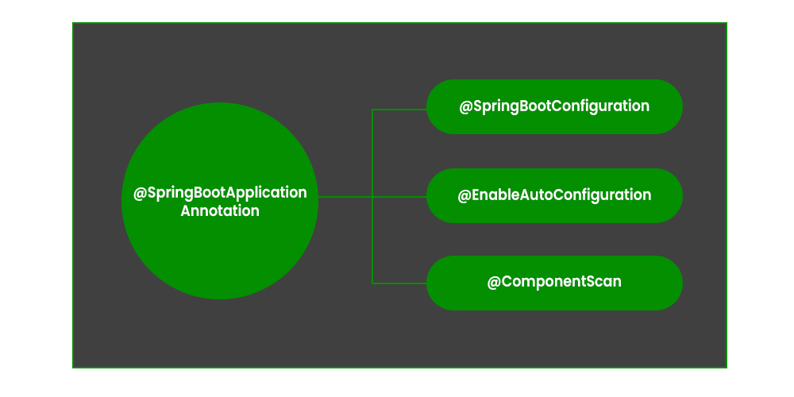
@SpringBootApplication

