Slide 1
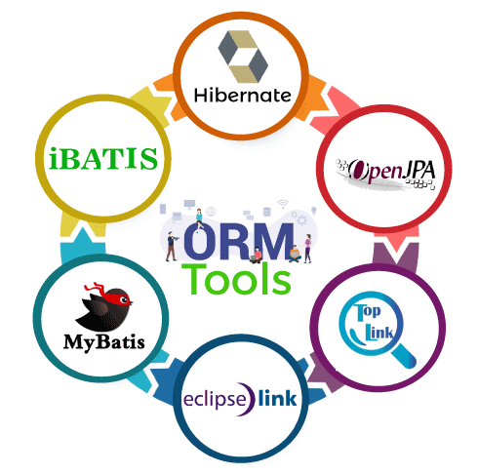
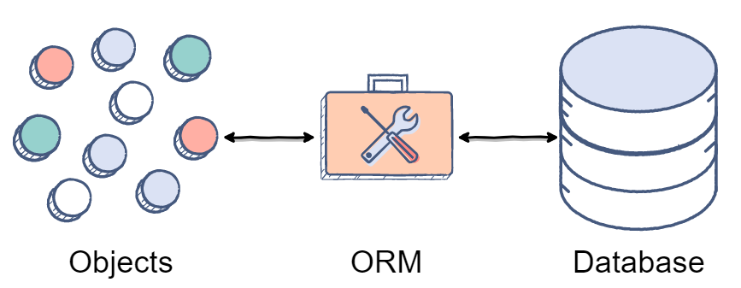
ORM
ORM is a technique for converting data between Java objects and relational databases (table). In simple words, we can say that the ORM implements responsibility of mapping the object to relational model and vice-versa.

Slide 2
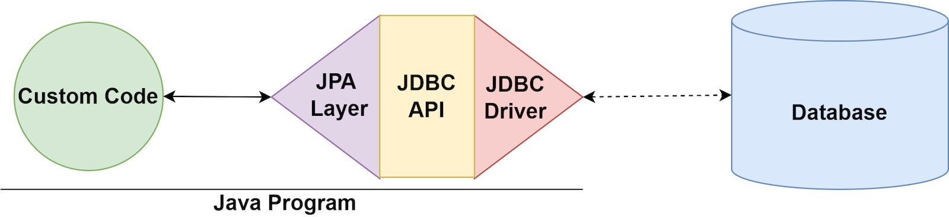
JPA
The Java Persistence API (JPA) is a Java specification for accessing, persisting, and managing data between Java objects / classes and a relational database.

Slide 3
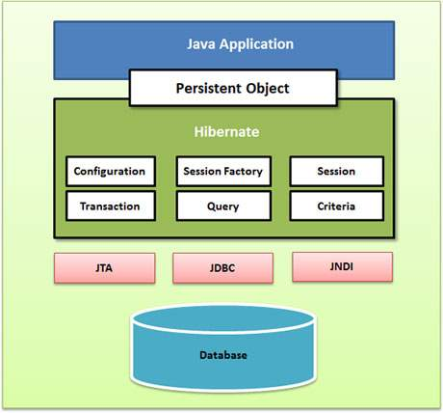
Hibernate architecture

Slide 4
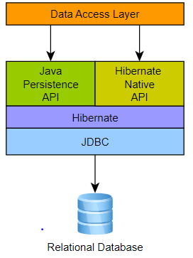
Hibernate VS JPA

Slide 5
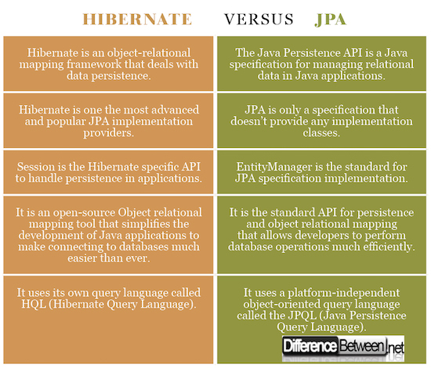
Hibernate VS JPA

Slide 6
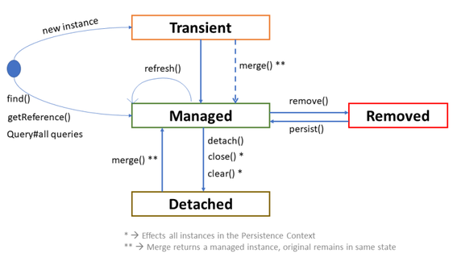
Entity lifecycle

Slide 7
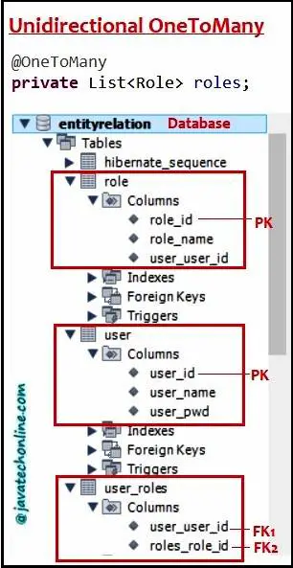
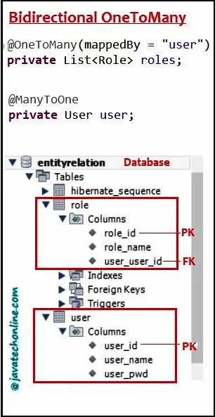
@OneToOne

Slide 8
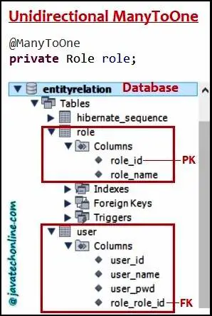
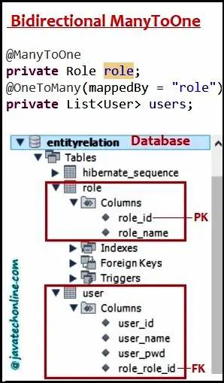
@OneToMany (@ManyToOne)

Slide 9
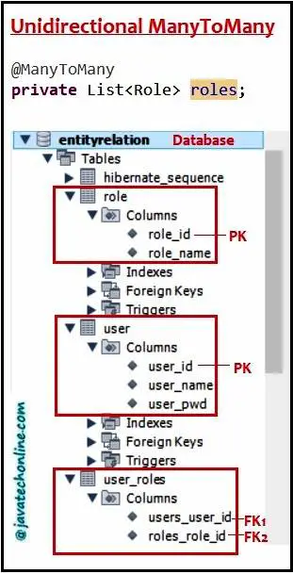
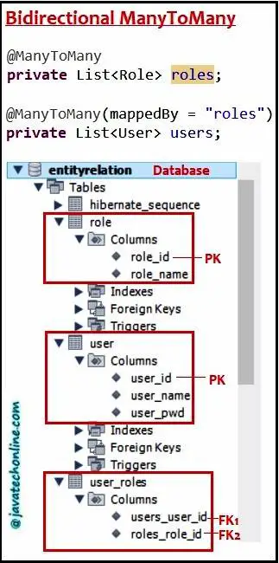
@ManyToMany

Slide 10
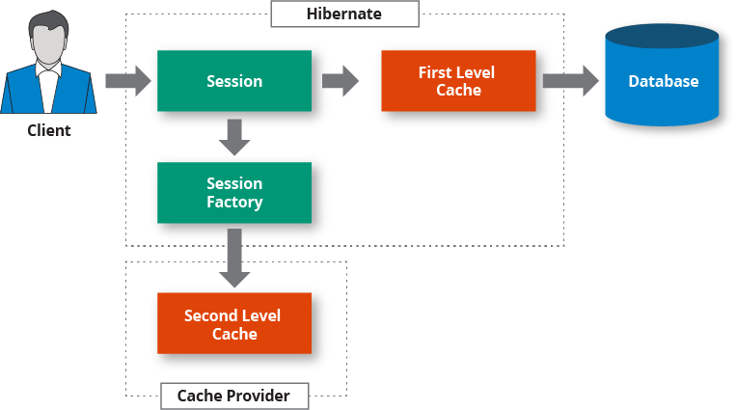
Hibernate cashes

