Slide 1
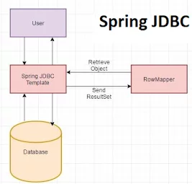
JdbcTemplate helicopter viev

Slide 2
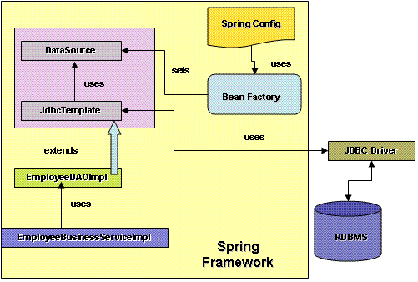
JdbcTemplate

Slide 3
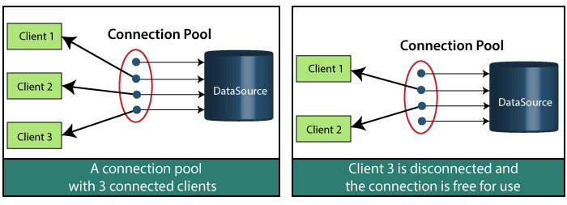
Connection pool

Slide 4
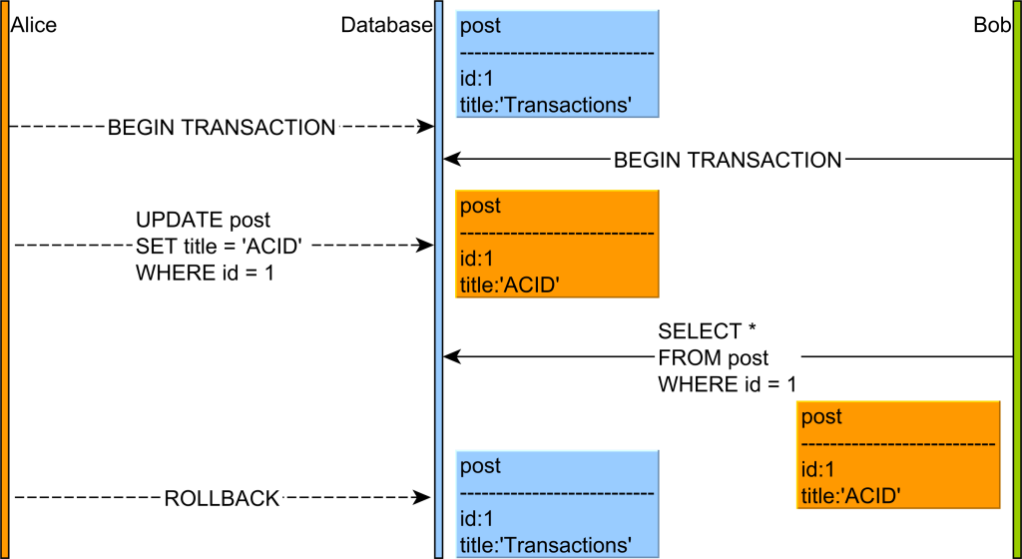
SQL Dirty Read

Slide 5
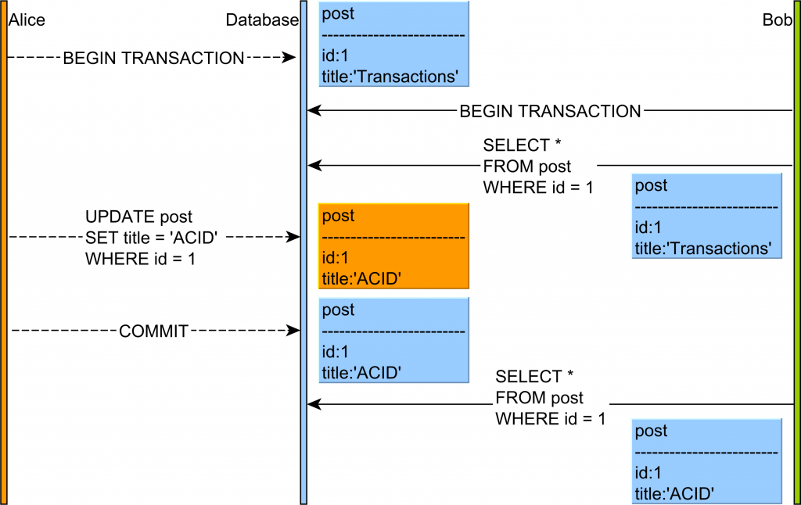
SQL Not repeatable read

Slide 6
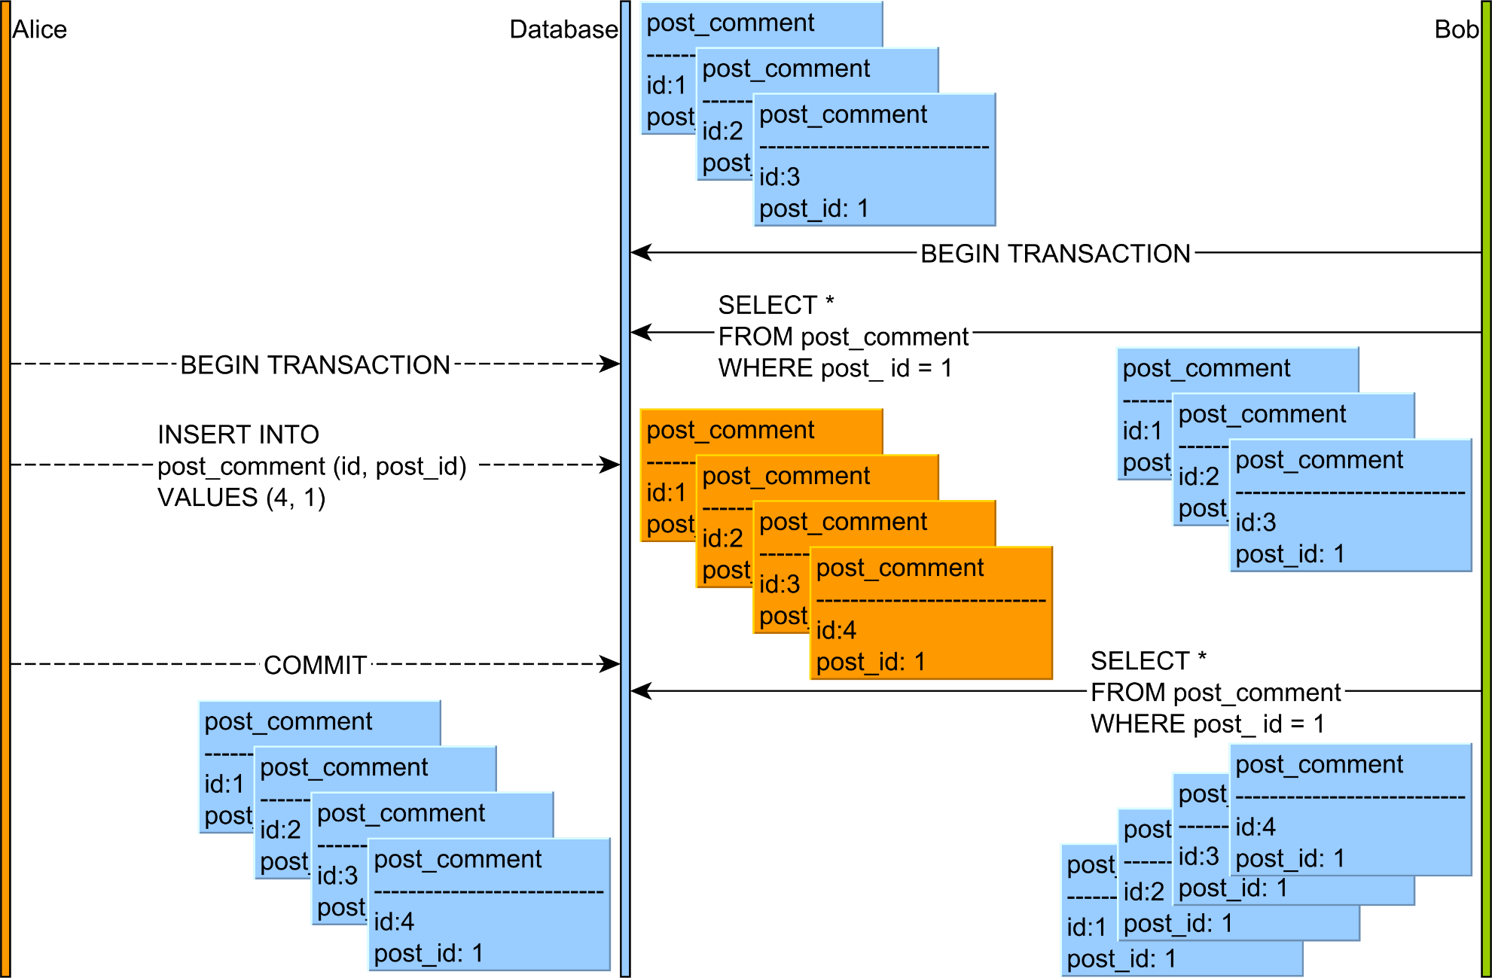
SQL Phantom read

Slide 7
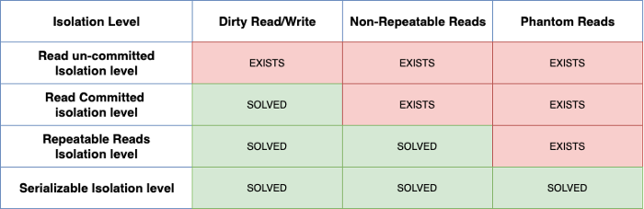
SQL Transactions Isolation level

