Slide 1
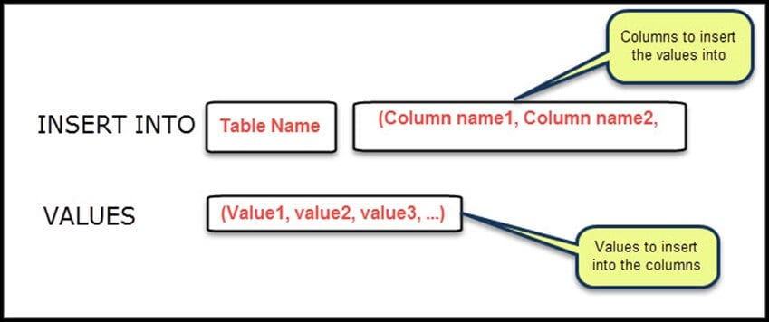
INSERT

Slide 2
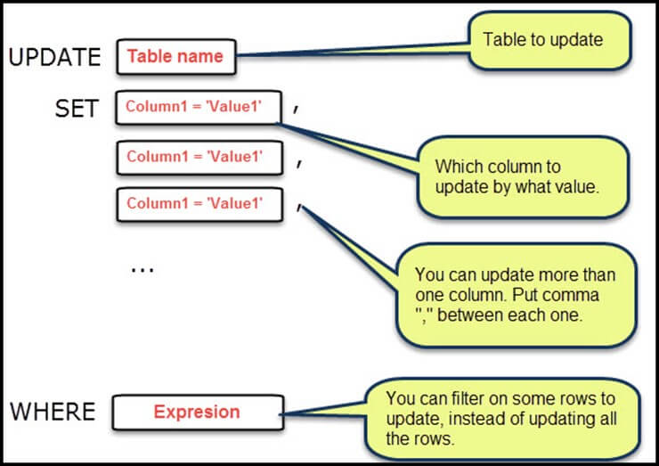
UPDATE

Slide 3
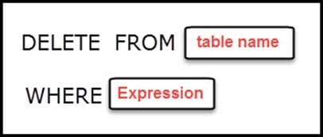
DELETE

Slide 4
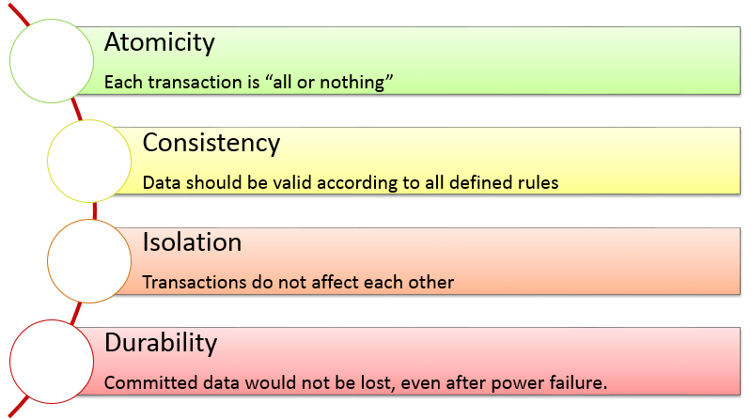
Transactions ACID

Slide 5
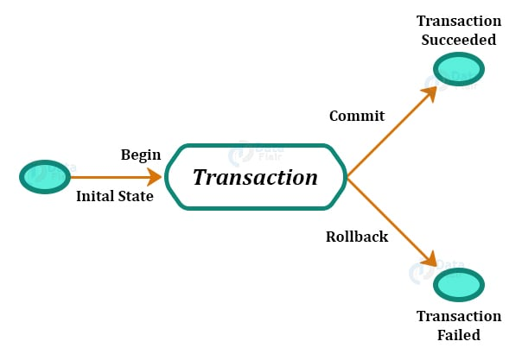
Commit/Rollback

Slide 6
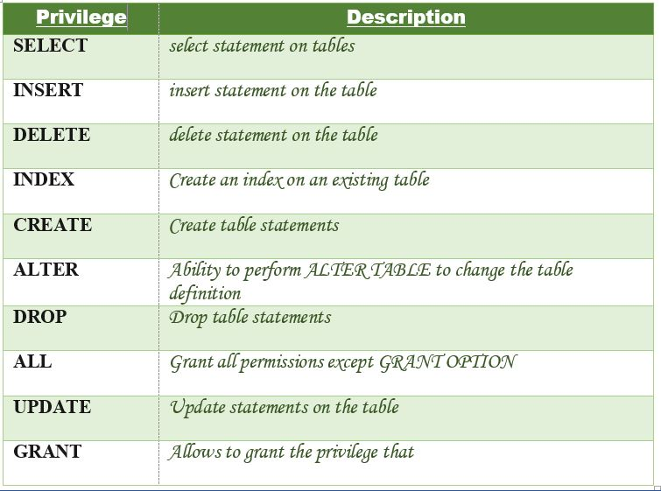
GRANT/REVOKE

Slide 7
INSERT, UPDATE, DELETE statements
INSERT
Insert Multiple Rows
UPDATE
DELETE

Slide 8
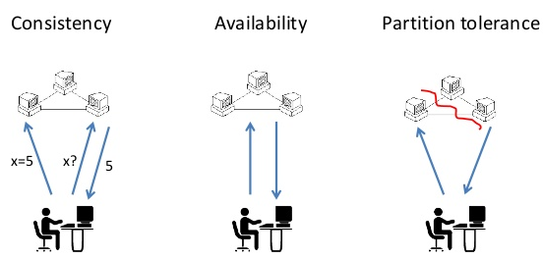
CAP Theorem

Slide 9
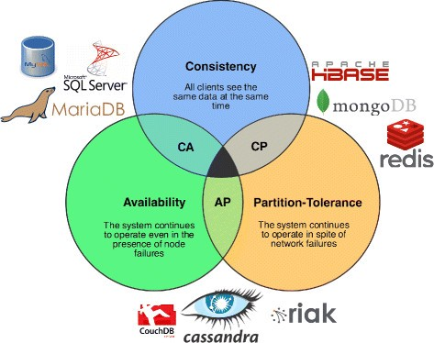
CAP Theorem

