Slide 1
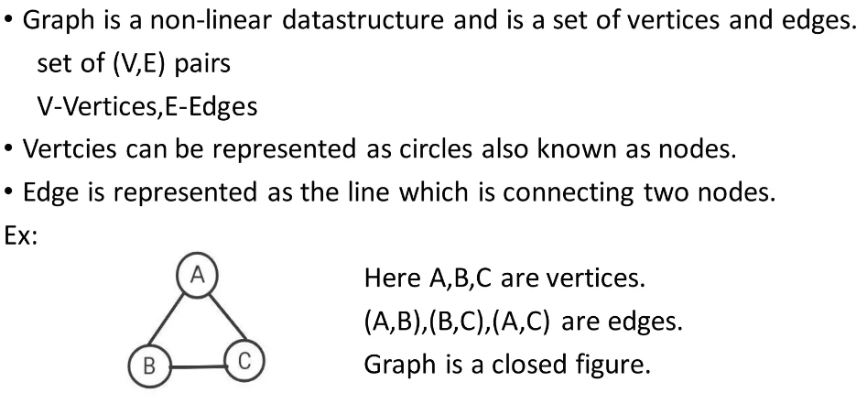
Graph

Slide 2
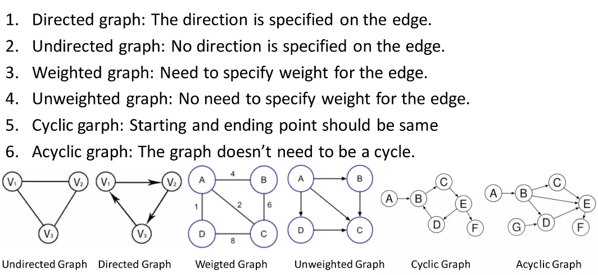
Types of Graphs

Slide 3
Adjacency Matrix

Slide 4
Adjacency List

Slide 5
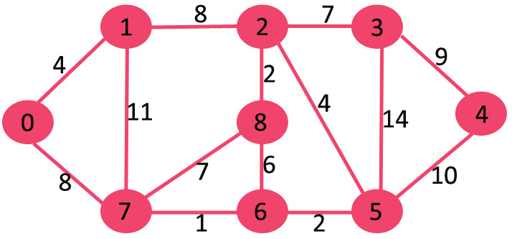
Shortest Path by Dijkstra

