Slide 1
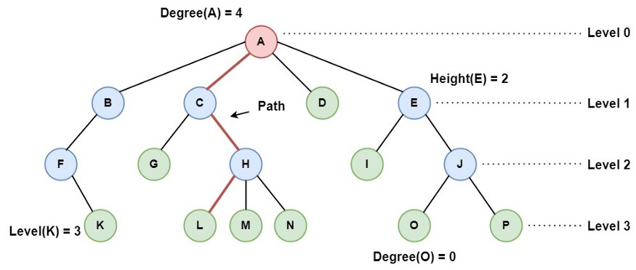
Tree Data Structure

Slide 2
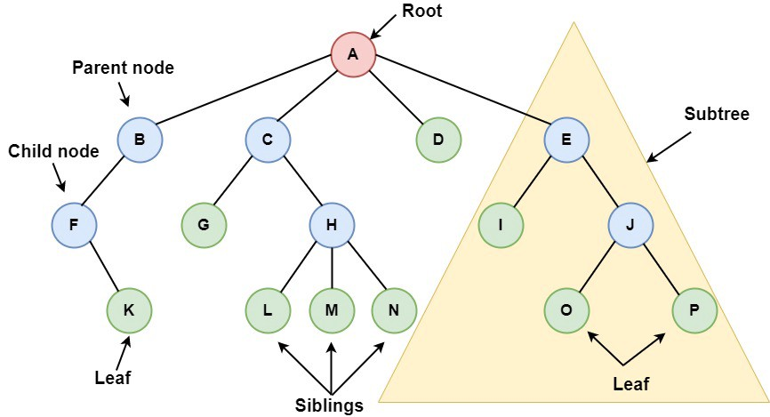
Tree Data Structure

Slide 3
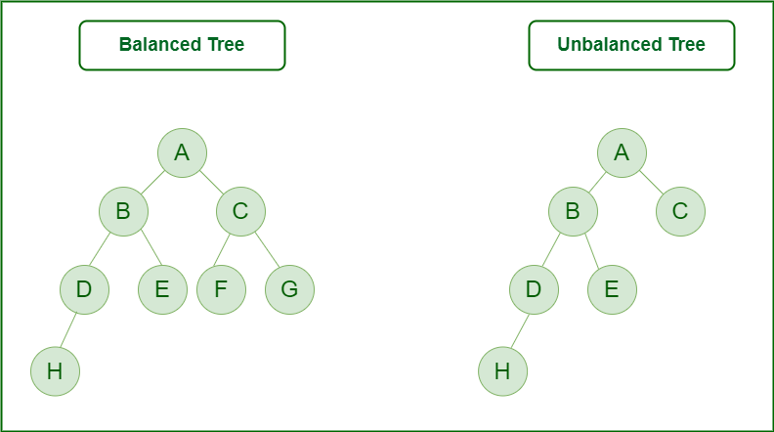
Binary Tree

Slide 4
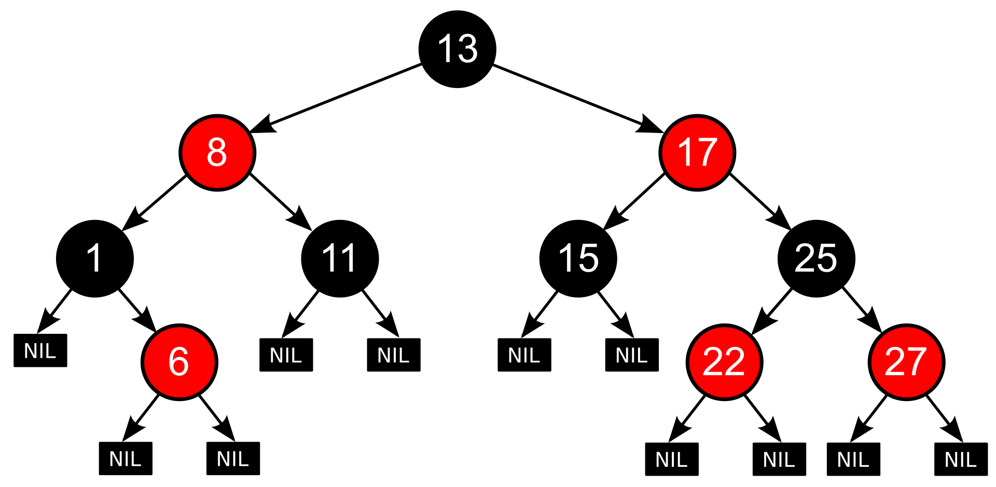
Red-Black Tree

Slide 5
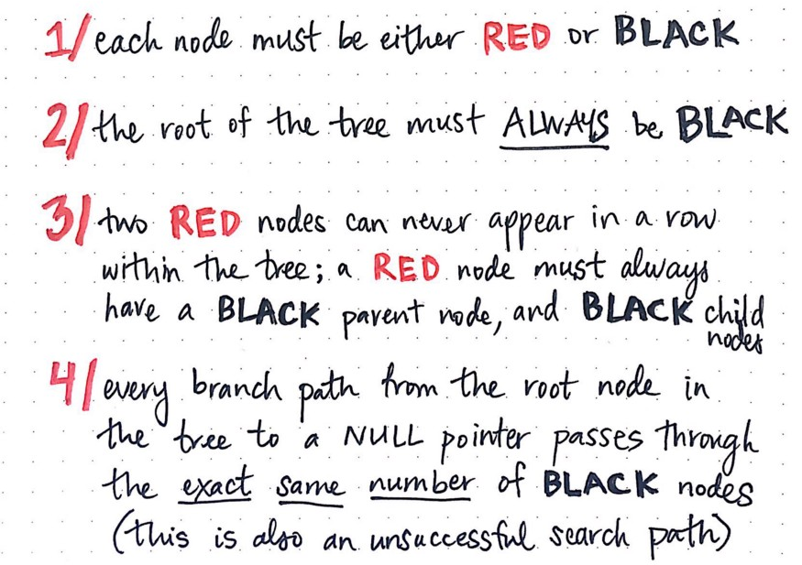
Red-Black Tree rules

Slide 6
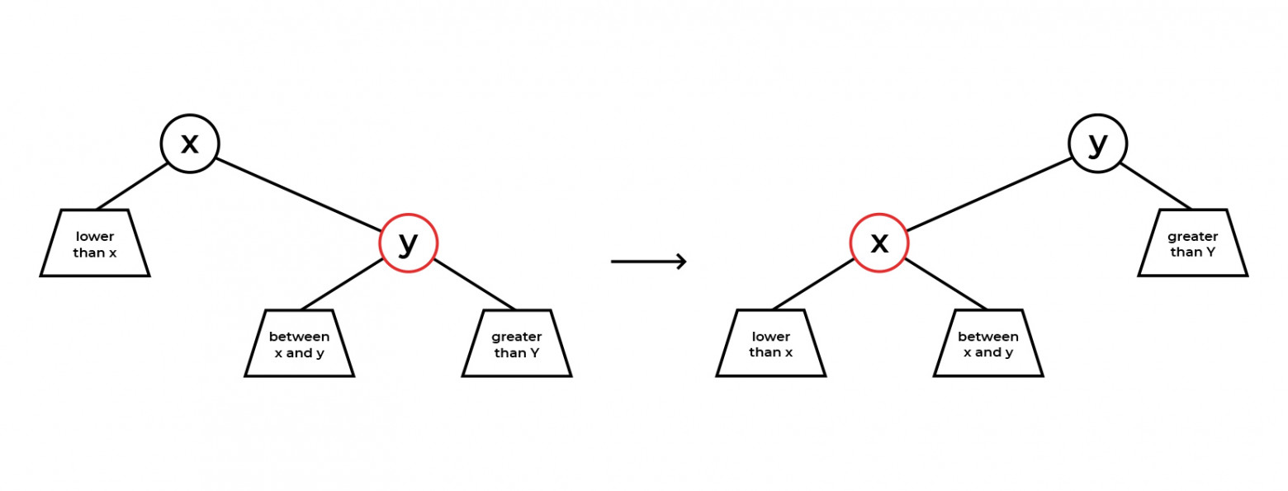
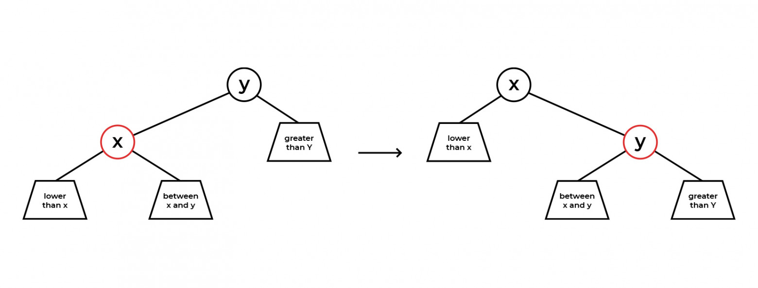
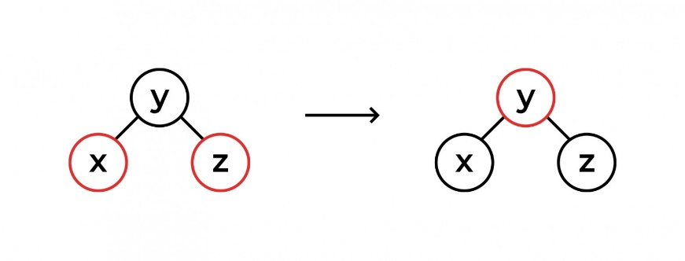
Red-Black Tree Operations

Slide 7
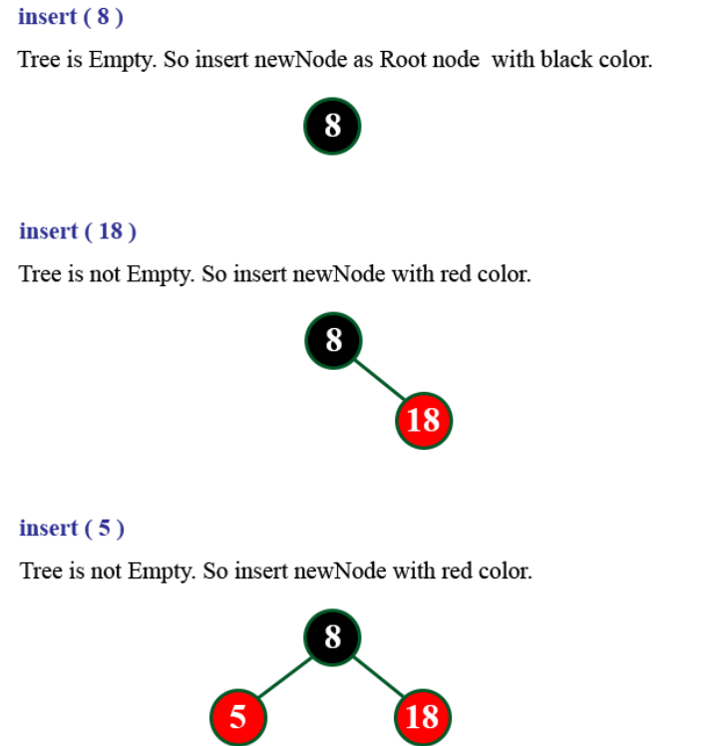
Red-Black 8,18, 5,15,17,25,40,80

Slide 8
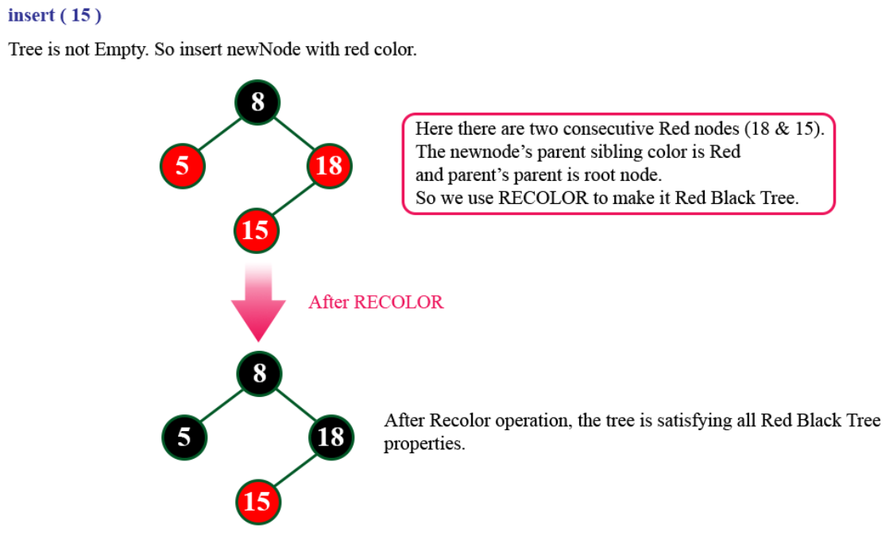
Red-Black 8,18, 5,15,17,25,40,80

Slide 9
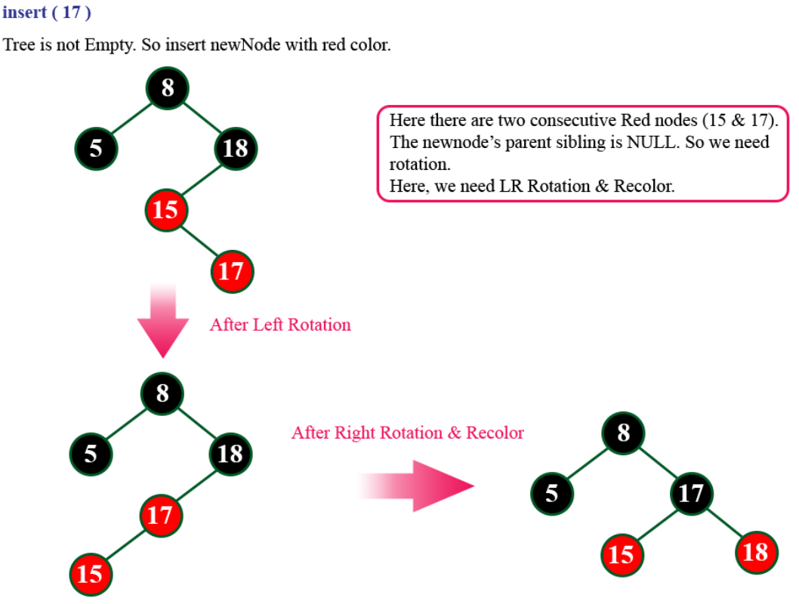
Red-Black 8,18, 5,15,17,25,40,80

Slide 10
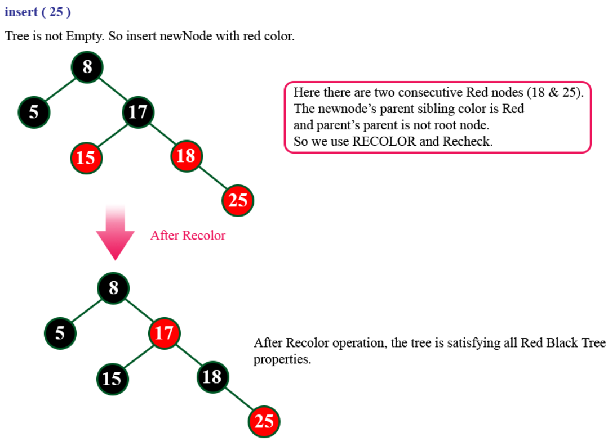
Red-Black 8,18, 5,15,17,25,40,80

Slide 11
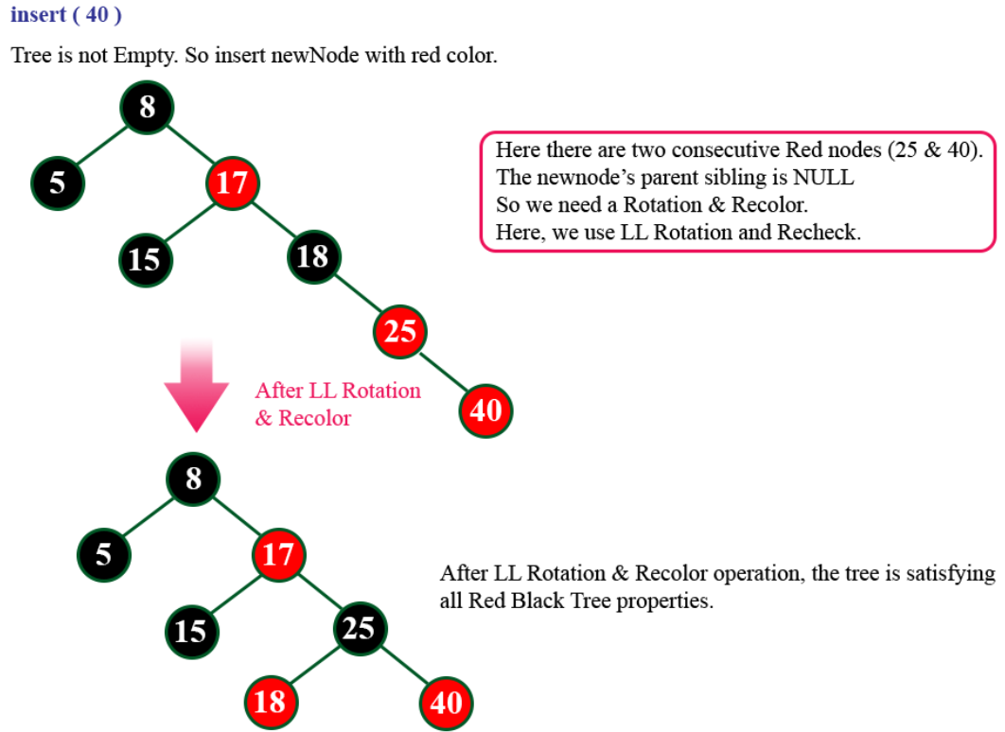
Red-Black 8,18, 5,15,17,25,40,80

Slide 12
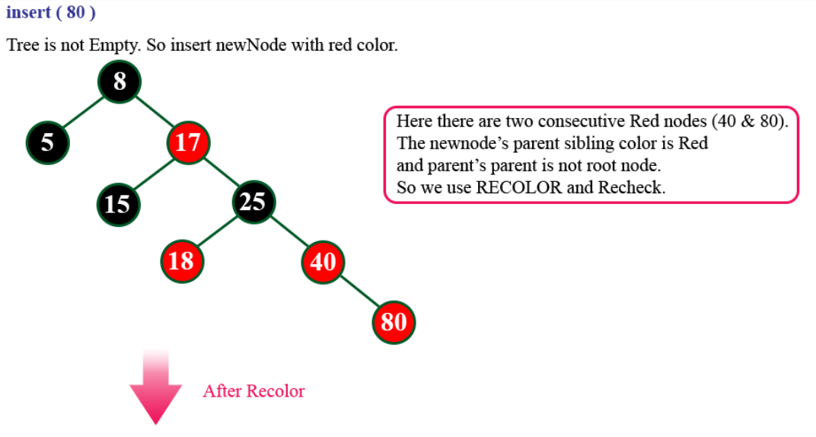
Red-Black 8,18, 5,15,17,25,40,80

Slide 13
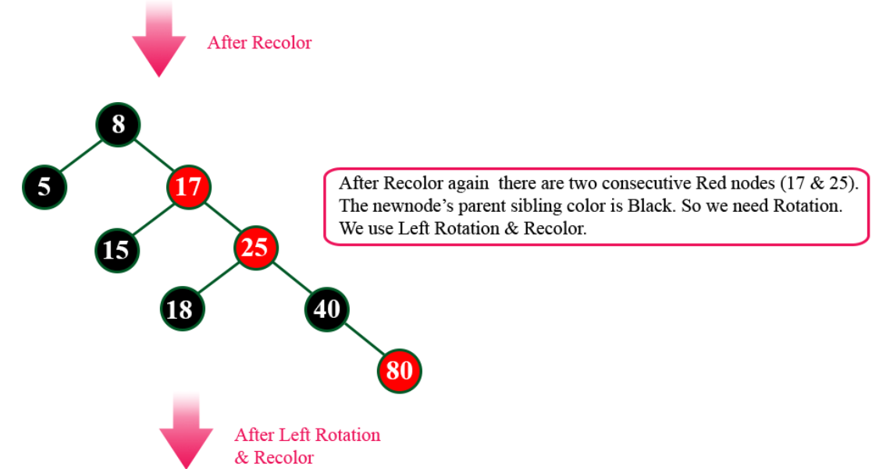
Red-Black 8,18, 5,15,17,25,40,80

Slide 14
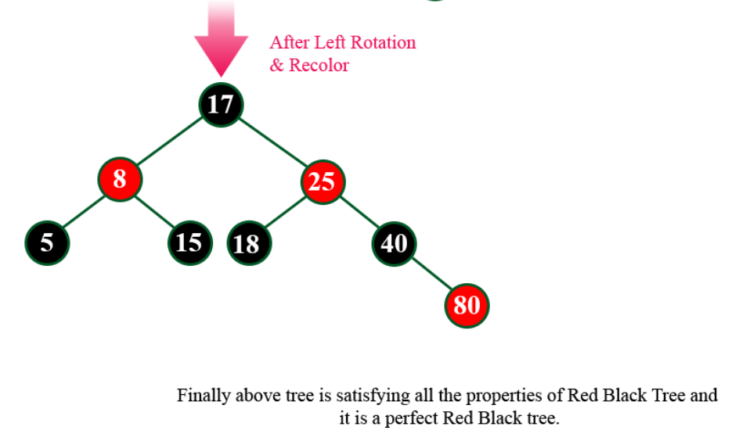
Red-Black 8,18, 5,15,17,25,40,80

