Slide 1
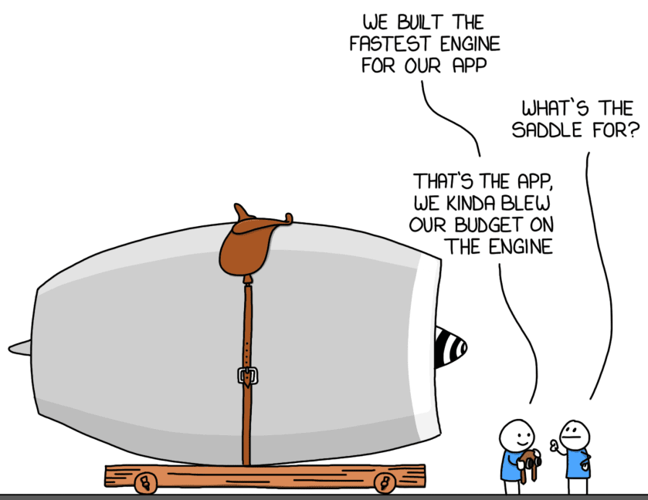
You Aren’t Gonna Need It(YAGNI)

Slide 2
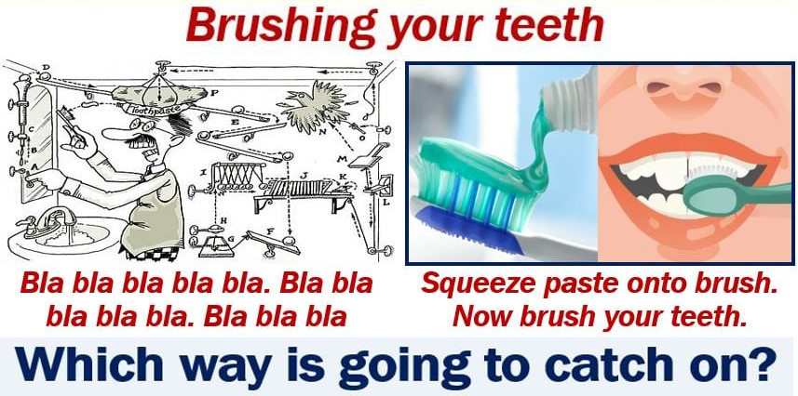
Keep It Simple, Stupid(KISS)

Slide 3
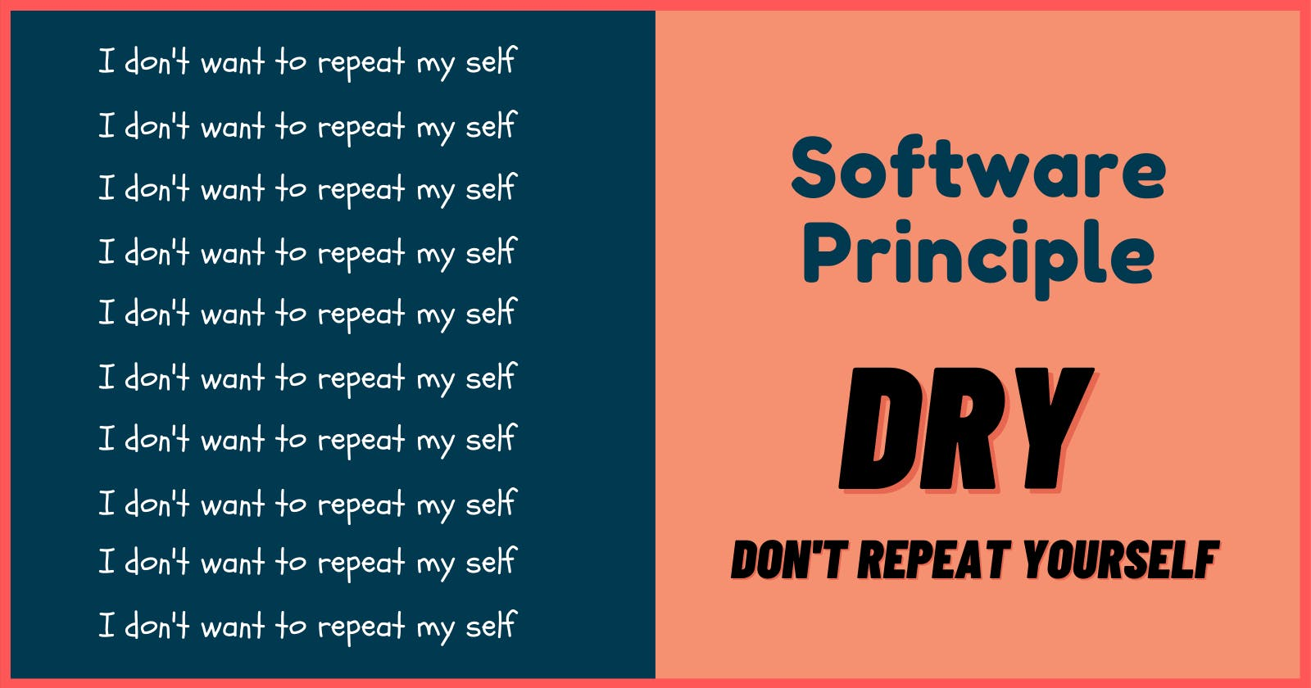
Don’t repeat yourself (DRY)

Slide 4
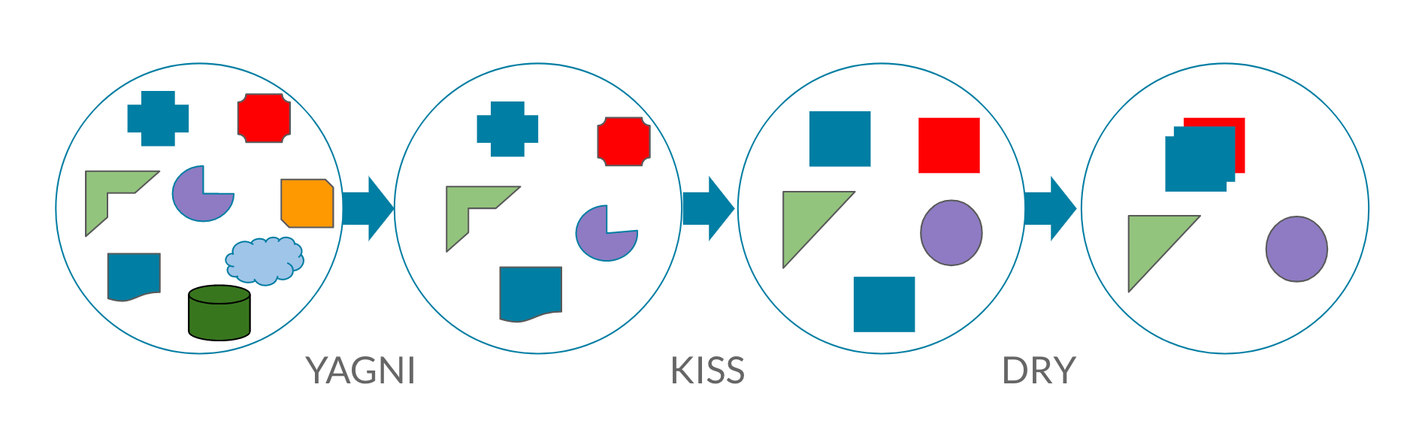
Together ☺

Slide 5
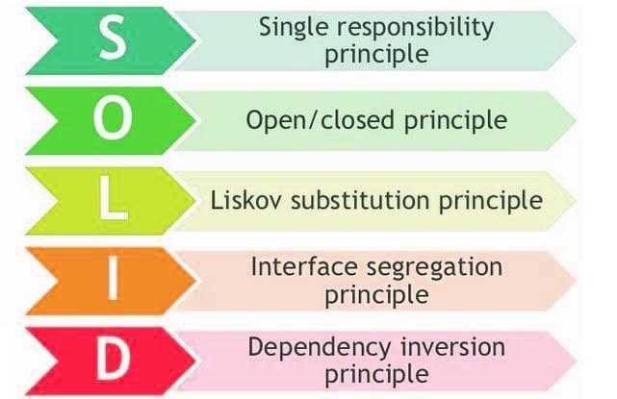
SOLID principles

Slide 6
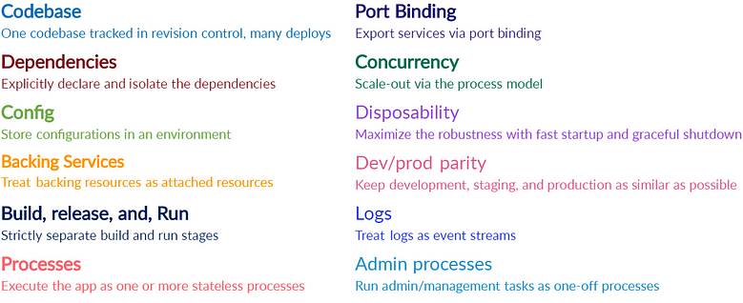
Twelve-Factor App

