Slide 1
Polymorphism
Compile time polymorphism
Runtime polymorphism
Method overloading
Method overriding
Data members polymorphism doesn’t work

Slide 2
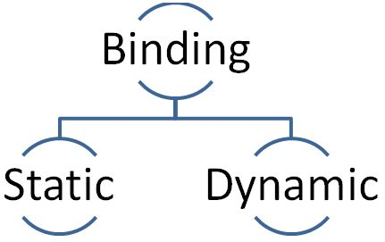
Polymorphism

Slide 3
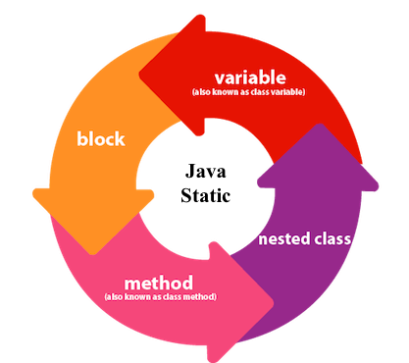
Static keyword

Slide 4
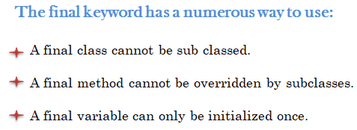
Final keyword

Slide 5
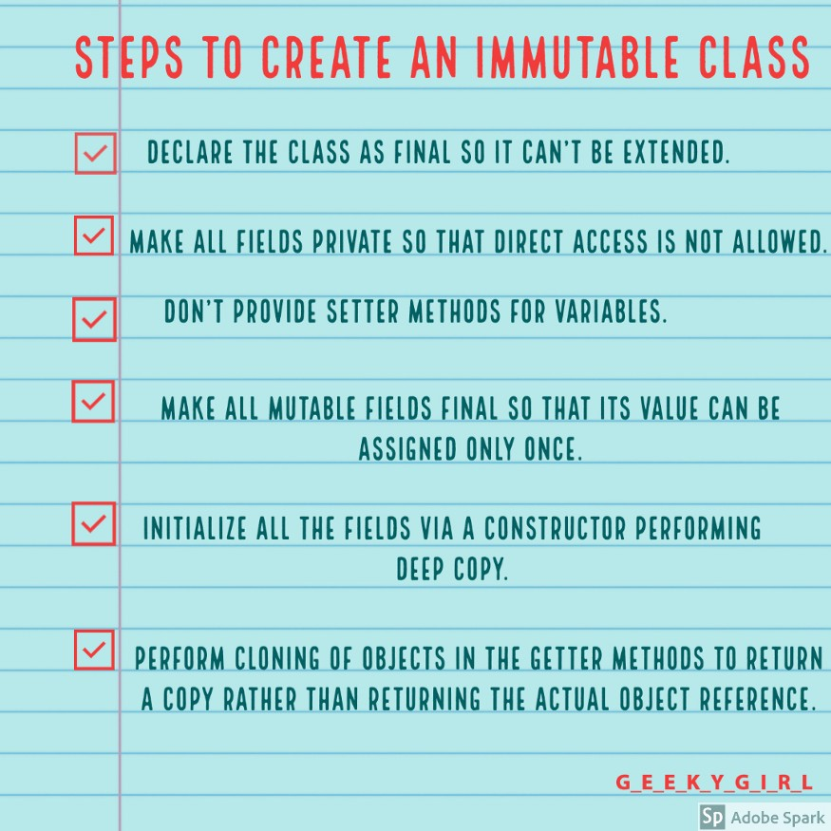
Immutable class

Slide 6
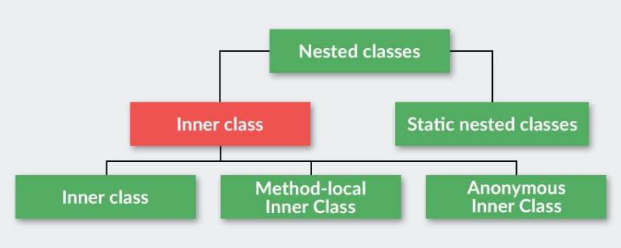
Nested classes

Slide 7
Java Interface
An interface can contain any number of methods
An interface does not contain any constructors
All the methods in an interface are abstract (except default and static)
An interface cannot contain instance fields. The only fields that can appear in an interface must be declared both static and final

Slide 8
Abstract class
An abstract class must be declared with an abstract keyword
It can have abstract and non-abstract methods
It cannot be instantiated
It can have constructors and static methods also
All abstract methods should be overridden by inheritors

Slide 9
Java Enums
Java class that extends java.lang.Enum
Special data type that enables for a variable to be a set of predefined constants
Constructors can be overloaded
Can have multiple methods
All enum values are statically available
Can extend only another enum

