Slide 1

Java build tools

Slide 2
Build tools responsibility
Compiling: Compiling source code into machine code
Dependency management: Identifying and patching necessary third party integrations
Automated tests: Executing tests and reporting failure
Packaging app for deployment: Prepares source code for deployment to servers

Slide 3
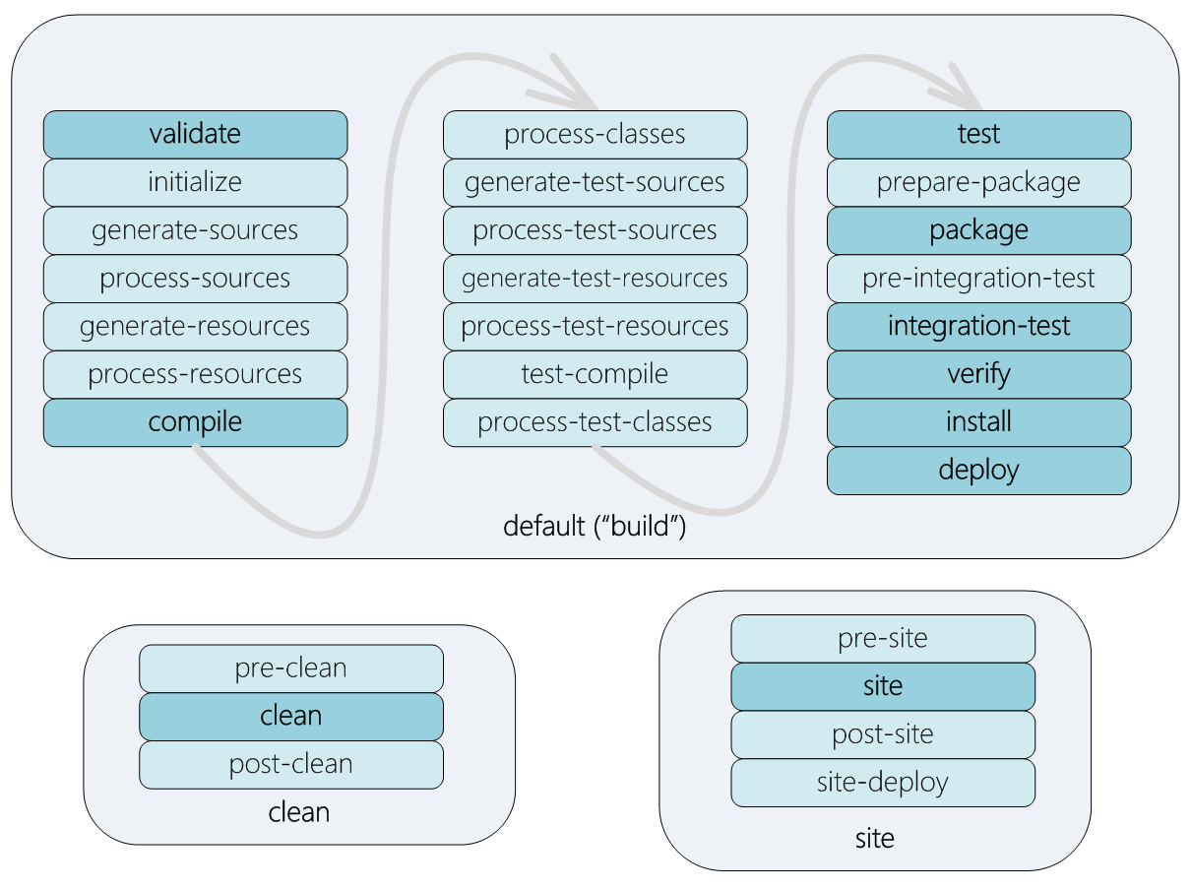
Maven phases

Slide 4
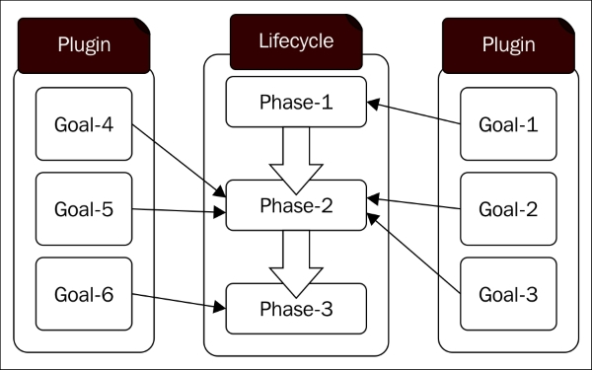
Maven goals and plugins

Slide 5
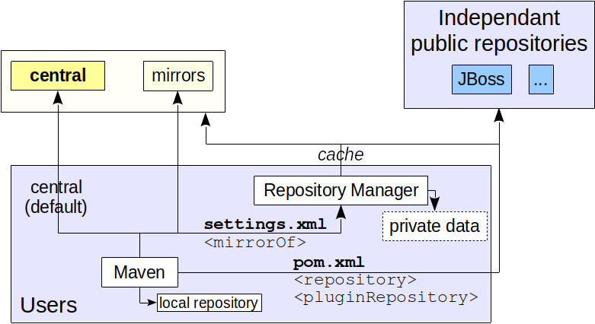
Maven repositories

Slide 6
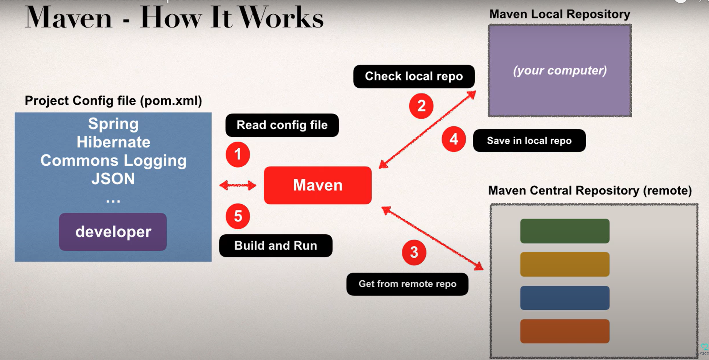
Maven dependencies

Slide 7
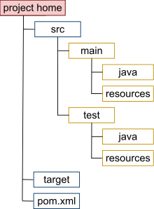
Maven project structure

Slide 8
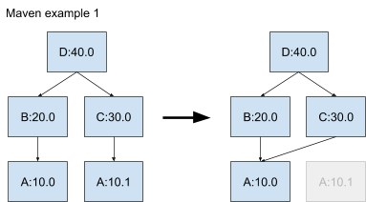
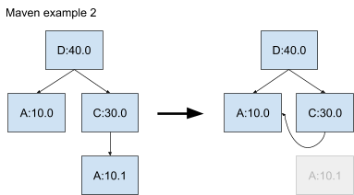
Maven version resolution

Slide 9
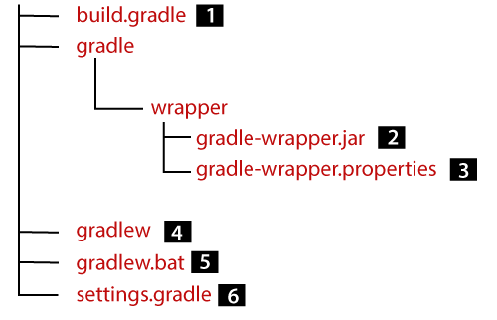
Gradle project structure

Slide 10
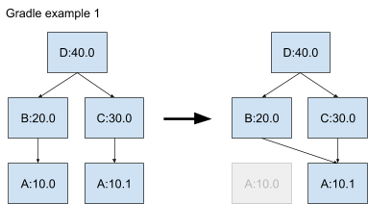
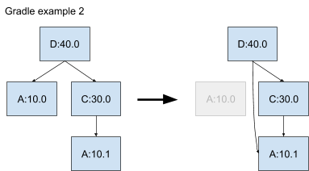
Gradle version resolution

Slide 11
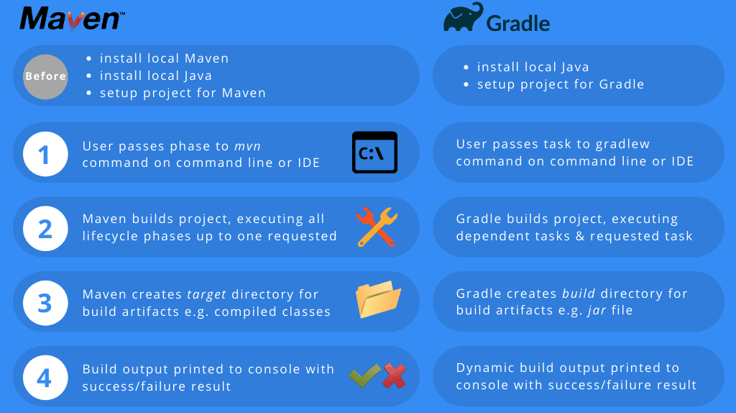
Build workflow

Slide 12
