Slide 1
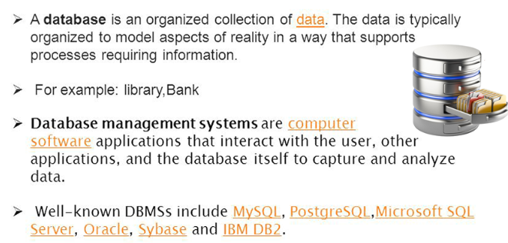
What is database?

Slide 2
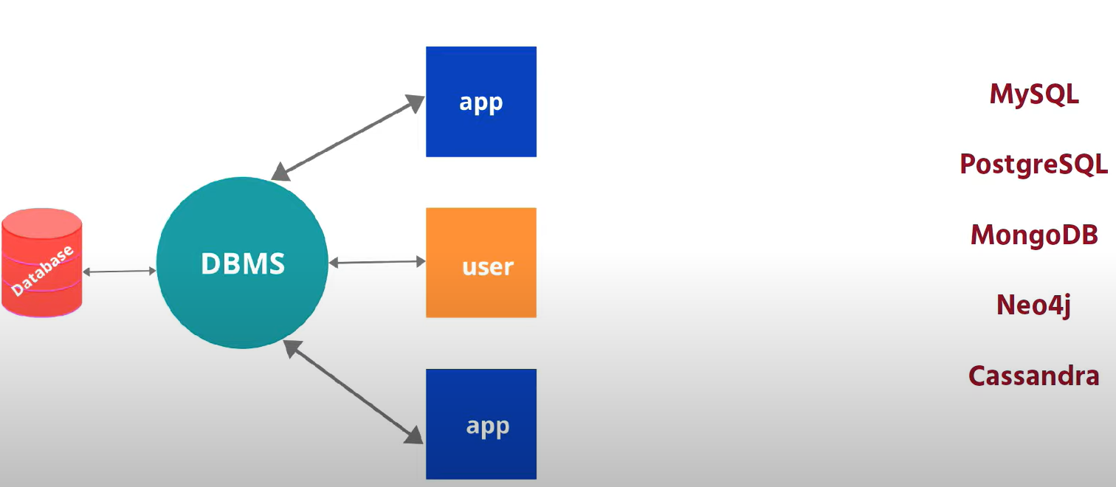
DBMS ≠ Database

Slide 3
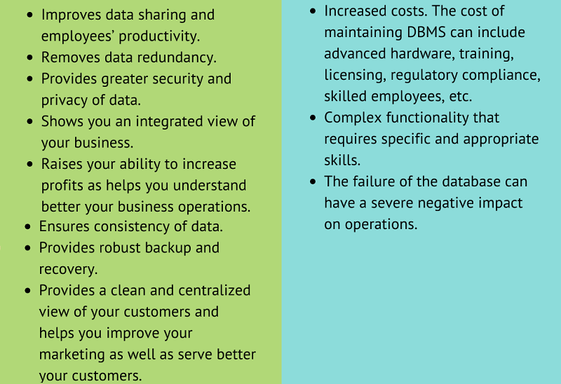
Database pros and cons

Slide 4
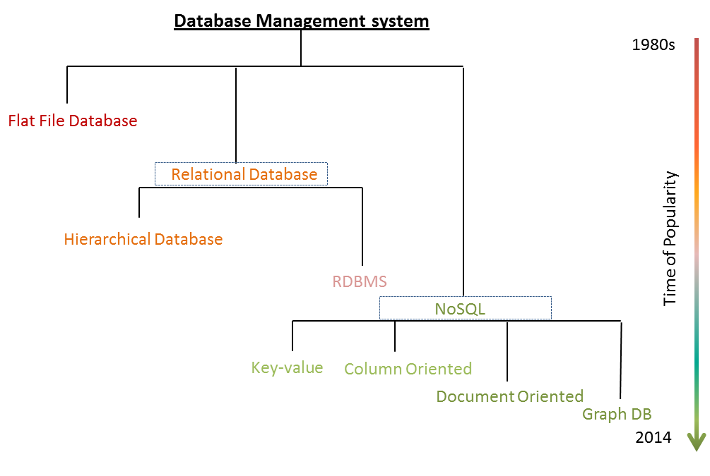
Evolution of Database

Slide 5
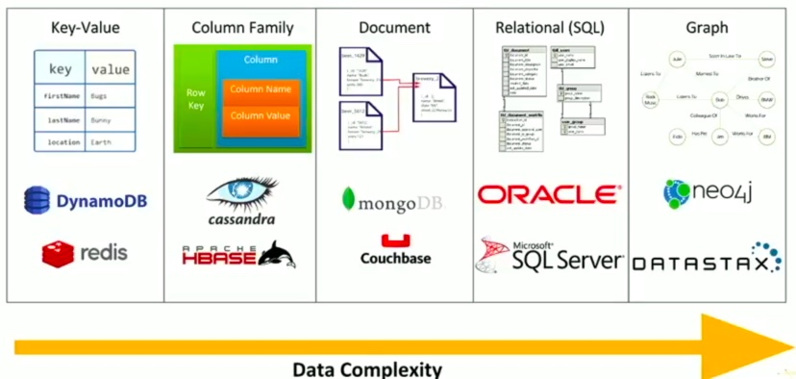
Database data structures

Slide 6
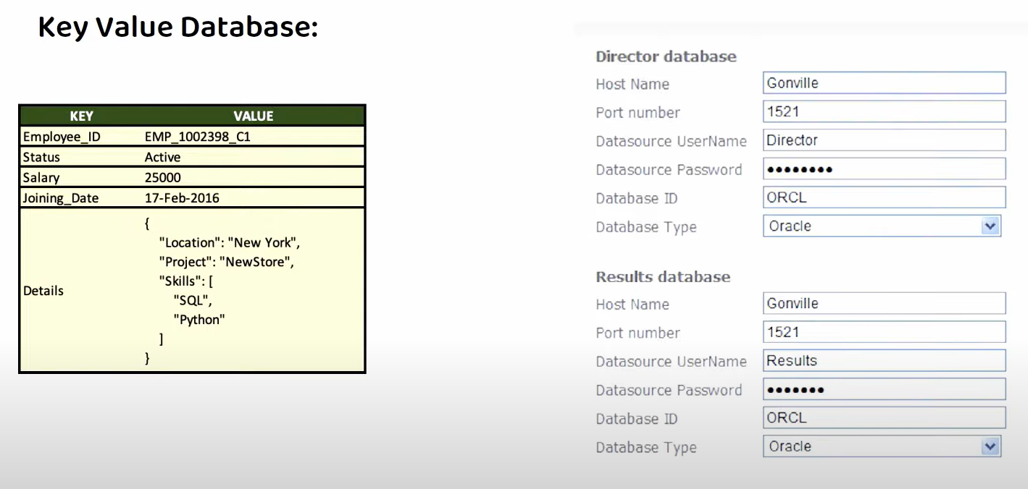
Key-value DB

Slide 7
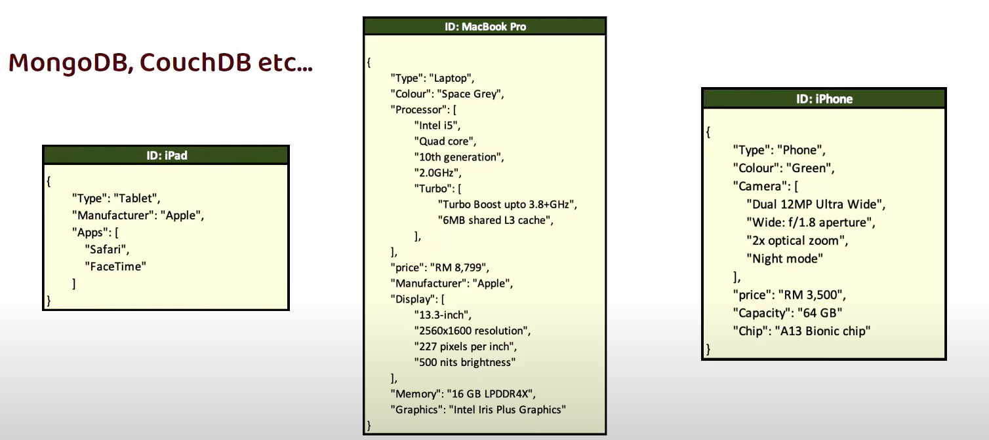
Document DB

Slide 8
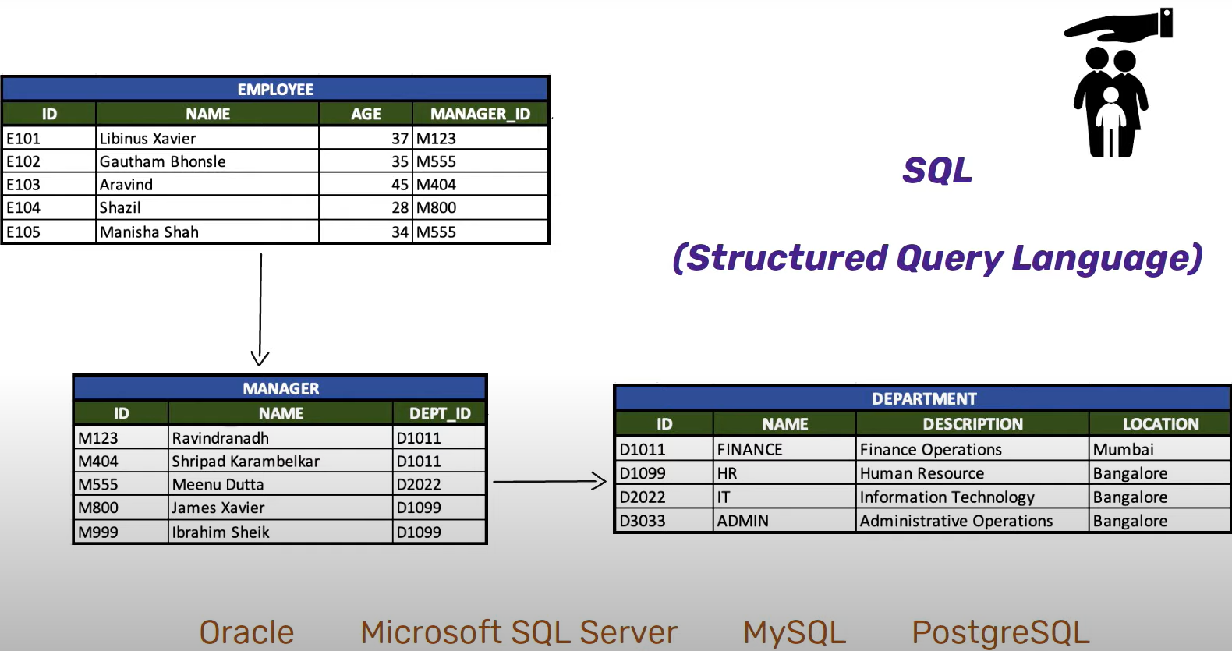
Relational DB

Slide 9
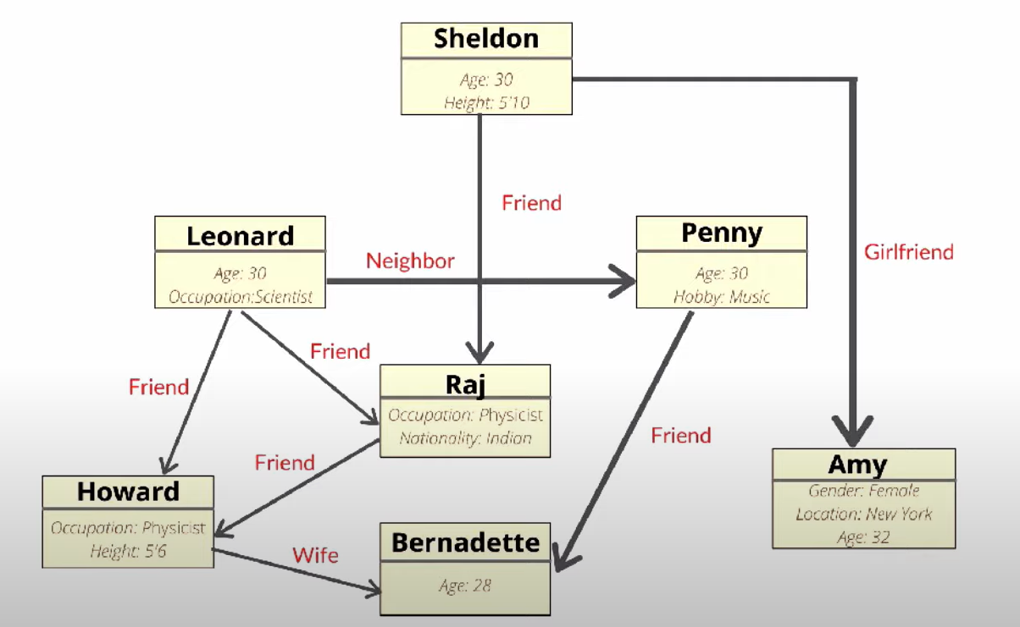
Graph DB

Slide 10
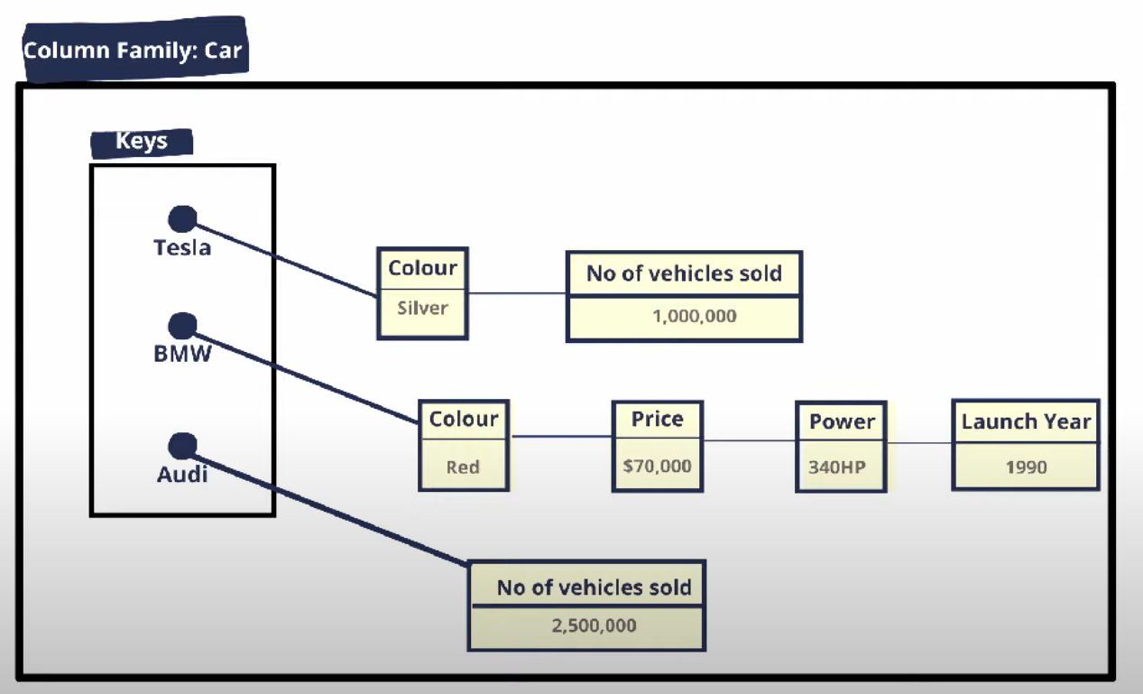
Wide Column DB

Slide 11
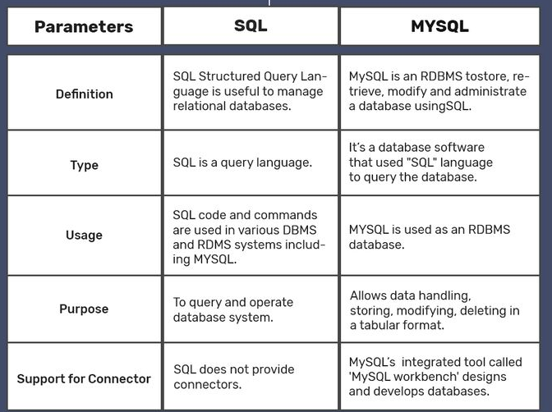
SQL VS MySQL

Slide 12
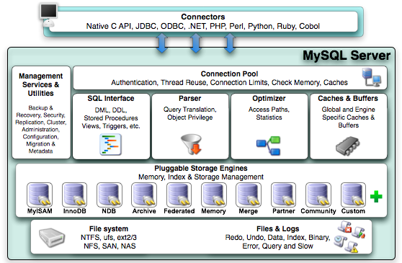
MySQL architecture

Slide 13
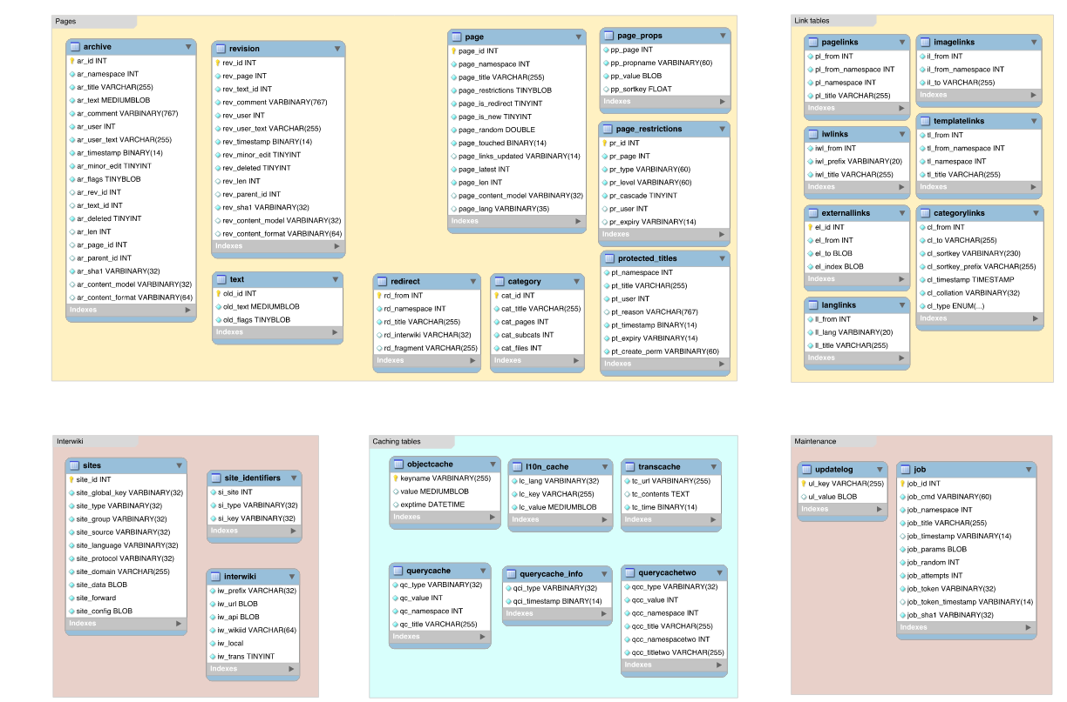
Schema
In a SQL database, a schema is a list of logical structures of data. A database user owns the schema, which has the same name as the database manager. In other words, schemas are similar to separate namespaces or containers used to handle database files

Slide 14
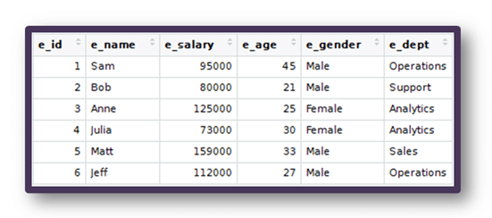
Table
A table is a database object which is comprised of rows and columns in SQL. Simplifying it more we can say that it’s a collection of related data held in a table format.

Slide 15
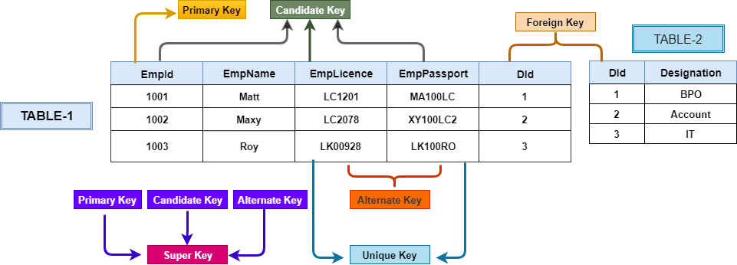
PK, FK
A Primary key is a column or a group of columns that uniquely identifies each row in a table Foreign creates a relationship between two tables, a primary (unic) key of one table is referred as a foreign key in another table

Slide 16
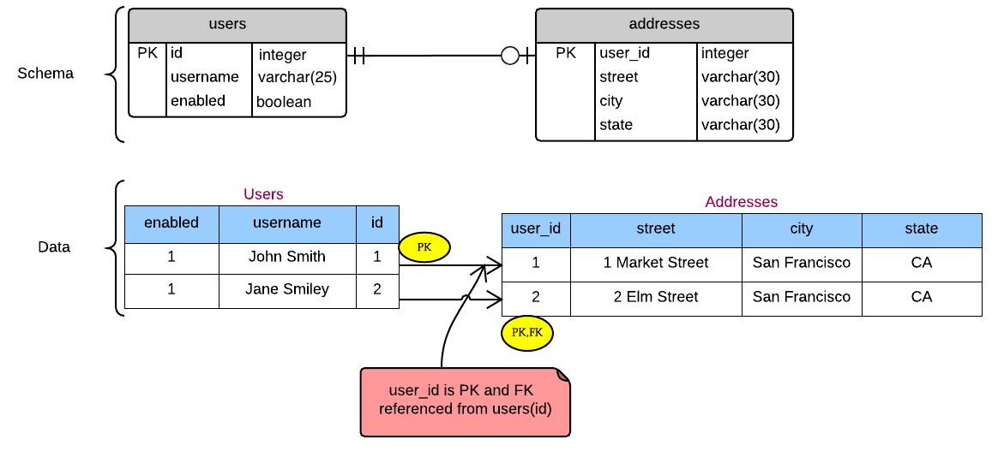
One-to-One relation

Slide 17
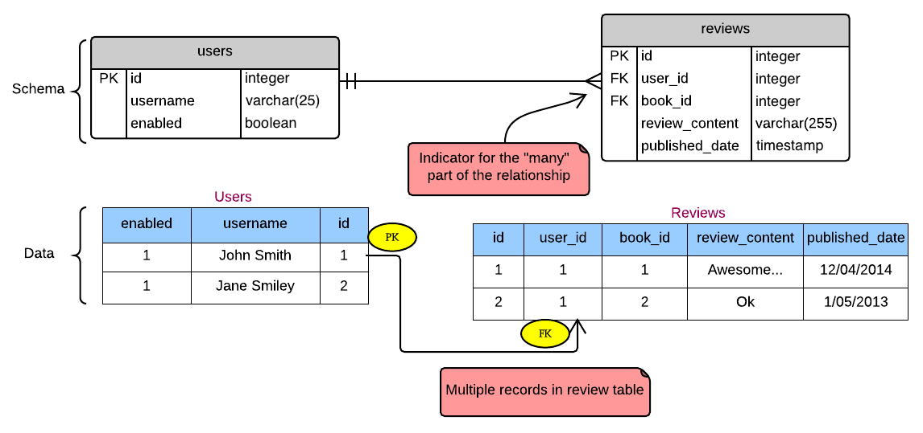
One-to-Many relation

Slide 18
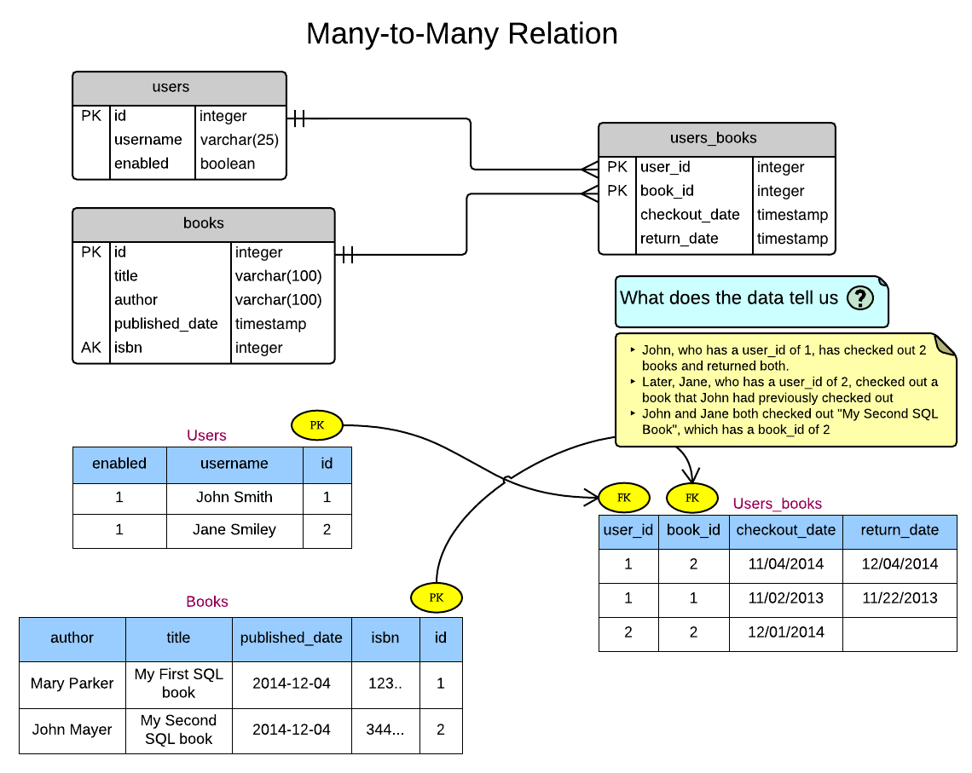
Many-to-Many relation

Slide 19
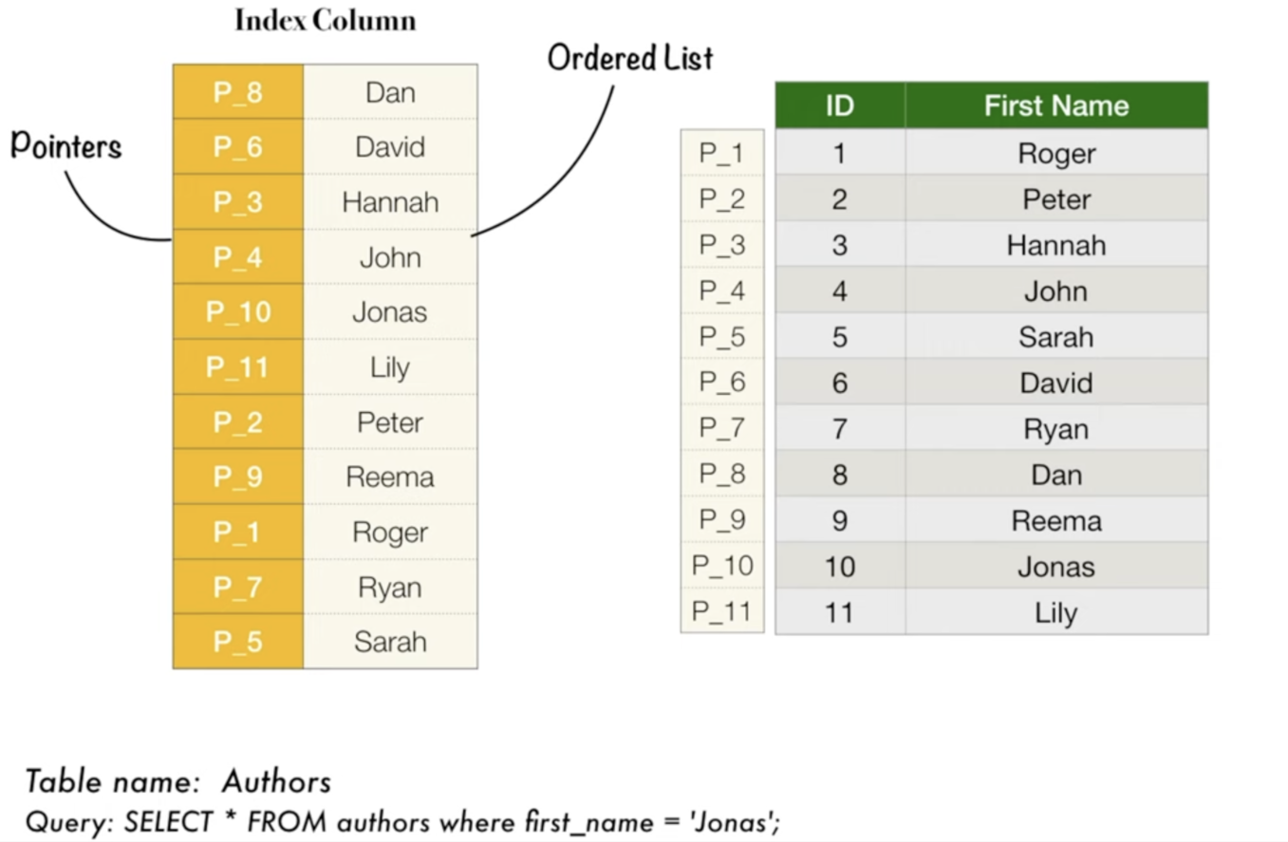
SQL Indexes

Slide 20
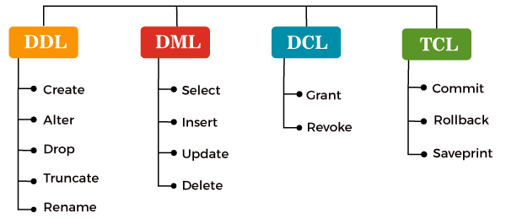
Types of SQL commands

Slide 21
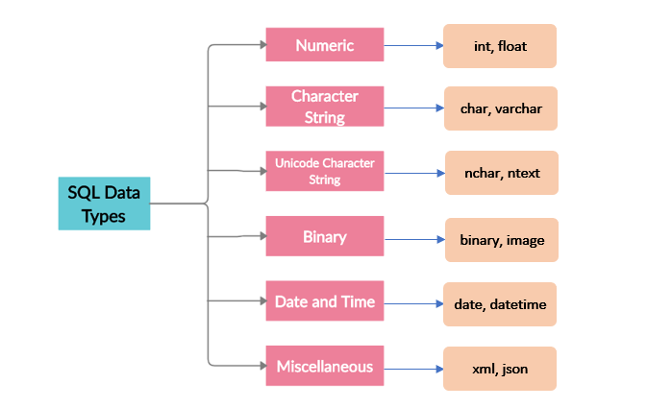
SQL data types (depends to impl)

Slide 22
Managing DB
MANAGING DATABASES
Select a Database
Create Databases
Drop Databases
MANAGING TABLES
Create Tables
Rename Tables
Alter Tables
Drop Columns
Add Columns
Drop Tables
Truncate Tables

Slide 23
MySQL Constraints
Primary Key
Foreign Key
Disable Foreign Key Checks
UNIQUE Constraint
NOT NULL Constraint
DEFAULT Constraint
CHECK Constraint

