Slide 1
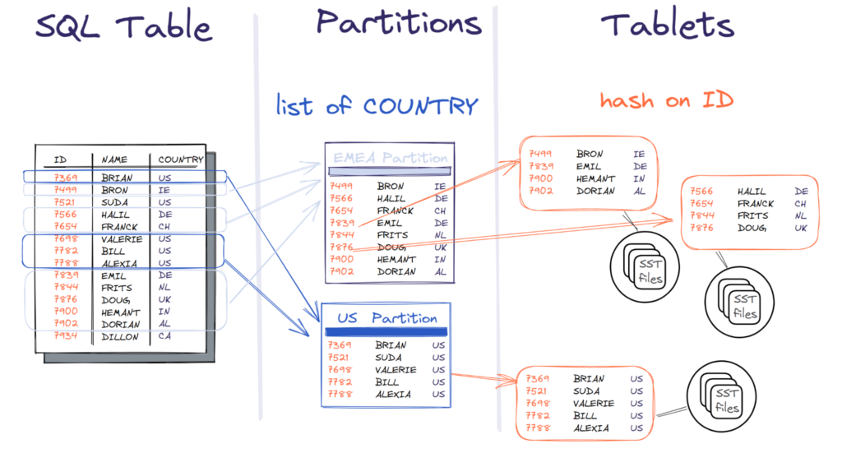
Partitioning

Slide 2
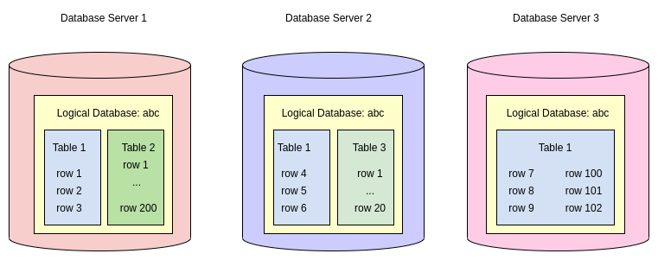
Sharding

Slide 3
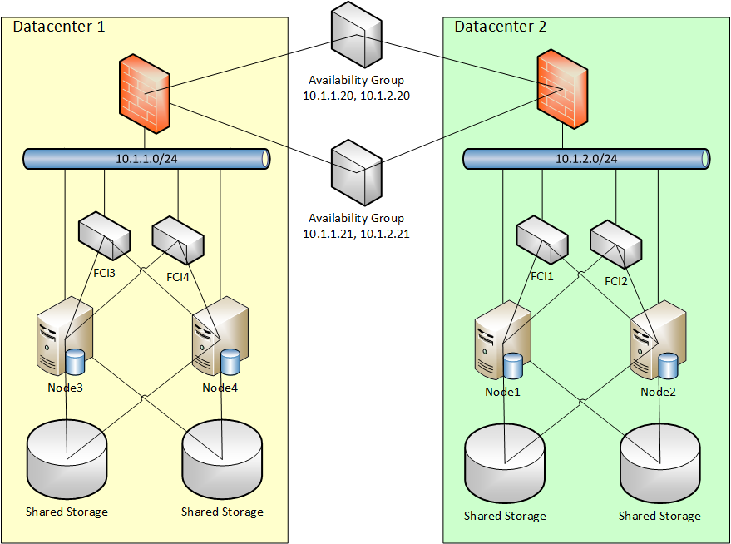
Clustering

Slide 4
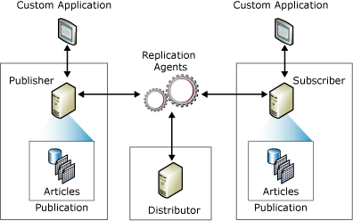
Replication

Slide 5
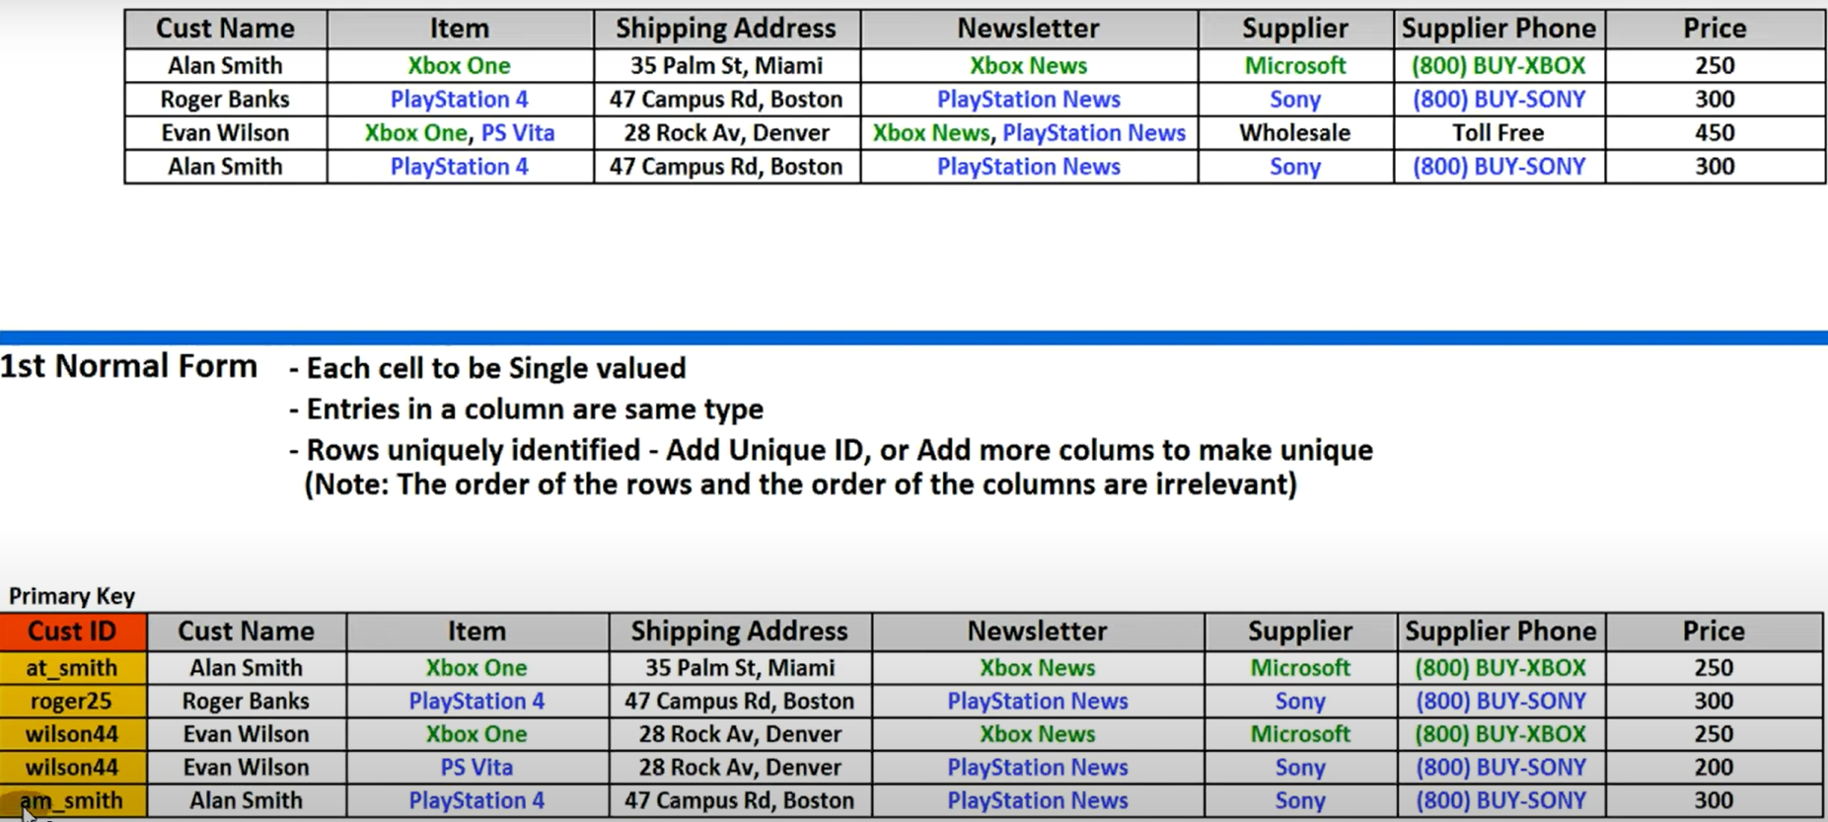
First normal form 1NF

Slide 6
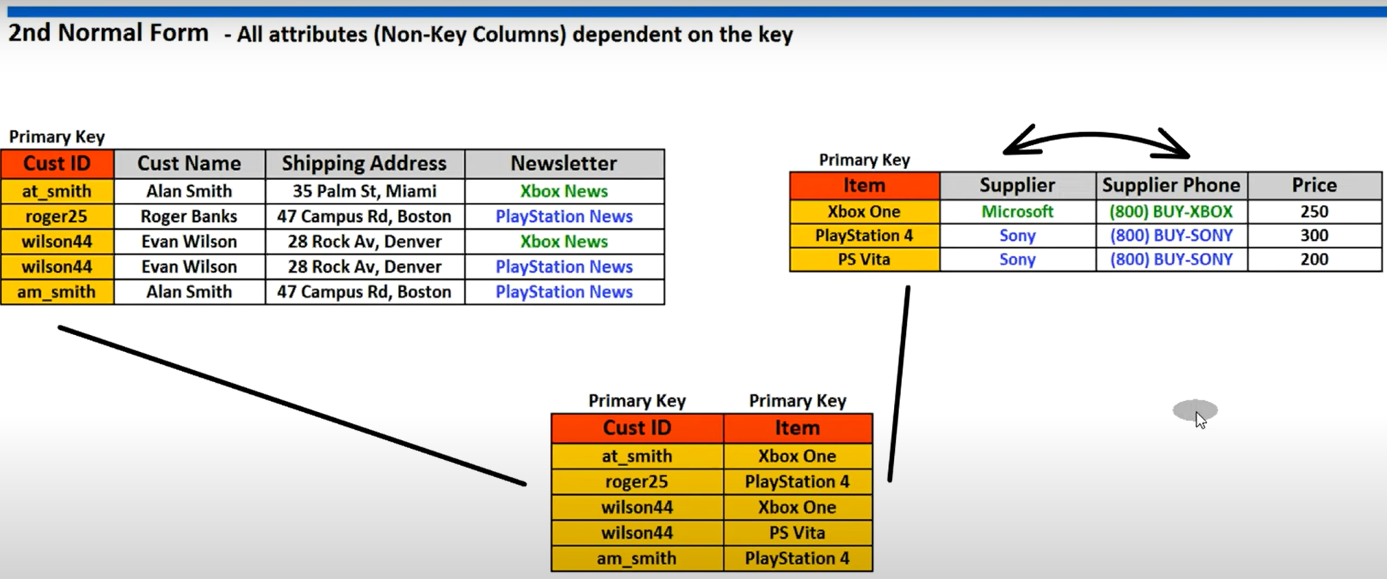
Second normal form 2NF

Slide 7
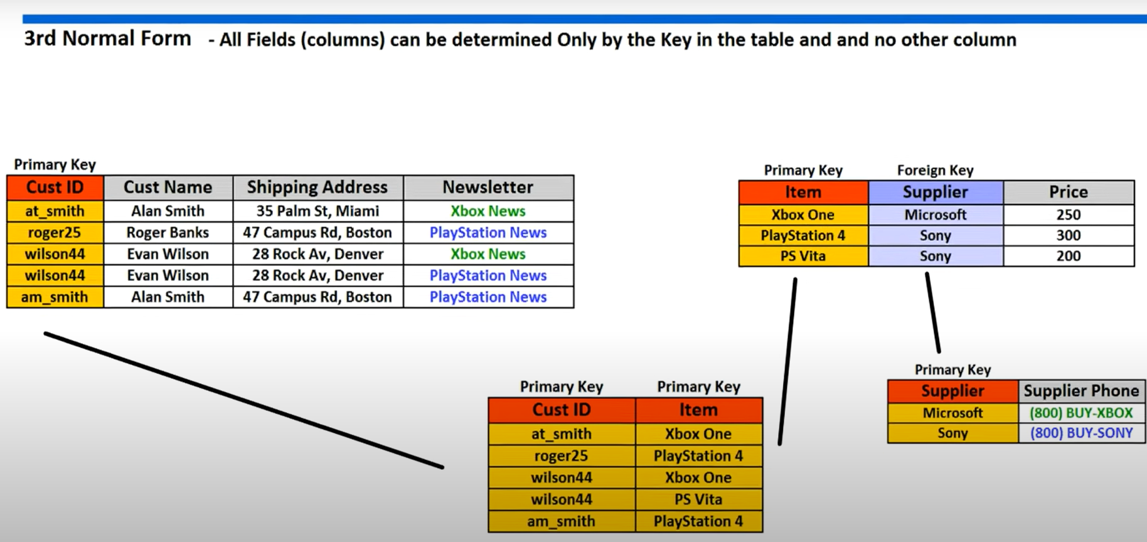
Third normal form 3NF

Slide 8
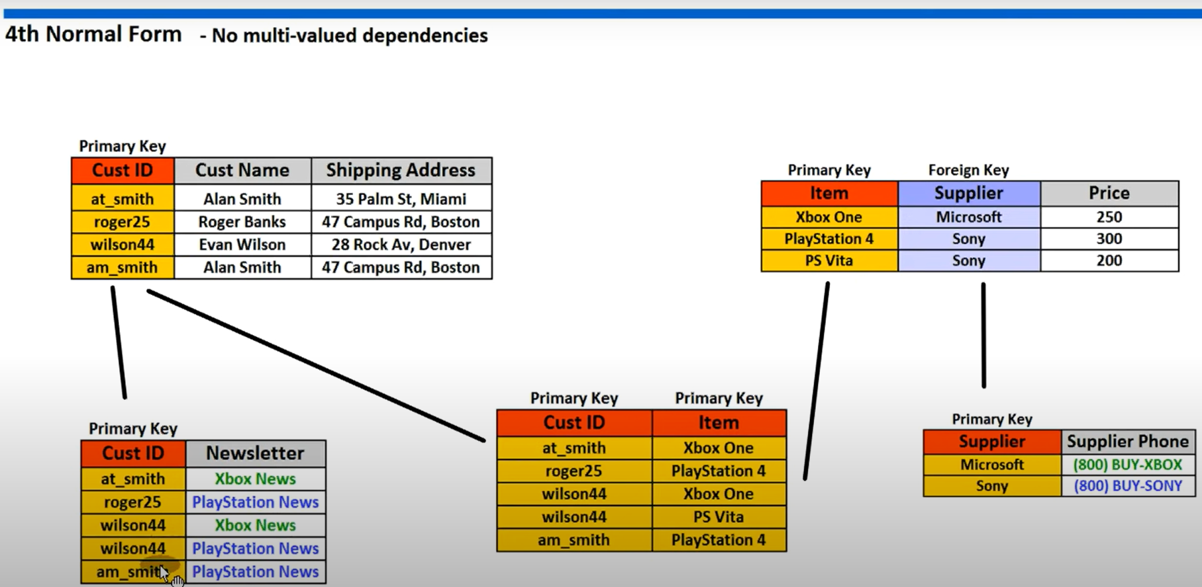
Fourth normal form 4NF

Slide 9
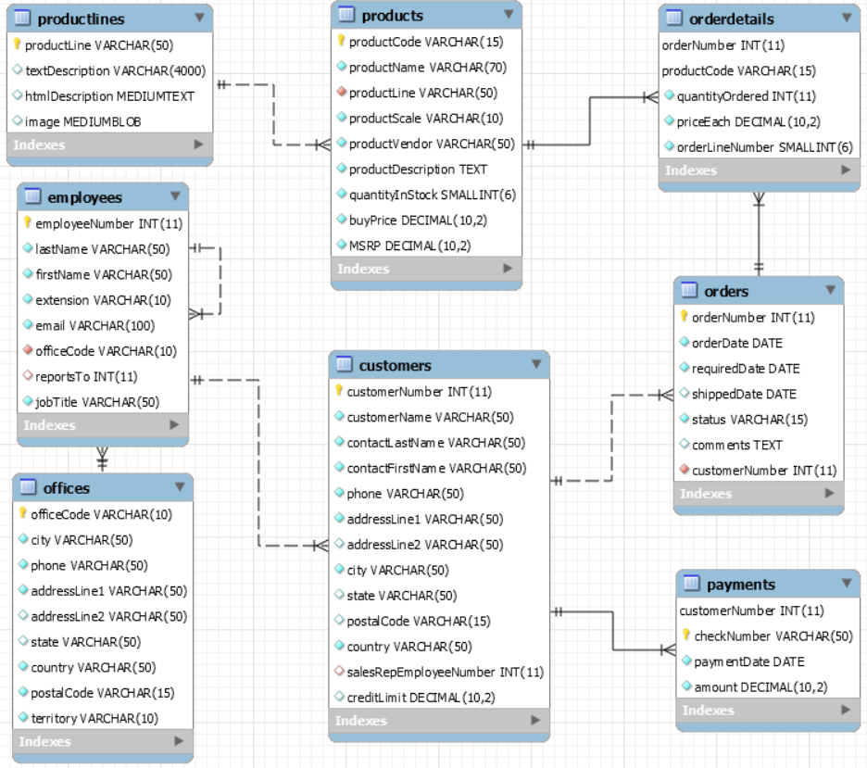

Slide 10
SELECT statement
SELECT
WHERE
AND
OR
IN
BETWEEN
LIKE
IS NULL
ORDER BY
SELECT DISTINCT
UNION
MINUS
INTERSECT

