Slide 1
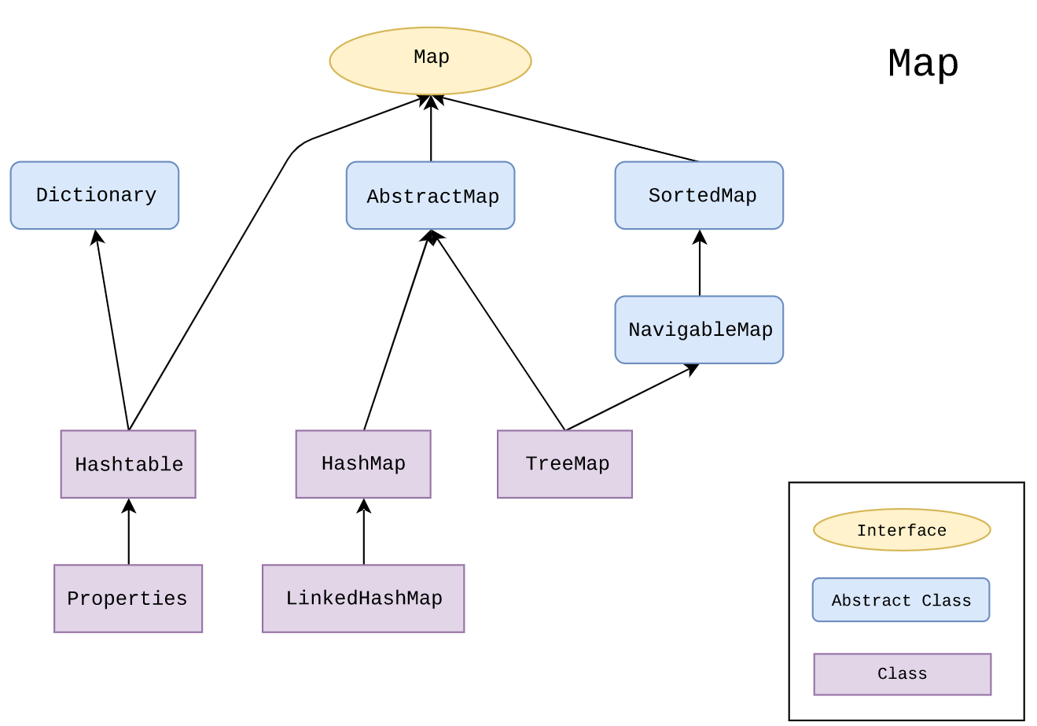
Map main implementations

Slide 2
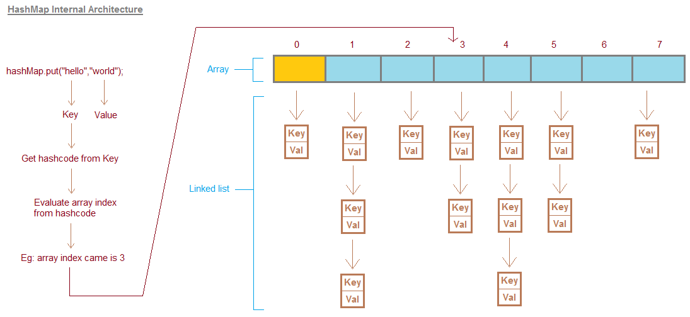
HashMap Internal structure Java7

Slide 3
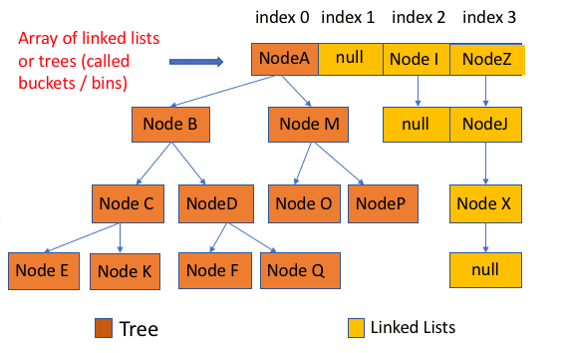
HashMap Internal structure Java8

Slide 4
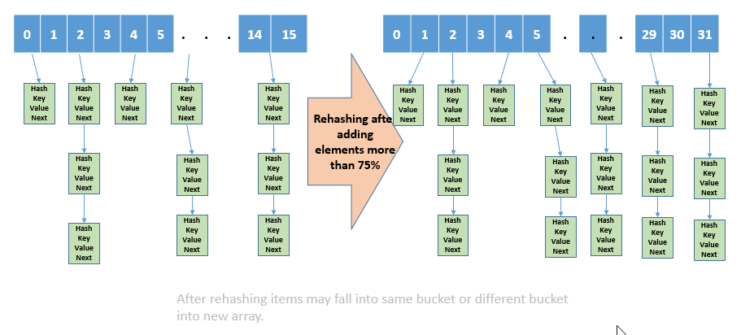
HashMap Load factor

Slide 5
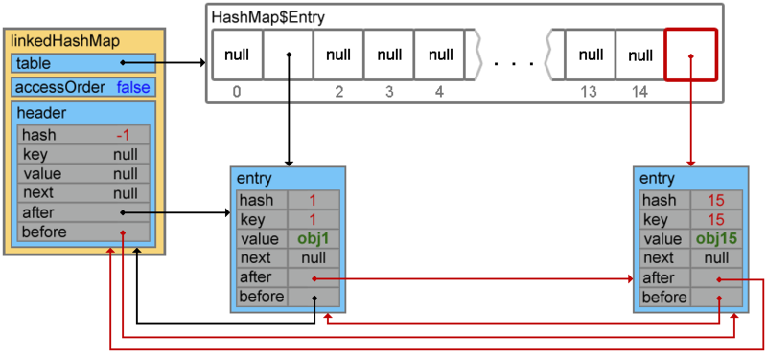
LinkedHashMap

Slide 6
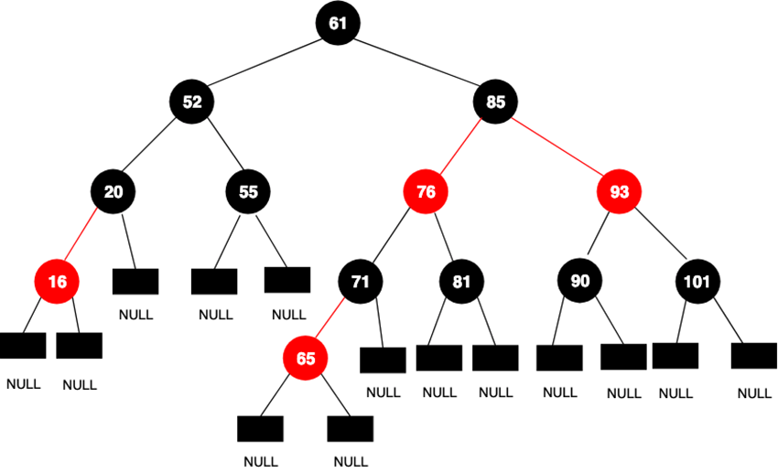
TreeMap

