Slide 1
What is “Web project”
Web project is anything involving the production or maintenance of a website or web app. This could be a standalone website or app, or it could be a single component or page. It could even be a “back-end” system for serving data to the user interface

Slide 2
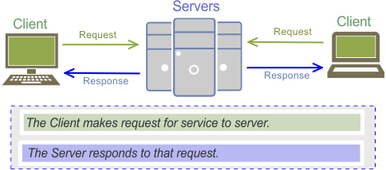
Client-server architecture

Slide 3
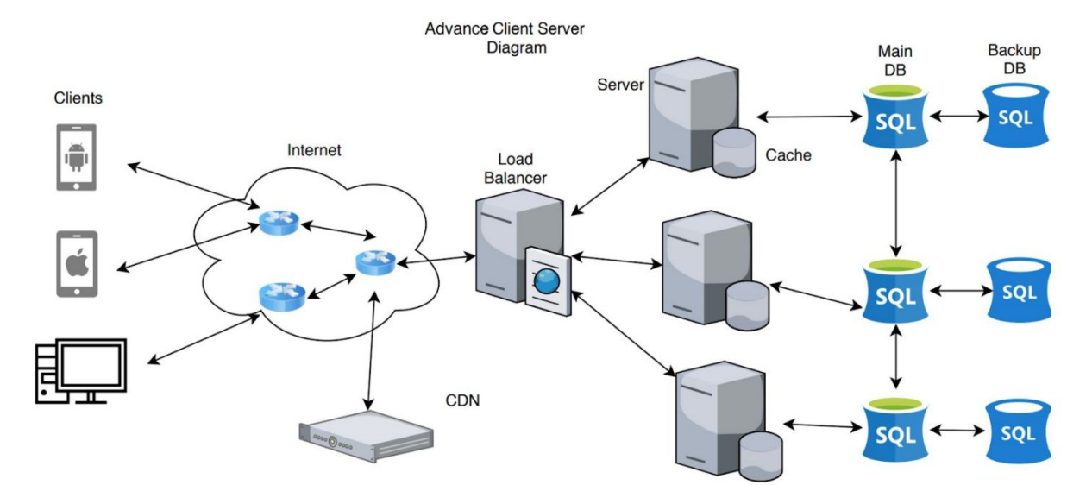
Client-server architecture

Slide 4
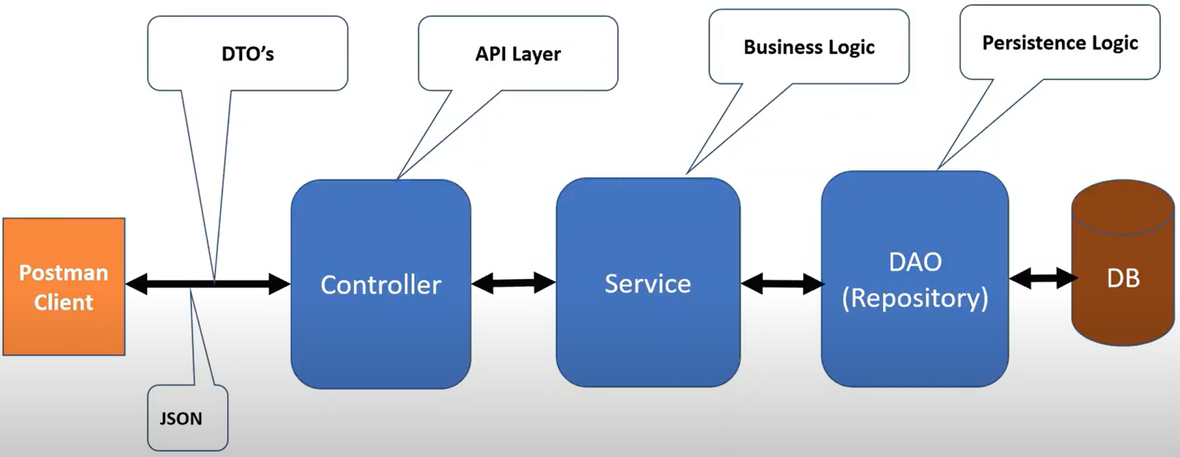
Typical web java-app architecture

Slide 5
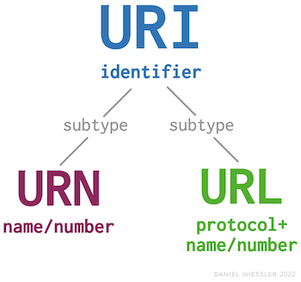
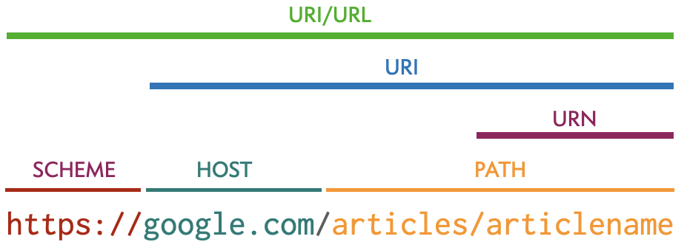
URL, URI

Slide 6
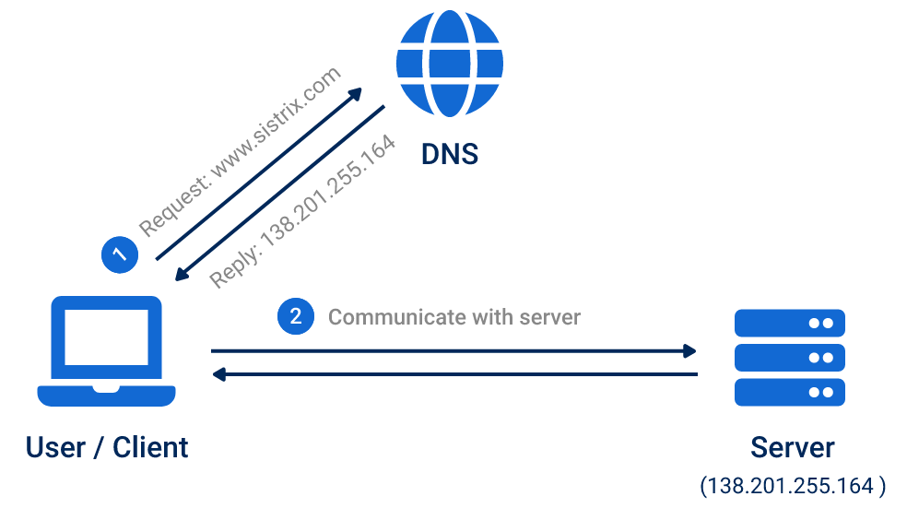
DNS

Slide 7
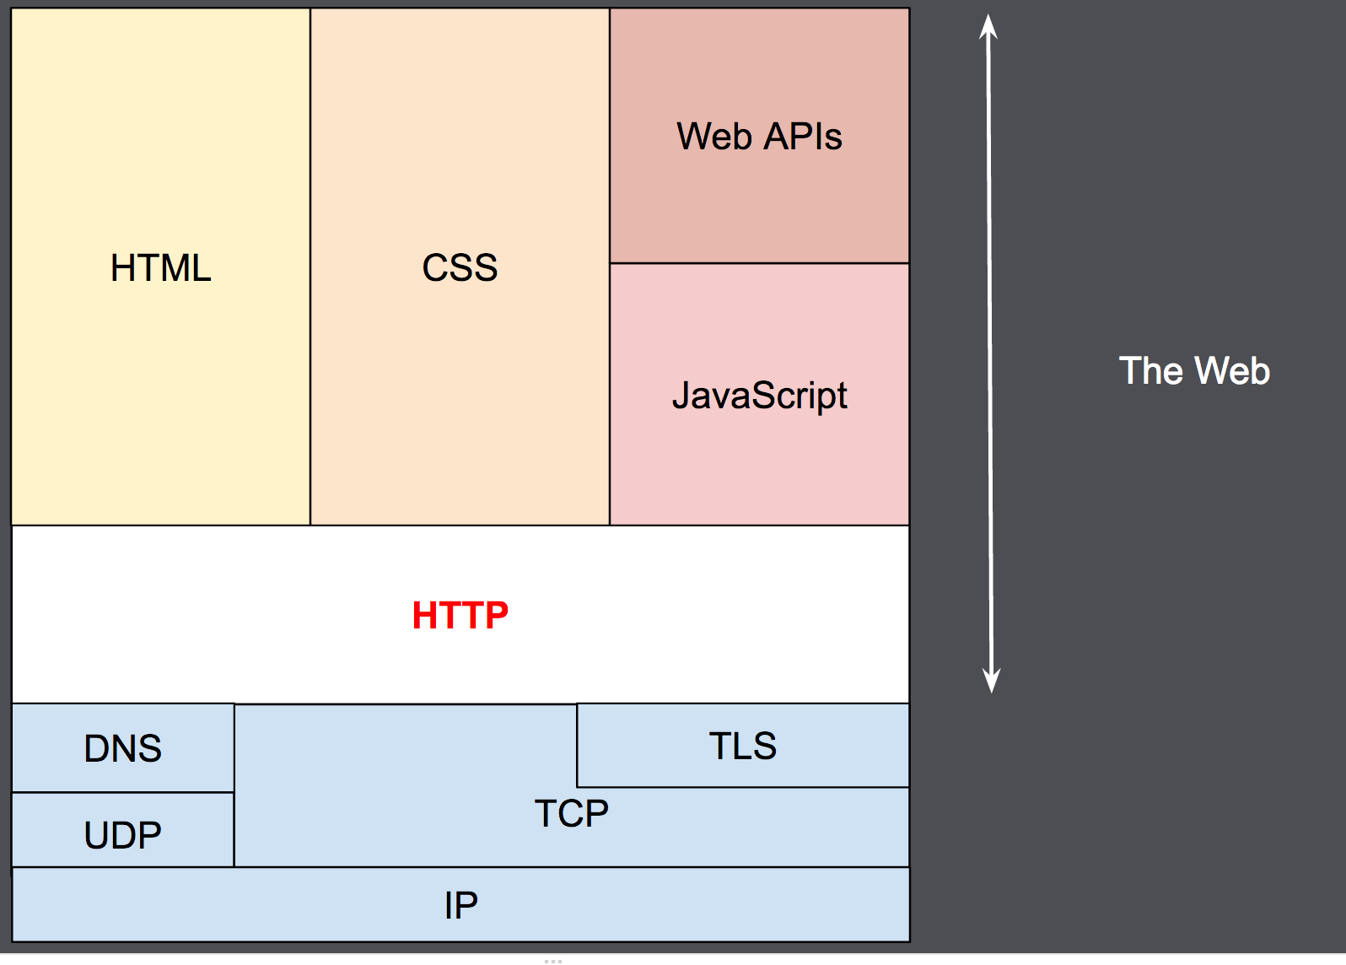
Web Protocols

Slide 8
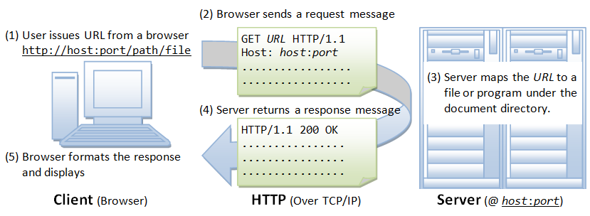
HTTP Protocol

Slide 9
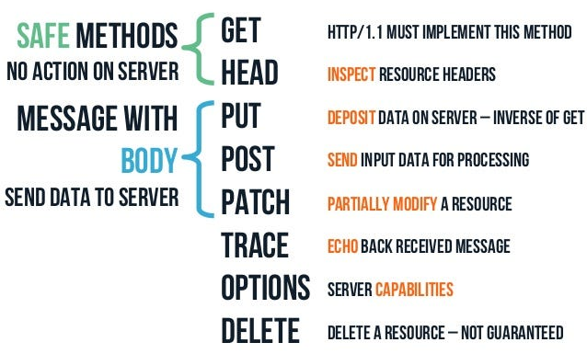
HTTP Methods

Slide 10
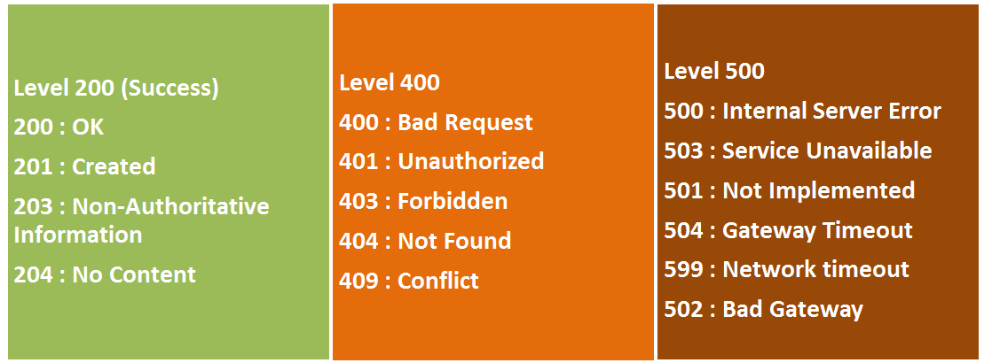
HTTP Status codes

Slide 11
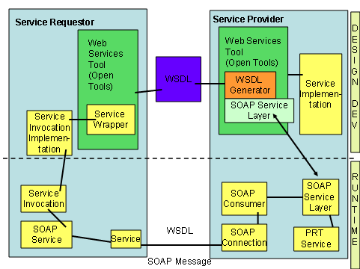
SOAP Architecture

Slide 12
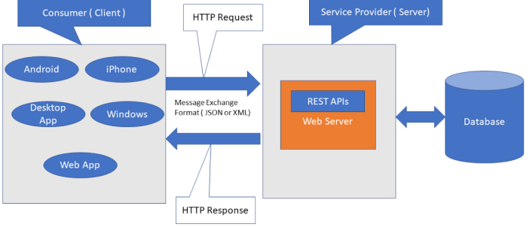
REST Architecture

Slide 13
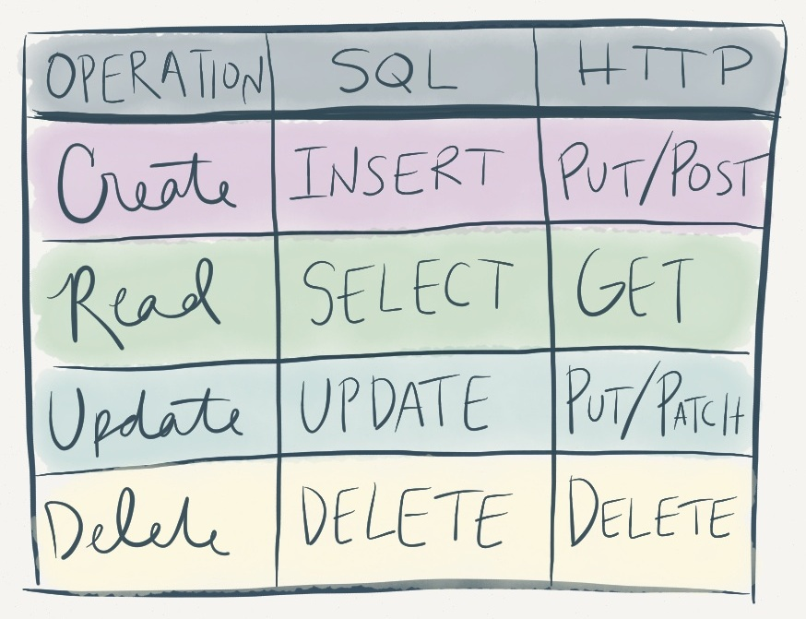
HTTP Methods SQL mapping

Slide 14
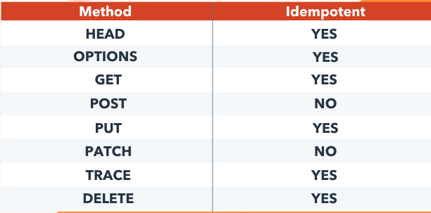
HTTP Methods Idempotency
A request method is considered idempotent if the intended effect on the server of multiple identical requests with that method is the same as the effect for a single such request. And it's worthwhile to mention that idempotency is about the effect produced on the state of the resource on the server and not about the response status code received by the client.

Slide 15
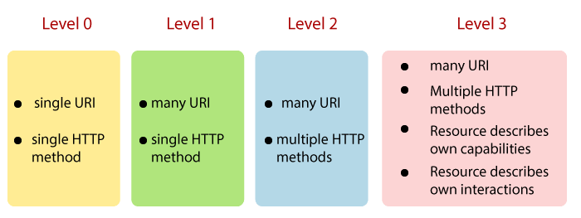
Maturity Model

Slide 16
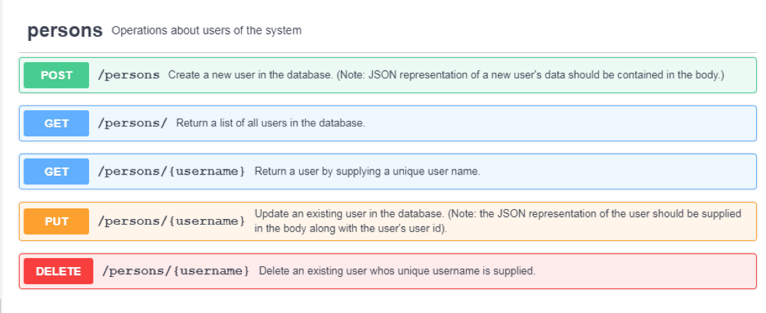
REST URL best practice

Slide 17
SOAP vs REST
SOAP | REST
SOAP is a standard protocol for creating web services. | REST is an architectural style to create web services.
SOAP is acronym for Simple Object Access Protocol. | REST is acronym for Representational State Transfer.
SOAP uses WSDL to expose supported methods and technical details. | REST exposes methods through URIs, there are no technical details.
SOAP web services and client programs are bind with WSDL contract | REST doesn’t have any contract defined between server and client
SOAP web services and client are tightly coupled with contract. | REST web services are loosely coupled.
SOAP learning curve is hard, requires us to learn about WSDL generation, client stubs creation etc. | REST learning curve is simple, POJO classes can be generated easily and works on simple HTTP methods.
SOAP supports XML data format only | REST supports any data type such as XML, JSON, image etc.
SOAP web services are hard to maintain, any change in WSDL contract requires us to create client stubs again and then make changes to client code. | REST web services are easy to maintain when compared to SOAP, a new method can be added without any change at client side for existing resources.
SOAP web services can be tested through programs or software such as Soap UI. | REST can be easily tested through CURL command, Browsers and extensions such as Chrome Postman.

