Slide 1
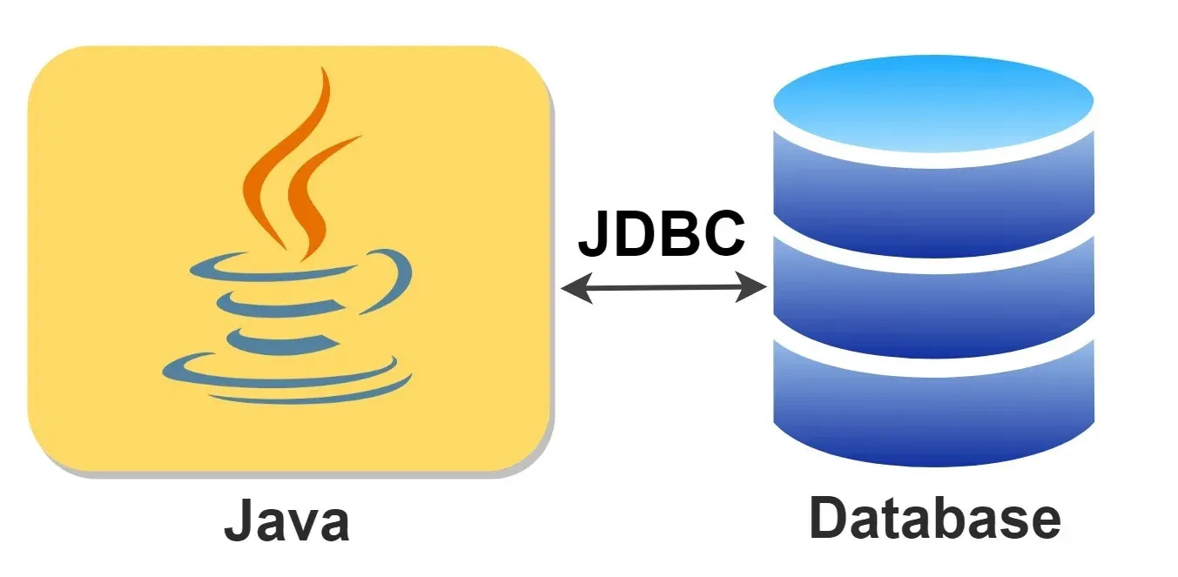
JDBC

Slide 2
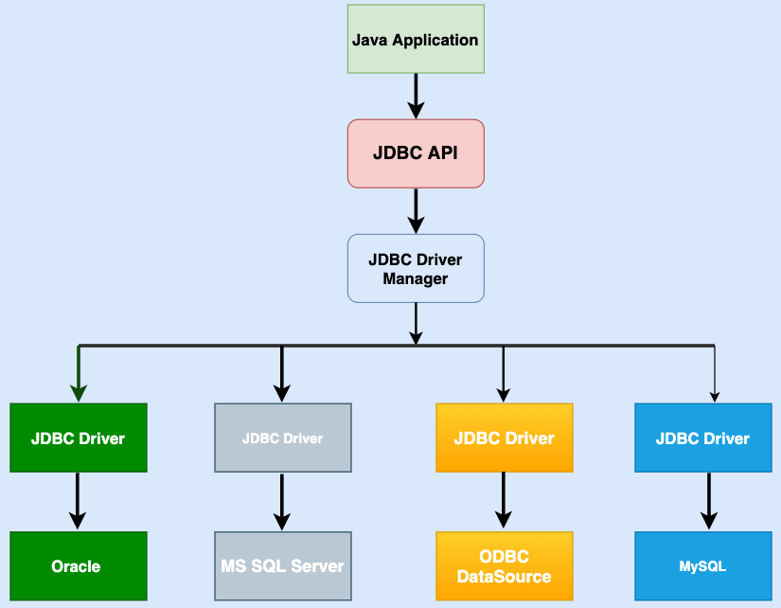
JDBC Architecture

Slide 3
JDBC following objects
Driver: This is the interface that controls communication with the database server. It also withdraws information associated with driver objects.
Driver Manager: It manages any required set of JDBC drivers
Connection: This is an interface or session that houses all the methods to connect to any database.
Statements: This is used to carry out a static SQL statement
ResultSet: This is used to access the result row-by-row

Slide 4
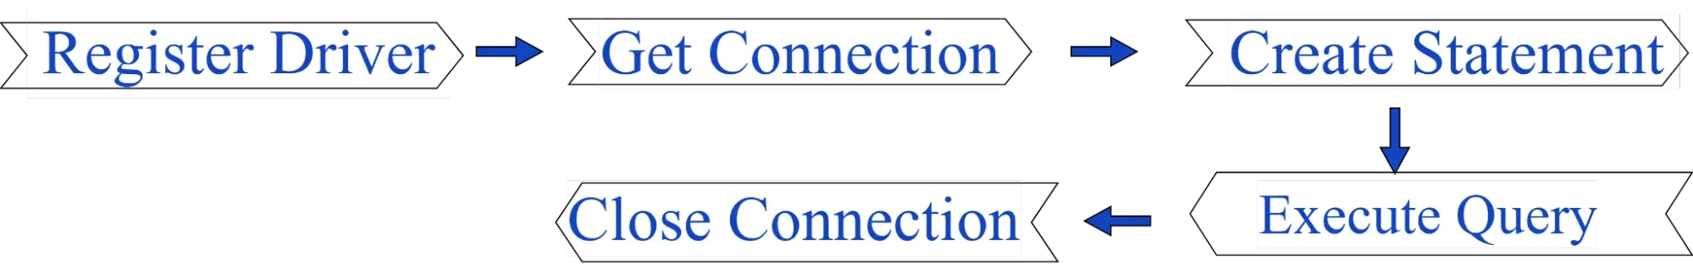
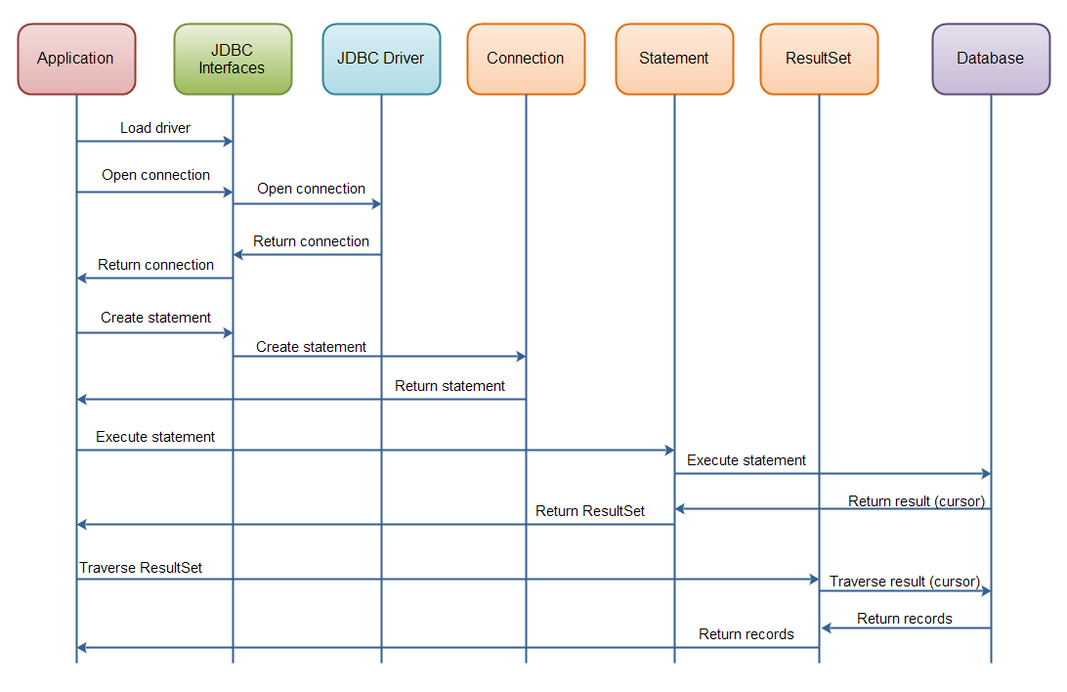
JDBC Connectivity process

Slide 5
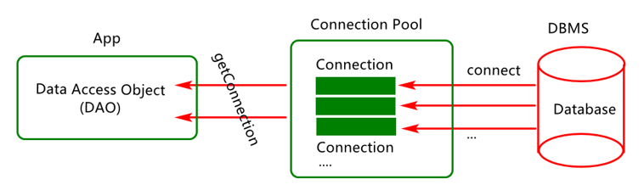
Connections pool

Slide 6
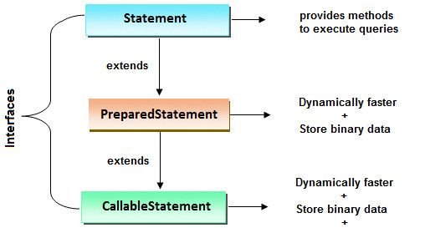
Statement

Slide 7
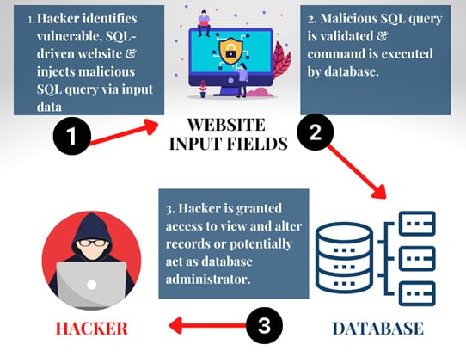
SQL injection attack

