Slide 1
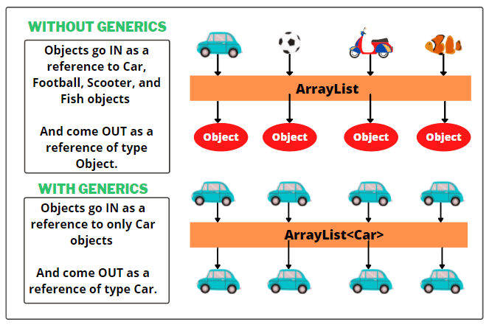
Generics

Slide 2
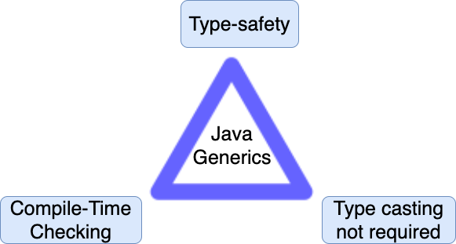
Generics

Slide 3
Naming convention
E - Element (used extensively by the Java Collections Framework, for example ArrayList, Set etc.)
K - Key (Used in Map)
N - Number
T - Type
V - Value (Used in Map)
S,U,V etc. - 2nd, 3rd, 4th types

Slide 4
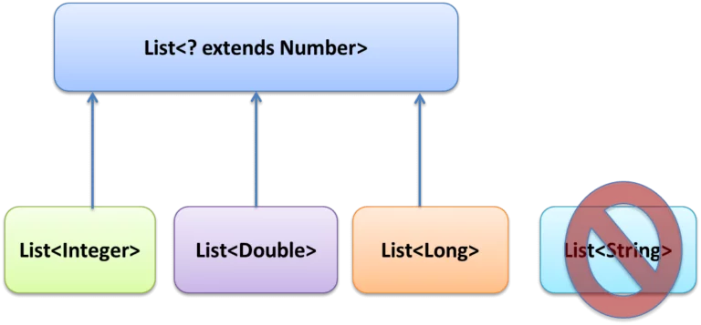
Generics upper bounded

Slide 5
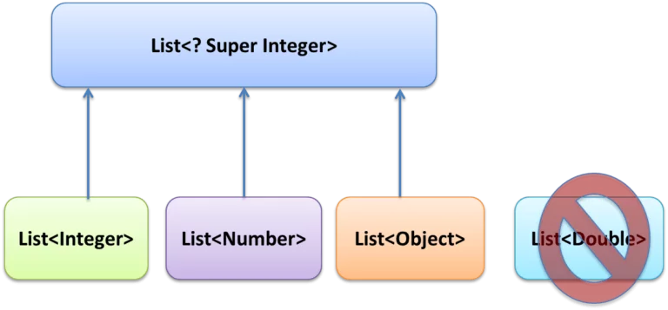
Generics lower bounded

Slide 6
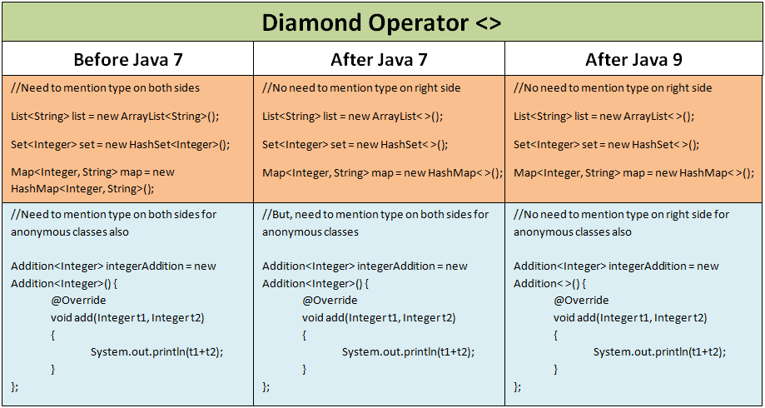
Diamond operator<>

Slide 7
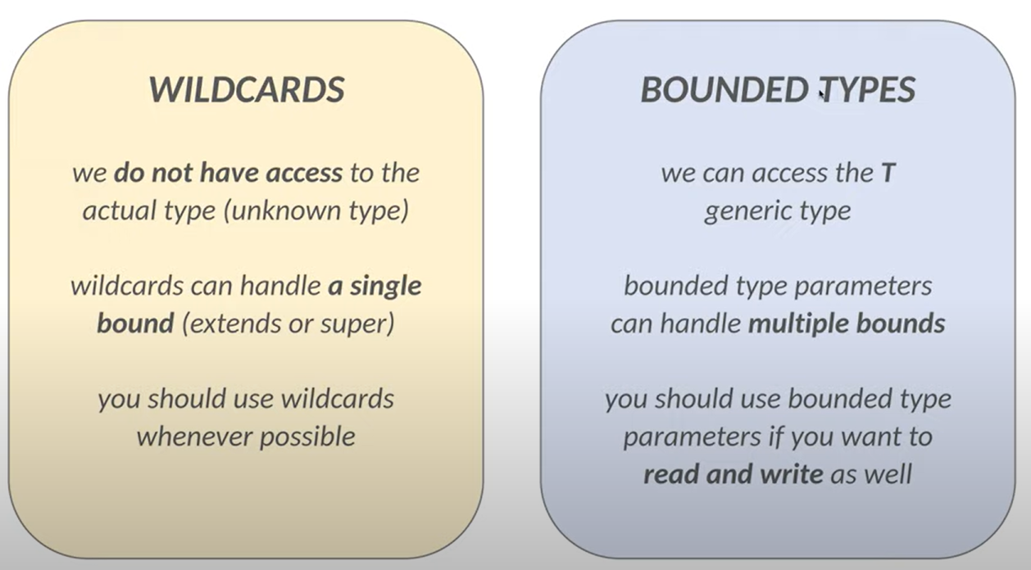
Wildcards VS Bounded types

Slide 8
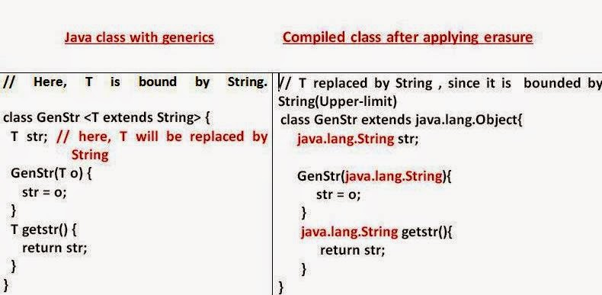
Generics erasure

Slide 9
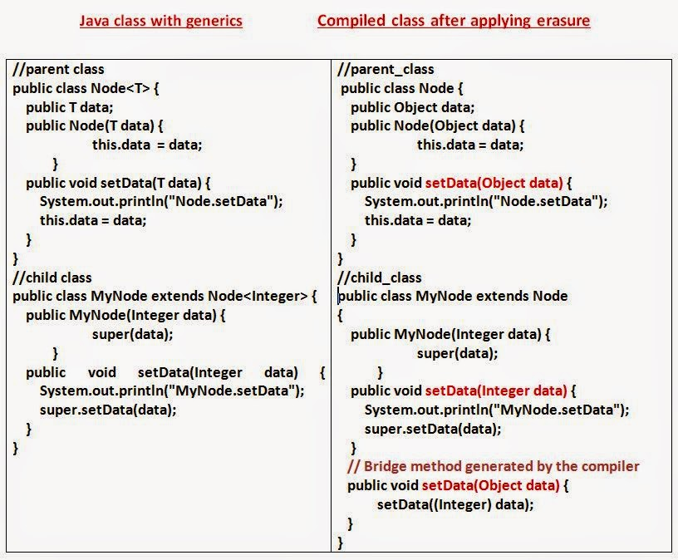
Generics erasure

Slide 10
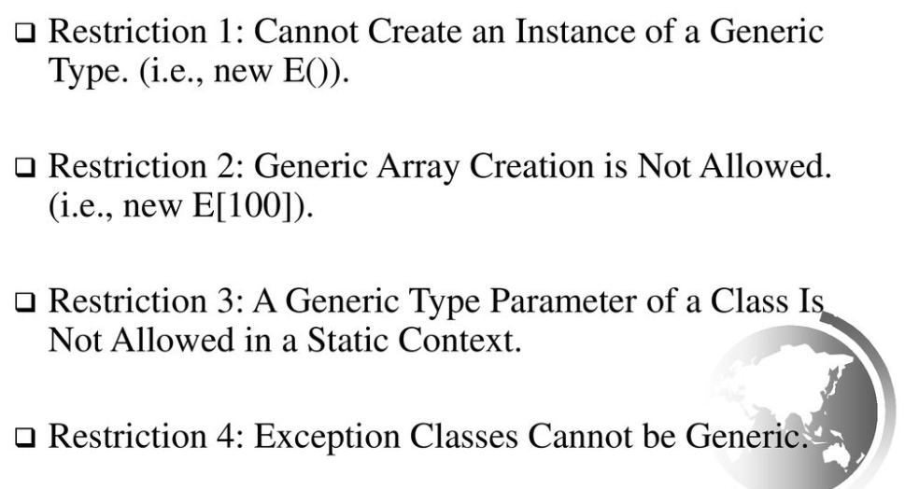
Restrictions on generics

