Slide 1
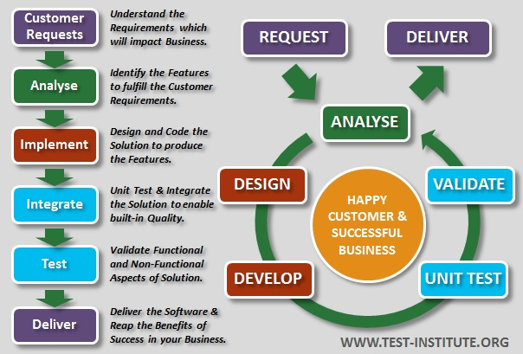
CI/CD process

Slide 2
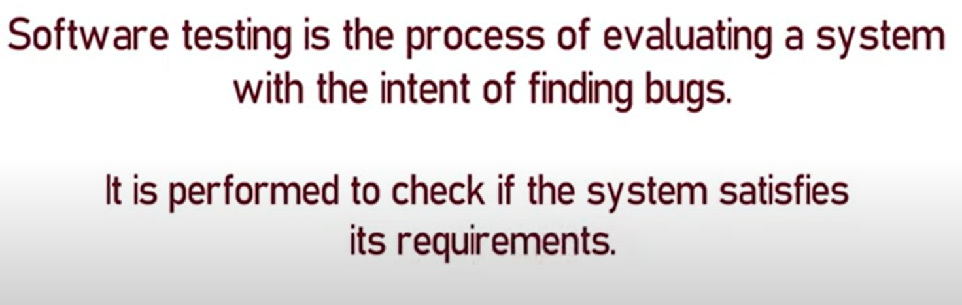
What is Software testing

Slide 3
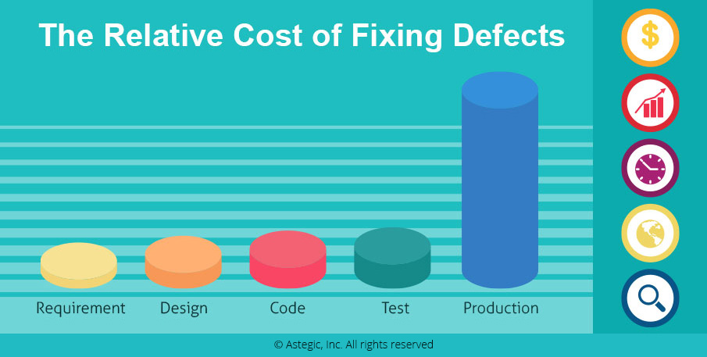
Cost of bugs

Slide 4
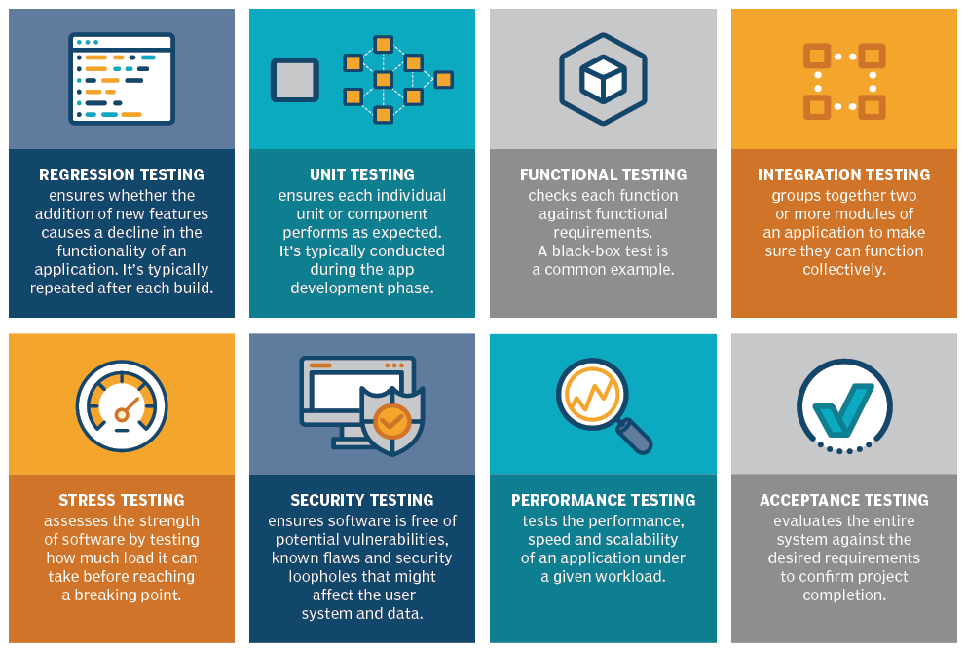
Types of Software testing

Slide 5
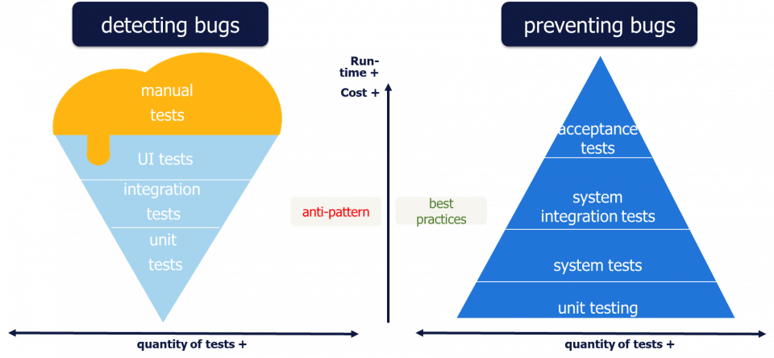
Testing pyramid

Slide 6
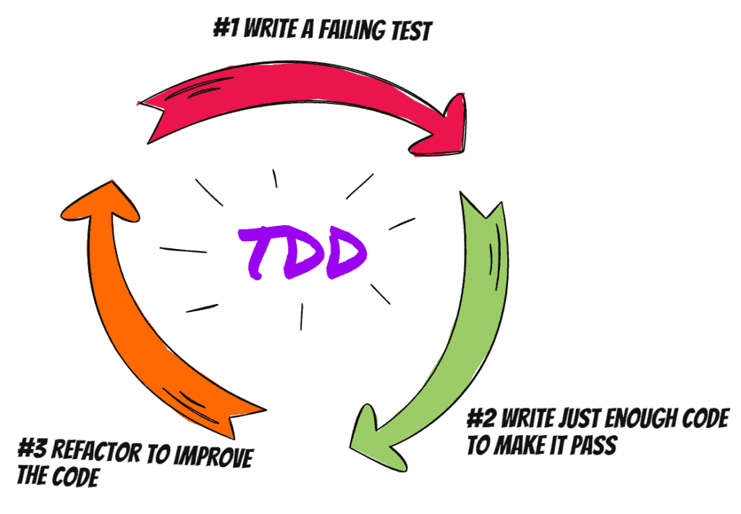
Test drive development

Slide 7

Popular frameworks

Slide 8
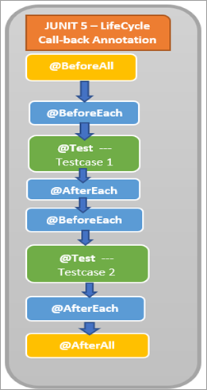
Junit5 lifecycle annotations

Slide 9
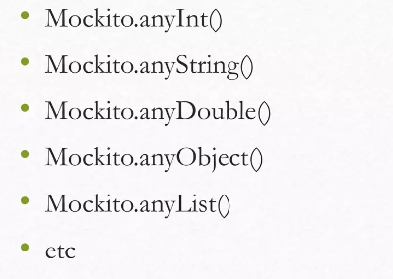
Junit5 argument matchers

Slide 10
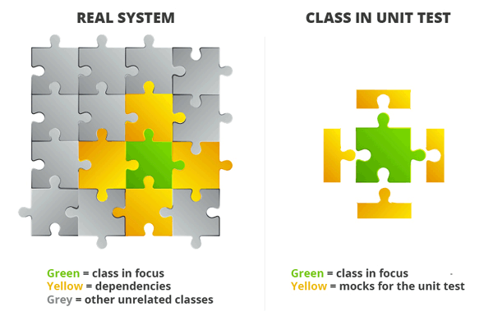
Mockito responsibilities

Slide 11
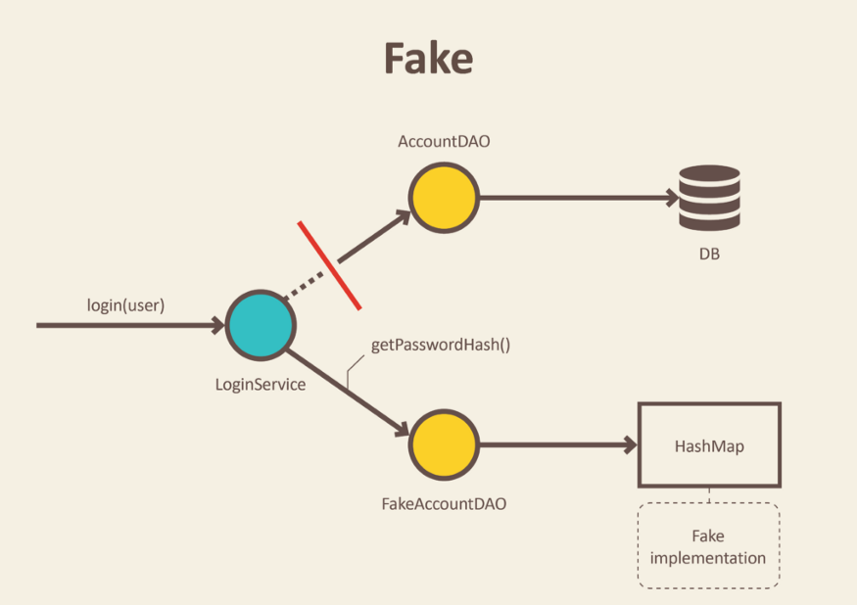
Fake dependency

Slide 12
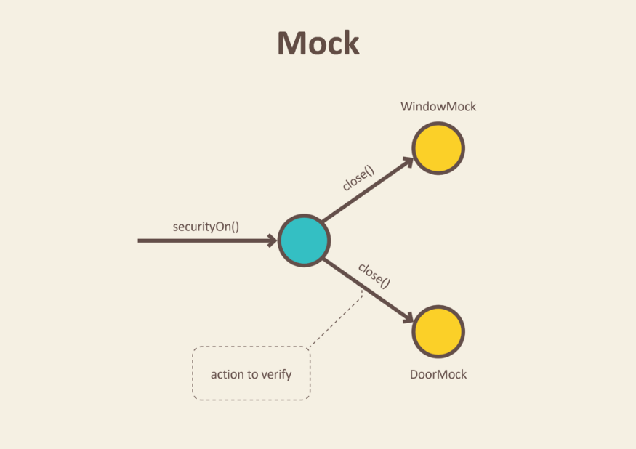
Mock dependency

Slide 13
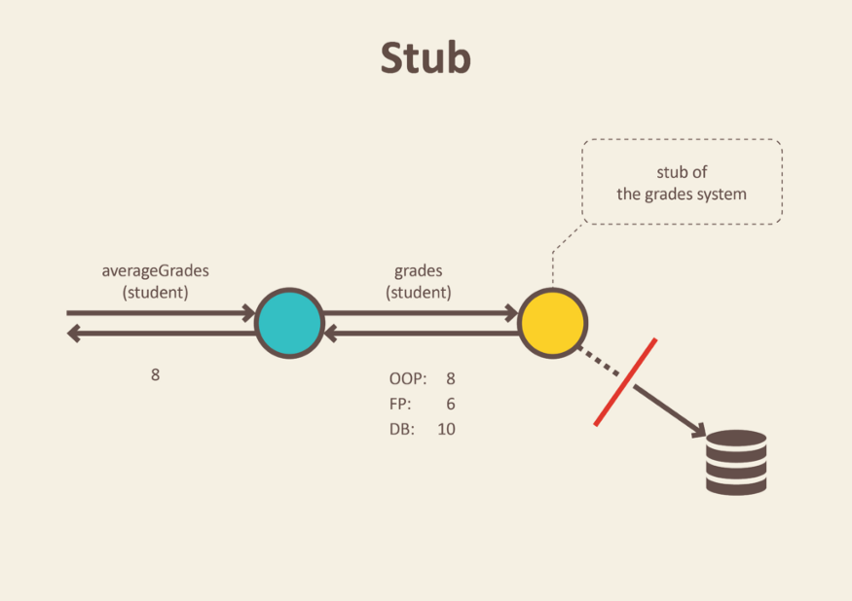
Spy dependency

