Slide 1
JAVA

Slide 2
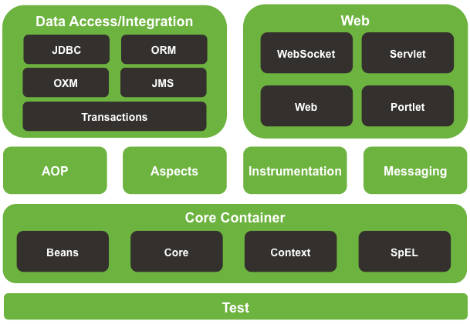
Spring framework runtime

