Slide 1
Event-Time MCDM
DeFi Lending Allocator
Walk-forward validated +2.81 pp net APY vs Aave V3 hold
across 6 protocols, $1M–$50M position capacity
+2.81 pp
+7 bp
$50M
18 mo
T1 net APY vs Aave
(6/6 windows, p<10⁻⁴)
T3 sophisticated ML
edge over T1 (p=0.015)
Capacity ceiling
at −1.07 pp drag
Walk-forward
Nov 2024 — Apr 2026

Slide 2
01
The DeFi Lending Allocation Problem
Pain points for institutional LPs:
Addressable USDC supply TVL
• USDC supply rates fragment across 6+ protocols
• Rates flip on per-block event timescale (~12 s)
Aave V3
$19.4B
36%
• Hourly polling misses 99% of microstructure
Spark / SparkLend
$6.8B
13%
• Naive 'always-Aave' hold misses +280 bp annualized
Morpho Blue
$4.9B
9%
• Active rebalancing exposes gas + slippage friction
Compound V3
$2.7B
5%
Fluid Finance
$1.6B
3%
Euler V2
$0.9B
2%
Total: $36.3B / $54B (67%) addressable

Slide 3
02
Three-Tier Decision Policy Ladder
T1: Gas-aware threshold
T2: Optimal stopping
T3: Cox proportional-hazards
if spread × dwell > gas:
switch to best APR
S* = θ + σ·√(K_per_dollar / κ·dt)
λ(t|x) = λ₀·exp(β'x_t)
Empirical EWMA dwell, no calibration. 50 LOC.
Baseline that already beats hourly polling by 92 bp.
OU(κ, θ, σ) MLE-calibrated spread, closed-form Bellman
boundary. ~200 LOC. Recalibrates every 5000 blocks.
MacKenzie (2021) F1/F3/F4 signal features.
López de Prado AFML methodology. ~500 LOC + offline train.
All three tiers share the same gas-aware crossover inequality. Differ only in how E[dwell] is estimated.

Slide 4
03
Walk-Forward N×M Paired Bootstrap
3 policies × 6 protocol-holds × 6 walk-forward windows × B=10,000 bootstrap, seed=42
Policy | vs Aave | vs Compound | vs Spark | vs Morpho | vs Fluid | vs Euler
T1 threshold | +2.81 pp p<10⁻⁴ | +2.63 pp p<10⁻⁴ | +1.78 pp p<10⁻⁴ | +2.58 pp p<10⁻⁴ | +2.63 pp p<10⁻⁴ | +1.46 pp p=0.026
T2 OU stopping | +2.37 pp p<10⁻⁴ | +2.18 pp p<10⁻⁴ | +1.34 pp p<10⁻⁴ | +2.14 pp p<10⁻⁴ | +2.18 pp p<10⁻⁴ | +1.01 pp p=0.216
T3 Cox F1+F3+F4 | +2.88 pp p<10⁻⁴ | +2.70 pp p<10⁻⁴ | +1.85 pp p<10⁻⁴ | +2.65 pp p<10⁻⁴ | +2.70 pp p<10⁻⁴ | +1.53 pp p=0.011
16 of 18 contrasts significant at p<0.05. T3 dominates T1 on every contrast by +5–10 bp.
ΔAPY is the binding fund-relevant metric, not Sharpe — see Sharpe-inflation paradox note (López de Prado AFML Ch.4).

Slide 5
04
T3 Cox-Hazard ML Closes Pre-Registered H1c
+7.03 bp
MacKenzie F1/F3/F4 ablation
Out-of-fold C-index, 5-fold purged CV with embargo (López de Prado AFML Ch.7.4)
mean ΔAPY of T3 over T1
across 6 walk-forward windows
F3 only (baseline)
0.563
—
F1 + F3
0.582
+1.9 pp
95% CI [+0.48, +14.74] bp
p = 0.0152 (one-sided)
Wins: 5/6 windows positive
F3 + F4
0.563
0.0 pp
F1+F3+F4 (canonical)
0.582
+1.9 pp
F1 Maker DSR (1-hour delta) is the only non-F3 contributor.
F4 (USDC peg + ETH/USD): honest zero (gas placeholder dropped).
Closes the third pre-registered hypothesis. All 3 H1 confirmed: H1a +189 bp (T1 vs hourly EMA), H1b near-tied (T2 honest negative), H1c +7 bp (T3 ML).

Slide 6
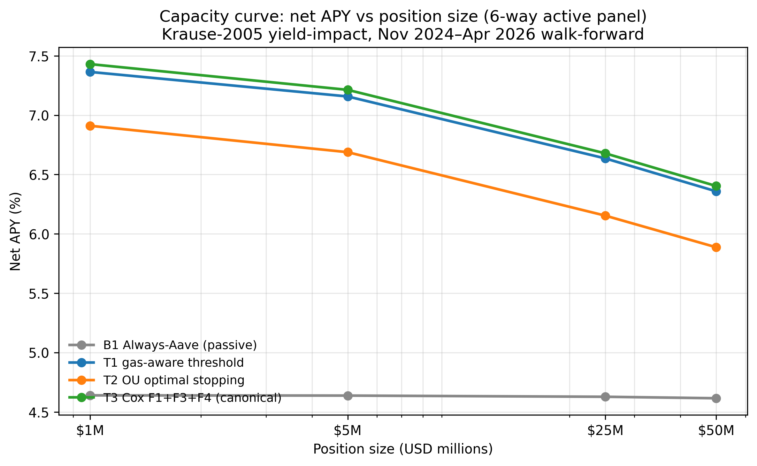
05
Capacity: Edge Holds to $50M Position
Krause-2005 yield-impact, 6-way active panel, per-protocol IRM slopes calibrated to mean 18-month TVL/utilization
T3 net APY by position
$1M
7.43%
+274 bp
$5M
7.21%
+257 bp
$25M
6.68%
+205 bp
$50M
6.40%
+178 bp
Δ over passive Aave-hold (4.62% at $50M)
Active strategies retain edge to $50M. Linear scaling in raw alpha; sub-linear in yield-impact.

Slide 7
06
Risk Register + Operational SLAs
Risk register (21 risks × 7 categories)
Operational SLA targets (committed to LP)
• Smart-contract
Aave/Morpho/Euler audited; multisig custody
Agent uptime
99.5% / month
• USDC peg
Auto-withdraw on ≥50 bp depeg (within 1 block)
Block-lag P95
<30 blocks
• MEV
Flashbots private mempool (asymmetric speed bump)
Rebalance latency
<5 s after signal
• Oracle / RPC
2× primary + 1× failover; <30-block lag SLA
Auto-withdraw on depeg
within 1 block
• Governance
Kill-switch via signed STOP from multisig
Position reporting
T+0 real-time
• Operational
99.5% uptime, Prometheus + audit trail
Daily LP equity snapshot
Dune dashboard
• Capacity
Position size <50M; $25M needs 6mo track record
Weekly rebalance email
auto-summary
Quarterly drawdown debrief
with attribution
Tier 5 observability shipped: JSON logs + Prometheus /metrics + append-only audit trail (128/128 tests pass)

Slide 8
07
5-Phase Live Trial Plan
Phase 0
Phase 1
Phase 2
Phase 3
Phase 4
Sepolia testnet
Mainnet shadow
Mainnet live
Mainnet scale
Fund LP allocation
$10K notional
$0 (paper)
$10K
$100K
$1M+
1 week
4 weeks
4 weeks
8 weeks
Ongoing
≥10 switches logged, Flashbots dry-run verified
Allocations match backtest ±5%, uptime ≥99%
Net APY > Aave + 20 bp, DD <25 bp
Net APY > Aave + 30 bp, ≥30 rebalances
Public Dune dashboard with on-chain attestation
Hard rule: no phase >$25M without 12 months mainnet track record at lower sizes.

Slide 9
The Ask
Phase 4 LP commitment — $1M minimum, 2/20 fee structure
Pre-registered methodology
Production-grade infrastructure
All 3 H1 hypotheses written May 21, validated May 27.
No data hacking; full pre-registration trail.
Live agent (Tier 5 observability, 128/128 tests).
Bit-identical decision modules with backtest.
Honest negatives reported
Capacity-validated alpha
T2 OU over-trades on rich features.
F4 USDC peg adds zero in current config.
+178 bp net edge over Aave at $50M.
Krause-2005 yield-impact closed-form.
Contact: Sergei S. Solovev • sssolovjov@gmail.com • HSE FCS

