Slide 1


Slide 2

Dipartimento di ingegneria industriale e dell’informazione
Project 3 - Control of a chain of mass-spring-damper systems
Industrial Control
Faiola, Davide ID:[563969]
Goldsmits Ybarra, Sergi ID:[554495]
Scerbo, Serena ID:[567233]

Slide 3




Introduction
chain of mass-spring-damper system
Data:
L = 6
M=1
h=2
K=10
q= 10e-5
r=10e-6
The purpose of the project is to design a stabilizing controller for a chain of L = 6 mass-spring-damper systems. The state-space model is defined as follows:
n. of sub-systems
mass of blocks
damping constant
spring constant
Positions of the masses [i = 2j −1, with j = 1, ..., 6]
Velocity of the 1st mass
Velocity of masses from 2 to 5
Velocity of the 6th mass
Output -> position of 1st mass

Slide 4
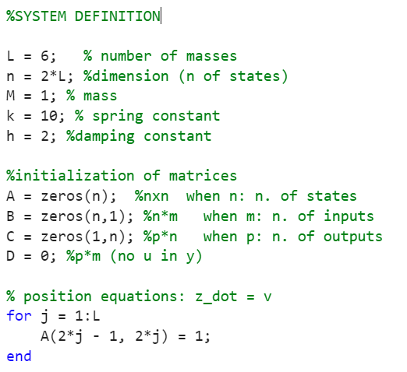
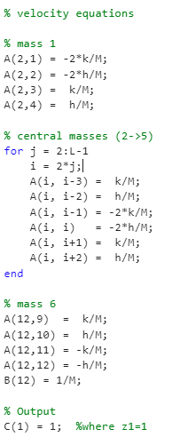
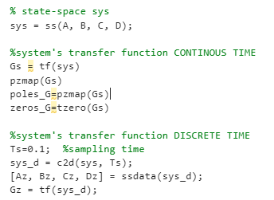
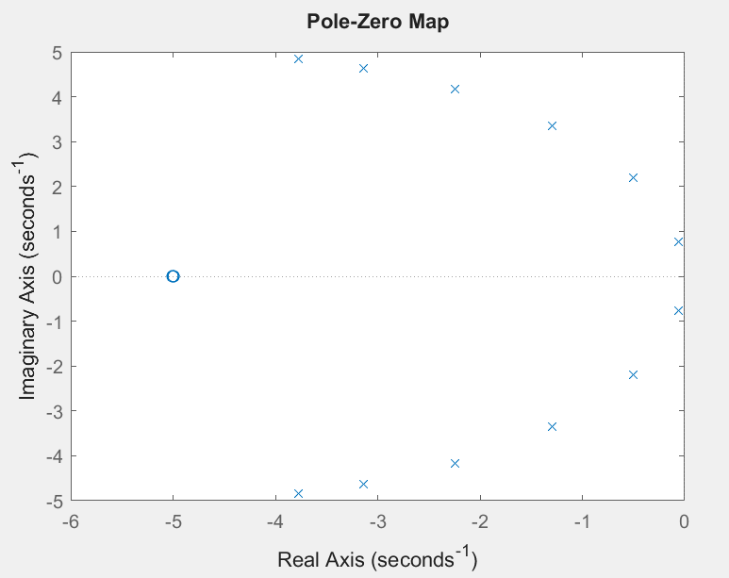

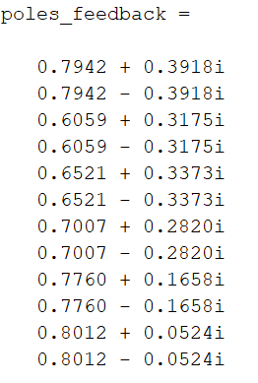
Definition of the system (MATLAB)
Stability check - continuous
Stability check - discrete

Slide 5
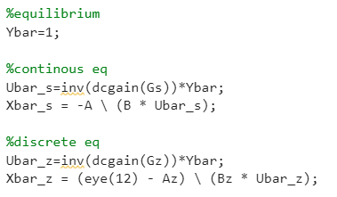
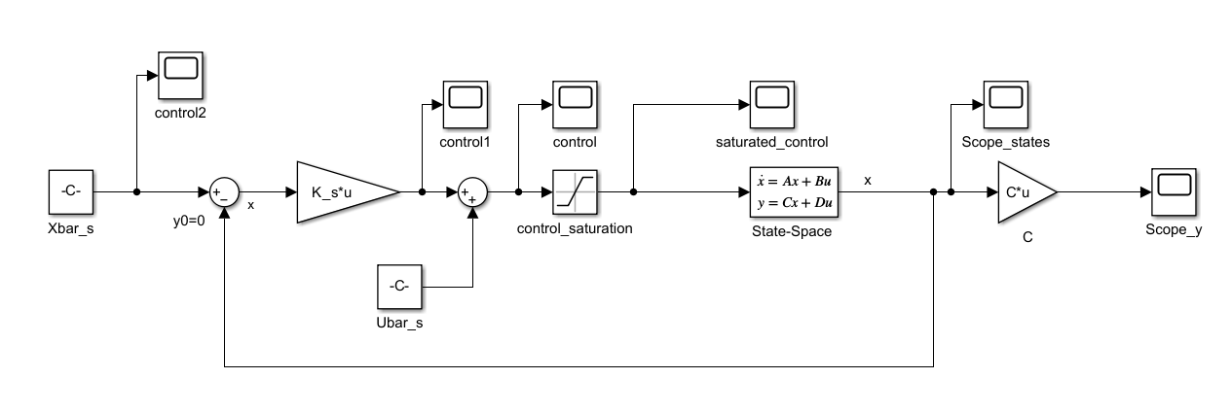
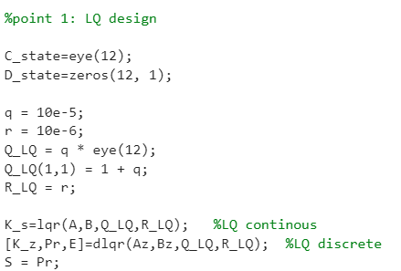
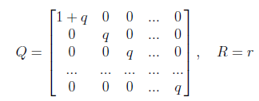
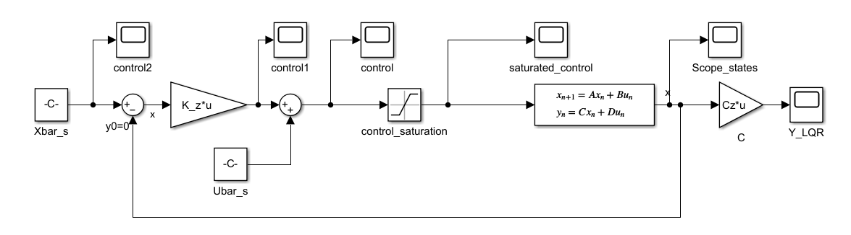
1. Design of a stabilizing LQ controller
Computation of the equilibrium point for Ybar=1 (both for continuous and discrete case)
Continuous case
Discrete case

Slide 6
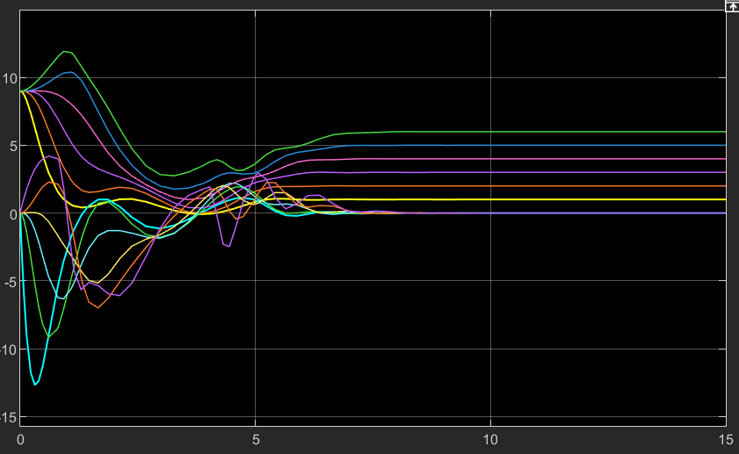
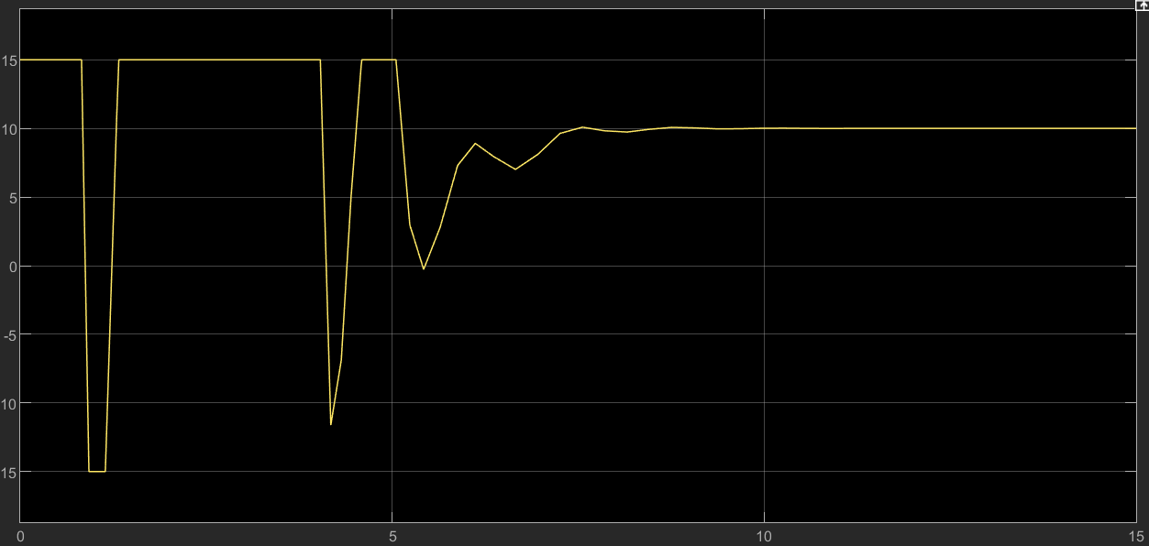

1. Design of a stabilizing LQ controller
Continuous case results
Saturated optimal input
States scope
Simulation time & initial conditions

Slide 7
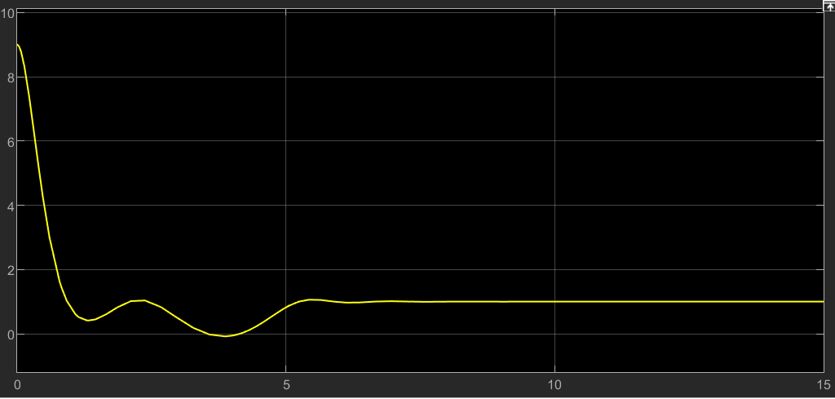
1. Design of a stabilizing LQ controller
Continuous case results
Output scope

Slide 8
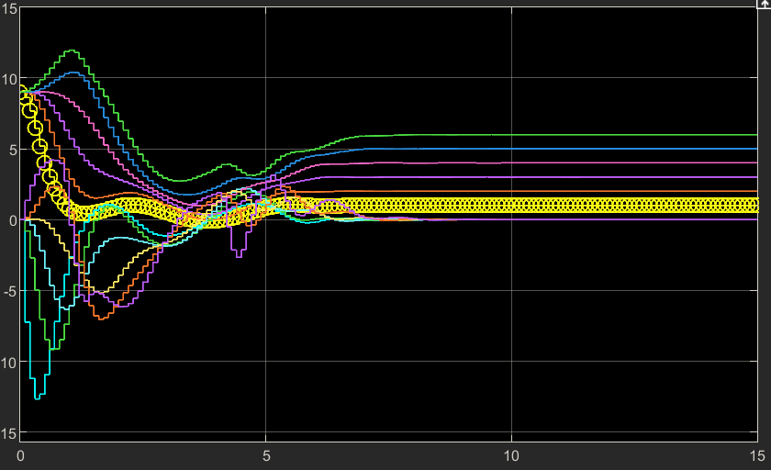
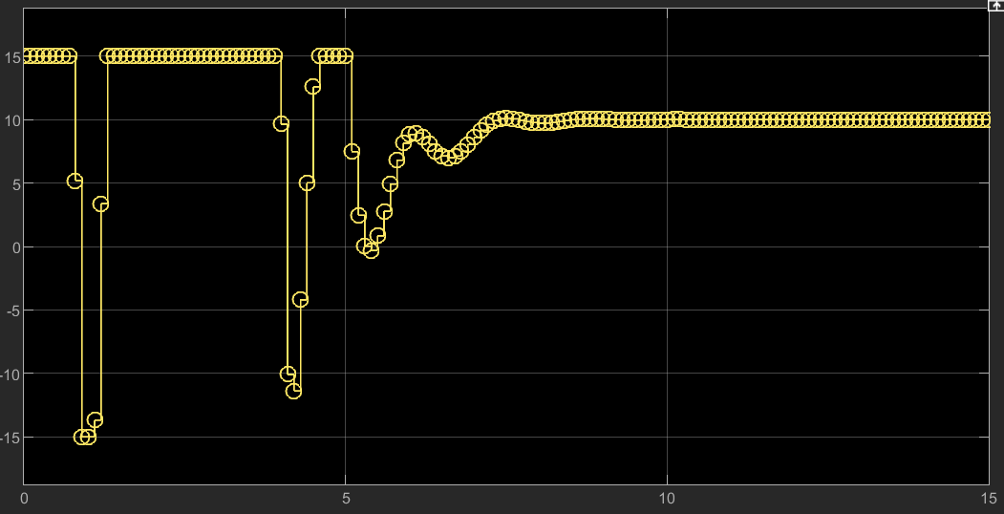
1. Design of a stabilizing LQ controller
Discrete case results
Saturated optimal input
States scope
Simulation time & initial conditions

Slide 9
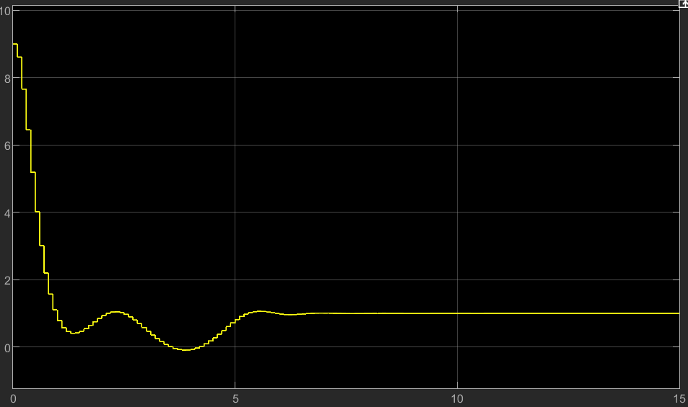
1. Design of a stabilizing LQ controller
Discrete case results
Output scope

Slide 10
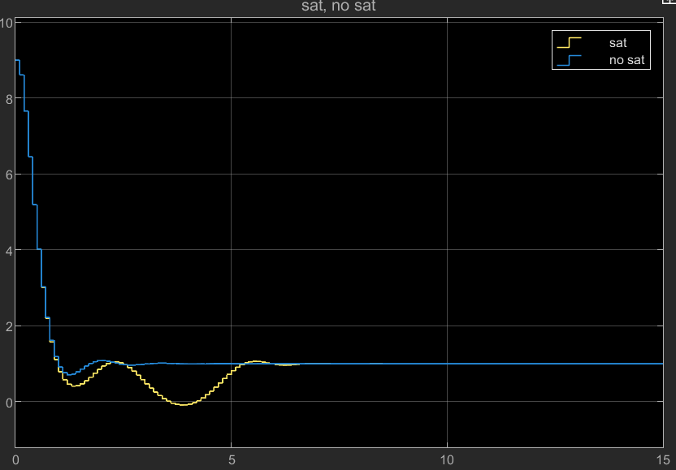
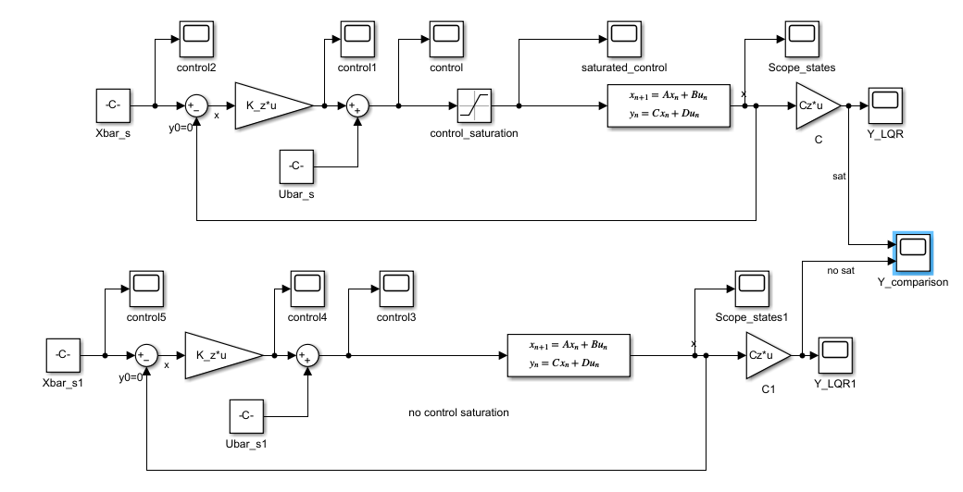
1. Design of a stabilizing LQ controller
Discrete case results (sat/no-sat comparison)
Output scope

Slide 11
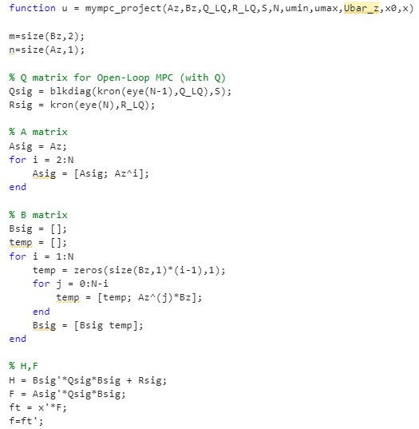
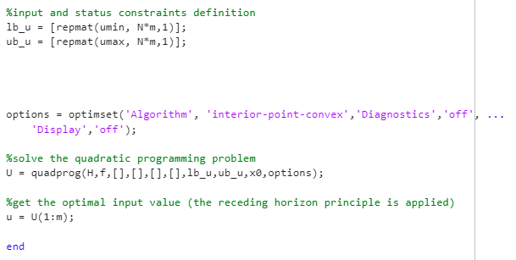
2. Design of an unconstrained MPC controller
Mympc function
The simulation is done with N=3, 6, 20
The input constraints are selected as –inf, +inf

Slide 12
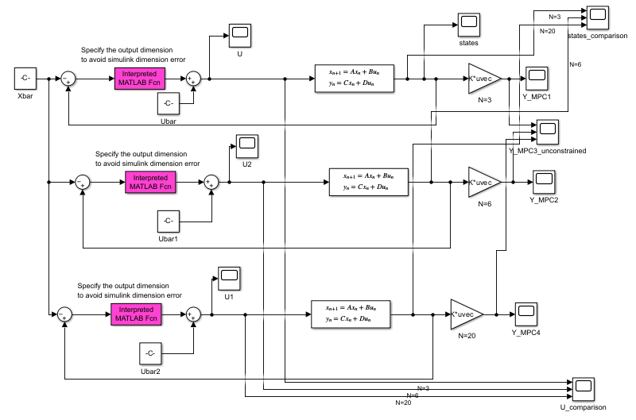
2. Design of an unconstrained MPC controller

Slide 13
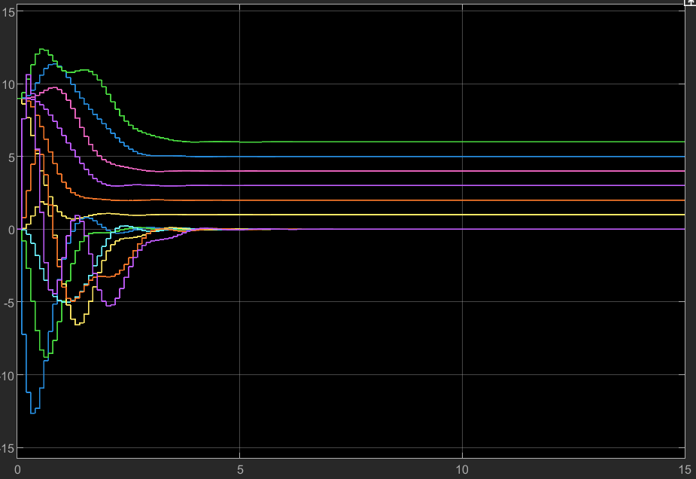
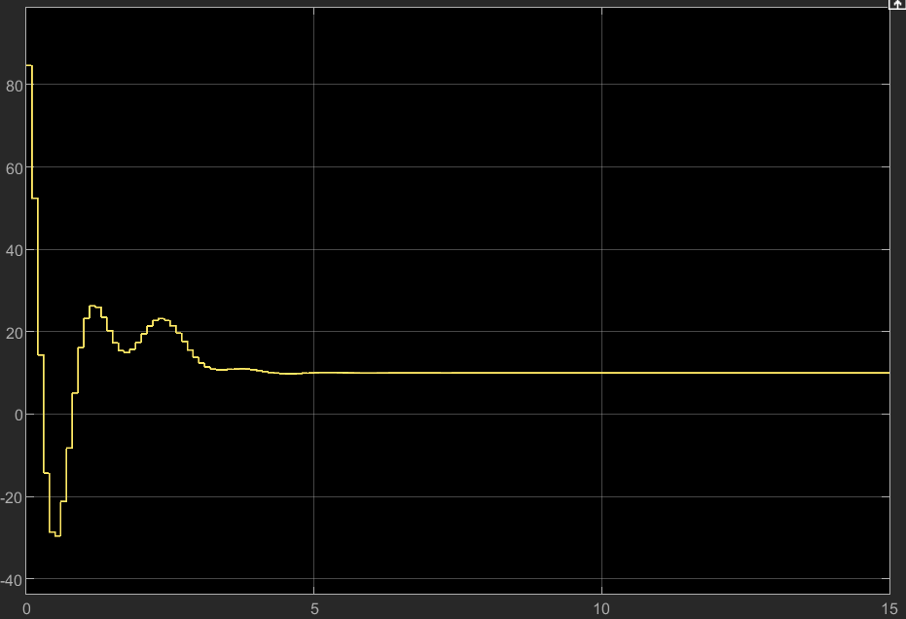
2. Design of an unconstrained MPC controller
Optimal input
States scope

Slide 14
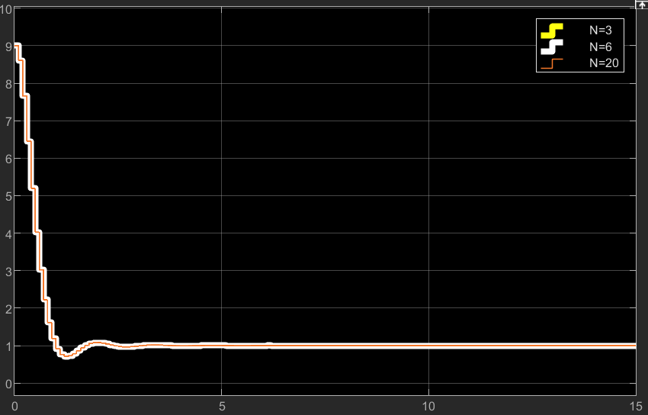
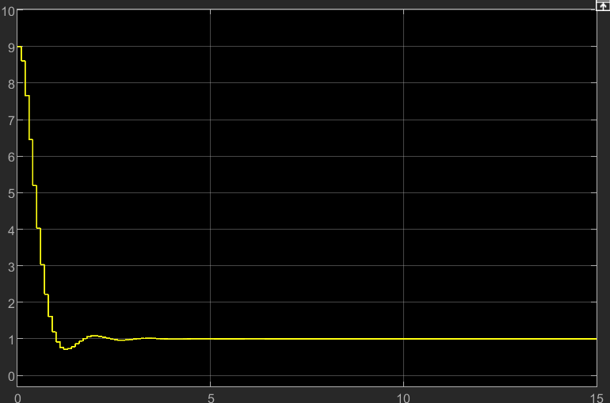
2. Design of an unconstrained MPC controller
Output scope
LQ unconstrained
Remarks: the scopes are overlapped due to S=Pr, therefore the performance of the MPC is equal to the LQR

Slide 15
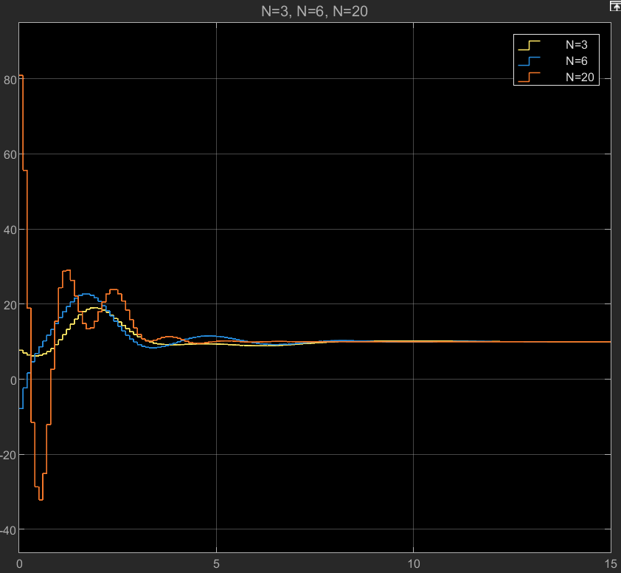
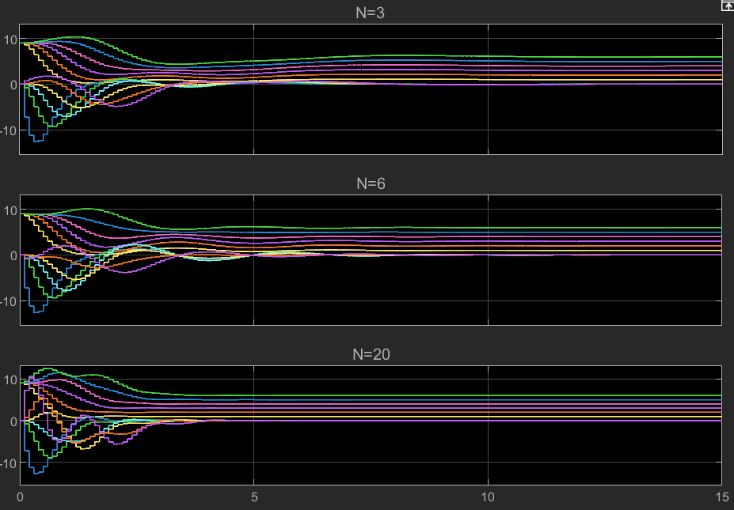
3. Design of an unconstrained MPC controller, assuming S=0.
Optimal input
States scope

Slide 16
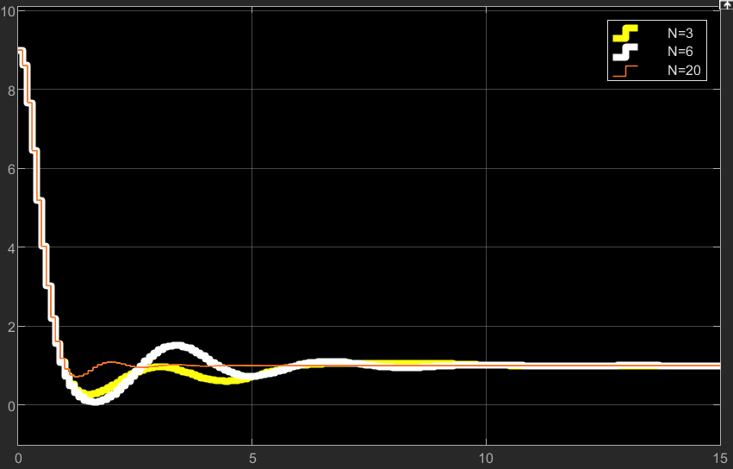
3. Design of an unconstrained MPC controller, assuming S=0.
Output scope
Remarks: with a larger prediction horizon N the system stabilizes earlier

Slide 17
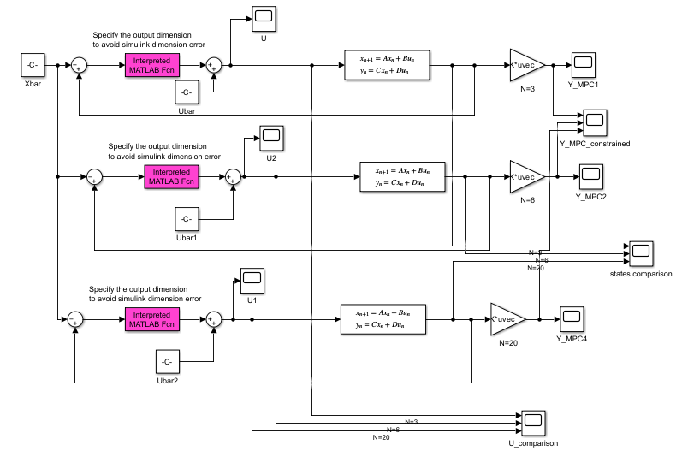

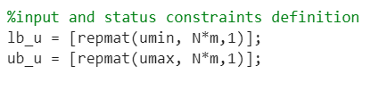

4. Design of an MPC controller with input constraints
Input constraints addition in mympc function

Slide 18
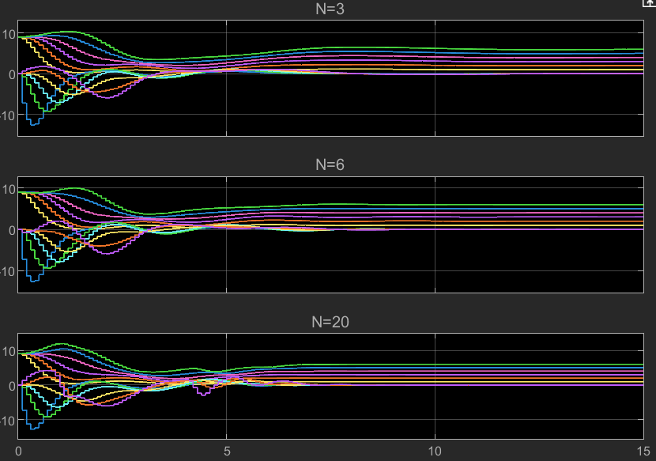
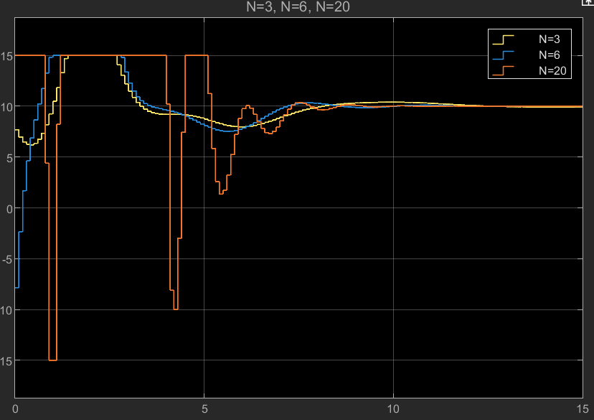
4. Design of an MPC controller with input constraints
Optimal input
States scope

Slide 19
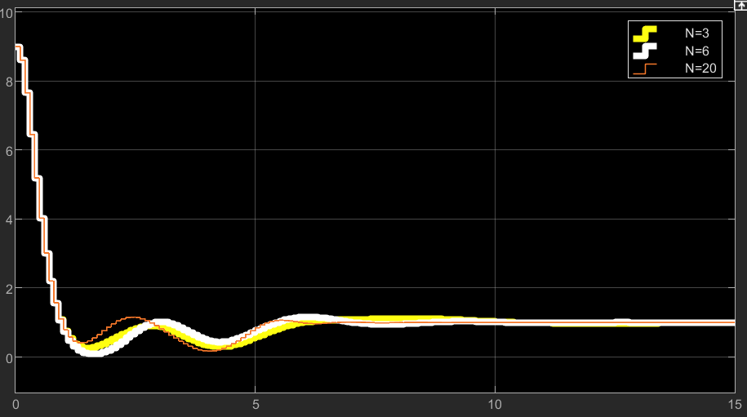
4. Design of an MPC controller with input constraints
Output scope
Remarks:
With a larger prediction horizon N the system stabilizes earlier
Due to the presence of input constraints, the system stabilizes later comparing with the previous cases, where we could implement the computed optimal u for all the simulation time

Slide 20
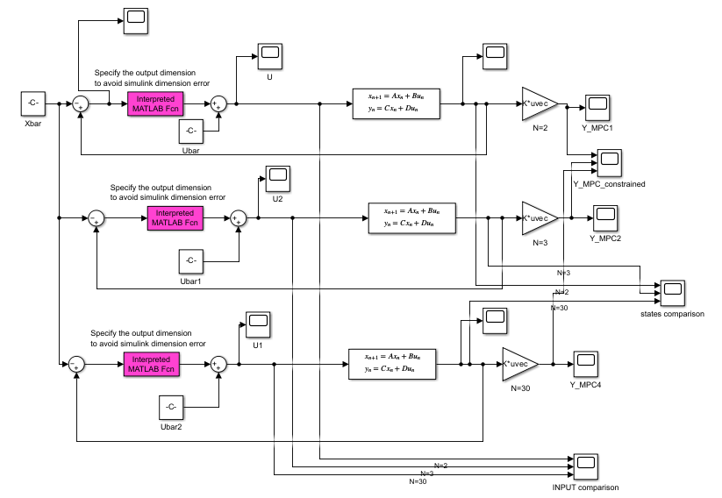



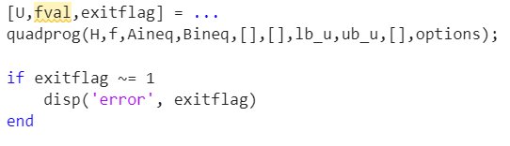
5. Design of an MPC controller with state and input constraints
Check of the feasibility of all the optimization process, to choose the N for this case

Slide 21
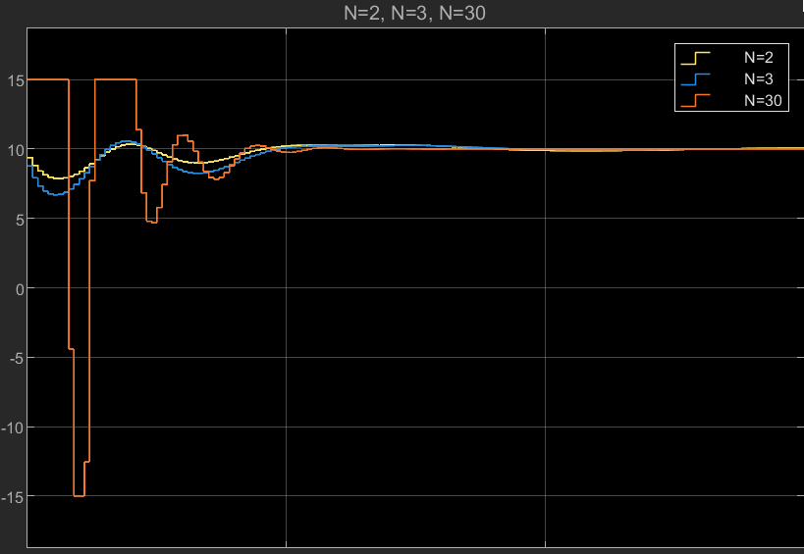
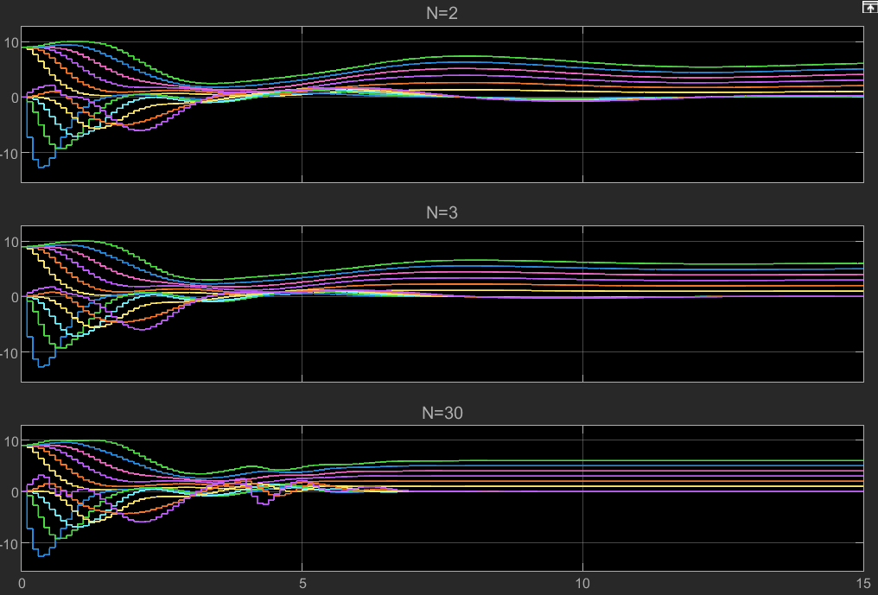
5. Design of an MPC controller with state and input constraints
Optimal input
States scope
Remarks: due to the presence of the state constraints, the states range in [-10,10]

Slide 22
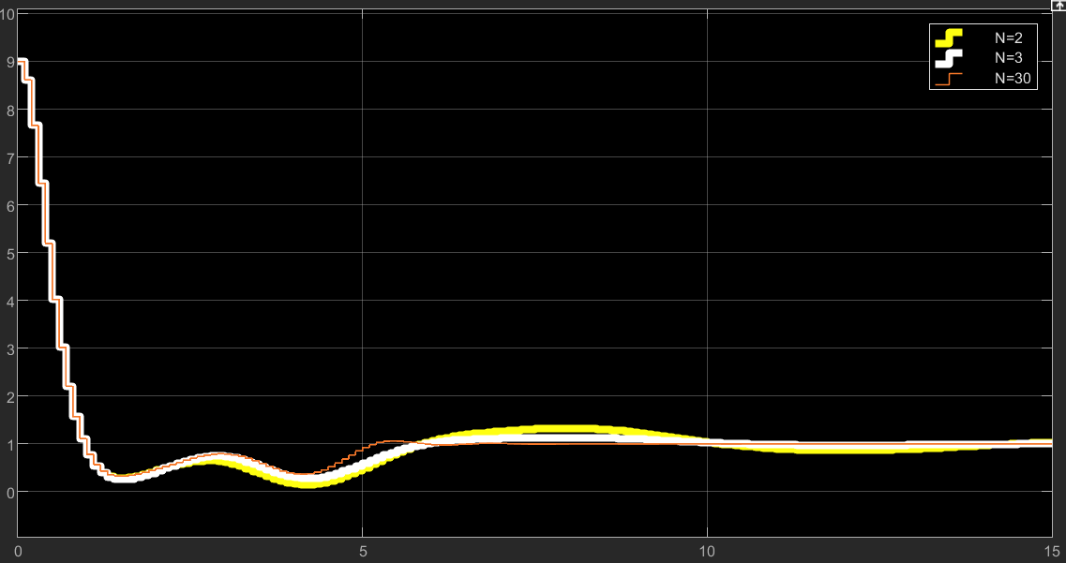
5. Design of an MPC controller with state and input constraints
Output scope
Remarks: due to the presence of the state constraints, the output stabilizes later

Slide 23
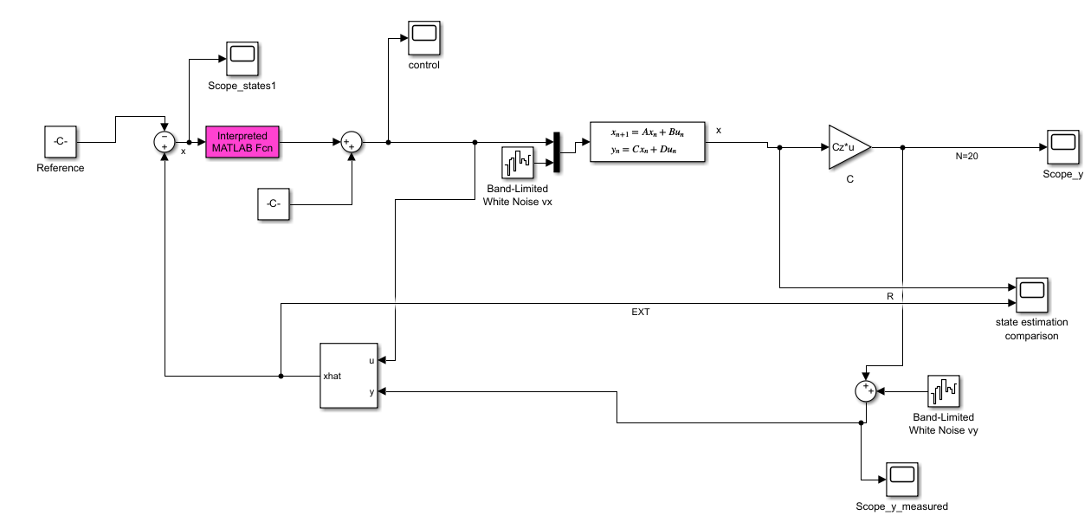
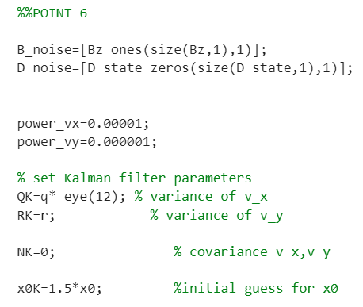
6. Design of an MPC controller with non-measurable states and noise (Kalman filter)
Remarks: due to the presence of the state constraints, we have chosen an initial condition x0=[3,0,3,0,3,0,3,0,3,0,3,0] , otherwise we get an error due to the initial condition on the Kalman filter (x0K)

Slide 24
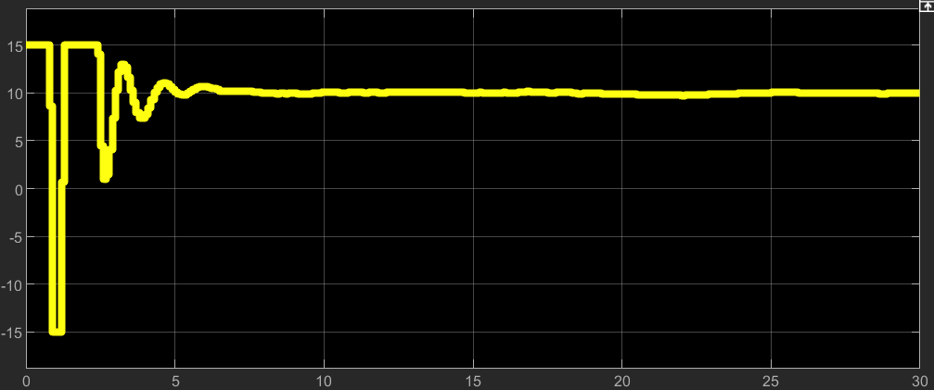
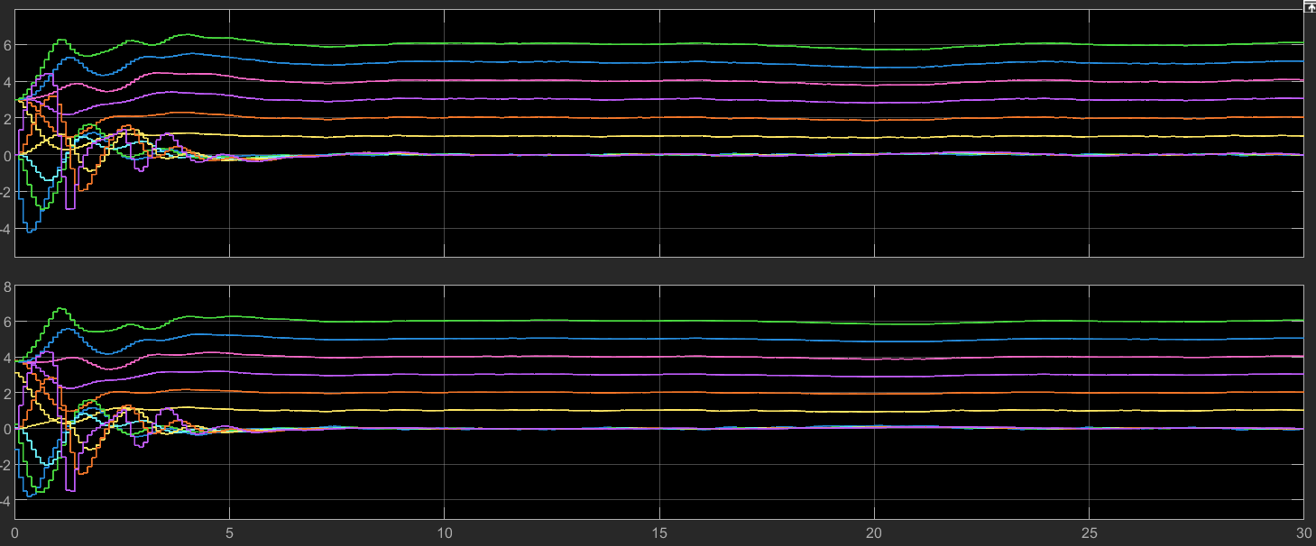
6. Design of an MPC controller with non-measurable states and noise (Kalman filter)
Tsim=30 s
N=20
Optimal input
Real states
States estimation

Slide 25
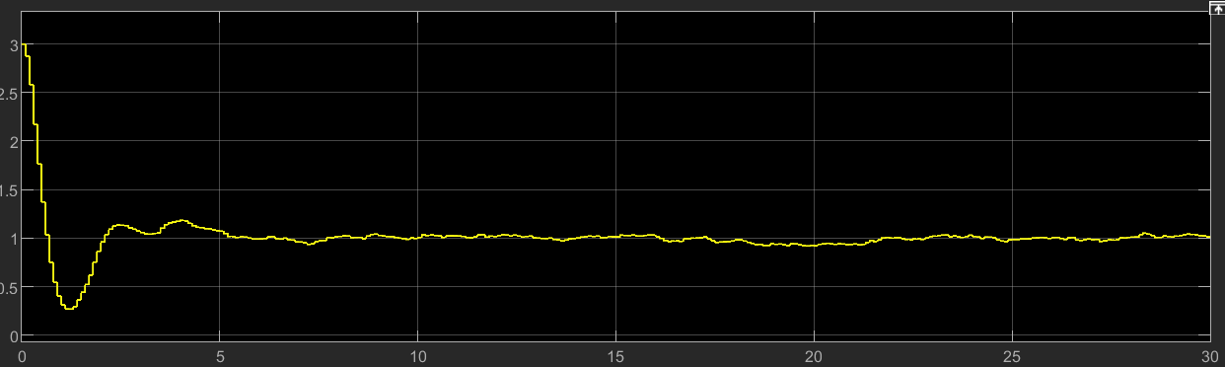
6. Design of an MPC controller with non-measurable states and noise (Kalman filter)
Output scope

Slide 26
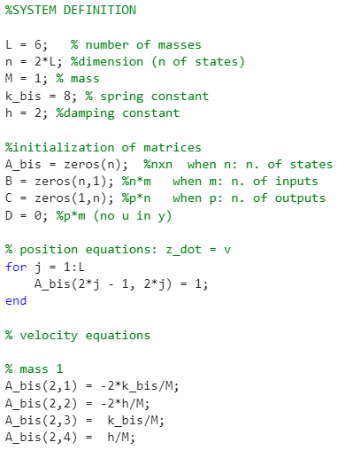
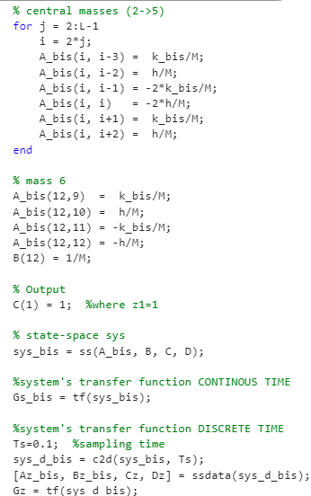
7. Velocity form MPC (with model uncertainties )
First of all, we created a bis system with the k=8 and we put it in the discrete state-space block in Simulink for simulating an uncertainty
System definition with different spring constant (k=8)

Slide 27
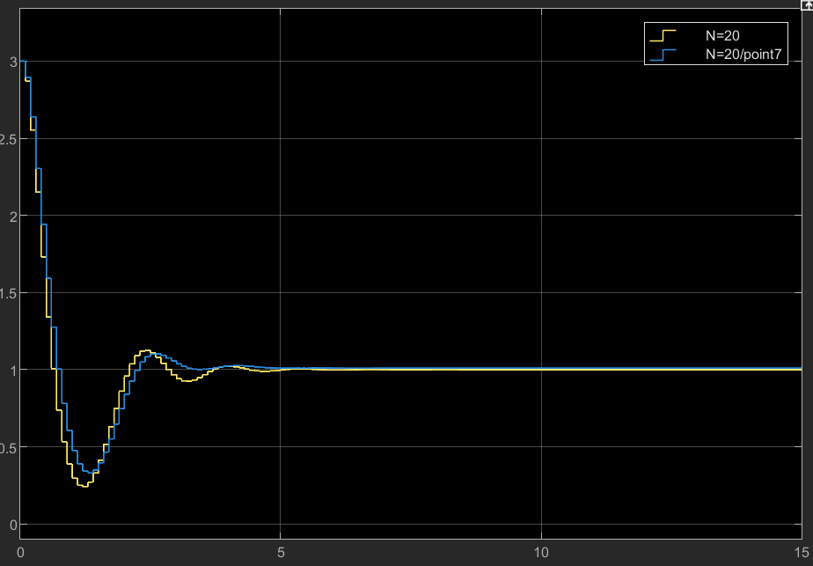
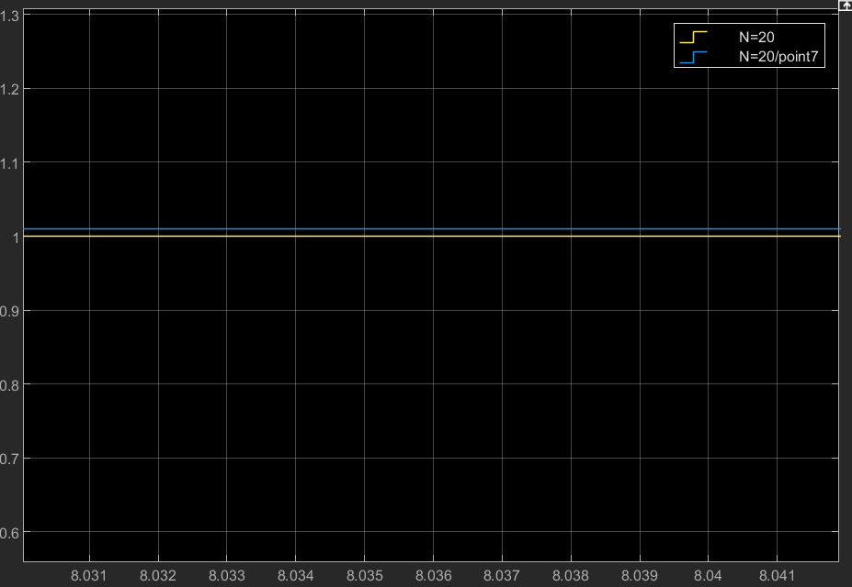
7. Velocity form MPC (with model uncertainties )
As first attempt, we tried to implement a simulation with the uncertainties on the model in one of the previous cases (input constraints case) and we noticed that the system stabilizes, but not around 1.
In the graph below, it is depicted a comparison between the outputs with and without uncertainties
Blue: uncertainties
Yellow: no uncertainties

Slide 28
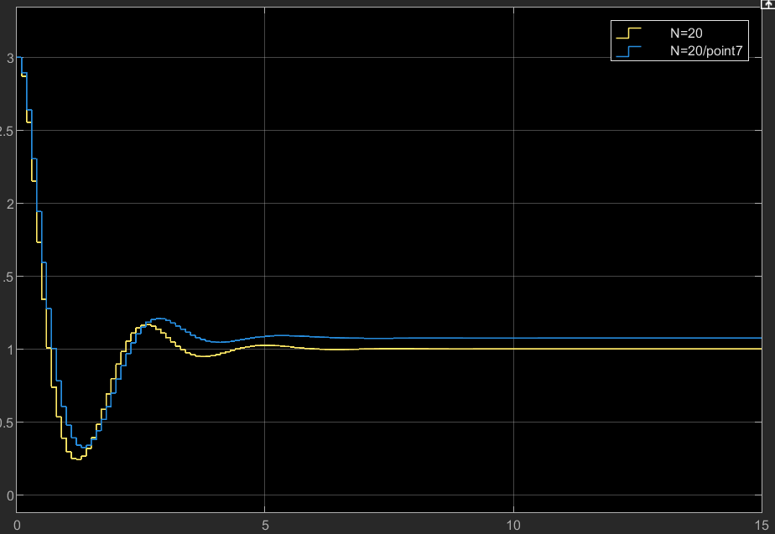
7. Velocity form MPC (with model uncertainties )
What happens if the input is penalised more?
Increasing R_LQ, we can notice that the error on the steady-state increases.
Remark: we applied the same R_tilde on both the cases in the graph
N=20
R_tilde= 100* R_LQ
Output scope

Slide 29
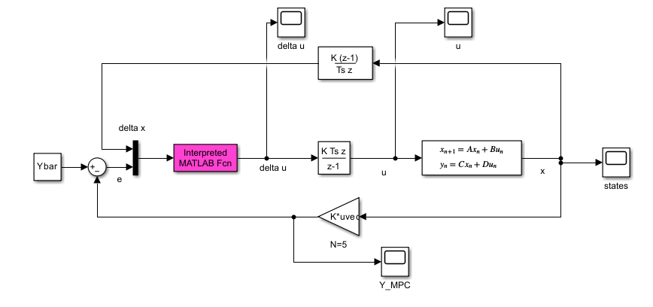
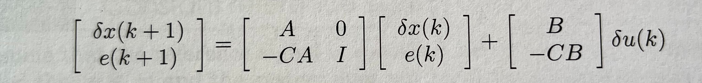

7. Velocity form MPC (with model uncertainties )
Δx(k)=x(k)−x(k−1)
In the MPC function the spring constant is k=10, as defined in the data
u(k)=u(k−1)+Δu(k)
Construction of new matrices A_tilde and B_tilde to implement a new mympc_velocityform function with only input constrains

Slide 30



7. Velocity form MPC (with model uncertainties )
Tsim=100 s
N=5
states scope
Output scope

Slide 31

7. Velocity form MPC (with model uncertainties )
What happens if the input is penalised more?
Since we are penalizing an input signal based on an inaccurate model, the system takes longer to stabilize, but it reaches a zero error (it stabilizes at 1 as desired)
Tsim=200 s
N=5
R_tilde= 5* R_LQ
Output scope

Slide 32
THANKS FOR THE ATTENTION

