Slide 1

GROUP BY

Slide 2
SQL
Welcome to this section on GROUP BY and Aggregate functions.
GROUP BY will allow us to aggregate data and apply functions to better understand how data is distributed per category.

Slide 3
SQL
Section Overview
Aggregate Functions
GROUP BY - Part One - Theory
GROUP BY - Part Two - Implementation
Challenge Tasks for GROUP BY
HAVING - Filtering with a GROUP BY
Challenge Tasks for HAVING

Slide 4
Let’s get started!

Slide 5
Aggregate Functions

Slide 6
SQL
SQL provides a variety of aggregate functions.
The main idea behind an aggregate function is to take multiple inputs and return a single output.
https://www.postgresql.org/docs/current/functions-aggregate.html

Slide 7
SQL
Most Common Aggregate Functions:
AVG() - returns average value
COUNT() - returns number of values
MAX() - returns maximum value
MIN() - returns minimum value
SUM() - returns the sum of all values

Slide 8
SQL
Aggregate function calls happen only in the SELECT clause or the HAVING clause.

Slide 9
SQL
Special Notes
AVG() returns a floating point value many decimal places (e.g. 2.342418…)
You can use ROUND() to specify precision after the decimal.
COUNT() simply returns the number of rows, which means by convention we just use COUNT(*)

Slide 10
SQL
Let’s see some examples in our database!

Slide 11
GROUP BY
PART ONE

Slide 12
SQL
GROUP BY allows us to aggregate columns per some category.
Let’s explore this idea with a simple example.

Slide 13
SQL
Category | Data Value
A | 10
A | 5
B | 2
B | 4
C | 12
C | 6

Slide 14
SQL
Category | Data Value
A | 10
A | 5
B | 2
B | 4
C | 12
C | 6
We need to choose a categorical column to GROUP BY.
Categorical columns are non-continuous.
Keep in mind, they can still be numerical, such as cabin class categories on a ship (e.g. Class 1, Class 2, Class 3)

Slide 15
SQL
Category | Data Value
A | 10
A | 5
B | 2
B | 4
C | 12
C | 6
Let’s now see what happens with a GROUP BY call.

Slide 16
SQL
A | 10
A | 5
Category | Data Value
A | 10
A | 5
B | 2
B | 4
C | 12
C | 6
B | 2
B | 4
C | 12
C | 6

Slide 17
SQL
A | 10
A | 5
Aggregate Function
SUM
Category | Data Value
A | 10
A | 5
B | 2
B | 4
C | 12
C | 6
Category | Result
A | 15
B | 6
C | 18
B | 2
B | 4
C | 12
C | 6

Slide 18
SQL
A | 10
A | 5
Aggregate Function
AVG
Category | Data Value
A | 10
A | 5
B | 2
B | 4
C | 12
C | 6
Category | Result
A | 7.5
B | 3
C | 9
B | 2
B | 4
C | 12
C | 6

Slide 19
SQL
A | 10
A | 5
Aggregate Function
COUNT
Category | Data Value
A | 10
A | 5
B | 2
B | 4
C | 12
C | 6
Category | Result
A | 2
B | 2
C | 2
B | 2
B | 4
C | 12
C | 6

Slide 20
SQL
SELECT category_col , AGG(data_col)
FROM table
GROUP BY category_col

Slide 21
SQL
SELECT category_col , AGG(data_col)
FROM table
GROUP BY category_col
The GROUP BY clause must appear right after a FROM or WHERE statement.

Slide 22
SQL
SELECT category_col , AGG(data_col)
FROM table
WHERE category_col != ‘A’
GROUP BY category_col
The GROUP BY clause must appear right after a FROM or WHERE statement.

Slide 23
SQL
SELECT category_col , AGG(data_col)
FROM table
GROUP BY category_col
In the SELECT statement, columns must either have an aggregate function or be in the GROUP BY call.

Slide 24
SQL
SELECT category_col , AGG(data_col)
FROM table
GROUP BY category_col
In the SELECT statement, columns must either have an aggregate function or be in the GROUP BY call.

Slide 25
SQL
SELECT category_col , AGG(data_col)
FROM table
GROUP BY category_col
In the SELECT statement, columns must either have an aggregate function or be in the GROUP BY call.

Slide 26
SQL
SELECT company, division, SUM(sales)
FROM finance_table
GROUP BY company,division
In the SELECT statement, columns must either have an aggregate function or be in the GROUP BY call.

Slide 27
SQL
SELECT company, division, SUM(sales)
FROM finance_table
GROUP BY company,division
In the SELECT statement, columns must either have an aggregate function or be in the GROUP BY call.

Slide 28
SQL
SELECT company, division, SUM(sales)
FROM finance_table
GROUP BY company,division
In the SELECT statement, columns must either have an aggregate function or be in the GROUP BY call.

Slide 29
SQL
SELECT company, division, SUM(sales)
FROM finance_table
WHERE division IN (‘marketing’, ‘transport’)
GROUP BY company,division
WHERE statements should not refer to the aggregation result, later on we will learn to use HAVING to filter on those results.

Slide 30
SQL
SELECT company, SUM(sales)
FROM finance_table
GROUP BY company
ORDER BY SUM(sales)
If you want to sort results based on the aggregate, make sure to reference the entire function

Slide 31
SQL
SELECT company, SUM(sales)
FROM finance_table
GROUP BY company
ORDER BY SUM(sales)
LIMIT 5
If you want to sort results based on the aggregate, make sure to reference the entire function

Slide 32
GROUP BY
PART TWO

Slide 33
SQL
Let’s jump to our database and work through some GROUP BY examples!

Slide 34
GROUP BY
CHALLENGE TASKS

Slide 35
SQL
Challenge
Expected Result
Hints
Solution

Slide 36
SQL
We have two staff members, with Staff IDs 1 and 2. We want to give a bonus to the staff member that handled the most payments. (Most in terms of number of payments processed, not total dollar amount).
How many payments did each staff member handle and who gets the bonus?

Slide 37
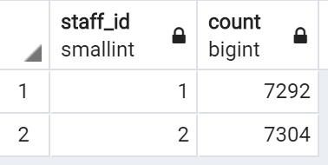
SQL
Expected Result

Slide 38
SQL
Hints
Use the payment table
Understand the difference between COUNT and SUM

Slide 39
SQL
Solution
SELECT staff_id,COUNT(amount)
FROM payment
GROUP BY staff_id

Slide 40
SQL
Solution
SELECT staff_id,COUNT(*)
FROM payment
GROUP BY staff_id

Slide 41
SQL
Corporate HQ is conducting a study on the relationship between replacement cost and a movie MPAA rating (e.g. G, PG, R, etc…).
What is the average replacement cost per MPAA rating?
Note: You may need to expand the AVG column to view correct results

Slide 42
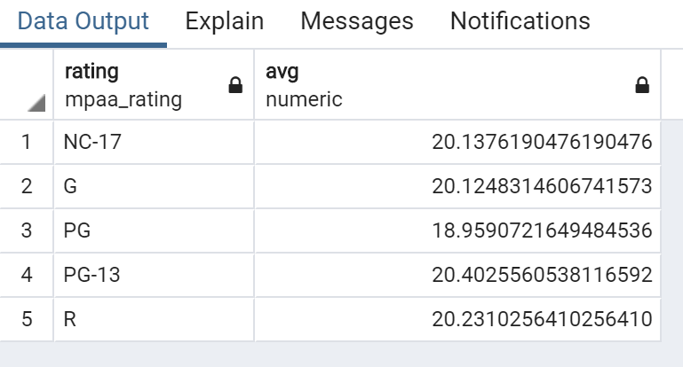
SQL
Expected Result

Slide 43
SQL
Hints
Use the film table
Recall that AVG returns back many significant digits, you can either stretch the column or use ROUND() to fix this issue.

Slide 44
SQL
Solution
SELECT rating , AVG(replacement_cost)
FROM film
GROUP BY rating

Slide 45
SQL
Solution
SELECT rating , ROUND(AVG(replacement_cost),2)
FROM film
GROUP BY rating

Slide 46
SQL
We are running a promotion to reward our top 5 customers with coupons.
What are the customer ids of the top 5 customers by total spend?

Slide 47
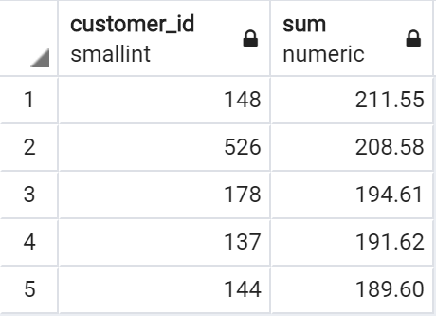
SQL
Expected Results

Slide 48
SQL
Hints
Use the payment table
Use ORDER BY
Recall you can order by the results of an aggregate function
You may want to use LIMIT to view just the top 5

Slide 49
SQL
Solution
SELECT customer_id , SUM(amount)
FROM payment
GROUP BY customer_id
ORDER BY SUM(amount) DESC
LIMIT 5

Slide 50
HAVING

Slide 51
SQL
The HAVING clause allows us to filter after an aggregation has already taken place.
Let’s take a look back at one of our previous examples.

Slide 52
SQL
SELECT company, SUM(sales)
FROM finance_table
GROUP BY company

Slide 53
SQL
SELECT company, SUM(sales)
FROM finance_table
WHERE company != ‘Google’
GROUP BY company
We’ve already seen we can filter before executing the GROUP BY, but what if we want to filter based on SUM(sales)?

Slide 54
SQL
SELECT company, SUM(sales)
FROM finance_table
WHERE company != ‘Google’
GROUP BY company
We can not use WHERE to filter based off of aggregate results, because those happen after a WHERE is executed.

Slide 55
SQL
SELECT company, SUM(sales)
FROM finance_table
WHERE company != ‘Google’
GROUP BY company
HAVING SUM(sales) > 1000
HAVING allows us to use the aggregate result as a filter along with a GROUP BY

Slide 56
SQL
SELECT company, SUM(sales)
FROM finance_table
GROUP BY company
HAVING SUM(sales) > 1000

Slide 57
SQL
Let’s explore some examples of HAVING in our database!

Slide 58
HAVING
CHALLENGE TASKS

Slide 59
SQL
These challenge tasks will all utilize the HAVING clause.
Challenge
Expected Result
Hints
Solution

Slide 60
SQL
Challenge
We are launching a platinum service for our most loyal customers. We will assign platinum status to customers that have had 40 or more transaction payments.
What customer_ids are eligible for platinum status?

Slide 61
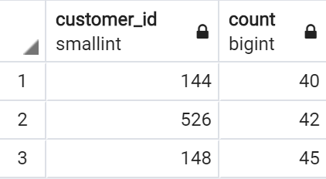
SQL
Expected Result

Slide 62
SQL
Hints
Use the payment table
Recall any column can be passed into a COUNT() call

Slide 63
SQL
Solution
SELECT customer_id, COUNT(*)
FROM payment
GROUP BY customer_id
HAVING COUNT(*) >= 40;

Slide 64
SQL
Challenge
What are the customer ids of customers who have spent more than $100 in payment transactions with our staff_id member 2?

Slide 65
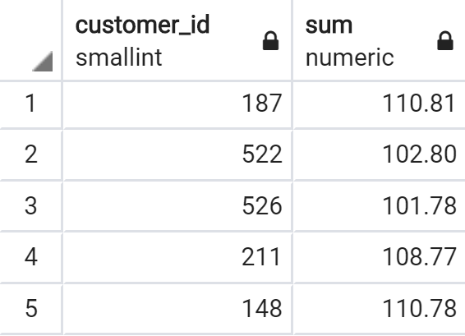
SQL
Expected Result

Slide 66
SQL
Hints
Use the payment table
Remember to use WHERE to first filter based on the staff_id , then use the GROUP BY clause

Slide 67
SQL
Solution
SELECT customer_id, SUM(amount)
FROM payment
WHERE staff_id = 2
GROUP BY customer_id
HAVING SUM(amount) > 100

