Slide 1

JOINS

Slide 2
SQL
Welcome to this section on JOINS.
JOINS will allow us to combine information from multiple tables!
Let’s see what we will learn in this section

Slide 3
SQL
Section Overview
Creating an alias with the AS clause
Understanding different kinds of JOINs
INNER JOINS
OUTER JOINS
FULL JOINS
UNIONS
Challenge Tasks

Slide 4
AS

Slide 5
SQL
Before we learn about JOINs , let’s quickly cover the AS clause which allows us to create an “alias” for a column or result.
Let’s see the example syntax

Slide 6
SQL
SELECT column AS new_name
FROM table

Slide 7
SQL
SELECT SUM(column) AS new_name
FROM table

Slide 8
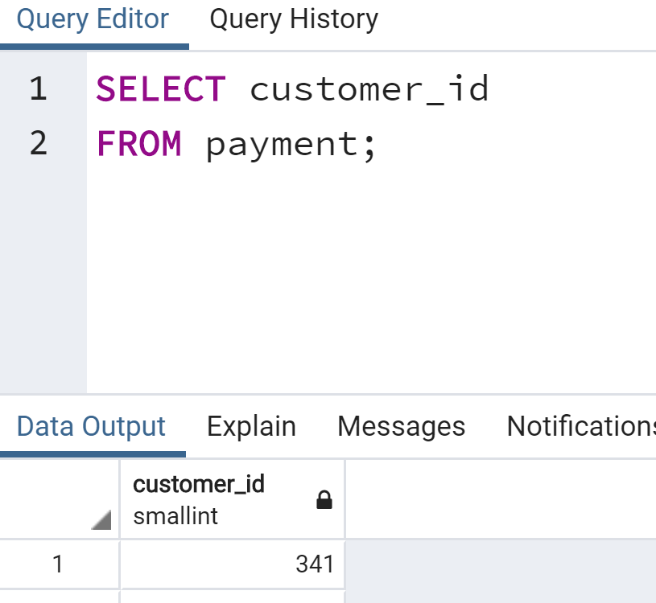
SQL
Example

Slide 9
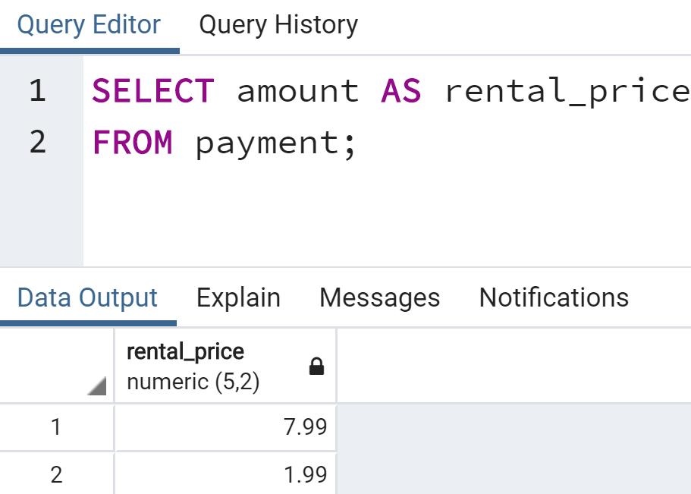
SQL
Example

Slide 10
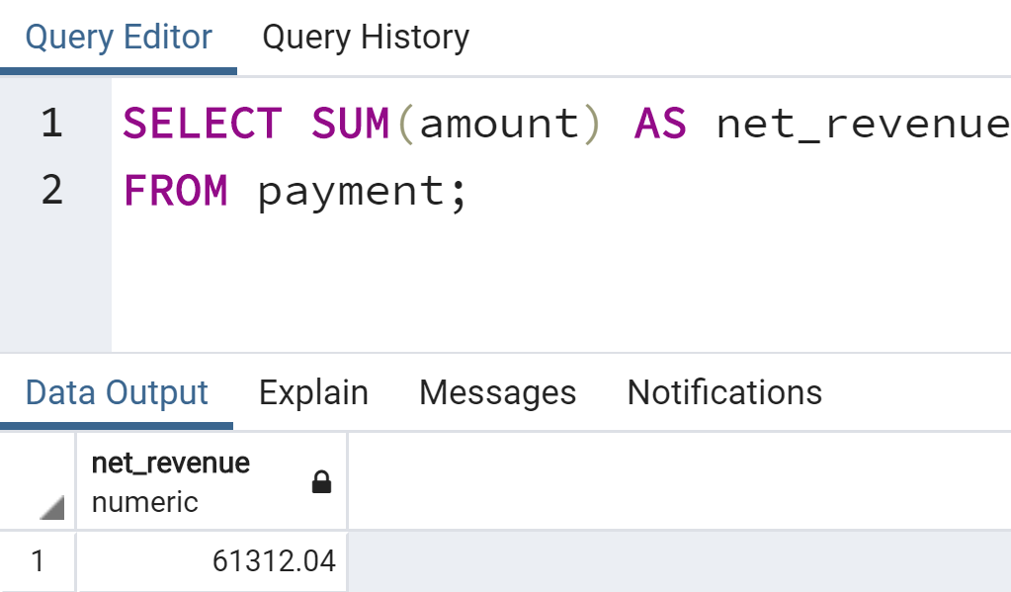
SQL
Example

Slide 11
SQL
The AS operator gets executed at the very end of a query, meaning that we can not use the ALIAS inside a WHERE operator.
Let’s walk through a few examples in pgAdmin!

Slide 12
INNER JOIN

Slide 13
SQL
There are several types of JOINs, in this lecture we will go through the simplest JOIN type, which is an INNER JOIN

Slide 14
SQL
What is a JOIN operation?
JOINs allow us to combine multiple tables together.
The main reason for the different JOIN types is to decide how to deal with information only present in one of the joined tables.

Slide 15
SQL
Let’s imagine a simple example.
Our company is holding a conference for people in the movie rental industry.
We’ll have people register online beforehand and then login the day of the conference.

Slide 16
SQL
After the conference we have these tables
REGISTRATIONS
reg_id | name
1 | Andrew
2 | Bob
3 | Charlie
4 | David
LOGINS
log_id | name
1 | Xavier
2 | Andrew
3 | Yolanda
4 | Bob

Slide 17
SQL
The respective id columns indicate what order they registered or logged in on site.
REGISTRATIONS
reg_id | name
1 | Andrew
2 | Bob
3 | Charlie
4 | David
LOGINS
log_id | name
1 | Xavier
2 | Andrew
3 | Yolanda
4 | Bob

Slide 18
SQL
For the sake of simplicity, we will assume the names are unique.
REGISTRATIONS
reg_id | name
1 | Andrew
2 | Bob
3 | Charlie
4 | David
LOGINS
log_id | name
1 | Xavier
2 | Andrew
3 | Yolanda
4 | Bob

Slide 19
SQL
To help you keep track, Registrations names’ first letters go A,B,C,D
REGISTRATIONS
reg_id | name
1 | Andrew
2 | Bob
3 | Charlie
4 | David
LOGINS
log_id | name
1 | Xavier
2 | Andrew
3 | Yolanda
4 | Bob

Slide 20
SQL
An INNER JOIN will result with the set of records that match in both tables.
REGISTRATIONS
reg_id | name
1 | Andrew
2 | Bob
3 | Charlie
4 | David
LOGINS
log_id | name
1 | Xavier
2 | Andrew
3 | Yolanda
4 | Bob

Slide 21
SQL
An INNER JOIN will result with the set of records that match in both tables.
REGISTRATIONS
reg_id | name
1 | Andrew
2 | Bob
3 | Charlie
4 | David
LOGINS
log_id | name
1 | Xavier
2 | Andrew
3 | Yolanda
4 | Bob

Slide 22
SQL
SELECT * FROM TableA
INNER JOIN TableB
ON TableA.col_match = TableB.col_match

Slide 23
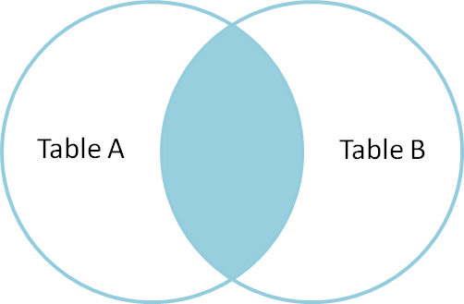
SQL
SELECT * FROM TableA
INNER JOIN TableB
ON TableA.col_match = TableB.col_match

Slide 24
SQL
SELECT * FROM TableB
INNER JOIN TableA
ON TableA.col_match = TableB.col_match

Slide 25
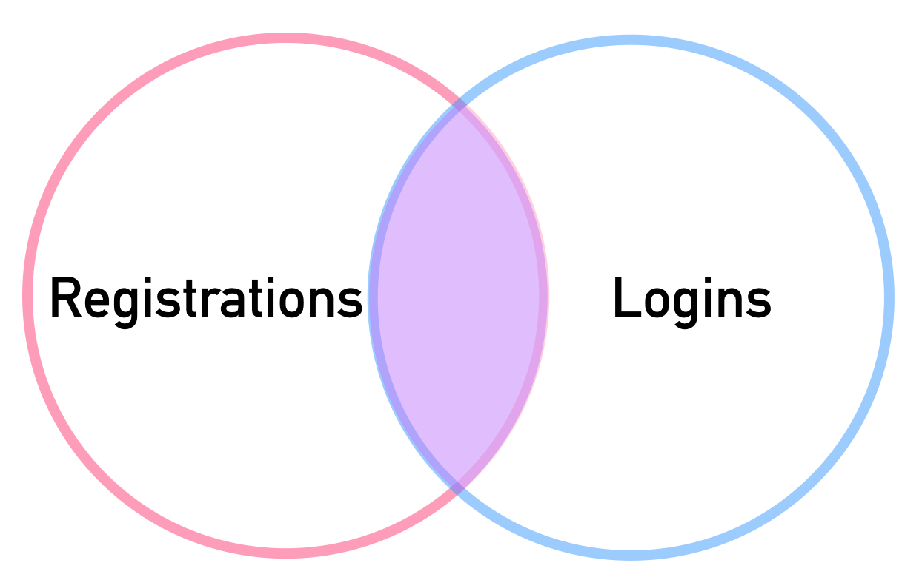
SQL
SELECT * FROM Registrations
INNER JOIN Logins
ON Registrations.name = Logins.name
REGISTRATIONS
reg_id | name
1 | Andrew
2 | Bob
3 | Charlie
4 | David
LOGINS
log_id | name
1 | Xavier
2 | Andrew
3 | Yolanda
4 | Bob

Slide 26
SQL
SELECT * FROM Registrations
INNER JOIN Logins
ON Registrations.name = Logins.name
REGISTRATIONS
reg_id | name
1 | Andrew
2 | Bob
3 | Charlie
4 | David
LOGINS
log_id | name
1 | Xavier
2 | Andrew
3 | Yolanda
4 | Bob

Slide 27
SQL
SELECT * FROM Registrations
INNER JOIN Logins
ON Registrations.name = Logins.name
REGISTRATIONS
reg_id | name
1 | Andrew
2 | Bob
3 | Charlie
4 | David
LOGINS
log_id | name
1 | Xavier
2 | Andrew
3 | Yolanda
4 | Bob

Slide 28
SQL
SELECT * FROM Registrations
INNER JOIN Logins
ON Registrations.name = Logins.name
REGISTRATIONS
reg_id | name
1 | Andrew
2 | Bob
3 | Charlie
4 | David
LOGINS
log_id | name
1 | Xavier
2 | Andrew
3 | Yolanda
4 | Bob
RESULTS
reg_id | name | log_id | name
1 | Andrew | 2 | Andrew
2 | Bob | 4 | Bob

Slide 29
SQL
SELECT reg_id,Logins.name,log_id
FROM Registrations
INNER JOIN Logins
ON Registrations.name = Logins.name
RESULTS
reg_id | name | log_id
1 | Andrew | 2
2 | Bob | 4

Slide 30
SQL
SELECT reg_id,Logins.name,log_id
FROM Registrations
INNER JOIN Logins
ON Registrations.name = Logins.name
RESULTS
reg_id | name | log_id
1 | Andrew | 2
2 | Bob | 4

Slide 31
SQL
Remember that table order won’t matter in an INNER JOIN
Also if you see just JOIN without the INNER, PostgreSQL will treat it as an INNER JOIN.
Let’s see some examples in pgAdmin!

Slide 32
OUTER JOINS

Slide 33
SQL
There are few different types of OUTER JOINs
They will allow us to specify how to deal with values only present in one of the tables being joined.
These are the more complex JOINs, take your time when trying to understand them!

Slide 34
SQL
In these lectures we will explain:
FULL OUTER JOIN
Clarifying WHERE null
LEFT OUTER JOIN
Clarifying WHERE null
RIGHT OUTER JOIN
Clarifying WHERE null

Slide 35
FULL OUTER JOIN

Slide 36
SQL
Let’s review our two example tables from the previous lectures.
REGISTRATIONS
reg_id | name
1 | Andrew
2 | Bob
3 | Charlie
4 | David
LOGINS
log_id | name
1 | Xavier
2 | Andrew
3 | Yolanda
4 | Bob

Slide 37
SQL
We know we would join these tables together on the name column
REGISTRATIONS
reg_id | name
1 | Andrew
2 | Bob
3 | Charlie
4 | David
LOGINS
log_id | name
1 | Xavier
2 | Andrew
3 | Yolanda
4 | Bob

Slide 38
SQL
Recall we match Andrew and Bob in both tables
REGISTRATIONS
reg_id | name
1 | Andrew
2 | Bob
3 | Charlie
4 | David
LOGINS
log_id | name
1 | Xavier
2 | Andrew
3 | Yolanda
4 | Bob

Slide 39
SQL
But we have names that only appear in one table!
REGISTRATIONS
reg_id | name
1 | Andrew
2 | Bob
3 | Charlie
4 | David
LOGINS
log_id | name
1 | Xavier
2 | Andrew
3 | Yolanda
4 | Bob

Slide 40
SQL
Let’s see how the different OUTER JOINs deal with this discrepancy.
REGISTRATIONS
reg_id | name
1 | Andrew
2 | Bob
3 | Charlie
4 | David
LOGINS
log_id | name
1 | Xavier
2 | Andrew
3 | Yolanda
4 | Bob

Slide 41
SQL
We will first take a look at the simplest, which is a FULL OUTER JOIN
REGISTRATIONS
reg_id | name
1 | Andrew
2 | Bob
3 | Charlie
4 | David
LOGINS
log_id | name
1 | Xavier
2 | Andrew
3 | Yolanda
4 | Bob

Slide 42
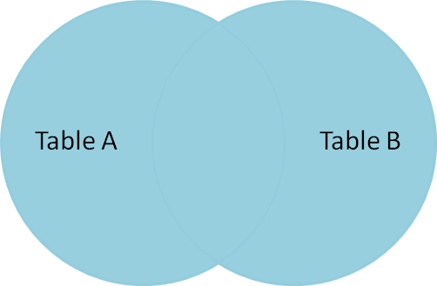
SQL
SELECT * FROM TableA
FULL OUTER JOIN TableB
ON TableA.col_match = TableB.col_match

Slide 43
SQL
SELECT * FROM TableB
FULL OUTER JOIN TableA
ON TableA.col_match = TableB.col_match

Slide 44
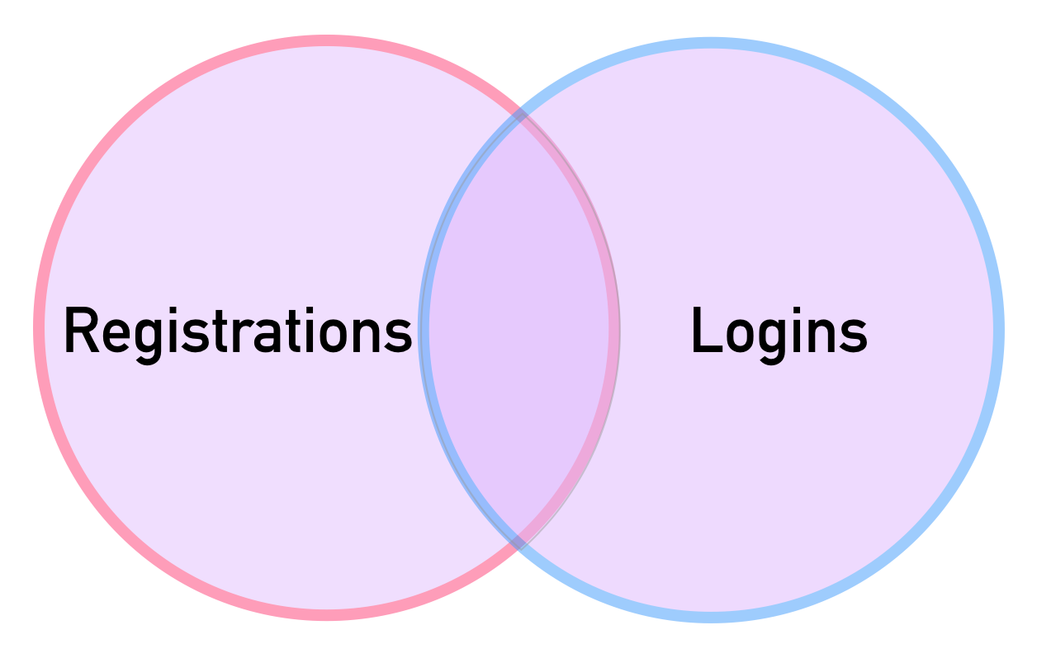
SQL
SELECT * FROM Registrations
FULL OUTER JOIN Logins
ON Registrations.name = Logins.name
REGISTRATIONS
reg_id | name
1 | Andrew
2 | Bob
3 | Charlie
4 | David
LOGINS
log_id | name
1 | Xavier
2 | Andrew
3 | Yolanda
4 | Bob

Slide 45
SQL
SELECT * FROM Registrations FULL OUTER JOIN Logins
ON Registrations.name = Logins.name
REGISTRATIONS
reg_id | name
1 | Andrew
2 | Bob
3 | Charlie
4 | David
LOGINS
log_id | name
1 | Xavier
2 | Andrew
3 | Yolanda
4 | Bob

Slide 46
SQL
SELECT * FROM Registrations FULL OUTER JOIN Logins
ON Registrations.name = Logins.name
RESULTS
reg_id | name | log_id | name
1 | Andrew
2 | Bob
3 | Charlie
4 | David
REGISTRATIONS
reg_id | name
1 | Andrew
2 | Bob
3 | Charlie
4 | David
LOGINS
log_id | name
1 | Xavier
2 | Andrew
3 | Yolanda
4 | Bob

Slide 47
SQL
SELECT * FROM Registrations FULL OUTER JOIN Logins
ON Registrations.name = Logins.name
RESULTS
reg_id | name | log_id | name
1 | Andrew | 2 | Andrew
2 | Bob | 4 | Bob
3 | Charlie
4 | David
REGISTRATIONS
reg_id | name
1 | Andrew
2 | Bob
3 | Charlie
4 | David
LOGINS
log_id | name
1 | Xavier
2 | Andrew
3 | Yolanda
4 | Bob

Slide 48
SQL
SELECT * FROM Registrations FULL OUTER JOIN Logins
ON Registrations.name = Logins.name
RESULTS
reg_id | name | log_id | name
1 | Andrew | 2 | Andrew
2 | Bob | 4 | Bob
3 | Charlie | null | null
4 | David | null | null
REGISTRATIONS
reg_id | name
1 | Andrew
2 | Bob
3 | Charlie
4 | David
LOGINS
log_id | name
1 | Xavier
2 | Andrew
3 | Yolanda
4 | Bob

Slide 49
SQL
SELECT * FROM Registrations FULL OUTER JOIN Logins
ON Registrations.name = Logins.name
RESULTS
reg_id | name | log_id | name
1 | Andrew | 2 | Andrew
2 | Bob | 4 | Bob
3 | Charlie | null | null
4 | David | null | null
null | null | 1 | Xavier
null | null | 3 | Yolanda
REGISTRATIONS
reg_id | name
1 | Andrew
2 | Bob
3 | Charlie
4 | David
LOGINS
log_id | name
1 | Xavier
2 | Andrew
3 | Yolanda
4 | Bob

Slide 50
FULL OUTER JOIN
with WHERE
Get rows unique to either table
(rows not found in both tables)

Slide 51
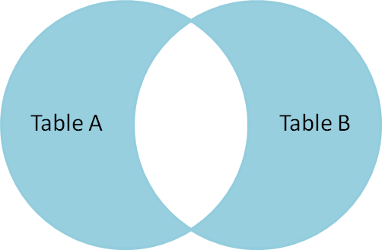
SQL
SELECT * FROM TableA
FULL OUTER JOIN TableB
ON TableA.col_match = TableB.col_match
WHERE TableA.id IS null OR
TableB.id IS null

Slide 52
SQL
SELECT * FROM TableB
FULL OUTER JOIN TableA
ON TableA.col_match = TableB.col_match
WHERE TableA.id IS null OR
TableB.id IS null

Slide 53
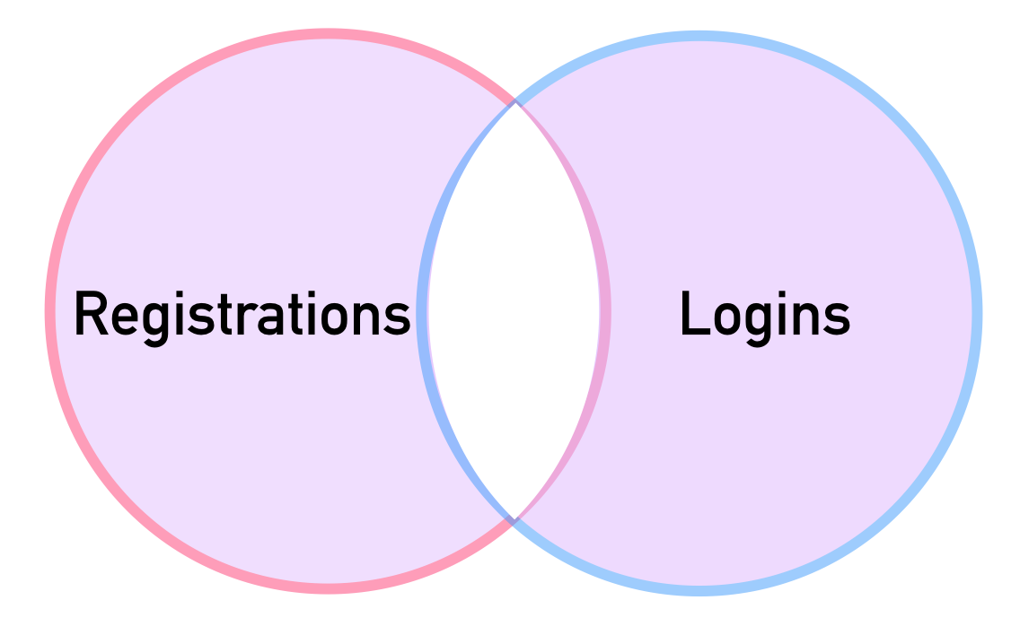
SQL
SELECT * FROM Registrations FULL OUTER JOIN Logins
ON Registrations.name = Logins.name
WHERE Registrations.reg_id IS null OR
Logins.log_id IS null

Slide 54
SQL
SELECT * FROM Registrations FULL OUTER JOIN Logins
ON Registrations.name = Logins.name
RESULTS
reg_id | name | log_id | name
1 | Andrew | 2 | Andrew
2 | Bob | 4 | Bob
3 | Charlie | null | null
4 | David | null | null
null | null | 1 | Xavier
null | null | 3 | Yolanda
REGISTRATIONS
reg_id | name
1 | Andrew
2 | Bob
3 | Charlie
4 | David
LOGINS
log_id | name
1 | Xavier
2 | Andrew
3 | Yolanda
4 | Bob

Slide 55
SQL
SELECT * FROM Registrations FULL OUTER JOIN Logins
ON Registrations.name = Logins.name
WHERE Registrations.reg_id IS null OR
Logins.log_id IS null
REGISTRATIONS
reg_id | name
1 | Andrew
2 | Bob
3 | Charlie
4 | David
RESULTS
reg_id | name | log_id | name
3 | Charlie | null | null
4 | David | null | null
null | null | 1 | Xavier
null | null | 3 | Yolanda
LOGINS
log_id | name
1 | Xavier
2 | Andrew
3 | Yolanda
4 | Bob

Slide 56
SQL
Let’s see a quick example in pgAdmin of FULL OUTER JOINs!

Slide 57
LEFT OUTER JOIN

Slide 58
SQL
A LEFT OUTER JOIN results in the set of records that are in the left table, if there is no match with the right table, the results are null.
Later on we will learn how to add WHERE statements to further modify a LEFT OUTER JOIN

Slide 59
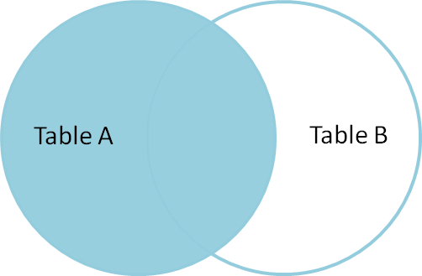
SQL
SELECT * FROM TableA
LEFT OUTER JOIN TableB
ON TableA.col_match = TableB.col_match

Slide 60
SQL
SELECT * FROM TableA
LEFT JOIN TableB
ON TableA.col_match = TableB.col_match

Slide 61
SQL
SELECT * FROM TableA
LEFT OUTER JOIN TableB
ON TableA.col_match = TableB.col_match

Slide 62
SQL
ORDER
MATTERS FOR
LEFT OUTER JOIN!
SELECT * FROM TableA
LEFT OUTER JOIN TableB
ON TableA.col_match = TableB.col_match

Slide 63
SQL
ORDER
MATTERS FOR
LEFT OUTER JOIN!
SELECT * FROM TableA
LEFT OUTER JOIN TableB
ON TableA.col_match = TableB.col_match

Slide 64
SQL
Let’s explore a LEFT OUTER JOIN with our two example tables.
REGISTRATIONS
reg_id | name
1 | Andrew
2 | Bob
3 | Charlie
4 | David
LOGINS
log_id | name
1 | Xavier
2 | Andrew
3 | Yolanda
4 | Bob

Slide 65
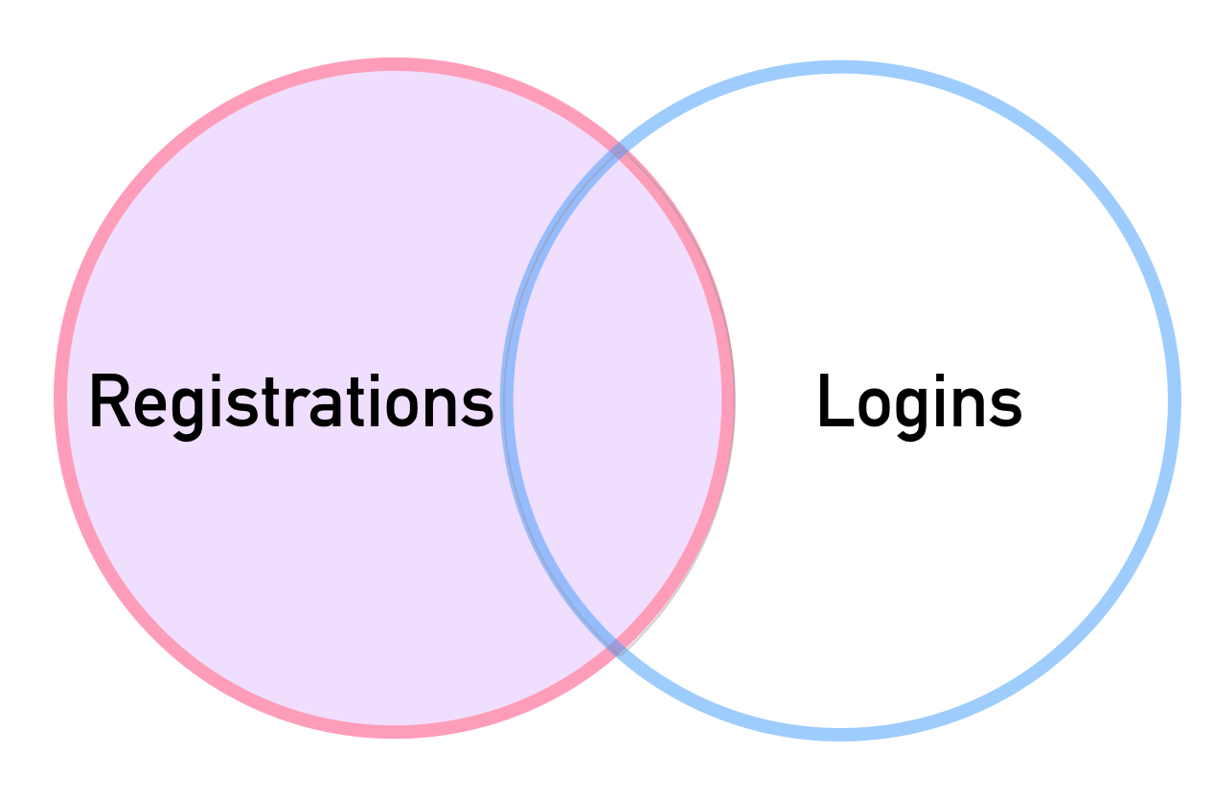
SQL
SELECT * FROM Registrations
LEFT OUTER JOIN Logins
ON Registrations.name = Logins.name
REGISTRATIONS
reg_id | name
1 | Andrew
2 | Bob
3 | Charlie
4 | David
LOGINS
log_id | name
1 | Xavier
2 | Andrew
3 | Yolanda
4 | Bob

Slide 66
SQL
SELECT * FROM Registrations
LEFT OUTER JOIN Logins
ON Registrations.name = Logins.name
REGISTRATIONS
reg_id | name
1 | Andrew
2 | Bob
3 | Charlie
4 | David
LOGINS
log_id | name
1 | Xavier
2 | Andrew
3 | Yolanda
4 | Bob
RESULTS
reg_id | name | log_id | name
1 | Andrew | 2 | Andrew
2 | Bob | 4 | Bob
3 | Charlie | null | null
4 | David | null | null

Slide 67
SQL
SELECT * FROM Registrations
LEFT OUTER JOIN Logins
ON Registrations.name = Logins.name
REGISTRATIONS
reg_id | name
1 | Andrew
2 | Bob
3 | Charlie
4 | David
LOGINS
log_id | name
1 | Xavier
2 | Andrew
3 | Yolanda
4 | Bob
RESULTS
reg_id | name | log_id | name
1 | Andrew | 2 | Andrew
2 | Bob | 4 | Bob
3 | Charlie | null | null
4 | David | null | null

Slide 68
LEFT OUTER JOIN
With WHERE
Get rows unique to left table

Slide 69
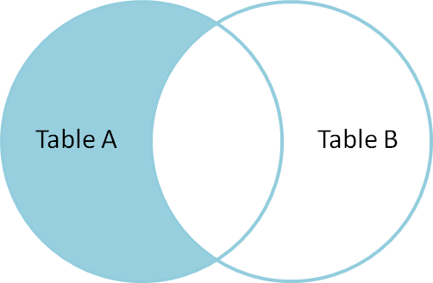
SQL
What if we only wanted entries unique to Table A? Those rows found in Table A and not found in Table B.

Slide 70
SQL
SELECT * FROM TableA
LEFT OUTER JOIN TableB
ON TableA.col_match = TableB.col_match
WHERE TableB.id IS null

Slide 71
SQL
SELECT * FROM Registrations
LEFT OUTER JOIN Logins
ON Registrations.name = Logins.name
REGISTRATIONS
reg_id | name
1 | Andrew
2 | Bob
3 | Charlie
4 | David
LOGINS
log_id | name
1 | Xavier
2 | Andrew
3 | Yolanda
4 | Bob
RESULTS
reg_id | name | log_id | name
1 | Andrew | 2 | Andrew
2 | Bob | 4 | Bob
3 | Charlie | null | null
4 | David | null | null

Slide 72
SQL
SELECT * FROM Registrations
LEFT OUTER JOIN Logins
ON Registrations.name = Logins.name
WHERE Logins.log_id IS null
REGISTRATIONS
reg_id | name
1 | Andrew
2 | Bob
3 | Charlie
4 | David
LOGINS
log_id | name
1 | Xavier
2 | Andrew
3 | Yolanda
4 | Bob
RESULTS
reg_id | name | log_id | name
3 | Charlie | null | null
4 | David | null | null

Slide 73
SQL
Let’s see some examples of LEFT OUTER JOINs in pgAdmin!

Slide 74
RIGHT JOINS

Slide 75
SQL
A RIGHT JOIN is essentially the same as a LEFT JOIN, except the tables are switched.
This would be the same as switching the table order in a LEFT OUTER JOIN.
Let’s quickly see some examples of a RIGHT JOIN.

Slide 76
SQL
SELECT * FROM TableA
RIGHT OUTER JOIN TableB
ON TableA.col_match = TableB.col_match
Table A
Table B

Slide 77
SQL
SELECT * FROM TableA
RIGHT JOIN TableB
ON TableA.col_match = TableB.col_match
Table A
Table B

Slide 78
SQL
SELECT * FROM TableA
RIGHT OUTER JOIN TableB
ON TableA.col_match = TableB.col_match
WHERE TableA.id IS null
Table A
Table B

Slide 79
SQL
It is up to you and how you have the tables organized “in your mind” when it comes to choosing a LEFT vs RIGHT join, since depending on the table order you specify in the JOIN, you can perform duplicate JOINs with either method.

Slide 80
JOIN
CHALLENGE TASKS

Slide 81
UNIONS

Slide 82
SQL
The UNION operator is used to combine the result-set of two or more SELECT statements.
It basically serves to directly concatenate two results together, essentially “pasting” them together.

Slide 83
SQL
SELECT column_name(s) FROM table1
UNION
SELECT column_name(s) FROM table2;

Slide 84
SQL
Let’s explore a UNION with two example tables.
Sales2021_Q1
name | amount
David | 100
Claire | 50
Sales2021_Q2
name | amount
David | 200
Claire | 100

Slide 85
SQL
SELECT * FROM Sales2021_Q1
UNION
SELECT * FROM Sales2021_Q2;
name | amount
David | 100
Claire | 50
David | 200
Claire | 100

Slide 86
SQL
SELECT * FROM Sales2021_Q1
UNION
SELECT * FROM Sales2021_Q2
ORDER BY name;
name | amount
David | 100
David | 200
Claire | 50
Claire | 100

Slide 87
JOIN
Challenges

Slide 88
SQL
California sales tax laws have changed and we need to alert our customers to this through email.
What are the emails of the customers who live in California?

Slide 89
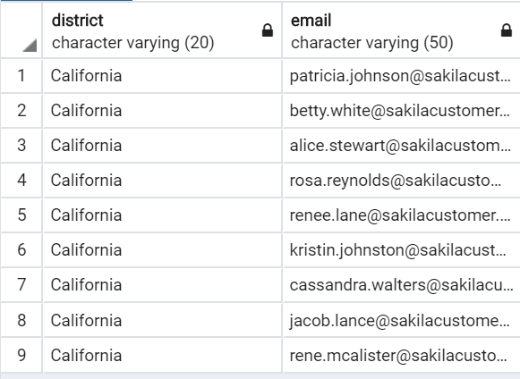
SQL
Expected Results

Slide 90
SQL
Hints
You will need to use the address and customer tables.
Look at the district column

Slide 91
SQL
SELECT district,email FROM address
INNER JOIN customer ON
address.address_id = customer.address_id
WHERE district = 'California'

Slide 92
SQL
A customer walks in and is a huge fan of the actor “Nick Wahlberg” and wants to know which movies he is in.
Get a list of all the movies “Nick Wahlberg” has been in.

Slide 93
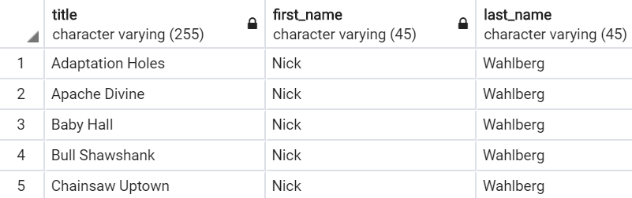
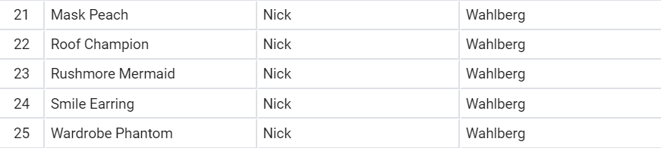
SQL
Expected Results
……………...

Slide 94
SQL
HINTS
You will need to do 2 JOINs in a row to do this in a single query.
Try using the online documentation or a simple google search to see how this is done.
Tables to use: actor, film, film_actor

Slide 95
SQL
SELECT title,first_name,last_name
FROM film_actor INNER JOIN actor
ON film_actor.actor_id = actor.actor_id
INNER JOIN film
ON film_actor.film_id = film.film_id
WHERE first_name = 'Nick'
AND last_name = 'Wahlberg'

