Slide 1
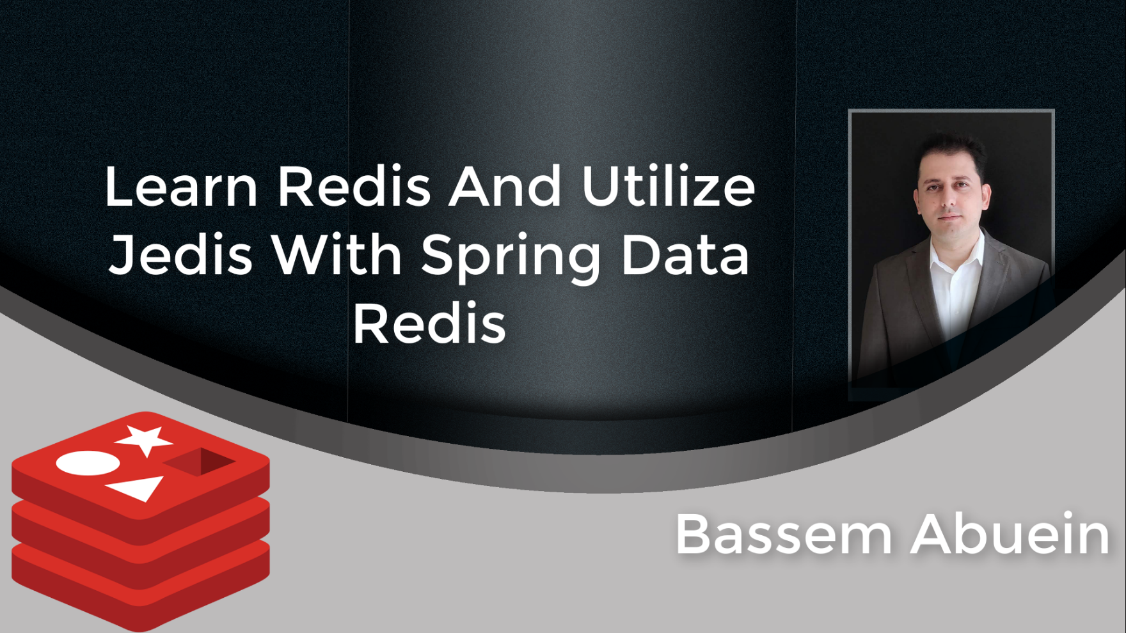

Slide 2

Section 1: Introduction

Slide 3
What is Redis?
Redis is powerful and extremely fast in memory database.
Stores data in key-value.
Persistence. Optionally, you can save the data to desk.
Mater slave Replication

Slide 4
What is Redis?
Open Source.
No indexing.
No query language.
LUA Support.

Slide 5
SQl
Structured relational databases.
Predefined DB Schema.
MySQL, Oracle, MS SQL Server, SQLite, Postgres, etc.

Slide 6
NoSQL
Unstructured.
Dynamic Schema.
Common types:
Key-Value stores (Redis, Voldemort, and Dynamo).
Document databases(MongoDB and CouchDB ).
Wide-Column databases (Cassandra and HBase).
Graph databases: (Neo4J and Infinite Graph)

Slide 7
Differences among SQl and NoSQl Databases
Schema: SQL stores data in tables. NoSQL stores in different methods(key/value, document, columnar, and graph).
Querying: SQL databases uses regular SQL statements. NoSQL uses UnQL(Unstructured Query Language).
Scalability: SQL databases are vertically(beef the same server hardware) scalable. NoSQL databases are horizontally(add more servers) scalable.

Slide 8
Differences among SQl and NoSQl Databases
Reliability: SQL databases are ACID friendly. Majority of NoSQL databases sacrifices the ACID property for performance reasons.

Slide 9
When to use SQL vs NoSQL
When to use SQL?
The data has stable and defined structure.
ACID compliance.
Not looking for insanely fast data retrieval. (reading from desk vs memory)

Slide 10
When to use SQL vs NoSQL
When to use NoSQL?
Storing big amount of data, that has no defined structure.
Using cloud storage and hosting.
Quick software development and prototyping.

Slide 11
Redis Usage In Web Applications
User Session management.
Caching.
Pub/Sub (Queues & Notifications).
Leaderboards for gaming apps.
Geospatial.

Slide 12
Section 2: Redis Installation

Slide 13
Installing Redis On Windows
Navigate to https://github.com/MicrosoftArchive/redis/releases
Two methods:
Download latest Redis Zip version, unzip it and run Redis right away.
MSI installer , like you install any other software on windows.

Slide 14
Installing Redis On Mac OS X
Two methods:
Using homebrew. → brew install redis
2. As in Redis download page (https://redis.io/download) → If you don’t have wget installed use Curl –O instead.

Slide 15
Installing Redis On Unix
As in Redis download page (https://redis.io/download).

Slide 16
Free Cloud/Hosted Installation
https://redislabs.com/

Slide 17
Redis GUI Client
Redis Desktop Manager (aka RDM):
is a fast open source Redis database management application for Windows, Linux and MacOS.
To install: https://redisdesktop.com/

Slide 18
Section 3: Redis Data Types And Commands

Slide 19
Redis Main Data Types
Strings
Lists
Sets
Sorted Sets
Hashes

Slide 20
Section 4: Redis Advanced

Slide 21
Redis Persistence Options
No persistence, dataset in memory.
RDB(Redis Database File)
AOF(Append Only File)
Hybrid(RDB & AOF)

Slide 22
RDB(Redis Database File)
RDB Makes a snapshot of the dataset at specific intervals.
How does it work?
Whenever Redis create a snapshot, this happens
1.Redis forks. New child process starts In addition to the parent process
2. The child process begins to write the dataset to a temporary RDB file.
3. Once the child process finishes writing to the new RDB file, it replaces the old one.
Commands:
--SAVE: block all the other clients, while saving the DB
--BGSAVE: Save the DB in background process.(preferred in production env, you don’t want to block Redis until it completes the snapshot)
In Redis.config file: save 30 100 means take a snapshot every 30 seconds if there are 100 keys changed.

Slide 23
RDB(Redis Database File)
Advantages:
A straightforward approach to backup and restore your data, enabled by default in redis.config file.
RDB is very good for disaster recovery, being a single compact file can be transferred to remote data centers (possibly encrypted).
RDB maximizes Redis performances since the only work the Redis parent process needs to do in order to persist is forking a child that will do all the rest. The parent instance will never perform disk I/O or alike.
Disadvantages:
Using RDB There is a possibility that you will lose data that stored in memory after RDB’s last snapshot.
When RDB frequently forks a child process to persist on disk, the fork can be time-consuming if the dataset is big.

Slide 24
AOF(Append Only File)
How does it work?
AOF logs each write operation received by the server, that will be played again at server startup, restoring the original dataset.
Advantages:
Durability, no data lost. (you can have 3 fsync policies:no fsync at all, fsync every second(default), fsync at every query).
Append only prevent data corruption.
Redis can automatically rewrite the AOF in the background when it gets too big
Disadvantages:
AOF writes to disk for every operation, an expensive task.
Size of AOF file is larger than RDB file. Also, AOF might be slower than RDB(it depends on fsync policies)

Slide 25
Hybrid Approach(RDB & AOF)
Recommended approach in Redis documentation. AOF provides data safety, and RDB delivers snapshots backups for disaster recovery.
Combining both AOF and RDB in the same instance is possible. In this case, when Redis restarts, the AOF file will be utilized to reproduce the original dataset since it is assured to be the most complete.
Recommended Read:
https://redis.io/topics/persistence

Slide 26
Redis Sentinel
Redis Sentinel is a system, designed to help managing Redis instances.
The primary purpose of using sentinel is to provide a high availability system, by monitoring, notifying, and providing instances failover.
Sentinel performs three tasks :
1- Monitoring: check if your master and slave instances are working as expected
2-Notification: notify other program or the system administrator via an API, when something goes wrong with the monitored instances.
3-Automatic failover: on master failure, sentinel promotes one of the slaves to Master, then make the other additional slaves use the new master.
Sentinel acts as a source of authority for clients. Clients connect to Sentinels in order to ask for the address of the current Redis master.

Slide 27
How do Sentinels work?
Redis (Slave)
Redis (Master)
Redis Client
Redis (Slave)

Slide 28
Sentinel how it works?
Sentinel 1
Redis (Slave)
Redis (Master)
Redis Client
Sentinel 2
Redis (Slave)
Sentinel 3

Slide 29
Sentinel, Things to Consider.
At lease three Sentinel instances to run on servers that fail in an independent way.
Redis Client must have Sentinel Support
Redis Sentinel is a specific execution mode of the Redis server itself.
Sentinel API provides information on the running instances(Sentinel API commands Examples: SENTINEL masters, SENTINEL slaves <master name> )
Redi sentinels documentation: https://redis.io/topics/sentinel

Slide 30
Redis Cluster
Redis Cluster is a data sharding solution with automatic management, failover, and replication.
Data sharding is a method to break up a big database (DB) into many smaller parts. It is the process of breaking up a DB across multiple machines to enhance the manageability, availability, performance, and load balancing of an application.
The reason for data sharding is that, after a certain scale point, it is cheaper and more attainable to scale horizontally by adding more machines than to grow it vertically by adding beefier servers.
Cluster mode provides similar high-availability to Sentinel mode, but the sharding allows more data to be stored in the cluster. Cluster Provides scalability to your application.

Slide 31
Cluster, How it works?
Redis (Master)
Redis (Slave)
Redis Client
Redis (Master)
Redis (Slave)
Redis (Master)
Redis (Slave)
Cluster bus ,node to node communication

Slide 32
Redis Cluster
https://redis.io/topics/cluster-tutorial

Slide 33
Redis Cluster VS Redis Sentinel
Similarities :Both solutions provide high availability for your system.
Use sentinel when speed isn’t your primary concern, which makes it an excellent option for smaller implementation with high availability concerns.
Redis cluster provides high availability plus clustering solution, it's an excellent choice to ensure high availability while keeping fast access speed in consideration to access your data.
Bottom line: If you need an automatic failover solution without going to a full cluster solution, then use Sentinel. For getting a complete clustering solution which splits your database in between multiple nodes then go for clustering.

Slide 34
Section 5: Jedis And Spring Data Redis

Slide 35
Redis Java Clients
Jedis
Lettuce
Redisson

Slide 36
Jedis
Small, light and extremely fast client library in java for Redis.
Supported by Spring Data.
Implementation using Jedis is painless.
Jedis instance is not thread safe.

Slide 37
Jedis Pool
Jedis Pool object is thread safe.
Pool is configurable.
Pool improve performance.

Slide 38
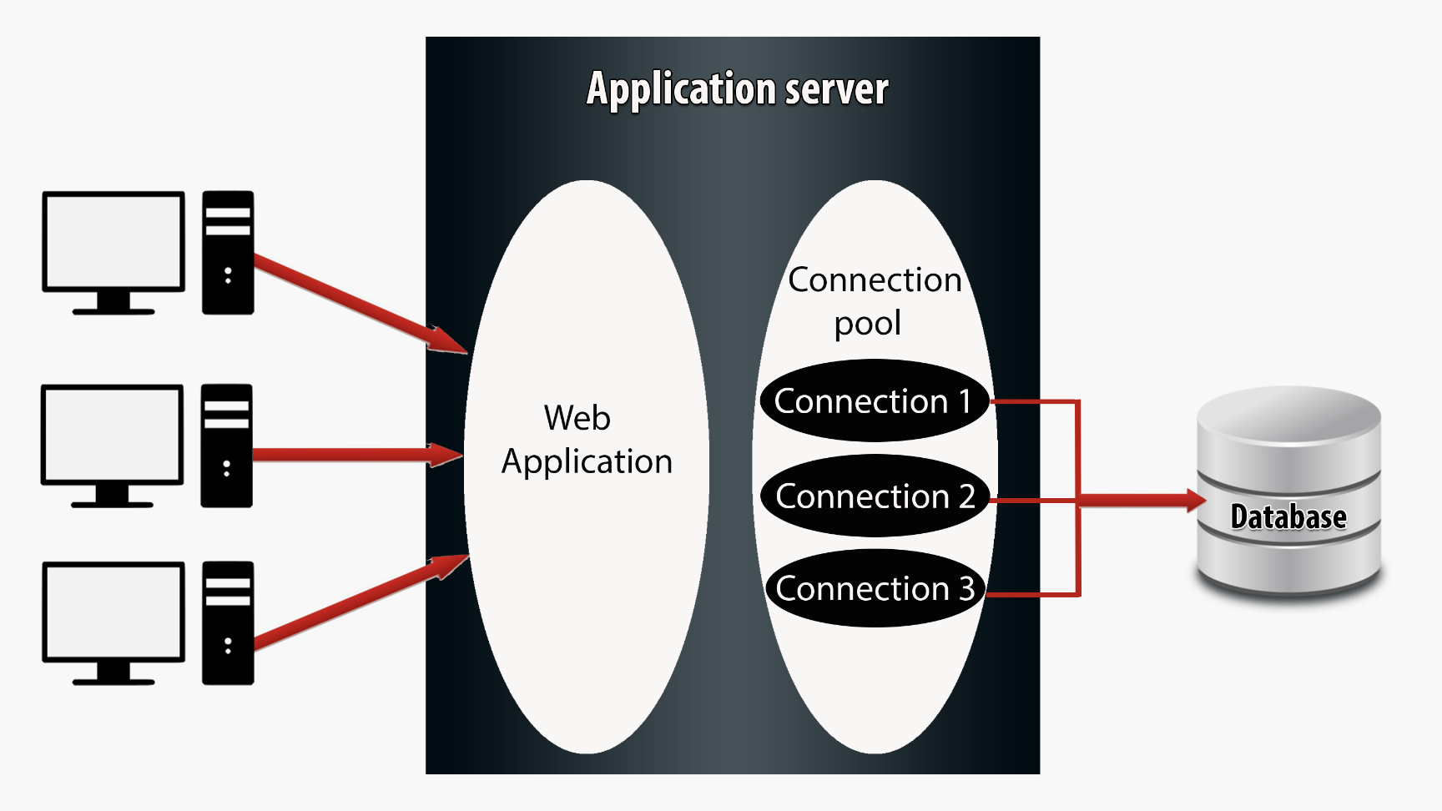
How Pooling Works

Slide 39
Redis Template
The RedisTemplate is crucial class in Spring Data Redis.
RedisTemplate class provides methods to communicate with a Redis instance.
Redis Template class takes two parameter on instantiation: the type of redis key and redis value.

Slide 40
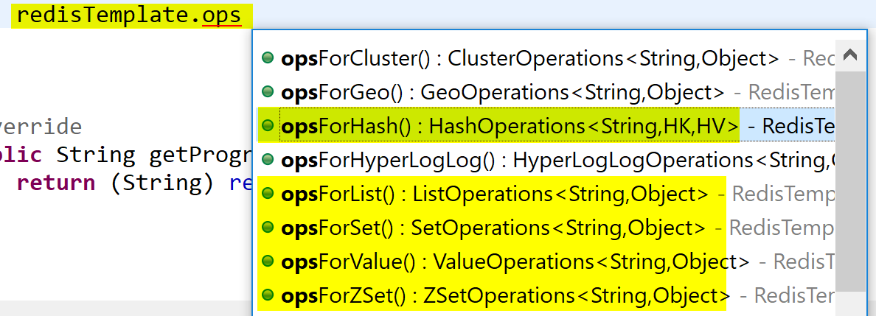
Redis Template Main Operations
For Value Operations use opsForValue(): returns redis string (or value) operations
For Hash Operations use opsForHash(): returns redis hash operations
For List Operations use opsForList(): returns redis hash operations
For Set Operations use opsForList(): returns redis set operations
For Zset Operations use opsForZSet() returns redis sorted set operations

Slide 41
Serializers
Problem: Data stored in redis in bytes
Required: Convert bytes to String, Json ,object,xml and vice versa.
Solution: Use Serializers

Slide 42
Serializers
GenericToStringSerializer: serializes strings to bytes and vice versa. Relies on the Spring {@link ConversionService}
JacksonJsonRedisSerializer: converts object to json and vice versa .
JdkSerializationRedisSerializer: Uses the default (Java based) serialization method.(Default Serializer for objects)
OxmSerializer : Uses the Object/XML mapping
StringRedisSerializer : Converts Strings into bytes and vice versa using the specified charset(by default UTF-8) .(Default Serializer for string values)

