Slide 1


Data Types in PostgreSQL

Slide 2

Agenda
Enum
Array
Range
Composite
Domain

Slide 3
Enum

Slide 4
Enum

Slide 5
Array

Slide 6
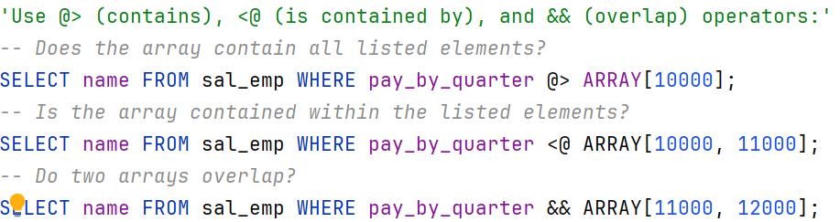
Array

Slide 7
Range

Slide 8
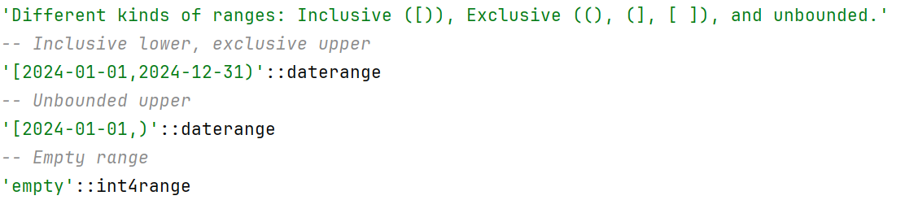
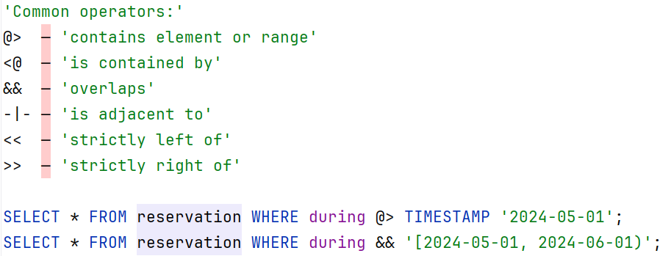
Range

Slide 9
Range

Slide 10
Composite

Slide 11
Composite

Slide 12
Domain

Slide 13
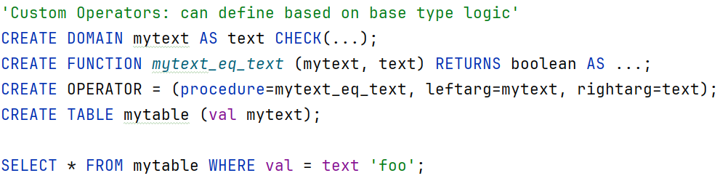
Domain

Slide 14

Thank you
Author: Serhii Kravchuk
My LinkedIn: Link
Date: May 2025
Join Codeus community in Discord
Join Codeus community in LinkedIn

