Slide 1





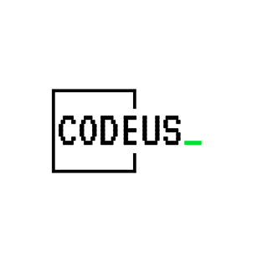
SQL Joins & CTEs Workshop
- Understanding Table Relationships and Complex Queries

Slide 2

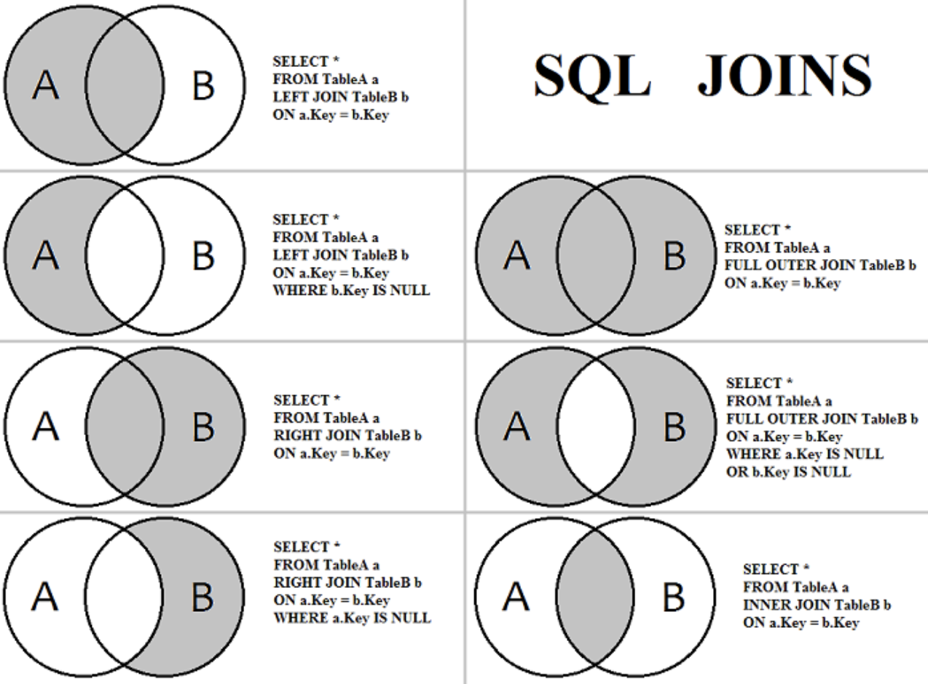
What is a JOIN?
• SQL JOIN combines rows from two or more tables
• Based on a related column between them
• Helps retrieve data that spans multiple tables
• Essential for relational database queries

Slide 3
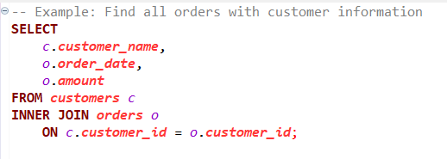
INNER JOIN
Returns only matching rows from both tables
Most common type of JOIN
Like intersection in set theory
Only returns data when there's a match in both tables

Slide 4
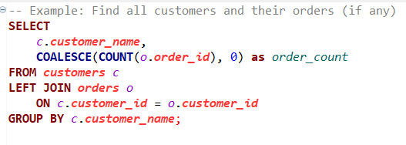
LEFT JOIN
Returns all records from the left table
Matching records from the right table
NULL for non-matching right table records
Useful for finding missing relationships

Slide 5
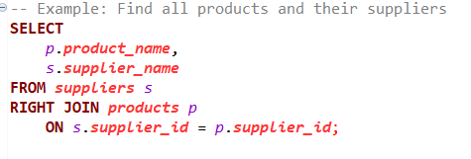
RIGHT JOIN
Returns all records from the right table
Matching records from the left table
NULL for non-matching left table records
Less common but useful in specific scenarios

Slide 6
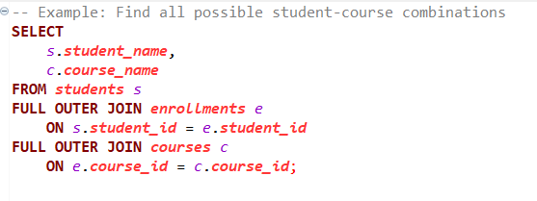
FULL OUTER JOIN
Combines LEFT and RIGHT JOIN
Returns all records from both tables
NULL where there are no matches
Useful for finding all missing relationships

Slide 7

What are CTEs?
Common Table Expressions (WITH clause)
Temporary named result set
Makes complex queries more readable
Can be referenced multiple times in main query
Helps break down complex logic

Slide 8
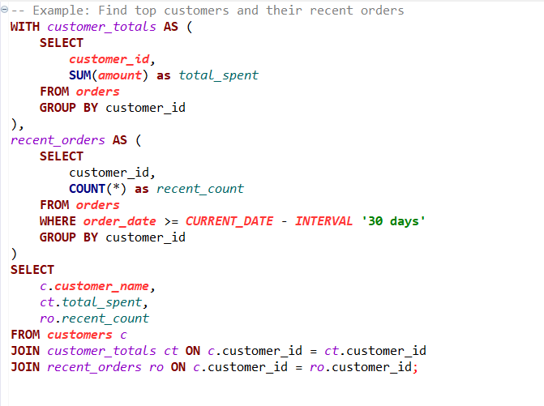
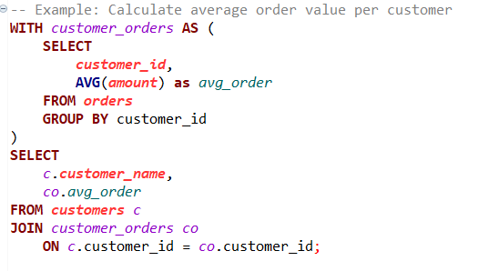
CTE examples

Slide 9
Common Pitfalls
Best Practices
• Always specify JOIN type explicitly
• Use meaningful table aliases
• Include JOIN conditions in ON clause
• Consider performance with large datasets
• Use CTEs for better code organization
• Comment complex queries
• Forgetting JOIN conditions
• Using wrong JOIN type
• Not handling NULL values
• Creating cartesian products
• Writing overly complex CTEs
• Poor naming conventions

Slide 10
Thank you! Happy Coding!

