Slide 1


PL/pgSQL Functions

Slide 2

PL/pgSQL: SQL + Procedural Logic
Combines SQL's data handling with procedural language features (variables, conditions, loops).
Allows embedding complex logic directly into the database.
Native language for PostgreSQL for efficient execution.

Slide 3
Key Advantages of PL/pgSQL Functions
Encapsulation: Grouping complex logic.
Reusability: Write once, use many times.
Performance: Can reduce network traffic and allow server-side optimizations.
Security: Control data access through functions.

Slide 4
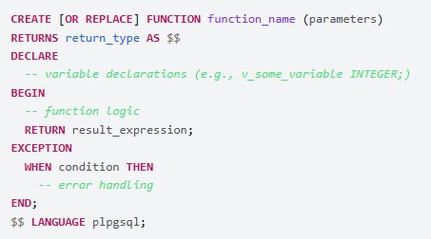
Anatomy of a PL/pgSQL Function
Key Components:
CREATE FUNCTION...: Defines the function.
RETURNS return_type: Specifies the function's output data type.
AS $$ ... $$: Delimits the function body (dollar quoting is common).
DECLARE: (Optional) Section for local variable declarations.
Example: v_count INTEGER := 0;
BEGIN ... END;: The main block containing executable SQL and procedural statements.
RETURN result_expression: Returns a value from the function (if not returning VOID).
EXCEPTION WHEN ...: (Optional) Handles errors that occur within the BEGIN...END block.
LANGUAGE plpgsql: Specifies PL/pgSQL as the function's language.

Slide 5
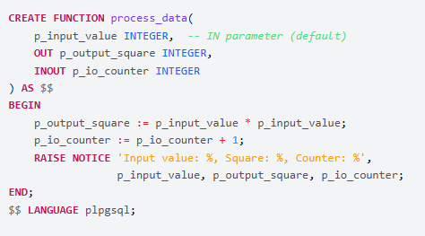
Inputs and Outputs: Examples
Parameter Modes:
IN (default): Input value.
OUT: Output value, assigned within the function.
INOUT: Input value, can be modified and returned.
Common Return Types:
Scalar types, SETOF record_type or TABLE(...), VOID.

Slide 6
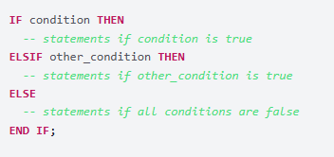
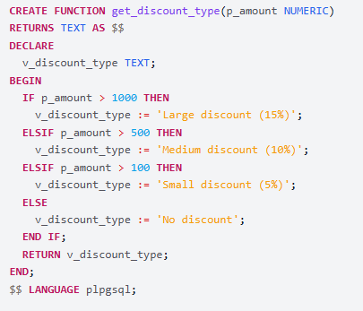
Making Decisions: The IF Statement
Syntax:
Example:

Slide 7
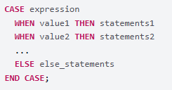
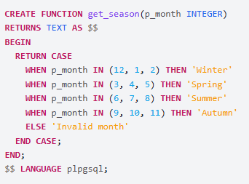
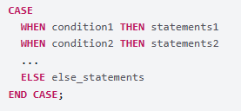
Alternative Decisions: The CASE Statement
Simple CASE:
Searched CASE:
Example (Searched CASE):

Slide 8
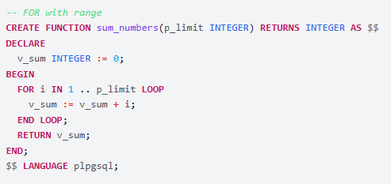


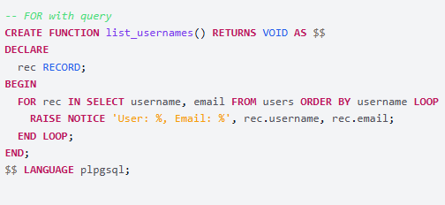
Repeating Actions: The FOR Loop
Examples:
FOR with range:
FOR with query (iterate over rows):

Slide 9

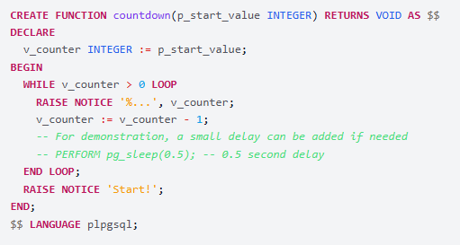
Repeating by Condition: The WHILE Loop
Syntax:
Example:

Slide 10
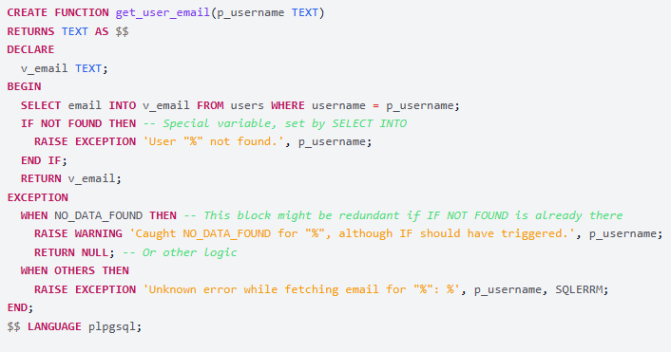
Managing Errors Gracefully
EXCEPTION Block: Catches errors from the BEGIN block.
Raising Errors: RAISE EXCEPTION (stops), RAISE NOTICE (informs).

Slide 11
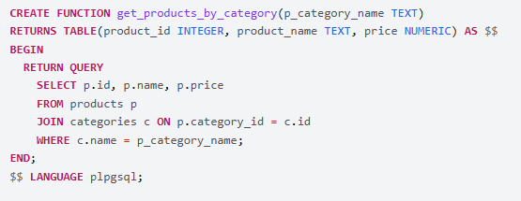
Returning Multiple Rows
Concept: Functions that return a set of rows.
Declaration: RETURNS SETOF data_type or RETURNS TABLE (...).
Returning Data: RETURN QUERY query; or RETURN NEXT expression;.

Slide 12
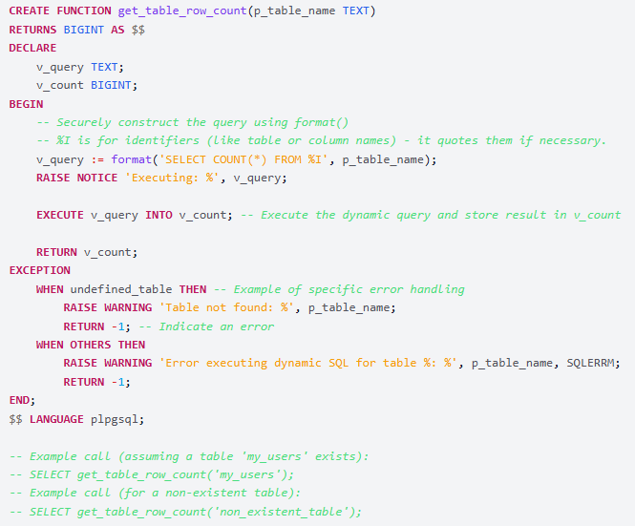
Building Queries on the Fly
EXECUTE Command: Allows constructing and executing SQL queries as strings. This is useful when table or column names are not known until runtime.

Slide 13
Writing Good Functions
Clear Naming: Use descriptive names.
Simplicity: Smaller, focused functions.
Error Handling: Implement checks.
Security with Dynamic SQL: Sanitize inputs.
Testing: Verify with various data.

Slide 14

Thank you
Author: Denys Kuchmei
My LinkedIn: https://www.linkedin.com/in/denys-kuchmei-7a8259208/
Date: May 2025
Join Codeus community in Discord
Join Codeus community in LinkedIn

