Slide 1


PostgreSQL Partitioning

Slide 2
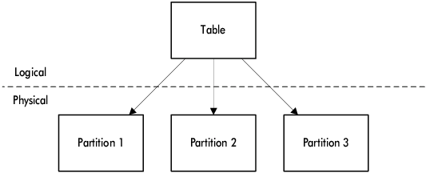

What is Partitioning
Split large tables into smaller pieces
Improves performance
Logical table interface with physical separation
Used for scaling and performance tuning

Slide 3
Partitioning Strategies
Range Partitioning: Based on value ranges (e.g. dates)
List Partitioning: Based on discrete values (e.g. types)
Hash Partitioning: Evenly distributes rows using hash
Multi-Level Partitioning: Combine strategies (e.g. year + type)

Slide 4
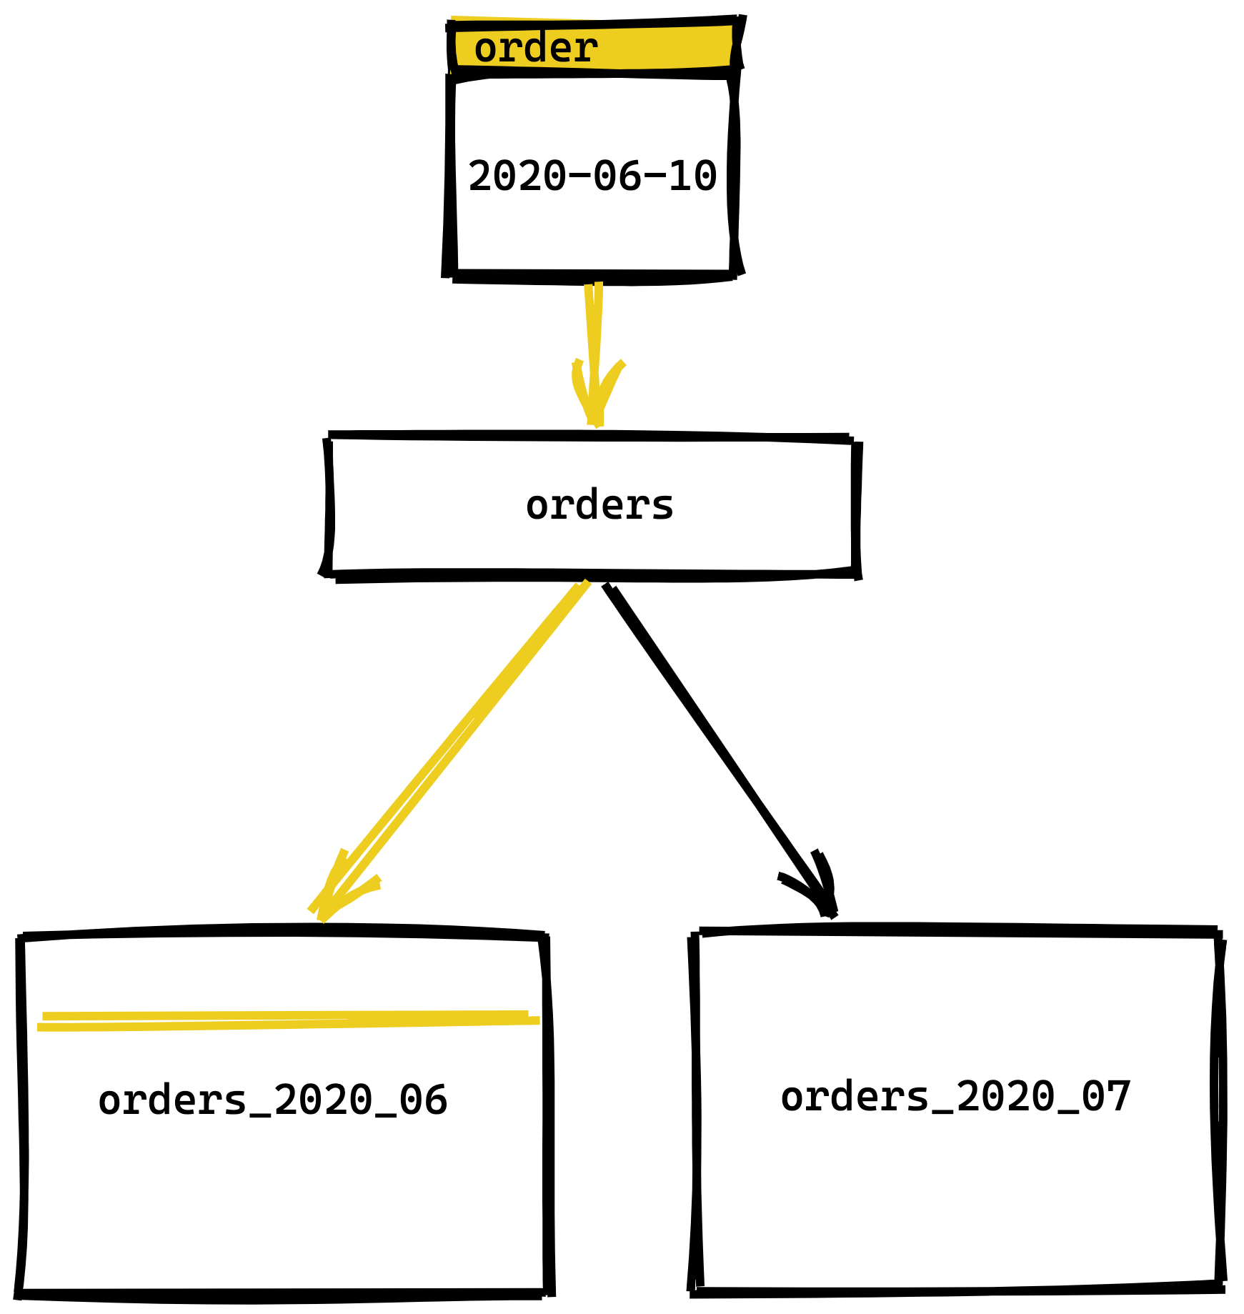
Key Concepts
Parent Table: Logical interface
Child Partition: Physical storage unit
Partition Key: Column used for routing
DEFAULT Partition: Catch-all for unmatched rows
Pruning: Skipping irrelevant partitions in queries

Slide 5
How it works
Insert: PostgreSQL routes row based on partition key
Select: Planner prunes non-matching partitions
Efficient data access when filters align with partition key

Slide 6
Basic Syntax
CREATE TABLE transactions_partitioned ( id INT GENERATED BY DEFAULT AS IDENTITY, transaction_date TIMESTAMP DEFAULT CURRENT_TIMESTAMP, PRIMARY KEY (id, transaction_date) ) PARTITION BY RANGE (transaction_date);
CREATE TABLE transactions_2024_01 PARTITION OF transactions_partitioned FOR VALUES FROM ('2024-01-01') TO ('2024-02-01');

Slide 7
Basic Syntax
CREATE TABLE accounts_partitioned ( id INT GENERATED BY DEFAULT AS IDENTITY, account_type VARCHAR(20) NOT NULL CHECK (account_type IN ('pending', completed')), PRIMARY KEY (id, account_type) ) PARTITION BY LIST (account_type);
CREATE TABLE pending_accounts PARTITION OF accounts_partitioned FOR VALUES IN ('pending ');

Slide 8
Basic Syntax
CREATE TABLE companies_partitioned ( id INT PRIMARY KEY, … ) PARTITION BY HASH (id);
CREATE TABLE customers_part_0 PARTITION OF customers_partitioned FOR VALUES WITH (MODULUS 4, REMAINDER 0);
… CREATE TABLE customers_part_1 PARTITION OF customers_partitioned FOR VALUES WITH (MODULUS 4, REMAINDER 3);

Slide 9
Basic Syntax
-- Detach a partition from the parent table ALTER TABLE transactions DETACH PARTITION transactions_2022; -- Drop the detached table DROP TABLE transactions_2022; -- Attach a previously detached table (must match partition key) ALTER TABLE transactions ATTACH PARTITION transactions_2022 FOR VALUES FROM ('2022-01-01') TO ('2023-01-01');

Slide 10

Thank you
Author: Dmytro Halchenko
My LinkedIn: https://www.linkedin.com/in/dmytro-halchenko-0307751b6/
Date: June 2025
Join Codeus community in Discord
Join Codeus community in LinkedIn

