Slide 1



MarketManager
A system to run and
manage a small shop

Slide 2
Why MarketManager?
Help small shops' owners to run their business easily and accurately
Problems to be solved:
keeping track of the current inventory.
Adding a new brand and a new product to the inventory.
Adding new customer and keeping track of the information of all customers
Show a picture of the product to the customer
Adding products to orders' lists
Updating products', customers', and orders' information.

Slide 3
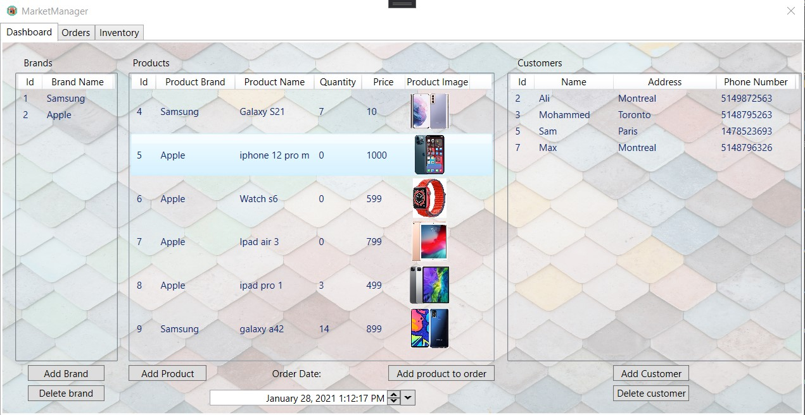
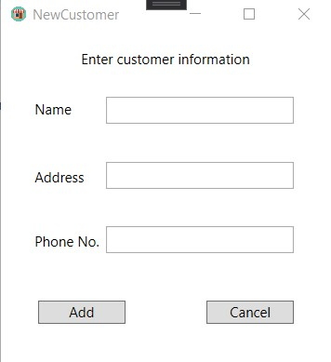
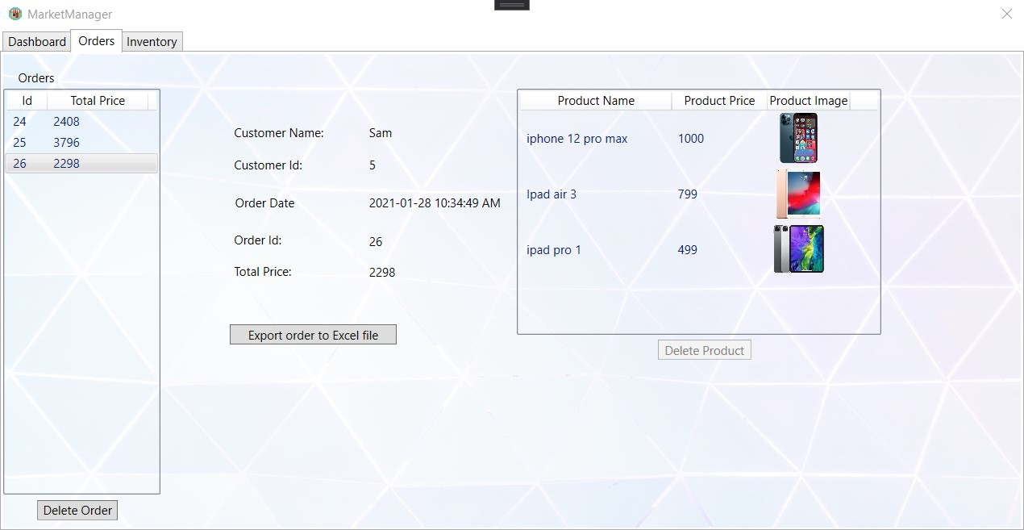
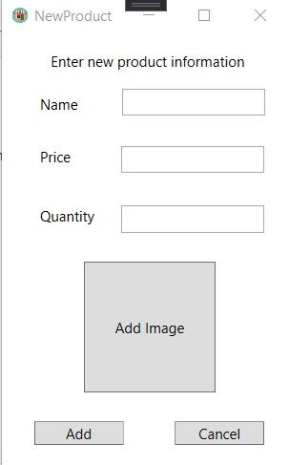
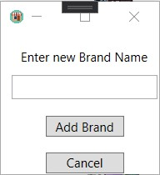
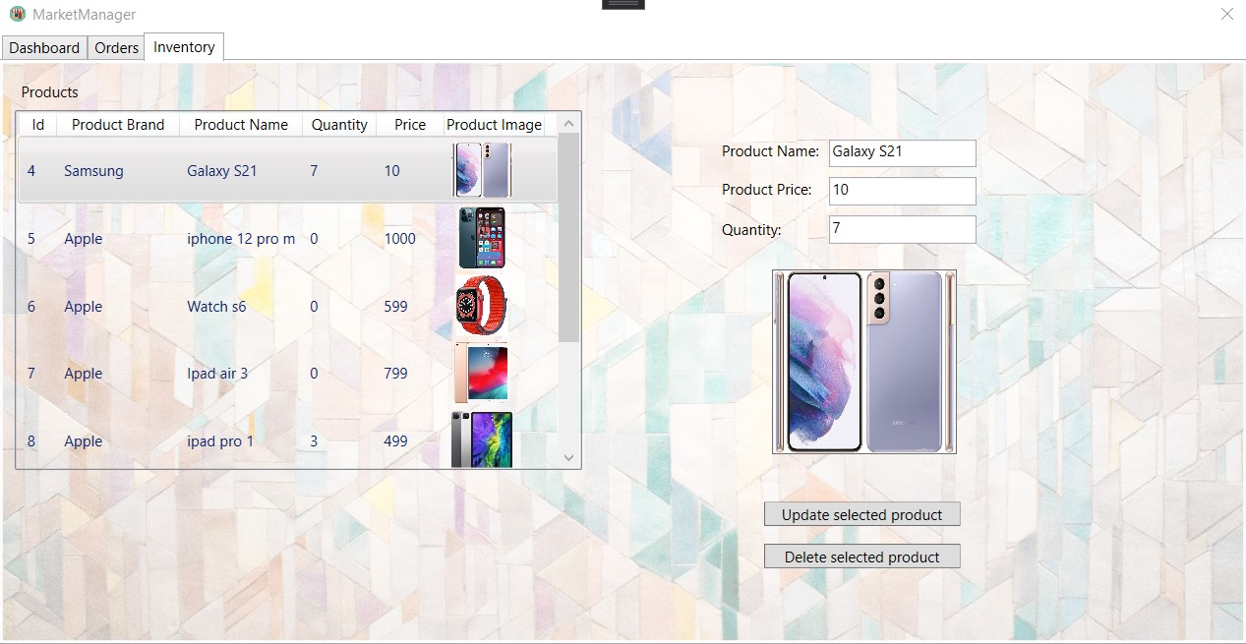
Main Windows of MarketManager
Dashboard
Orders
Inventory
Data Entry Windows

Slide 4
Dashboard

Slide 5
Main Windows of MarketManager
Dashboard
Orders
Inventory
Data Entry Windows

Slide 6
Orders

Slide 7
Main Windows of MarketManager
Dashboard
Orders
Inventory
Data Entry Windows

Slide 8
Inventory

Slide 9
Main Windows of MarketManager
Dashboard
Orders
Inventory
Data Entry Windows

Slide 10
Data Entry Windows
New Customer
New Product
New Brand

Slide 11
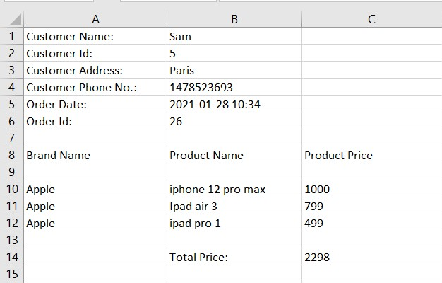
Low-Level Solution
One order after exported to Excel file

Slide 12
Summary
Shops managers are suffering to keep track of products, customers, and orders each day.
Using today's latest technologies, MarketManager was designed and developed to make the work of many small shops' managers easier and more accurate.
MarketManager enables managers to keep track of products, brands, customers, and orders very easily. Also, gives them the ability to show detailed information about products and orders.
MarketManager has a user friendly interface that is easy to understand and use.
Notes:
* 1 slide: Summary
- what was done and with what result.

