Slide 1

CODER HOUSE PROYECTO BASES DE DATOS FORMULA 1
IBARRA SERGIO
JUNE 2023

Slide 2
DATASET: Se decidió usar un dataset de Kaggle con información histórica de carreras de la formula 1
Se extrajo información acerca de cada Carrera en el ciruito professional de formula 1 desde el año 2009 hasta el 2022.
Esta información está dividida en muchas tablas tales como: circuits. cricuits_results , constructor_standings , constructors, driver_standings, drivers, lap_times, pin_stops, qualifiying, races, results, seasons, sprint_results, status.
Notes:
Seasonality, trend and noise in time series data | Python (datacamp.com)

Slide 3
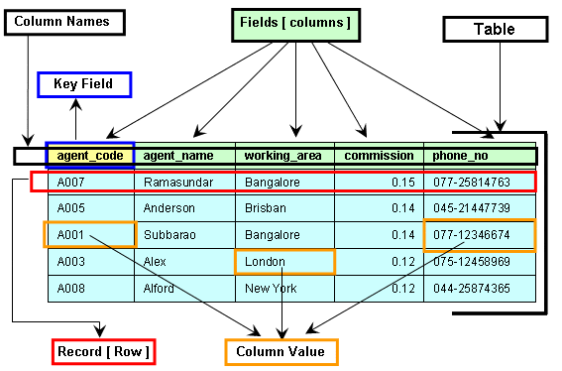
Definiendo las distintas entidades y sus campos

Slide 4
Se decidió usar un dataset de Kaggle con información histórica de carreras de la formula 1
Table: Constructors
Field | Type of Data
constructurID (PK) | Int
constructurRef | varchar
name | Varchar
Nationality | Varchar
utl | Varchar
Table: Circuits
Field | Type of Data
circuitID (PK) | Int
circuitRef | varchar
name | Varchar
location | Varchar
Country | Varchar
lat | Float
lng | Float
alt | Float
url | Varchar
Table: Constructors_results
Field | Type of Data
constructorResultsId (PK) | Int
raceId (FK on Race(raceID)) | Int
constructorId (FK on Constructors(constructorId)) | Int
Points | Int
Status | Varchar
Table: Constructors_stadings
Field | Type of Data
constructorStandingsId (PK) | Int
raceId (FK on Race(raceID)) | Int
constructorId (FK on Constructors(constructorId)) | Int
Points | Int
Position | Int
PositionText | Varchar
Wins | Int
Notes:
Seasonality, trend and noise in time series data | Python (datacamp.com)

Slide 5
Se decidió usar un dataset de Kaggle con información histórica de carreras de la formula 1
Table: Drivers
Field | Type of Data
driverId (PK) | Int
driverRef | varchar
number | Int
Code | Varchar
Forename | Varchar
surname | Varchar
dob | Date
nationality | Varchar
url | Varchar
Table: Lap_times
Field | Type of Data
raceId (FK on Race(raceID)) | Int
driverId (FK on Drivers(driverID)) | Int
lapID (PK) | Int
position | Int
time | Varchar
miliseconds | Int
Table: Driver_standings
Field | Type of Data
driverStandingsId(PK) | Int
raceId (FK on Race(raceID)) | Int
driverId (FK on Drivers(driverID)) | Int
Points | Int
Position | Int
PositionText | Int
Wins | Int
Table: pit_stops
Field | Type of Data
raceId (FK on Race(raceID)) | Int
driverId (FK on Drivers(driverID)) | Int
stop (PK) | Int
lap(FK on lap_times(lap)) | Int
Wins | Int
time | Varchar
duration | float
miliseconds | Int
Notes:
Seasonality, trend and noise in time series data | Python (datacamp.com)

Slide 6
Table: results
Field | Type of Data
resultID(PK) | Int
raceId (FK on Race(raceID)) | Int
driverId (FK on Drivers(driverID)) | Int
constructurID (PK) (FK on Constructor(constructorID)) | Int
number | Int
Grid | Int
position | Int
PositionText | Int
PositionOder | Int
position | Int
laps | Int
time | Varchar
miliseconds | Int
fastestLap | Int
rank | Int
fastestLapTime | Varchar
fastestLapSpeed | Float
statusId | Int
Table: races
Field | Type of Data
raceId (PK) | Int
year | Int
round | Int
circuitID (FK on Cicruits(circuitID)) | Int
name | Varchar
date | Date
time | Varchar
url | Varchar
fp1_date | Date
fp1_time | Varchar
fp2_date | Date
fp2_time | Varchar
fp3_date | Date
fp3_time | Varchar
quali_date | Date
quali_time | Varchar
sprint_date | Date
sprint_time | Varchar
Table: qualifiying
Field | Type of Data
qualifyId (PK) | Int
raceId (FK on Race(raceID)) | Int
driverId (FK on Drivers(driverID)) | Int
constructurID (FK on Constructor(constructorID)) | Int
number | Int
position | Int
q1 | Varchar
q2 | Varchar
q3 | Varchar
q4 | Varchar
Notes:
Seasonality, trend and noise in time series data | Python (datacamp.com)

Slide 7
Se decidió usar un dataset de Kaggle con información histórica de carreras de la formula 1
Table: sprint_results
Field | Type of Data
resultId(PK) | Int
raceId (FK on Race(raceID)) | Int
driverId (FK on Drivers(driverID)) | Int
constructurID (FK on Constructor(constructorID)) | Int
number | Int
Grid | Int
position | Int
PositionText | Int
PositionOder | Int
position | Int
laps | Int
time | Varchar
miliseconds | Int
fastestLap | Int
fastestLapTime | Varchar
statusId | Int
Table: Seasons
Field | Type of Data
year | Int
url | varchar
Table: Status
Field | Type of Data
StatusID (PK) | Int
status | varchar
Notes:
Seasonality, trend and noise in time series data | Python (datacamp.com)

Slide 8
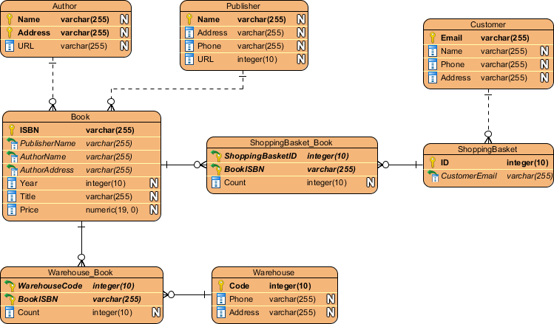
Definiendo las relaciones entre las distintas entidades

Slide 9
Se presenta la relación entre la distintas entidades de nuestra base Formula1
Table: races
Field | Type of Data
raceId (PK) | Int
year | Int
round | Int
circuitID (FK on Cicruits(circuitID)) | Int
name | Varchar
date | Date
time | Varchar
url | Varchar
fp1_date | Date
fp1_time | Varchar
fp2_date | Date
fp2_time | Varchar
fp3_date | Date
fp3_time | Varchar
quali_date | Date
quali_time | Varchar
sprint_date | Date
sprint_time | Varchar
Table: sprint_results
Field | Type of Data
resultId(PK) | Int
raceId (FK on Race(raceID)) | Int
driverId (FK on Drivers(driverID)) | Int
constructurID (FK on Constructor(constructorID)) | Int
number | Int
Grid | Int
position | Int
PositionText | Int
PositionOder | Int
position | Int
laps | Int
time | Varchar
miliseconds | Int
fastestLap | Int
fastestLapTime | Varchar
statusId | Int
Table: Drivers
Field | Type of Data
driverId (PK) | Int
driverRef | varchar
number | Varchar
Code | Varchar
Forename | Varchar
surname | Varchar
dob | Date
nationality | Varchar
url | Varchar
1:N
1:N
1:1
Table: Circuits
Field | Type of Data
circuitID (PK) | Int
circuitRef | varchar
name | Varchar
location | Varchar
Country | Varchar
lat | Float
lng | Float
alt | Float
url | Varchar
N:1
Table: Constructors
Field | Type of Data
constructurID (PK) | Int
constructurRef | varchar
name | Varchar
Nationality | Varchar
utl | Varchar
1:N
Table: results
Field | Type of Data
resultID(PK) | Int
raceId (FK on Race(raceID)) | Int
driverId (FK on Drivers(driverID)) | Int
constructurID (PK) (FK on Constructor(constructorID)) | Int
number | Int
Grid | Int
position | Int
PositionText | Int
PositionOder | Int
position | Int
laps | Int
time | Varchar
miliseconds | Int
fastestLap | Int
rank | Int
fastestLapTime | Varchar
fastestLapSpeed | Float
statusId | Int
1:N
1:1
N:1
Table: qualifiying
Field | Type of Data
qualifyId (PK) | Int
raceId (FK on Race(raceID)) | Int
driverId (FK on Drivers(driverID)) | Int
constructurID (FK on Constructor(constructorID)) | Int
number | Int
position | Int
q1 | Varchar
q2 | Varchar
q3 | Varchar
q4 | Varchar
1:1
1:1
1:1
Table: Driver_standings
Field | Type of Data
driverStandingsId(PK) | Int
raceId (FK on Race(raceID)) | Int
driverId (FK on Drivers(driverID)) | Int
Points | Int
Position | Int
PositionText | Int
Wins | Int
1:N
1:1
Table: Lap_times
Field | Type of Data
raceId (FK on Race(raceID)) | Int
driverId (FK on Drivers(driverID)) | Int
lap (PK) | Int
position | Int
time | Varchar
miliseconds | Int
1:N
N:1
Table: pit_stops
Field | Type of Data
raceId (FK on Race(raceID)) | Int
driverId (FK on Drivers(driverID)) | Int
stop (PK) | Int
lap(FK on lap_times(lap)) | Int
Wins | Int
time | Varchar
duration | float
miliseconds | Int
1:N
N:1
1:1
Table: Constructors_results
Field | Type of Data
constructorResultsId (PK) | Int
raceId (FK on Race(raceID)) | Int
constructorId (FK on Constructors(constructorId)) | Int
Points | Int
Status | Varchar
1:N
1:1
Table: Constructors_stadings
Field | Type of Data
constructorStandingsId (PK) | Int
raceId (FK on Race(raceID)) | Int
constructorId (FK on Constructors(constructorId)) | Int
Points | Int
Position | Int
PositionText | Int
Wins | Int
1:N
1:1
Notes:
Seasonality, trend and noise in time series data | Python (datacamp.com)

Slide 10
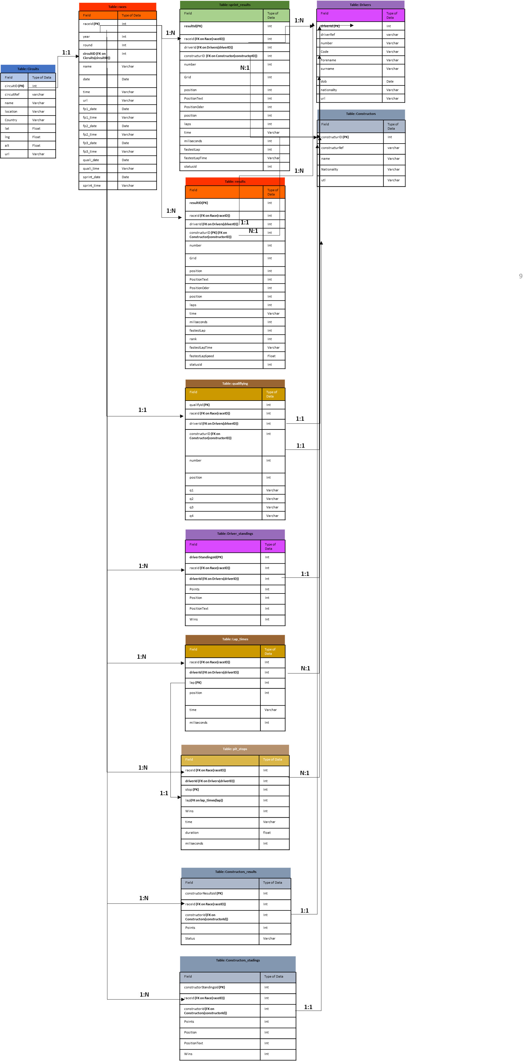
Se presenta la relación entre la distintas entidades de nuestra base Formula1
Notes:
Seasonality, trend and noise in time series data | Python (datacamp.com)

Slide 11
HIPOTESIS:
Se pretende analizar patrones, relaciones o tendencias en las distintas variables de estudio, por ejemplo.
¿Qué tantas veces aquel que empieza en primer lugar la carrera termina en primer lugar?
¿Existe una relación directa entre ganar Premios específicos
Notes:
Seasonality, trend and noise in time series data | Python (datacamp.com)

Slide 12

CODER HOUSE PROYECTO BASES DE DATOS TRANSFERMARKET
IBARRA SERGIO
JUNE 2023
Football Data from Transfermarkt | Kaggle

Slide 13
DATASET: Se decidió usar un dataset de Kaggle con información histórica futbolistas y sus precios de mercado
Se extrajo información acerca de cada precios de mercado de futbolistas
Esta información está dividida en muchas tablas tales como: appearances, club_games, clubs, competitions, game_events, games, player_valuations, players
Notes:
Seasonality, trend and noise in time series data | Python (datacamp.com)

Slide 14
Definiendo las distintas entidades y sus campos

Slide 15
Se decidió usar un dataset de Kaggle con información histórica de carreras de Transfermarkt
Table: appearances
Field | Type of Data
appearance_id (PK) | Varchar
game_id (FK on games(gameID)) | Int
player_id (FK on players(playerID)) | Int
player_club_id (FK on clubs(clubID)) | Int
player_current_club_id (FK on clubs(clubID)) | Int
competition_id (FK on competitions(competitonID)) | Varchar
date | Date
player_name | Varchar
yellow_cards | Int
red_cards | Int
Goals | Int
Assists | Int
minutes | Int
Table: clubs
Field | Type of Data
club_id (PK) | Int
Domestic_competition_id (FK on competitions(competitonID)) | Varchar
Club_code | Varchar
name | Varchar
Squad_size | Int
Average_age | Int
foreigners_number | Int
foreigners_percentage | Int
national_team_players | Int
net_transfer_record | Varchar
Table: club_games
Field | Type of Data
game_id (PK) | Int
club_id (FK on clubs(clubID)) | Varchar
opponent_id (FK on clubs(clubID)) | Varchar
own_goals | Int
own_position | Int
own_manager_name | Varchar
opponent_position | Int
opponent_goals | Int
hosting | Varchar
is_win | Boolean
Notes:
Seasonality, trend and noise in time series data | Python (datacamp.com)

Slide 16
Se decidió usar un dataset de Kaggle con información histórica de carreras de Transfermarkt
Table: games
Field | Type of Data
game_id (PK) | Int
competition_id (FK on competitions(competitonID)) | Varchar
opponent_id (FK on clubs(clubID)) | Varchar
Home_club_id (FK on clubs(clubID)) | Int
away_club_id (FK on clubs(clubID)) | Int
Home_club_goals | Int
Away_club_goals | Int
Home_club_position | Int
Away_club_position | Int
home_club_manager_name | Varchar
away_club_manager_name | Varchar
Stadium | Varchar
attendance | Int
season | Int
round | Varchar
date | date
Table: competitions
Field | Type of Data
competition_id (PK) | Varchar
competition_code | Varchar
name | Varchar
sub_type | Varchar
type | Varchar
country_id | Int
country_name | Varchar
domestic_league_code | Varchar
confederation | Varchar
Table: game_events
Field | Type of Data
game_id (PK) | Int
club_id (FK on clubs(clubID)) | Varchar
player_id (FK on players(playerID)) | Int
Player_in_id (FK on players(playerID)) | Int
minute | Int
type | Varchar
description | Varchar
Notes:
Seasonality, trend and noise in time series data | Python (datacamp.com)

Slide 17
Se decidió usar un dataset de Kaggle con información histórica de carreras de Transfermarkt
Table: player_valuations
Field | Type of Data
player_id (PK) | Int
Current_club_id (FK on clubs(clubID)) | Int
last_season | Int
datetime | date
date | date
dateweek | date
market_value_in_eur | Int
player_club_domestic_competition_id | Varchar
Table: players
Field | Type of Data
player_id (PK) | Int
Player_code | Varchar
country_of_birth | Varchar
city_of_birth | Varchar
country_of_citizenship | Varchar
date_of_birth | date
sub_position | Varchar
Position | Varchar
height_in_cm | Int
highest_market_value_in_eur | Int
agent_name | Varchar
Notes:
Seasonality, trend and noise in time series data | Python (datacamp.com)

Slide 18
Definiendo las relaciones entre las distintas entidades

Slide 19
Se decidió usar un dataset de Kaggle con información histórica de carreras de Transfermarkt
Table: clubs
Field | Type of Data
club_id (PK) | Int
Domestic_competition_id (FK on competitions(competitonID)) | Varchar
Table: appearances
Field | Type of Data
appearance_id (PK) | Varchar
game_id (FK on games(gameID)) | Int
player_id (FK on players(playerID)) | Int
player_club_id (FK on clubs(clubID)) | Int
player_current_club_id (FK on clubs(clubID)) | Int
competition_id (FK on competitions(competitonID)) | Varchar
Table: club_games
Field | Type of Data
game_id (PK) | Int
club_id (FK on clubs(clubID)) | Varchar
opponent_id (FK on clubs(clubID)) | Varchar
1:N
1:N
1:N
1:N
1:N
1:N
Table: games
Field | Type of Data
game_id (PK) | Int
competition_id (FK on competitions(competitonID)) | Varchar
opponent_id (FK on clubs(clubID)) | Varchar
Home_club_id (FK on clubs(clubID)) | Int
away_club_id (FK on clubs(clubID)) | Int
1:N
Table: competitions
Field | Type of Data
competition_id (PK) | Varchar
Table: game_events
Field | Type of Data
game_id (PK) | Int
club_id (FK on clubs(clubID)) | Varchar
player_id (FK on players(playerID)) | Int
Player_in_id (FK on players(playerID)) | Int
1:N
Table: player_valuations
Field | Type of Data
player_id (PK) | Int
Current_club_id (FK on clubs(clubID)) | Int
Table: players
Field | Type of Data
player_id (PK) | Int
N:1
Notes:
Seasonality, trend and noise in time series data | Python (datacamp.com)

