Slide 1
ISPR - MIDTERM 2 - ASSIGNMENT 2
IMAGE CLASSIFICATION
WITH BOW AND LDA FOR TOPIC DETECTION
SERGIO LATROFA - 640584

Slide 2
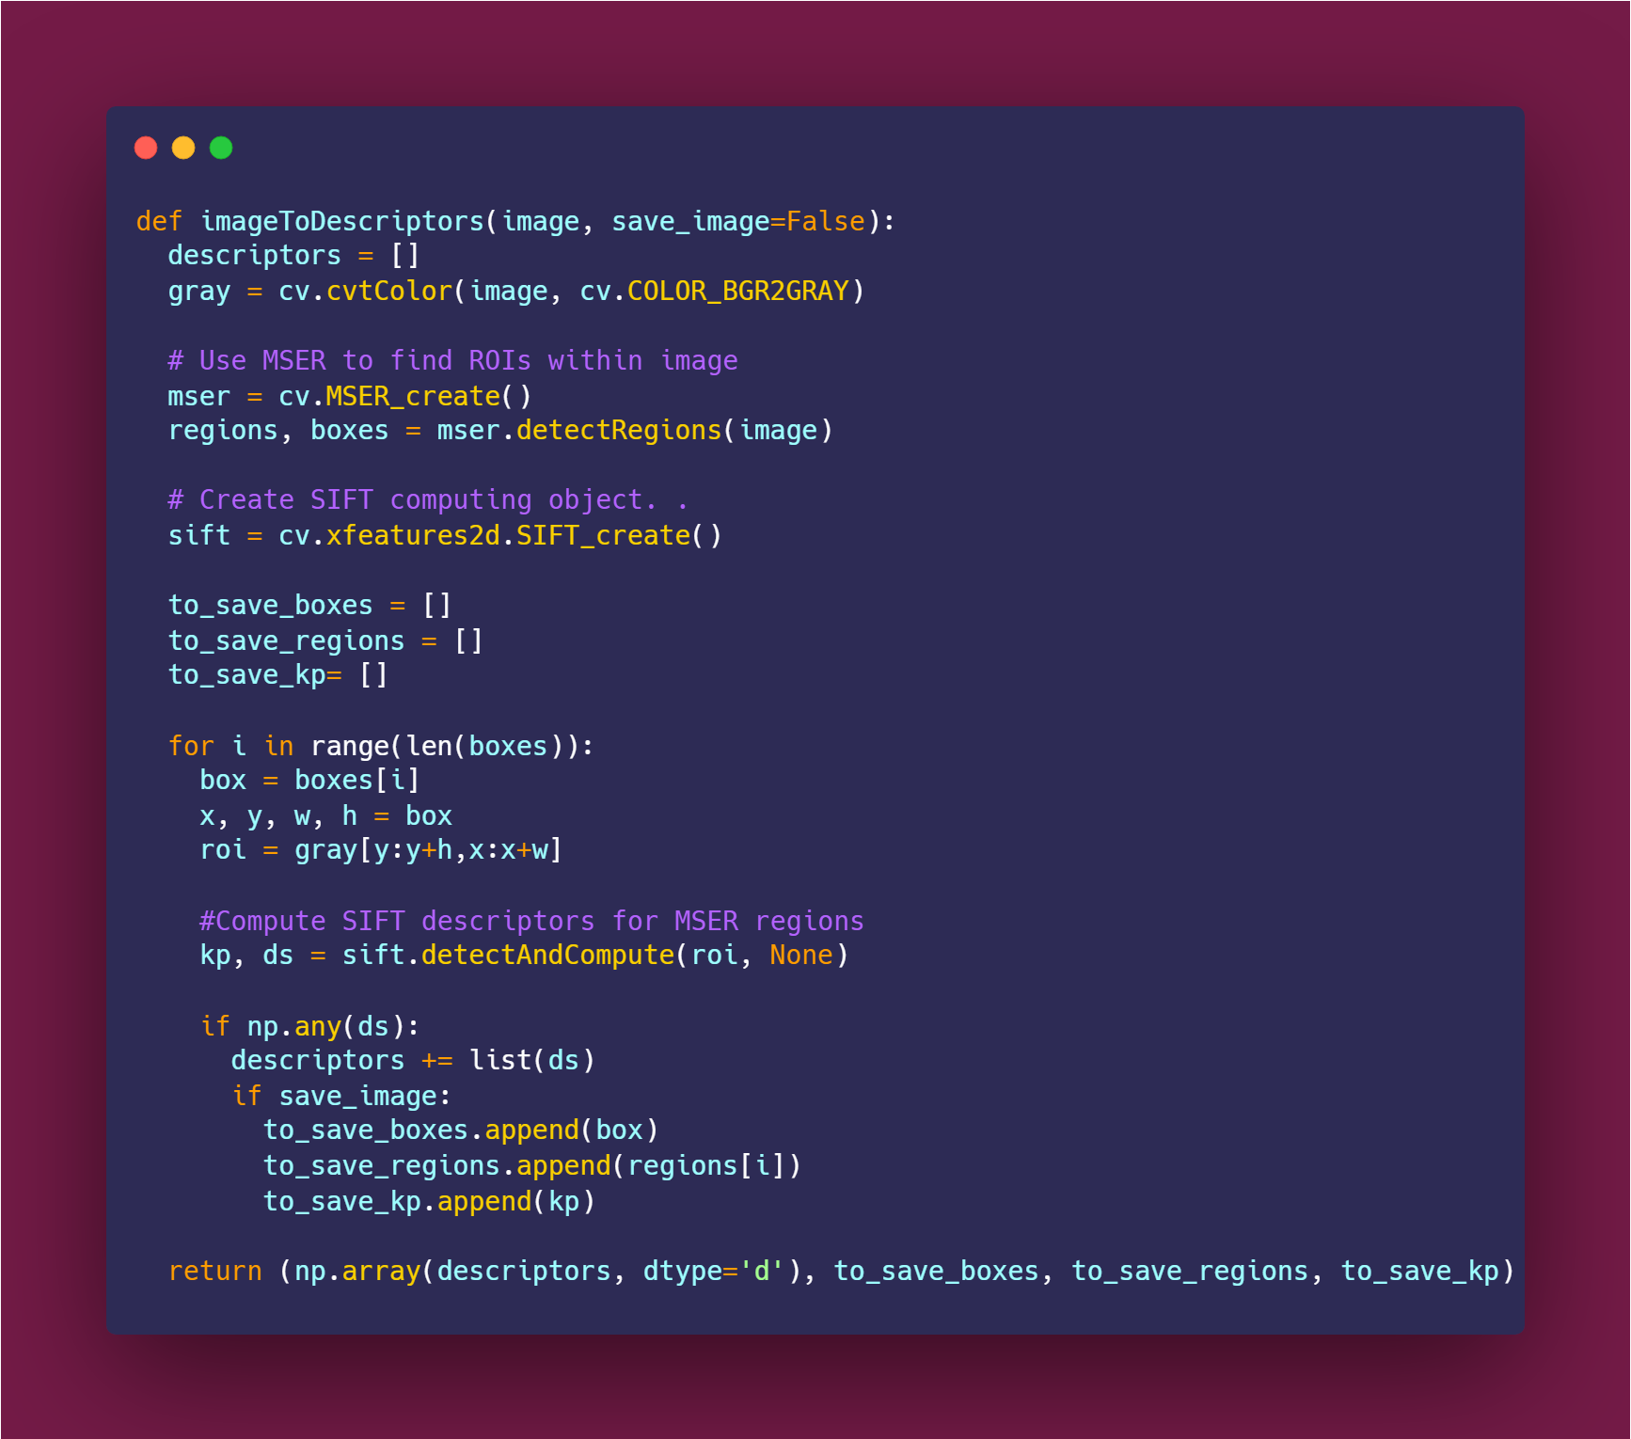
ISPR - MIDTERM 2 - ASSIGNMENT 2
EXTRACT VISUAL DESCRIPTORS
Extract maximally stable extremal regions MSER.
Apply Scale Invariant Feature Transform (SIFT) to regions, obtaining descriptors relative to local features.
Concatenate all the D, non-null, computed descriptors obtaining a tensor of shape D x 128.
Preprocessing
All considered notes were uploaded on a new Google Drive folder and loaded into the Colab Notebook using librosa.load function.
Each extracted time-series was then trimmed, applying again a librosa function to delete “silence” moment (according to a predetermined threshold).
J Matas, O Chum, M Urban, T Pajdla (2004). "Robust wide-baseline stereo from maximally stable extremal regions". Image and Vision Computing. ISSN 0262-8856: 761-767,.
1
David G. Lowe (2004). "Distinctive Image Features from Scale-Invariant Keypoints". Computer Science Department University of British Columbia Vancouver, B.C., Canada
2

Slide 3



ISPR - MIDTERM 2 - ASSIGNMENT 2
CODEBOOK CREATION: CLUSTERING
Each image contains a variable number of descriptors (like a document can contain variable number of words), anyway descriptors just consist in fixed dimension array ( 128 elements for SIFT descriptors), so they can be compared one to each other, using for example, distance metrics.
Idea here is to use a clustering algorithm to create, in unsupervised way, classes of visual descriptors.
In such a scenario, k-means algorithm allow us to maintain a minimal control, imposing the number of clusters. Such number will correspond to the cardinality of the theta vectors , and so will impact on the training (time and quality) of the LDA.
The resulting spit of the data will correspond to our k-visual-term “dictionary”, mapping all the descriptors found until now and also allow us to assign new descriptors to one of the k class, predicting the closest cluster.
K-Means as a minimization problem
Point-centroid distance is the cost function. Euclidean distance has been chosen as cost function for simplicity. Anyway, attempts with other metrics, like the cosine similarity, would surely be reasonable.

Slide 4
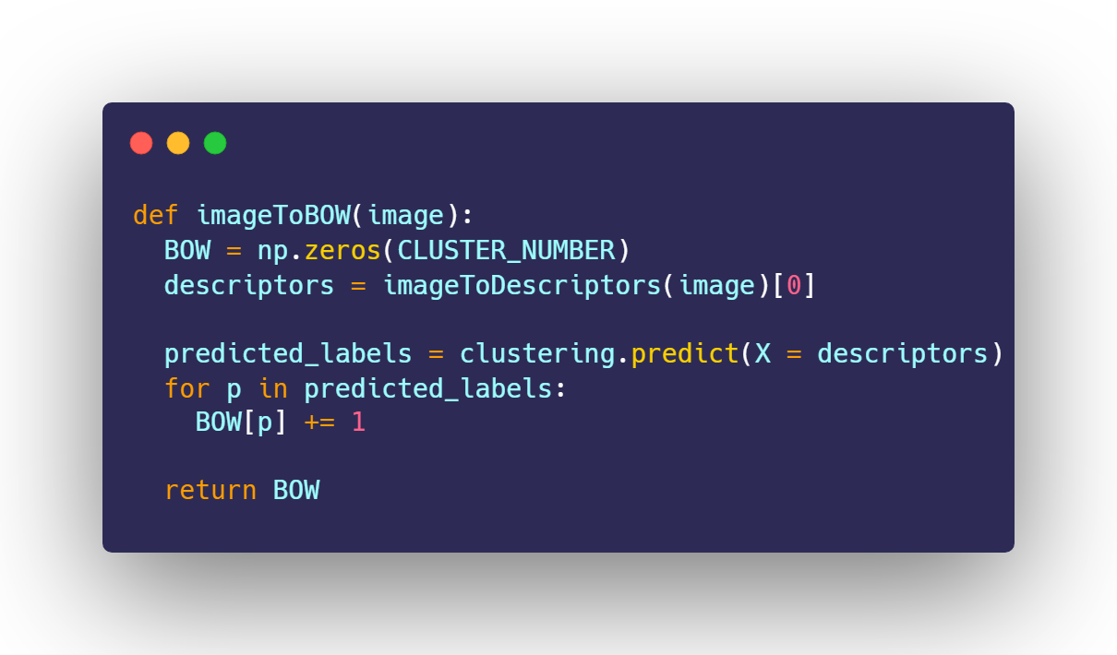
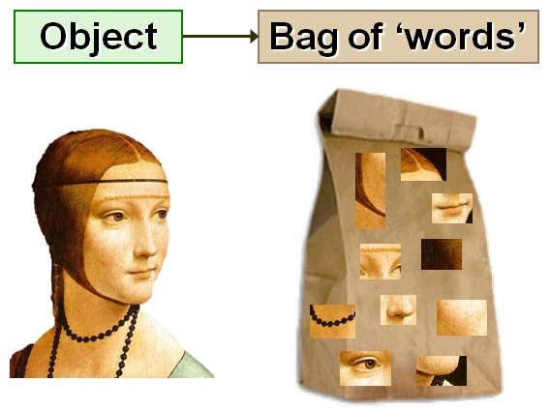
ISPR - MIDTERM 2 - ASSIGNMENT 2
DESCRIPTORS TO BAG OF WORDS
Once our dictionary, mapping descriptors in the R^128 to the K=500 possible words, we are ready to compute a new representation for our images, just counting the occurrences of each cluster instance, obtaining histograms, or probabilities if we divide by total number words of each document.
G. Csurka, C. R. Dance, L. Fan, J. Willamowski, and C. Bray (2004). "Visual Categorization with Bags of Keypoints". Workshop on Statistical Learning in Computer Vision. ECCV 2004
3

Slide 5



ISPR - MIDTERM 2 - ASSIGNMENT 2
LDA - INTUITIVELY
Given a number of topic and eventually some knowledge about their prior distribution (expressed by the alpha parameter), latent Dirichlet allocation allow us to map words space to a latent topic space, basing on the probability distributions observed in the training data.
sklearn implementation has been used, executing 10 iterations.
Alpha parameter was not set, assuming a uniform prior distribution of the topics towards the words (in our case the visual descriptors clusters).
Number of topic was set to 8, according to the number of subset of the dataset.

Slide 6
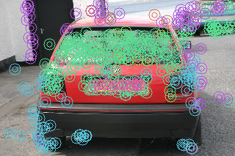
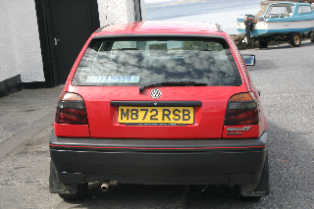
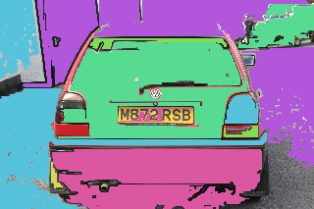
ISPR - MIDTERM 2 - ASSIGNMENT 2
COMMENTING THE RESULTS
LIMITATIONS AND POTENTIALITIES OF THE APPROACH
Visual patches of MSER maybe are too superficial
The method proposed here to compute visual descriptors is certainly fast, but meaningful information risk to be lost … SIFT should be computed at least on the whole image!
Not explainable results
Identified object, regions are associated to abstract topics, assign a precise meaning to them only observing images has not been possible for our cases
Global results seem more interesting than patches
Observing the main topic assigned to each class, we can see that similar images (the ones containing animals, or the ones containing vehicles) are tendentially assigned to the same topic, but such an observation should be better quantified.

Slide 7
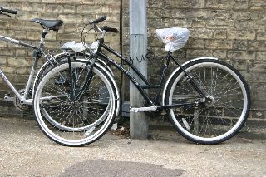
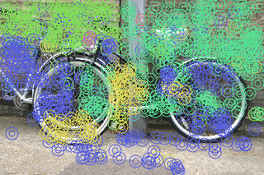
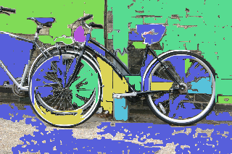
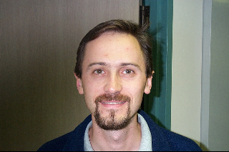
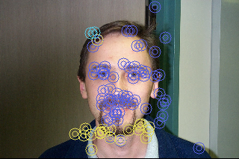
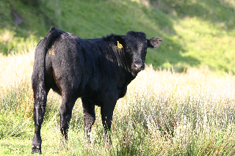
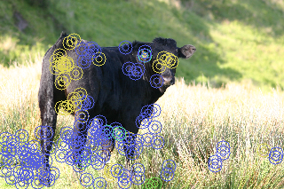
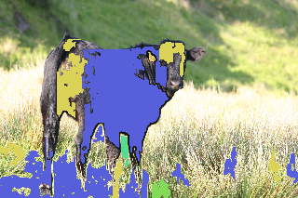
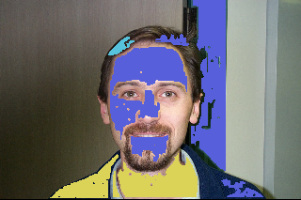
ISPR - MIDTERM 2 - ASSIGNMENT 2
OTHER TEST IMAGES

Slide 8

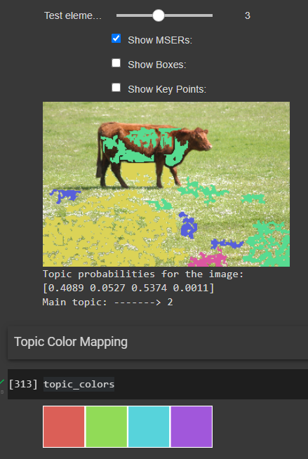
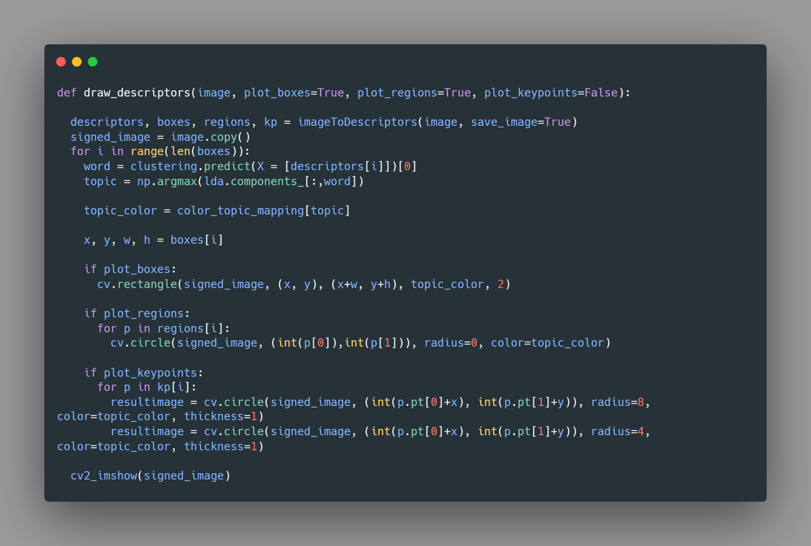
ISPR - MIDTERM 2 - ASSIGNMENT 2
CHECK THE CODE
INTERACTIVE WIDGETS
Thanks to the usage of interactive python Widgets, images can be switched and regions and topics can be observed and other results seen. Different attempt changing hyperparameters can also be done, just changing values of the constant and re-executing the code. An hyperlink in in the Colab Icon.

Slide 9


ISPR - MIDTERM 2 - ASSIGNMENT 2
Feature engineering and problem reformulation
Opportunity to understand importance of feature extraction processes, involving several studied algorithms.
FINAL CONSIDERATION
ABOUT LDA FOR IMAGES AS BOW
Understandable and simple to implement approach, involving instrument familiar concepts coming from affine fields, like natural language processing and information retrieval.
Topic and visual word remain “gray” concepts, not fully explainable in terms of object present in the images. They actually seems to be something useful especially in a data understanding phase, more than for actual image classification tasks, especially without additional information.
Bayesian Learning and mathematics
Direct application of several mathematical concepts, (probabilities, distributions, conditioning, histograms etc… ), which sometimes can appear as “too theoretical stuff”.
FURTHER “WEIRD” IMPROVEMENTS
A more deep model selection can certainly be carried on for the proposed model, experimenting with a pletora of hyperparameters like word and topic number or training iterations. Different sets of the images should be used to build the codebook can be analyzed (something K-Fold like), verifying impact of the sampling.
Maybe some interesting application with a similar approach can be thought for generative tasks.
ABOUT THE ASSIGNMENT

