Slide 1
A BOTTOM UP SENSOR TESTBED
Alumno: Sergio Almendros Díaz
Tutor: Jaume Barceló

Slide 2
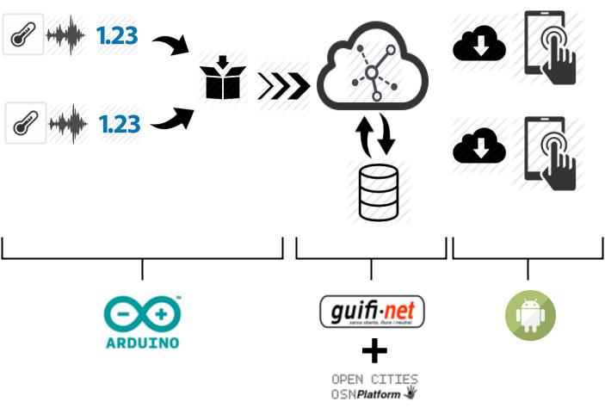
INTRODUCTION

Slide 3
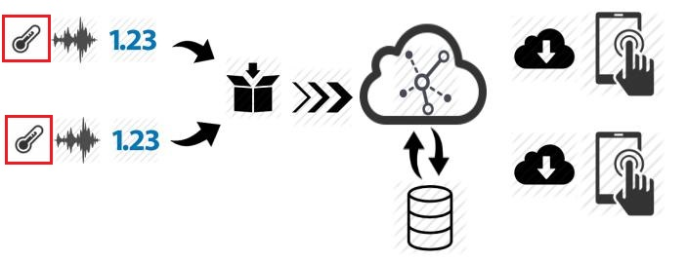
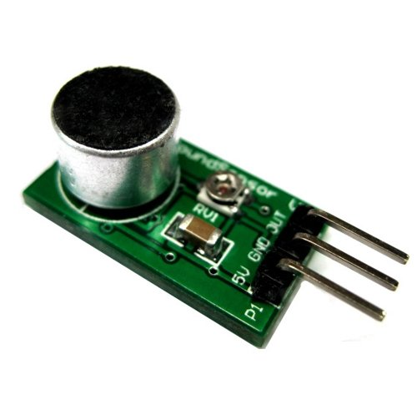
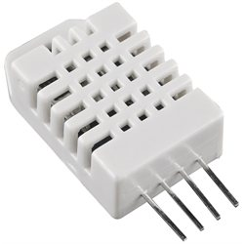
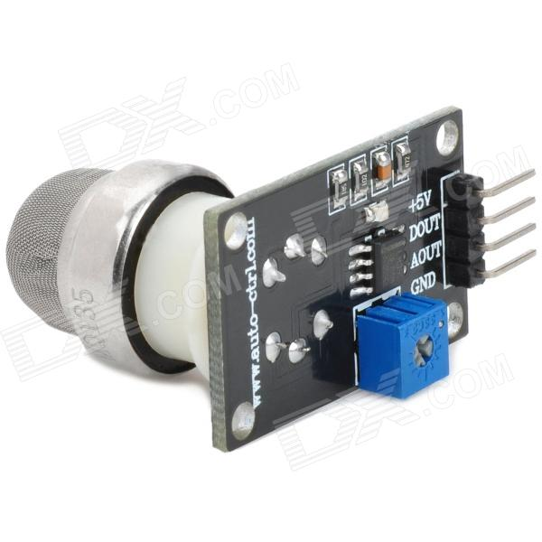
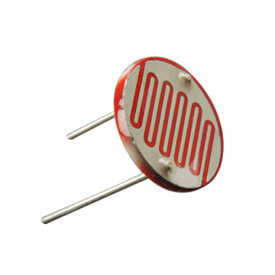
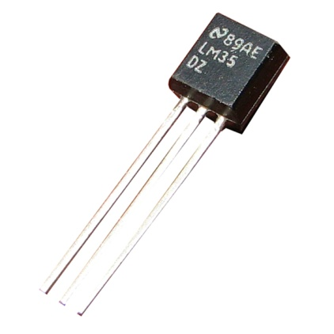
SENSORS

Slide 4
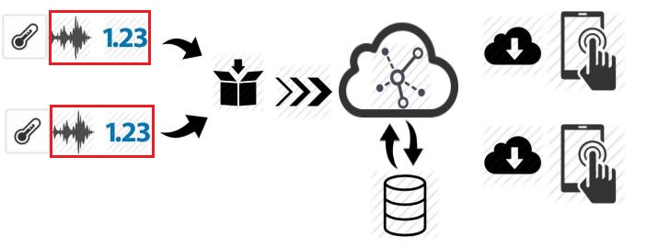
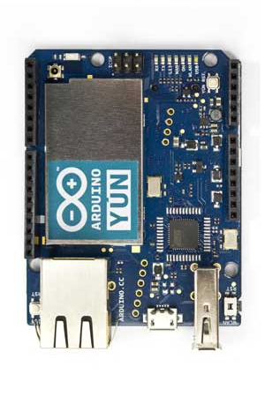
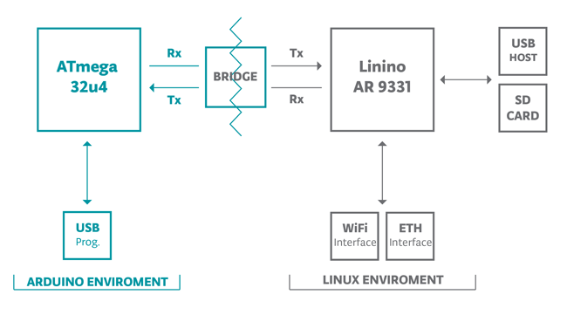
ARDUINO

Slide 5
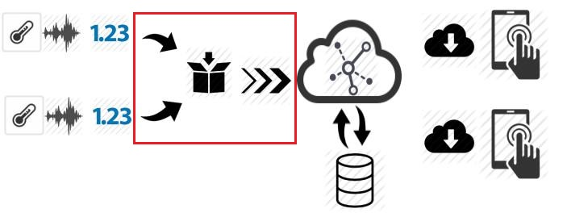
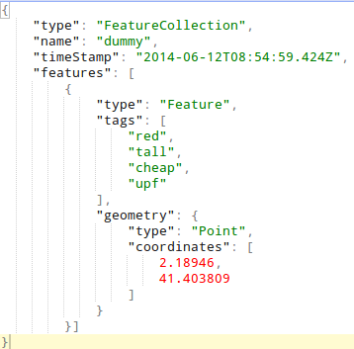
PYTHON
Modular
Fast prototyping
Easier to understand

Slide 6
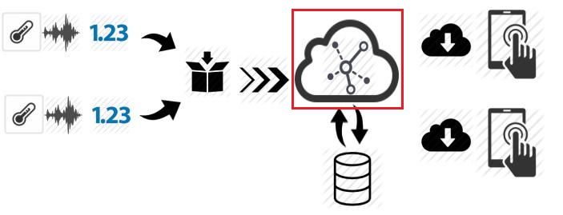
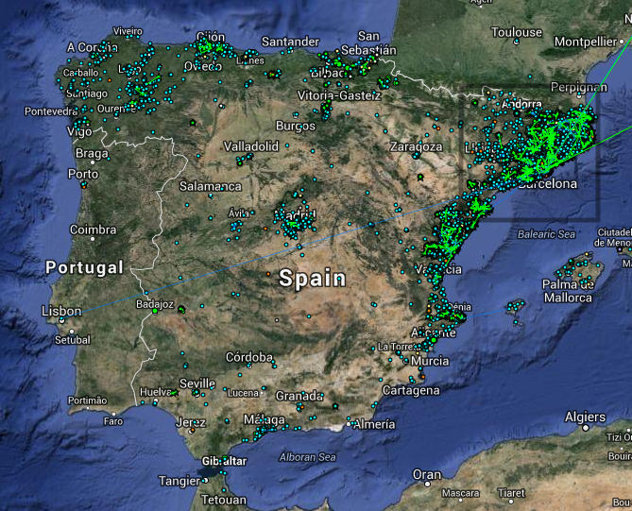
COMUNITY NETWORK
Guifi.
Participation
philosophy.
Open, free
and neutral
network.

Slide 7
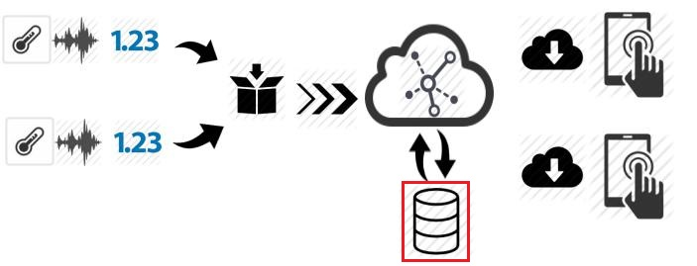


STORAGE RESOURCE BROKER
Opencities (at UPF)
Improving both projects
Intermediary

Slide 8
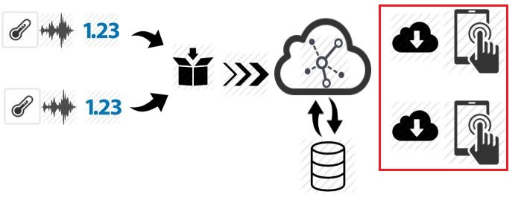
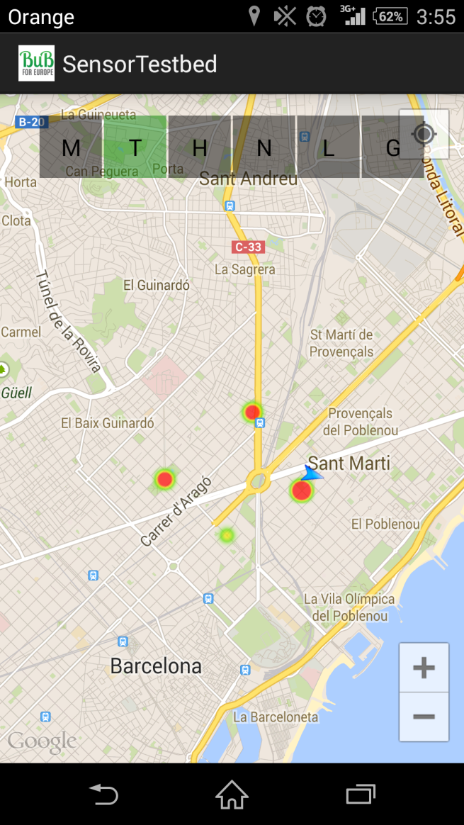
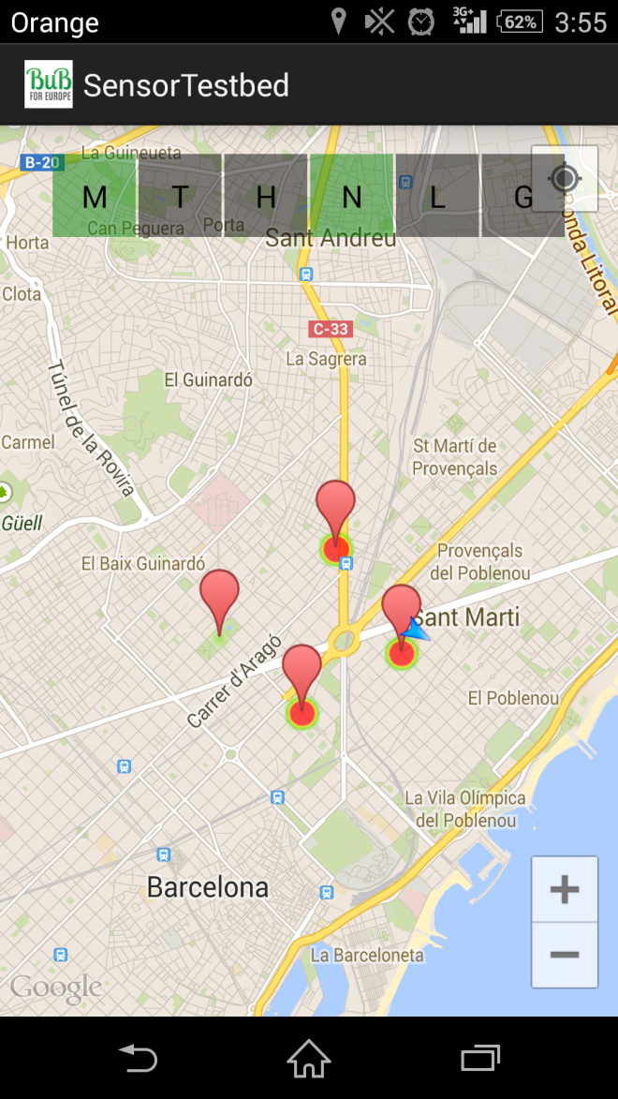
VISUALIZATION PLATFORM
Easy to
understand
Markers and
Heatmap
points
Google
Maps and
utility library

Slide 9
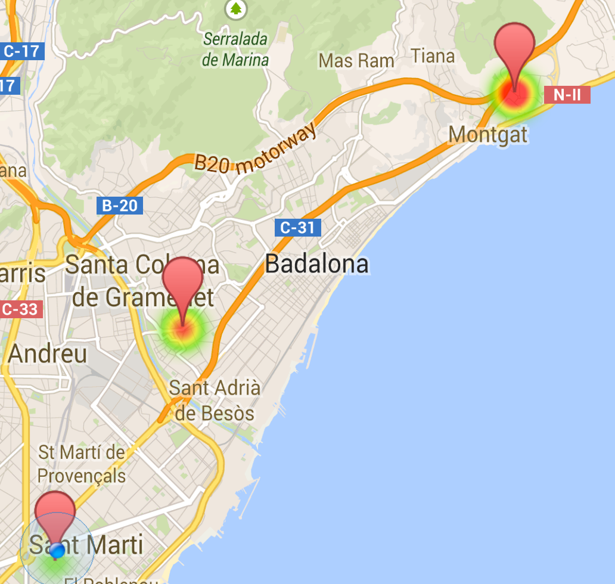
TESTBED
Free space
Different locations
Display the data
into some graphs

Slide 10
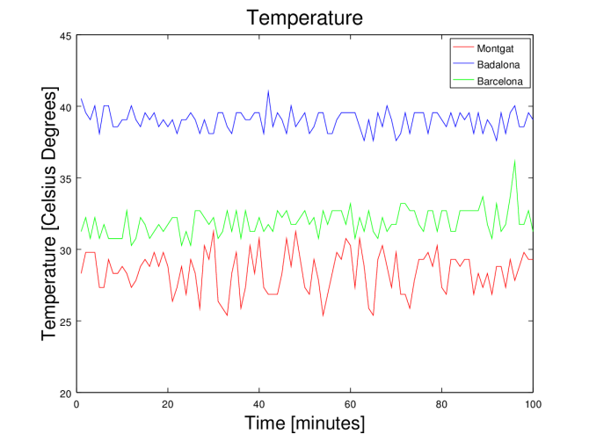
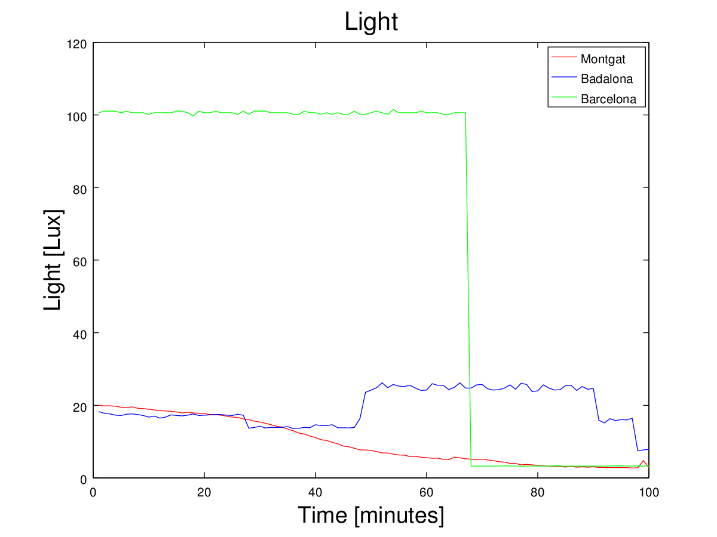
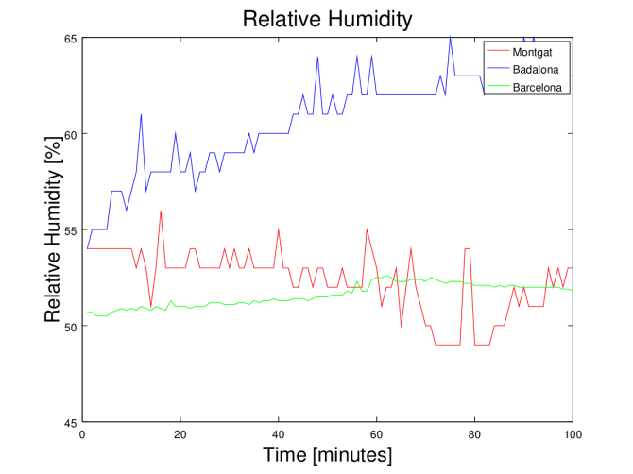
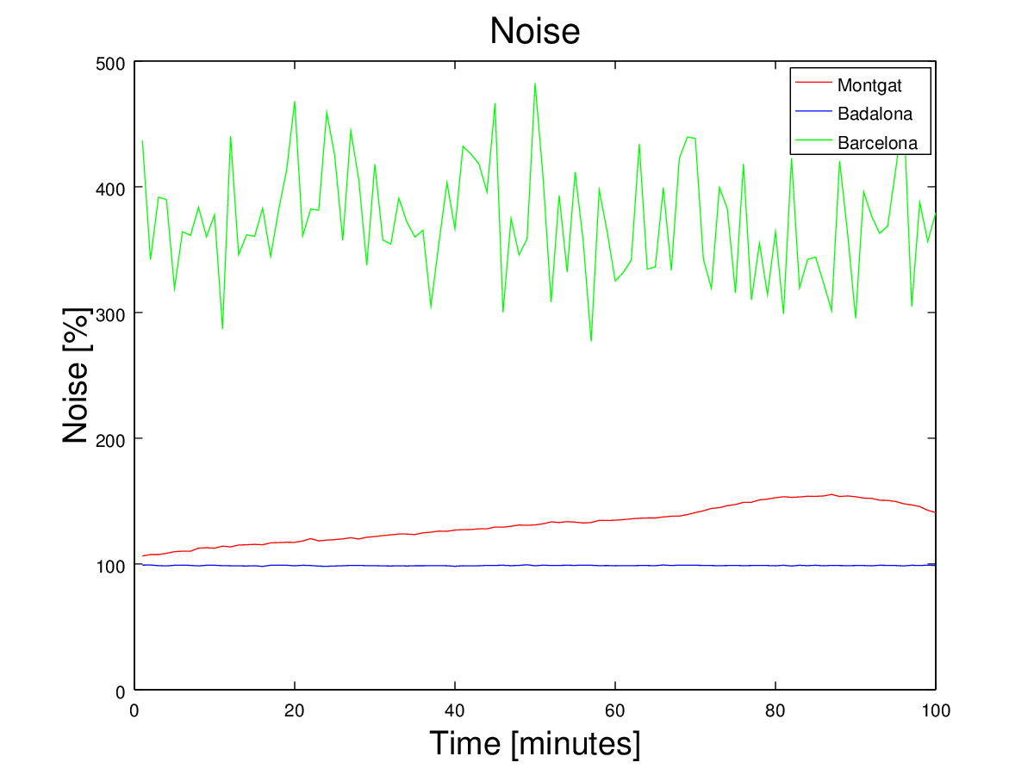
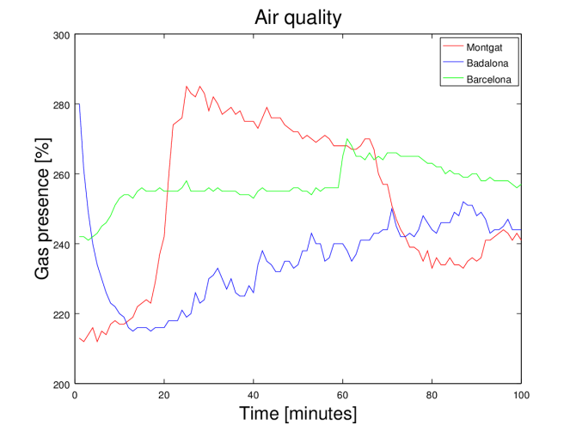
TESTBED RESULTS

Slide 11
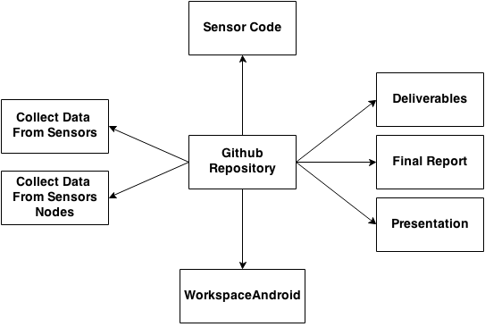
REPOSITORY

Slide 12
CONCLUSIONS
Deployment
Inexpensive
Open source
Mobile App
Github Repository
Goals Accomplished

Slide 13
FUTURE WORK
Can be improve
Build a prototype
PoE
Improve Android App
Diffuse

