Slide 1
A BOTTOM UP SENSOR TESTBED
Student: Sergio Almendros Díaz
Supervisors: Jaume Barceló and Davide Scaini

Slide 2
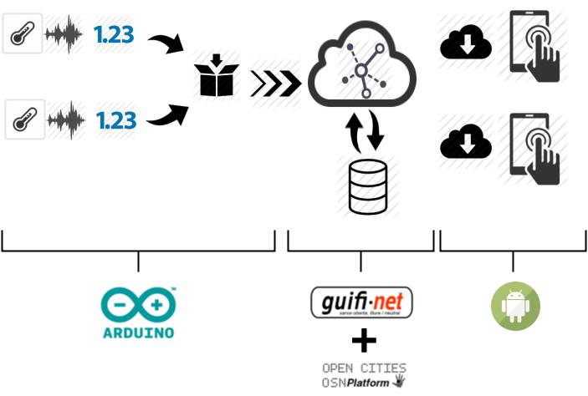
INTRODUCTION

Slide 3
Wireless Sensor Networks

Slide 4
Bottom Up Pattern

Slide 5
Outline

Slide 6
State of the Art
Smartcities

Slide 7
State of the Art
Companies

Slide 8
State of the Art
Open Data

Slide 9
State of the Art
Sensor Boards

Slide 10
Technology
Arduino YUN

Slide 11
Technology
Sensores

Slide 12
Technology
Upload Sensor Data

Slide 13
Technology
Community Network

Slide 14
Technology
Storage Resource Broker

Slide 15
Technology
Visualization Platform (Android App)

Slide 16
Testbed
What is a Testbed

Slide 17
Testbed
Goals

Slide 18
Testbed
Map scenario

Slide 19
Testbed
Results

Slide 20
Conclusions

Slide 21
Future Work

