Slide 1
A BOTTOM UP SENSOR TESTBED
Student: Sergio Almendros Díaz
Supervisors: Jaume Barceló and Davide Scaini

Slide 2
Outline
Introduction
State of the art
Technologies
Testbed
Conclusions
Future Work

Slide 3
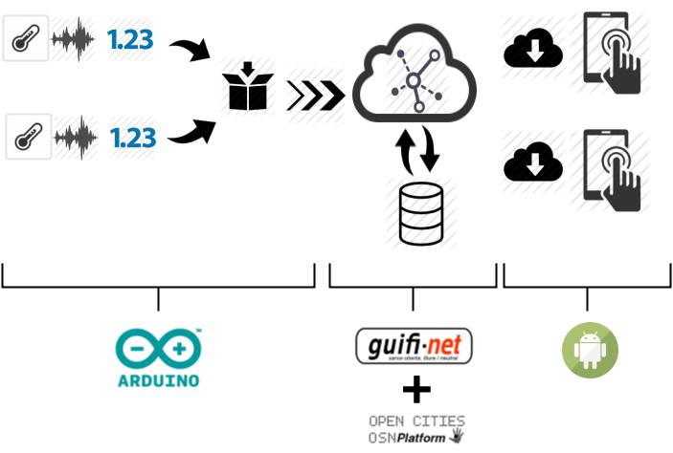
INTRODUCTION
/21

Slide 4
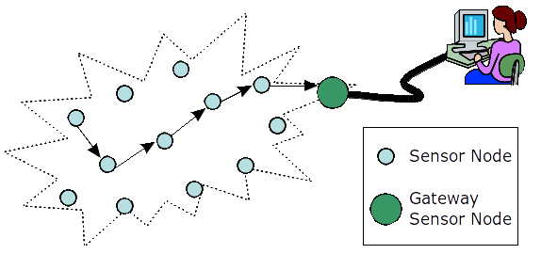
INTRODUCTION
Wireless Sensor Networks
A network composed of nodes.
A node:
  Is composed of a computer and sensors.
  A node has equipped wireless technology to create ad-hoc networks.
/21

Slide 5

INTRODUCTION
Bottom Up Broadband (BuB)
BuB defines network design, deployment and operation initiatives driven by end user needs.
These end users can be individuals, companies or institutions.
In BuB, those that need the network are the ones that take the initiative and participate in the organization and funding of the project
http://bubforeurope.net/
/21

Slide 6

State of the Art
Smartcities
A city capable of having real-time information.
Amsterdam:
  Flexible street lighting
  Smart parking
Santander:
  Environmental monitoring
  Traffic Intensity Monitoring
/21

Slide 7
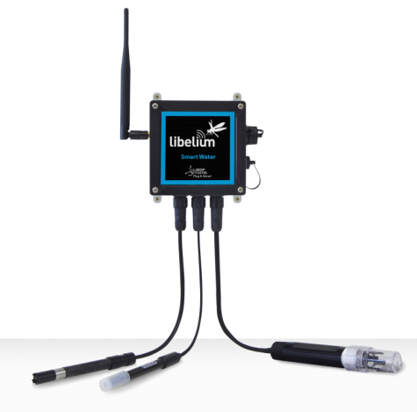
State of the Art
Companies
Smartcitizen is a platform that offers a sensor board based on Arduino to monitor the environment.
Libelium is an Internet of things platform provider, which supplies an open source sensor platform for the Internet of things.
Libelium Smart Water
/21

Slide 8
State of the Art
Open Data
The term Open data pursues the fact that certain types of data should be available for anyone to use, without any control mechanism, e.g. copyright.
Opencities, Xively and Sentilo are platform that allow the user to upload and download data.
/21

Slide 9
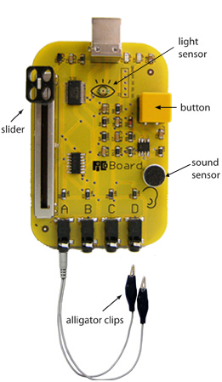
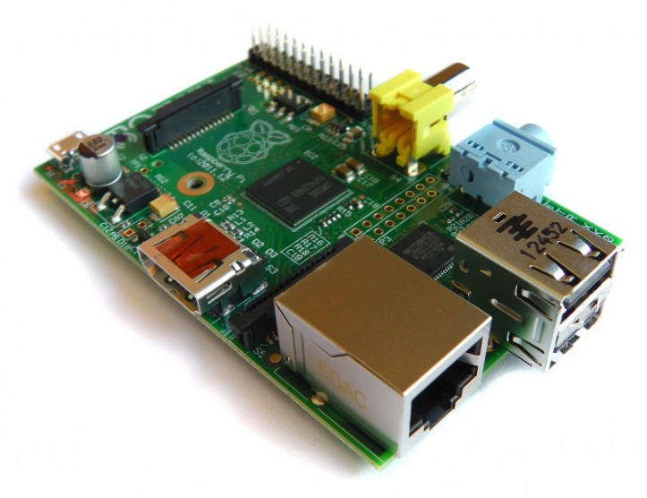
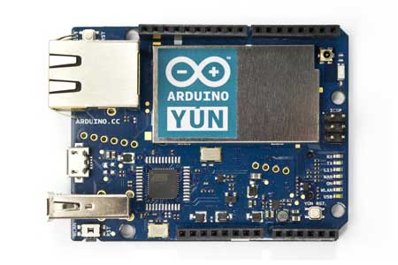
State of the Art
Sensor Boards
Some options for the sensor node:
Arduino YUN
Arduino YUN
Raspberry Pi model B
Picoboard
/21

Slide 10
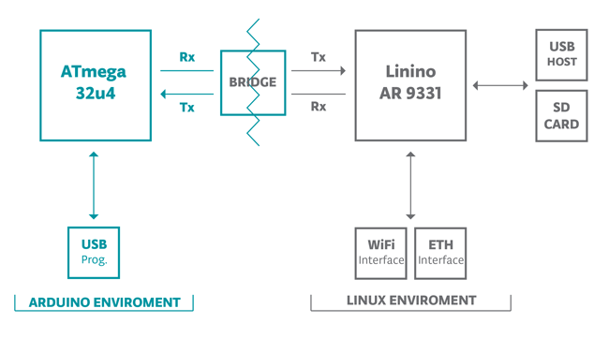
Technology
Arduino Yun
Micro controller board with two processors.
Has an Ethernet and WiFi module.
Arduino sketches can communicate with the Linux processor through the Bridge library
Arduino YUN Bridge
/21

Slide 11
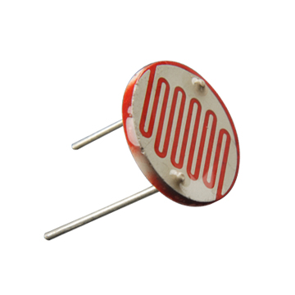
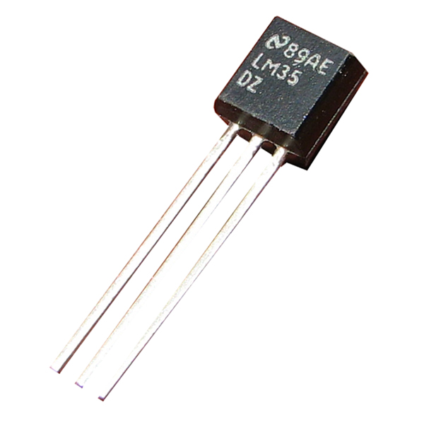
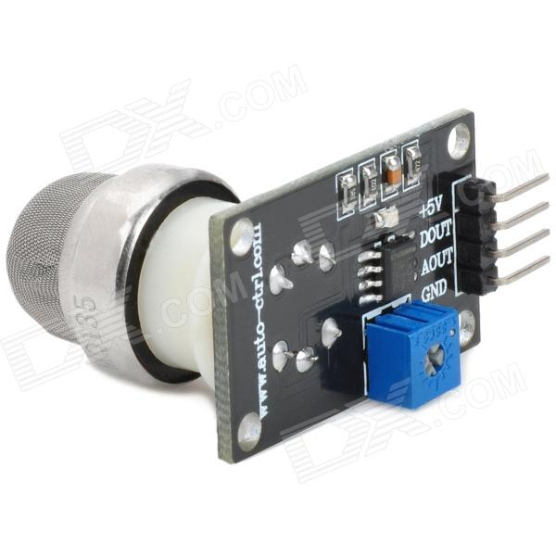
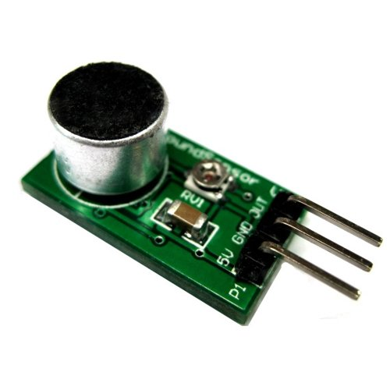
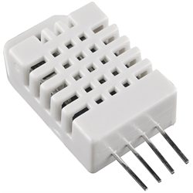
Technology
Sensors
The goal is to analyze the environment.
These sensors measure the aspects that may be more useful for citizens:
Temperature
Light
Noise
Humidity
/21
Air Quality

Slide 12
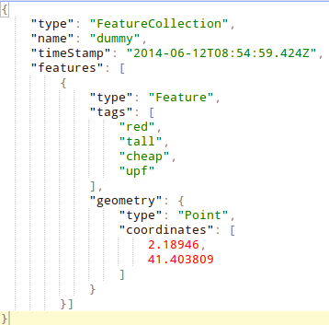
Technology
Upload Sensor Data
Upload the data from the sensors to a platform so that everyone can access them.
A GeoJSON message includes data from the 5 sensors.
A Python script has been used to upload this message.
GeoJSON message
/21

Slide 13
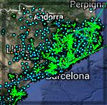
Technology
Community Network
Is a network created and used by a community.
Guifi is a network created by people interested in building an open, free and neutral network infrastructure.
Guifi is the network where
the Arduino nodes will be
deployed.
Guifi Nodes
/21

Slide 14

Technology
Storage Resource Broker
The entity that storage the sensor data and is between the sensor network and the android App.
Opencities is the opendata service that has been chosen:
  The developers are at UPF, so the process of improving both projects (feedback, bug fixing, etc) can be fast and effective.
  Easy API to upload and download the data.
/21

Slide 15
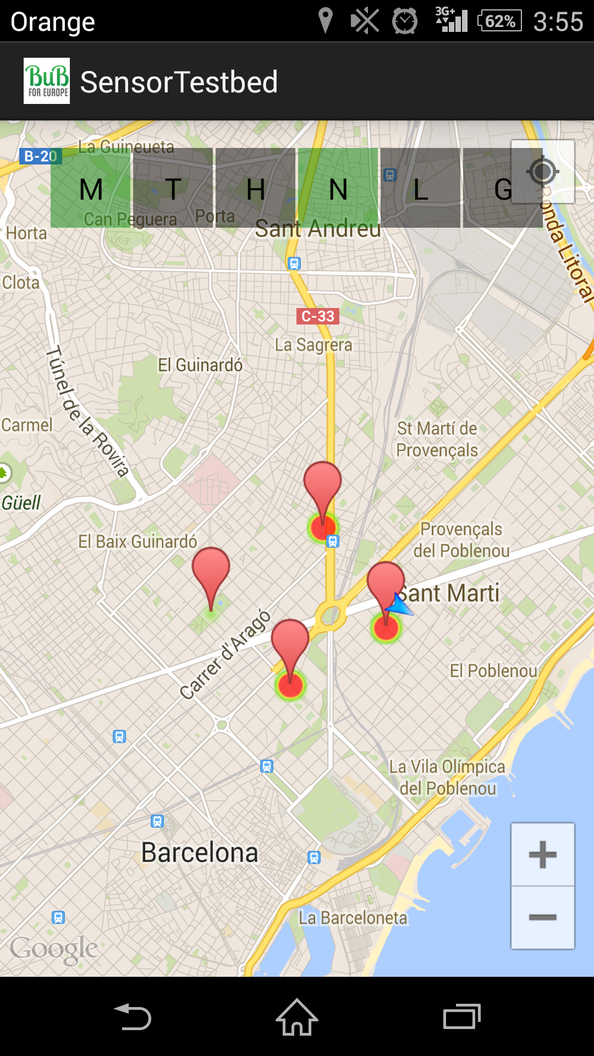
Technology
Visualization Platform
A map is used to display the data.
The goal is that a user checks it for a small period of time.
The Android operating system has been chosen.
Android App
/21

Slide 16
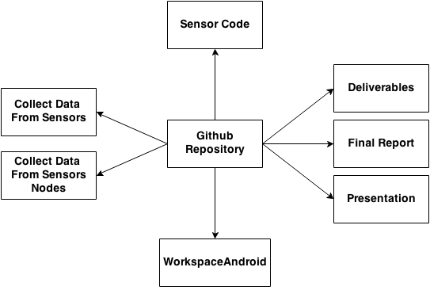
Repository
All the code, report, figures, etc has been stored in a public repository.
Github.com/SergioAlmendros
/21

Slide 17
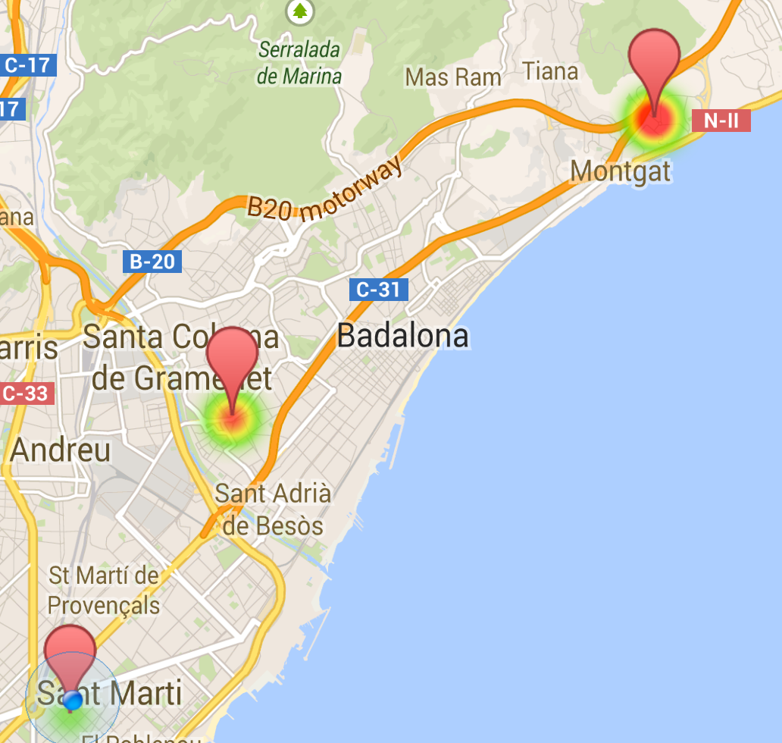
Testbed
A Testbed is a platform for experimentation of new technologies, scientific theories...
For this project, only three nodes had been deployed:
Testbed Nodes
/21

Slide 18
Testbed
Results
A Sensor Network has been deployed.
The data has been stored on as opendata.
A mobile application has been made.
A graphs has been made to show the collected data
/21

Slide 19
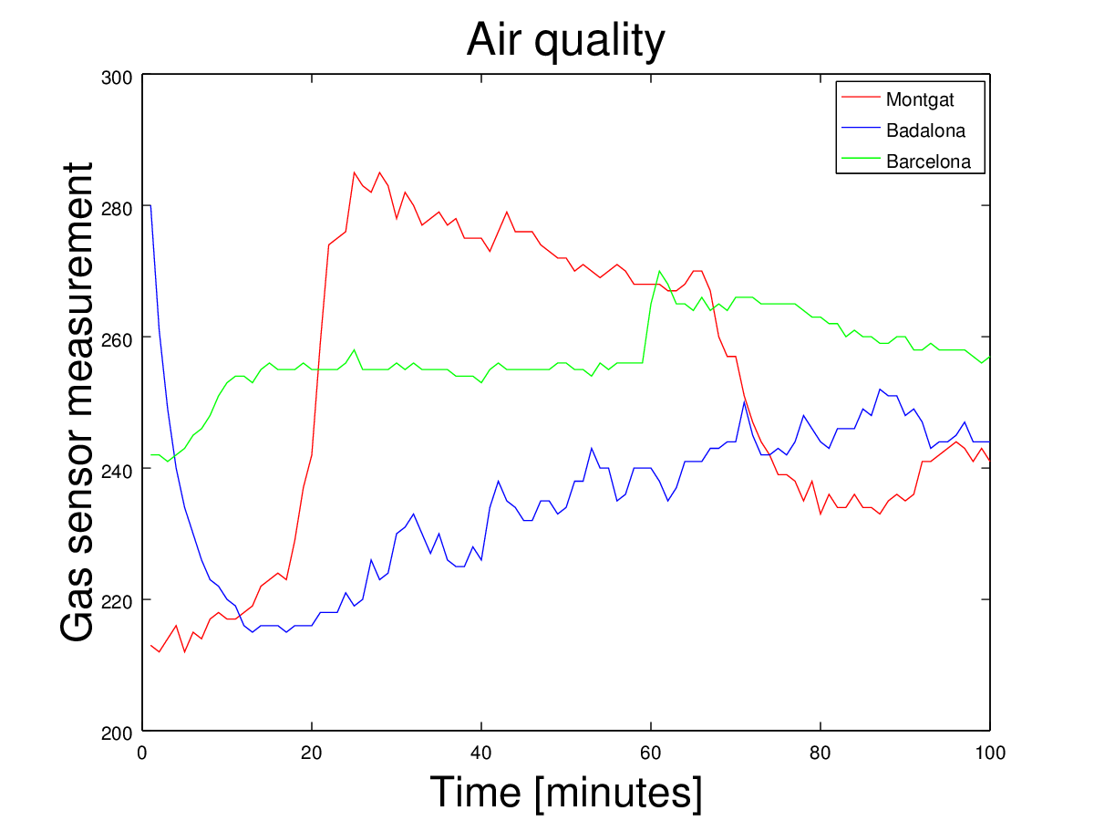
Testbed
Results
/21

Slide 20
Conclusions
The deployment of the sensor network has been successful
It has been shown that anyone can deploy its own network in an inexpensive way
A mobile application has been developed to serve as an example
The project had satisfied the goals presented at the start
/21

Slide 21
Future Work
Build a prototype.
Make the Arduino Power over Ethernet.
The mobile application showed some issues.
Show how the data changes during a period of time.
Diffuse the project.
/21

