Slide 1
The Penguin Ghetto

Slide 2
Before going through
What is the The Penguin Ghetto?
Background
Like Why?
How will it work?
How does it look?
Which tools we are going to use?

Slide 3
What is the penguin ghetto
The Penguin Ghetto is an online platform shaped as a videogame, where people can interact between each other in a funny way.
Users need to create an account to be able to wander through the lands of The Penguin Ghetto behind the skin of their personalized penguin.
Brings the possibility to interact between online users, chat and play with them.

Slide 4

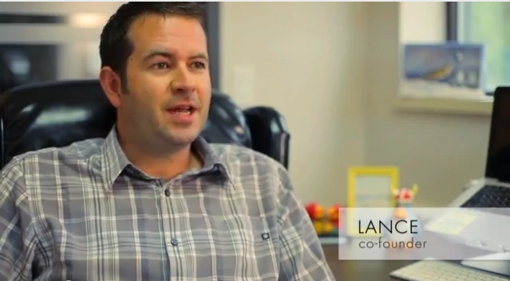
Background
Back in 2003 Lance Priebe and Lane Merrifield saw the need to create a social network for kids...

Slide 5
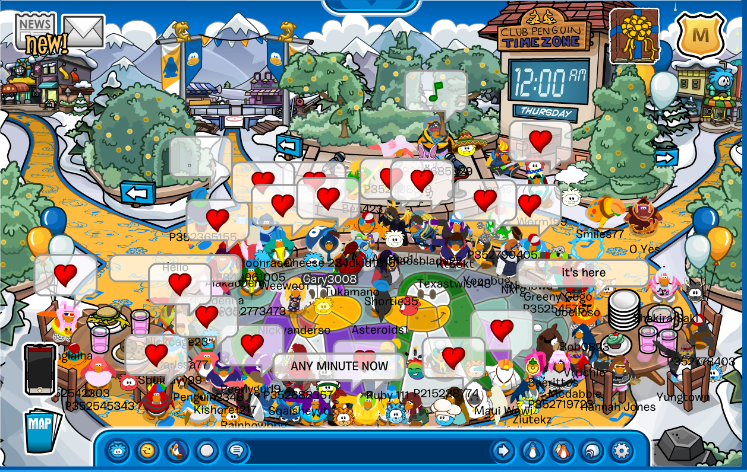
And thus…
It was a major success worldwide. Createing a full community of younglings.

Slide 6
Until fortnite…
Club Penguin set to close, breaking millennial hearts worldwide.
On march 30th of 2017 all Club Penguin servers went down.

Slide 7
Like Why?
Club Penguin was one of the most successful online communities ever existed. Making over 200 million users over its lifespan.
There were 8.5 million users online at its peak.
It’s a great idea that went down.

Slide 8
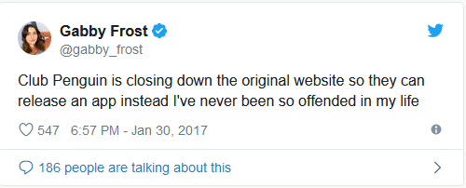
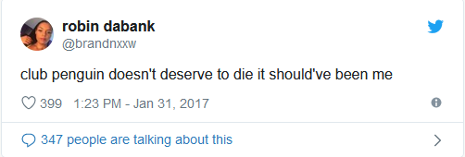
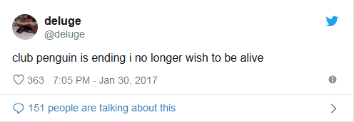
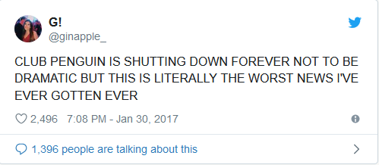
The Town Speaks

Slide 9
How will it work?
You can tap to choose to chat, walk or throw a snowball.
Create your account, personalize your penguin and login

Slide 10
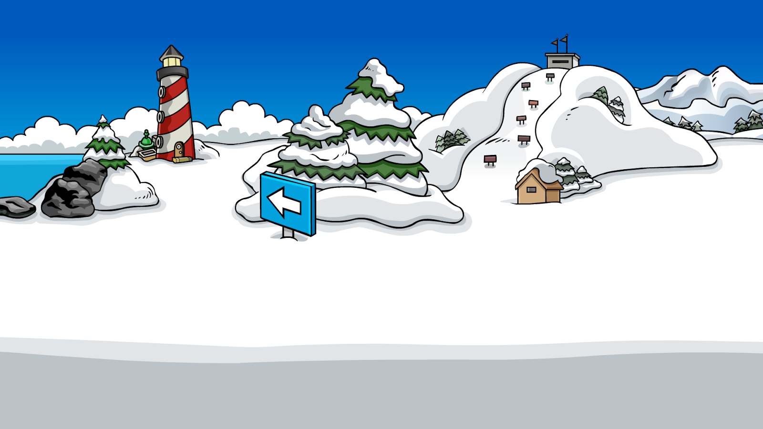





How will it look?
C’mon Jimmy

