Slide 1

The Future is on GOING
Open Source Infrastructure for Fair Commerce A protocol to power the next generation of e-commerce on Solana.
going.m.place@gmail.com

Slide 2
A $25.93T Global E-commerce Market is Fundamentally Broken
High Commissions.
15-30% fees that crush seller margins and increase buyer costs.
No Ownership
Users don't own their data or have control over their digital identities and assets.
Centralized Fragility
Opaque rules, censorship, and single points of failure risk the integrity of the ecosystem.

Slide 3

A Protocol, Not Just an App
Fair Commission
A protocol-level fee of 3% is enabled by blockchain efficiency, drastically cutting costs for both buyers and sellers.
Real Ownership
Value is shared back with the community via $G rewards, creating a system where users are also stakeholders.
Open Source Foundation
We're building an open-source protocol for others to build upon, fostering a global ecosystem of fair commerce.

Slide 4
Built for Solana, Impossible Elsewhere
Speed for Commerce
Solana's high-speed transactions (65,000 TPS) provide an instant user experience, crucial for real-world commerce.
Low Costs
Our low-commission model is only viable and scalable thanks to Solana's near-zero transaction fees.
DeFi Composability
We leverage Solana's liquid staking ecosystem to create our core innovation: a 'Yield-Bearing Escrow'.

Slide 5

The Core Innovation: Yield-Bearing Escrow
A unique trust mechanism that transforms traditional escrow into a yield-generating system.
Purchase
Buyer initiates a purchase. Funds are locked in our protocol.
Staking & Yield
Funds are automatically staked in a liquid staking pool (like JitoSOL), generating yield.
Delivery Confirmed
The buyer scans a QR code to confirm delivery.
Payment Released
Payment is released to the seller.
The yield from staking is used to back and distribute rewards in our native token, $G.
This creates a powerful incentive for sellers.
It ensures a sustainable token economy.

Slide 6
Our Commitment to the Ecosystem.
A 100% open-source smart contract protocol.
A public security audit report from a reputable firm.
Comprehensive developer documentation.
A functional demo application on Devnet.

Slide 7

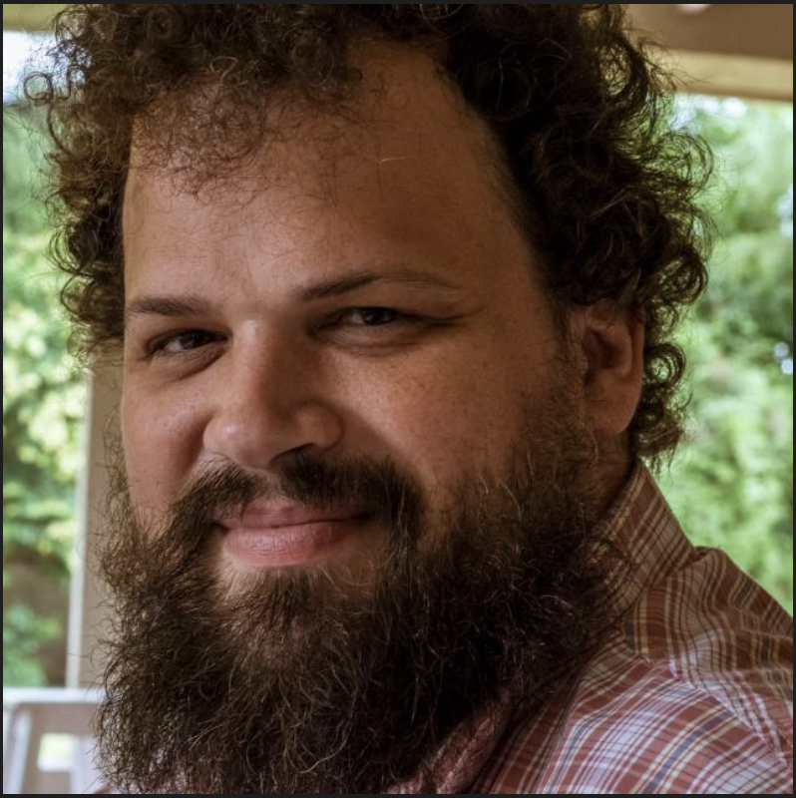


The Team
My vision for GOING was born from direct experience with a core problem. I began my career in wholesale, where I felt the pressure of high commissions from large platforms firsthand. I learned to code to build the solution I always wanted as a seller: one that treats its users as true partners.
To ensure technical excellence, I am supported by Juan Marchetto as a respected Technical Advisor.
I am also currently supported by a Director of Content and a UI/UX Designer, who have been integral in getting the project to this stage. This funding round will allow us to hire full-time talent to fill these critical roles and scale the team.
Sergio Ariel Solis Founder / Dev
Juan Marchetto Tech Advisor
Eliana Solis Director of Content
Giselle Solis Designer

Slide 8
Our Plan to Deliver Value
This timeline begins once the core development team is formally hired.
Onboarding & Protocol Architecture
Formal team kick-off. Finalize the technical litepaper and publish the public GitHub repository.
Core Protocol Development
Implement the core logic of the Yield-Bearing Escrow and the $G rewards mechanism. Complete internal testing on Devnet.
Audit & Refinement
Submit the smart contract for a full security audit by a reputable firm. Refine the demo application based on initial feedback.
Launch & Publication
Finalize the audit report. Publicly launch the open-source protocol and publish comprehensive developer documentation.

Slide 9
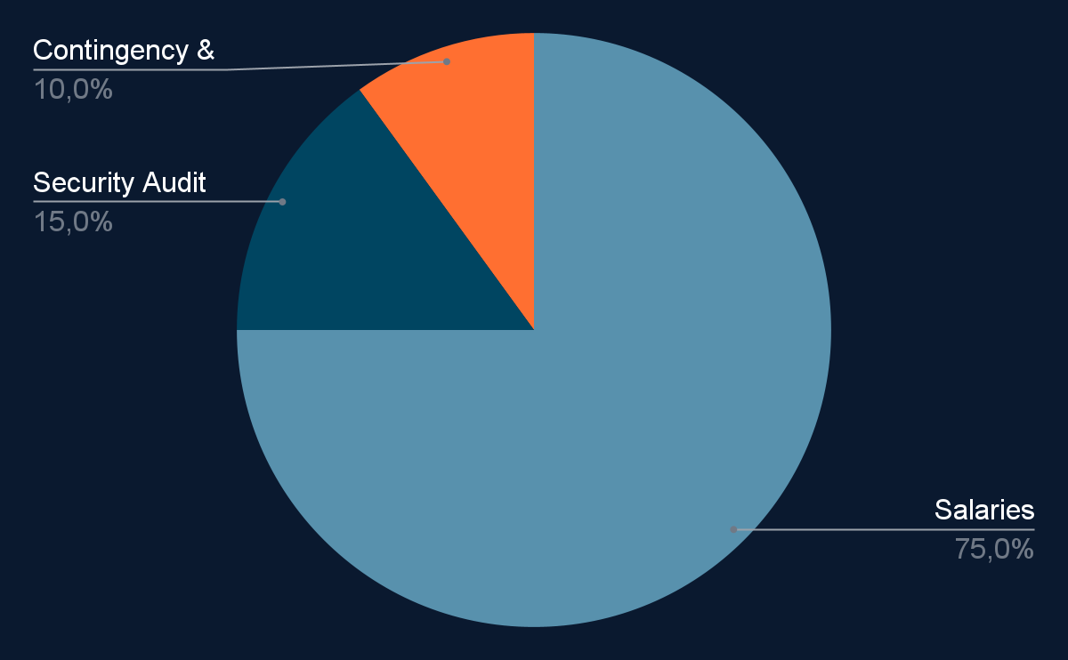
The Grant Request
$165,000
To fund a focused 5-month development sprint
*This grant will be structured as a milestone-based agreement.

Slide 10
The Future:
An Ecosystem of Commerce on 'Going
By funding this core infrastructure, you enable a new wave of fair commerce applications on Solana. Our success is directly tied to the ecosystem's growth, and we are committed to building a tool that helps it thrive.
Sergio Ariel Solis | going.m.place@gmail.com | going-taupe.vercel.app

