Slide 1

BRAND ASSET SYSTEM
Logo usage guide
Editable standards for safe use and digital implementation
VERSION 2.0 | SEPTEMBER 2026
CYTRIA BRAND ASSETS | VERSION 2.0
01

Slide 2
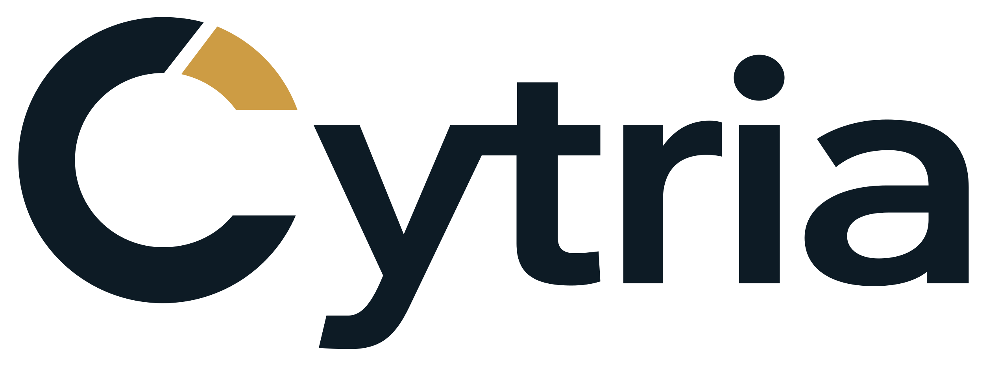
01
Approved logo versions
Always select the artwork designed for the background beneath it.
PRIMARY | ON LIGHT
REVERSED | ON DARK
Use SVG as the production master. One-colour variants are reserved for constrained reproduction.
CYTRIA BRAND ASSETS | VERSION 2.0
02

Slide 3




02
C symbol and social profiles
Use the C when the full name would be too small, repetitive or visually constrained.
C SYMBOL | LIGHT
C SYMBOL | DARK
SOCIAL PROFILE RULE
Use the prepared square masters. Their built-in padding protects the mark when platforms apply circular or rounded crops.
CYTRIA BRAND ASSETS | VERSION 2.0
03

Slide 4
03
Colour palette
Use the defined values rather than sampling compressed screenshots or social images.
CYTRIA NAVY
CYTRIA GOLD
OFF-WHITE
WHITE
#0D1B25
#CD9C44
#F7F8F6
#FFFFFF
RGB 13 27 37
RGB 205 156 68
RGB 247 248 246
RGB 255 255 255
COLOUR INTEGRITY
Keep the gold segment consistent across every application. Use flat colours for reliable reproduction, crisp small-size rendering and predictable contrast.
CYTRIA BRAND ASSETS | VERSION 2.0
04

Slide 5
04
Clear space and minimum size
Give the identity enough room to remain recognisable, calm and authoritative.
CLEAR SPACE
Maintain empty space equal to the width of the main C stroke around every side. Social masters already include crop-safe padding.
MINIMUM SIZE
Full logo 120 px digital / 30 mm print
C symbol 24 px digital
Bicolour C 32 px preferred
Below 32 px Use favicon assets
CYTRIA BRAND ASSETS | VERSION 2.0
05

Slide 6
05
Forbidden usage
Consistency protects recognition and prevents the identity from becoming visually unstable.
• Do not stretch, compress, rotate, skew, crop or rearrange the artwork.
• Do not recolour, resize or reposition the gold segment.
• Do not recreate the wordmark using live text or a substitute font.
• Do not add shadows, glows, outlines, gradients or decorative effects.
• Do not use navy on dark backgrounds or white on pale backgrounds.
• Do not place the logo over busy photography without a clean holding area.
• Do not violate the clear space or use illegibly small artwork.
• Do not use the original raster preview as a production master.
Photography: use a quiet high-contrast area or a controlled navy/off-white holding surface.
CYTRIA BRAND ASSETS | VERSION 2.0
06

Slide 7
06
Website implementation
Keep the full lockup as one SVG image. Do not combine a C image with typed text.
NEXT.JS HEADER
HEADER AND FOOTER
Use the on-light SVG on pale surfaces and the on-dark SVG on navy or dark surfaces. Preserve the SVG viewBox and natural aspect ratio.
<Image
src="/brand/cytria-logo-on-light.svg"
alt="Cytria"
width={190}
height={70}
priority
/>
FAVICON SYSTEM
Copy the Web folder into the public directory. Reference favicon.svg, apple-touch-icon.png and site.webmanifest in the application metadata.
The SVG favicon adapts for dark browser themes while retaining Cytria Gold.
CYTRIA BRAND ASSETS | VERSION 2.0
07

Slide 8
07
File selection
Use the master appropriate to the application and avoid uncontrolled duplicates.
01
MASTER SVG
Preferred production source
02
PNG
Transparent document fallbacks
03
SOCIAL
Crop-safe profile images
04
WEB
Favicons, touch icons and manifest
05
GUIDELINES
Governance and handoff
SOURCE OF TRUTH
Derive new exports from the supplied SVG masters. Record geometry or colour changes as a new kit version.
CYTRIA BRAND ASSETS | VERSION 2.0
08

