Slide 1
OPA – online Purchase application
Kids team MeMBERS:
300966930 – Aman preet kaur
300960367 – Fernando ito
300964037 – santhosh damodharan
300910506 – SERGIO DE ALMEIDA BRUNACCI

Slide 2
Agenda
Scope
Login
Customer View
Employee View
Show the App
Test – Issues

Slide 3
scope
Main activity with two login options one for customers and other one for shipment clerk.
Customers and Clerks username will be stored in Shared Preferences after successful login.
Create another activity that allows customers to place an order.
Customers can display or view the order information once they placed an order successfully.

Slide 4
Scope
Shipment clerk can view all the customer’s orders.
Customers can change the order details for a certain period after placing an order.
Clerks can update the status values “In-Process” into “Delivery”.

Slide 5
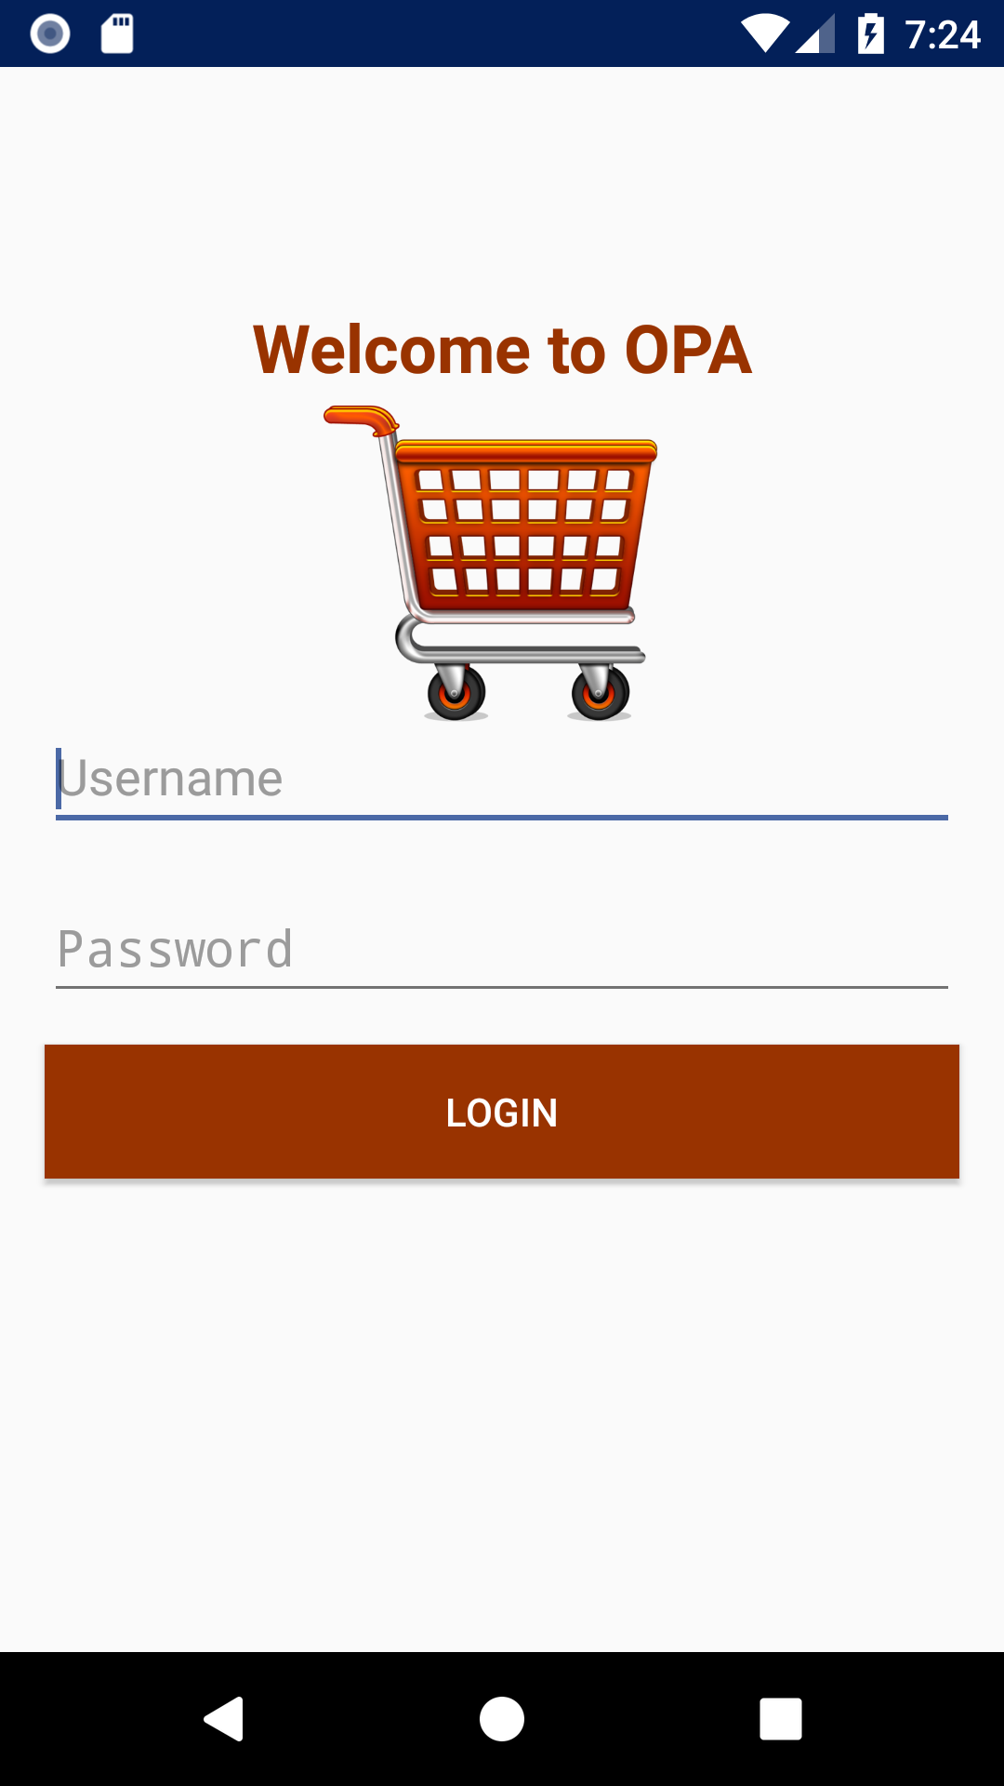
Login
Login as Customer
Login as Employee
Wrong authentication
Right authentication
Authentication enginee

Slide 6
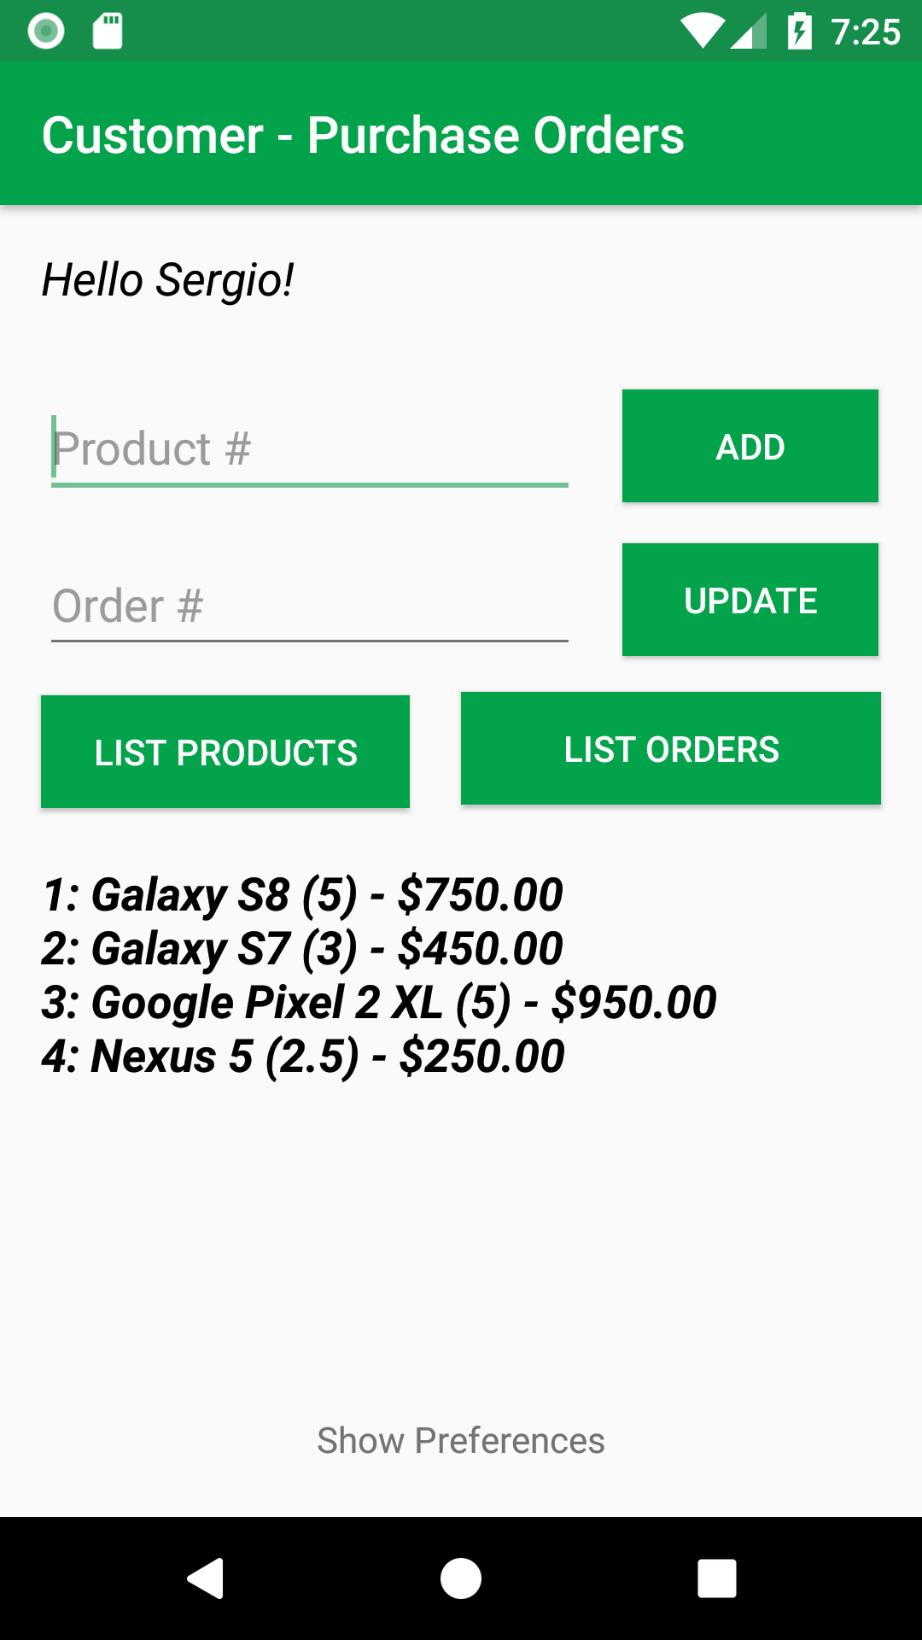
Customer view
Product:
List Product
Orders:
Add Order
Change Order
List Orders (by User)
Show Preferences

Slide 7
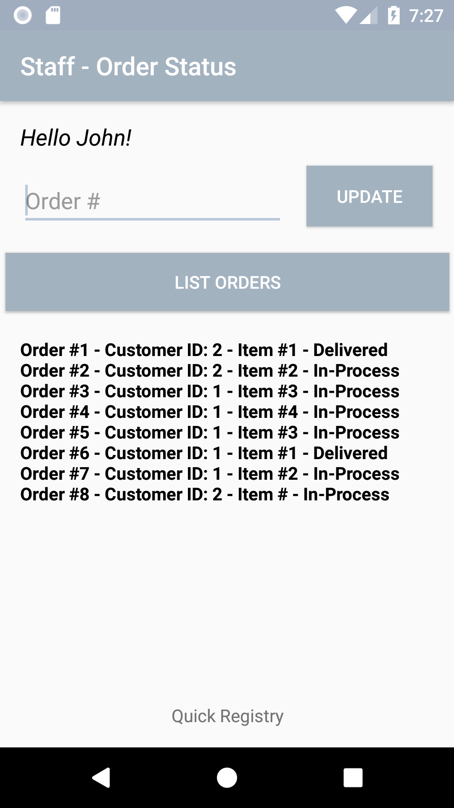
Employee view
List Orders (All customers)
Change Status (In-Process to Delivery)
Quick Registry:
Add /Update of:
Customers
Employees
Products

Slide 8
Demo

Slide 9
Test issues
If changes Available Virtual Device, the database is reset.
Create new data base for new device.
Faced conflicts while fetching the code from Github.
We created branch from each person and commit on that branch and pushed to master.
Update orders let the table corrupted.
Date format was not recognized on string variables and this crashed the database. The database was recreated to resolve the problem.

Slide 10
Questions & answers

Slide 11
Thank you and have a good one

