Slide 1

Lab Book 1.0. Waveguides
Student:

Slide 2
Instructions
General
SCRIPTS
From GitHub →
  Fork the repo: cccanvas-upv/pic-upv-lab1
  Clone the repo using VSCode
Run the Jupyter Notebook:
  WAVEGUIDES_Student.ipynb
W (width)
W (width)
Core
Core
h_core
h
(height)
Cladding
Cladding
Slab
h_slab
deep waveguide
shallow waveguide

Slide 3
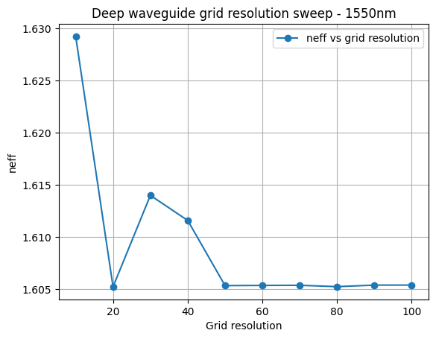
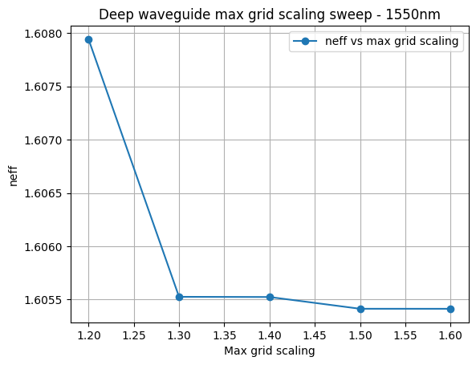
Learning outcome #1 – Convergence tests
DE waveguide, w = 1.2 µm, neff_TE0, wvl 1.55 µm.
deep waveguide
Paste neff_TE0 vs grid_resolution plot here
deep waveguide
Paste neff_TE0 vs max_grid_scaling plot here
The point at which the effective index stabilizes is in the range of 60 to 100 for Grid Resolution; therefore, we set the parameter to 100 and now calculate the sweep at maximum grid scaling, since the highest possible value for grid resolution will yield the best results but it will consume more time.
Max_grid_scaling: A parameter that aims to maximize the computational grid; the larger the grid, the higher the computational cost:
- 1.30: good balance between accuracy and computational cost.
- 1.50: the most conservative option if you want to ensure the result converges.
- 1.60: does not seem to provide a noticeable improvement over 1.50.

Slide 4
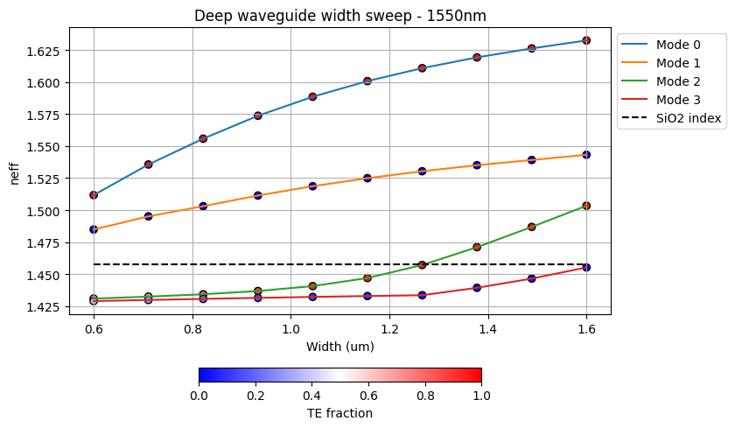
Learning outcome #2 – Width dependence
Width 0.6 - 1.6 µm (step 0.1 µm) – Wavelength 1.55 µm
deep waveguide
Paste plot here
Effective index increases with waveguide width for all modes, indicating stronger optical confinement as the core becomes wider. Modes 0 and 1 remain guided throughout the investigated width range (0.6–1.6 µm), corresponding to TE-like and TM-like fundamental modes.
The fundamental TE and TM modes remain guided across the entire width range. The TE fraction confirms the polarization behaviour: Modes 0 and 2 are predominantly TE-polarized, while Modes 1 and 3 are predominantly TM-polarized.

Slide 5
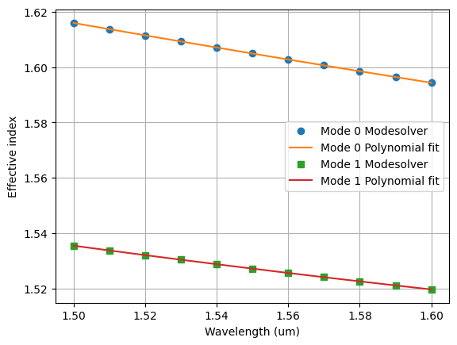
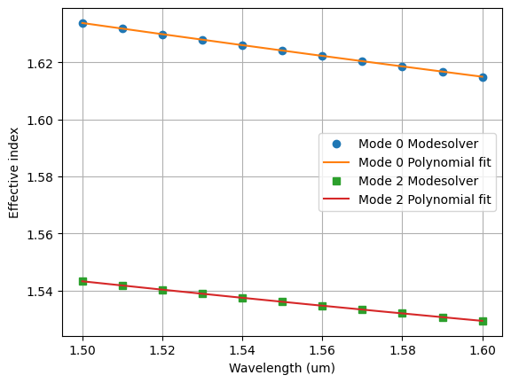
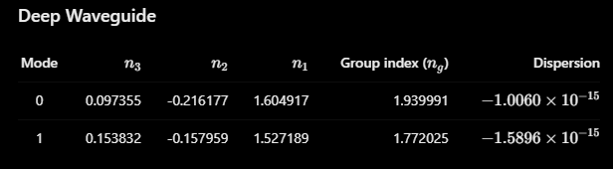
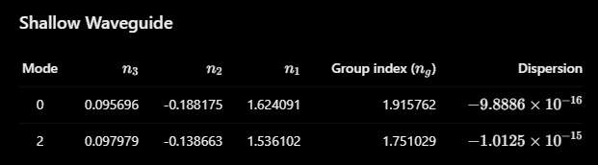

Learning outcome #3 – Waveguide compact model
Let’s model the waveguide using a second order polynomial:
$$n_{eff}\left(λ\right)=n_{1}+n_{2}\left(λ−λ_{0}\right)+n_{3}{\left(λ−λ_{0}\right)}^{2}$$
deep waveguide
neff_TE0 vs $λ$ with the second-degree polynomial fit
& neff_TM0 vs $λ$ with the second-degree polynomial fit
shallow waveguide
neff_TE0 vs $λ$ with the second-degree polynomial fit
& neff_TM0 vs $λ$ with the second-degree polynomial fit
slab: 150nm

Slide 6
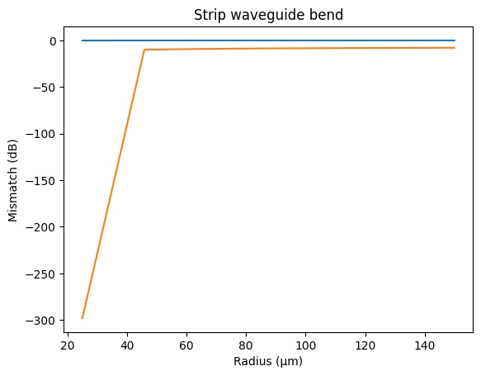
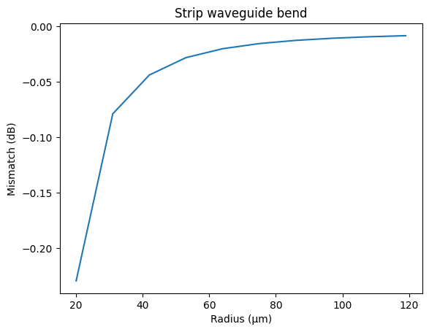
Learning outcome #4 – Bend waveguide radius vs. loss – deep
Find neff_TE0 for wvl 1.55 µm, width 1.0 µm for R=25,50,75,100, 125,150 µm
deep waveguide
Paste dB/90º neff_TE0 & neff_TM0 vs R
$α\left[\frac{dB}{90°}\right]=$ $R\frac{π}{2}α\left[\frac{dB}{µm}\right]$
It has been plotted the first TM and TE mode, on the right the TE0 mode where the safe radius is considered above 35 um. When increasing the radius, the mismatch losses decreases.

Slide 7
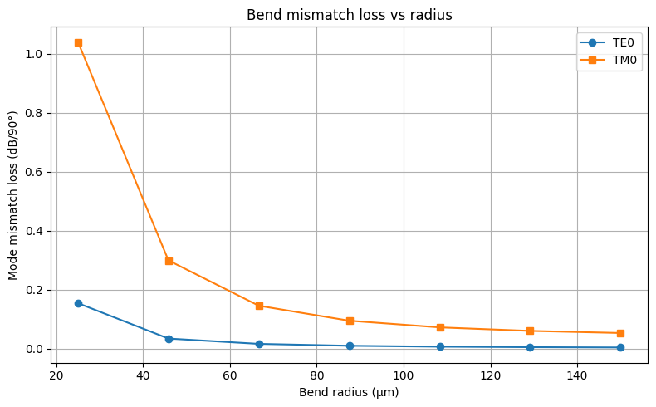

Learning outcome #4 – Bend waveguide radius vs. loss – deep- Alternative
Find neff_TE0 for wvl 1.55 µm, width 1.0 µm for R=25,50,75,100, 125,150 µm
deep waveguide
Paste dB/90º neff_TE0 & neff_TM0 vs R
$α\left[\frac{dB}{90°}\right]=$ $R\frac{π}{2}α\left[\frac{dB}{µm}\right]$
It has been plotted the first TM and TE mode, on the right the TE0 mode where the safe radius is considered above 35 um. When increasing the radius, the mismatch losses decreases. A new approach has been created, using the overlap and the mismatch losses as -20 log(overlap) we arrive at a different and more coherent result.

Slide 8

Thank you

