Slide 1



Shape-based low-thrust trajectory optimization enhanced via orthogonal
functions, collocation and regularization
Sergio Cuevas del Valle, Hodei Urrutxua and
Pablo Solano-López
23 Jun 2022

Slide 2
contents
1
4
Introduction and state of the art
Orbit determination applications
2
Shape-based optimization: our general optimization methodology
5
Mission examples and testbench cases
3
Low-thrust transfers applications
6
Conclusions and future research

Slide 3
Introduction

Slide 4
Introduction
Shape-based method have gained in recent years increasing attention for astrodynamics optimization problems
However, previous work has focused on:
Special, case-dependent functions [Petropoulos and Longuski 2004, Roa et al. 2016, Morante et al. 2018]
Generation of low-cost initial guesses [Conway 2012, Huo et al. 2019]
Lack of systematic exploitation of the mathematical formulation of the problem [Huo et al. 2019]
This work investigates novel aspects, enhancements and approaches to these techniques for optimal control and navigation problems in astrodynamics
The main novelties introduced are:
A generic approach to TVB Bolza problems
Exploitation of new orthogonal functions
Introduction of the nodal sampling grid
Use of regularized coordinates
Orbit determination for thrusted objects

Slide 5
shape-based general optimization methodology

Slide 6
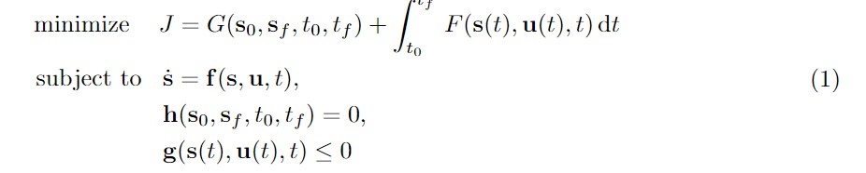
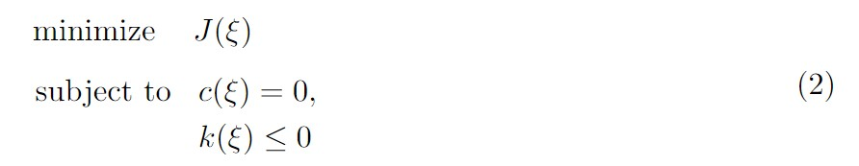
GENERAL METHODOLOGY
A shape-based algorithm will be used to solve the following optimal control Bolza problem
The optimal solution S is given by the flow and control law minimizing the cost J and satisfying the path and boundary constraints
The shape-based approach will discretized (1) into a finite NLP problem (2) to be standardly solved (IPOPT, SQP)

Slide 7
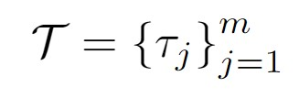
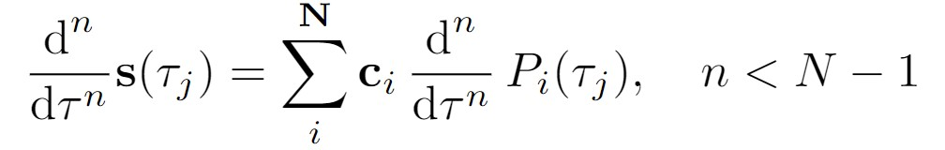
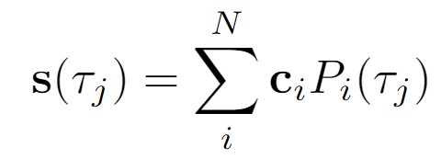

GENERAL METHODOLOGY
The NLP problem is evaluated and solved at the sampling grid T
State vector derivatives are readily available
The system’s state vector is expanded using a polynomial family (either orthogonal or non-orthogonal)
The optimization variables set is (primarily) given by

Slide 8
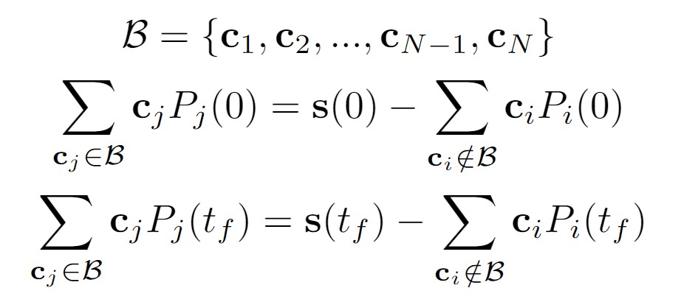
GENERAL METHODOLOGY
Our NLP problem will only handle path constraints. Dynamics and boundary constraints are imposed via:
The control law is solved as a residual of the state vector evolution and the problem’s dynamics vector field
Boundary conditions are directly imposed on the state vector’s expansion. Possibly nonlinear system

Slide 9
GENERAL METHODOLOGY: final algorithm
Define the problem
Define the sampling grid
Generate an initial guess from a third-order polynomial
Iteratively, following an NLP solver, do:
Solve B to impose boundary conditions
Compute the control law
Minimize J and respect path constraints
Compute the final optimal solution using state’s vector polynomial description and control law residual definition

Slide 10
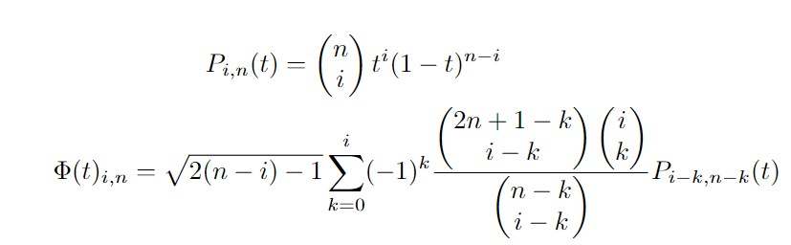
orthogonal polynomials
Traditional shape-based methods have focused on general spirals or non-orthogonal polynomials
Our approach is based on:
Chebyshev
Legendre
Laguerre
Hermite
Bernstein and orthogonal Bernstein

Slide 11
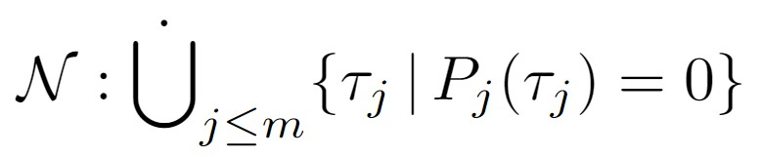
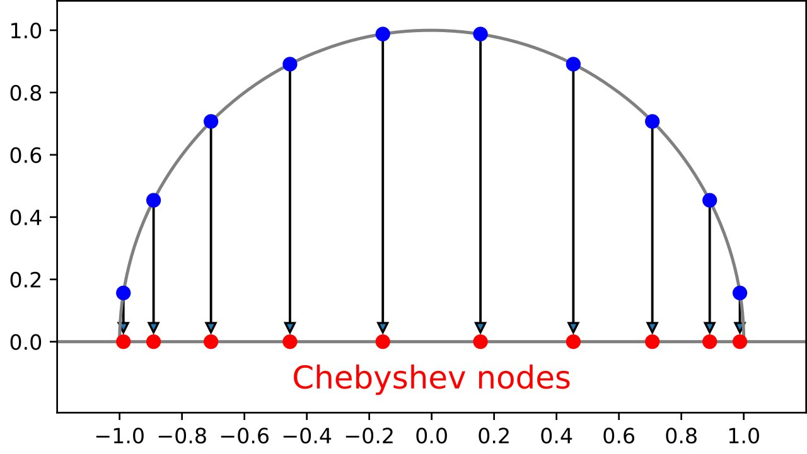
Nodal sampling grid
Several options exist to define the sampling grid:
It may be defined arbitrarily as desired
It can be constructed based on the nodes of the state vector expansion to exploit Approximation Theory
It can be adapted to the problem’s dynamics (fictitous time)

Slide 12
Low-thrust orbital transfers

Slide 13
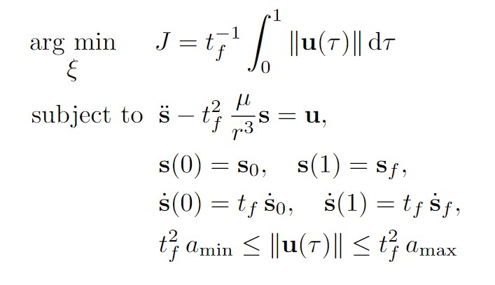
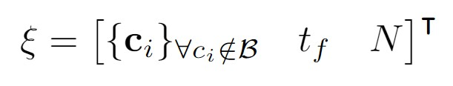
LOW-THRUST ORBITAL TRANSFERS
Low-thrust orbital transfers can be computed using our shape-based method
Its main advantages are:
Reduced computational cost
Flexibility and adaptability
The normalized, time-free or time-fixed optimal control problem is:
Both the time of flight and the number of revolutions can be subject to the optimization process

Slide 14
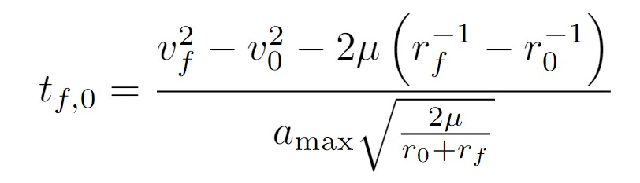
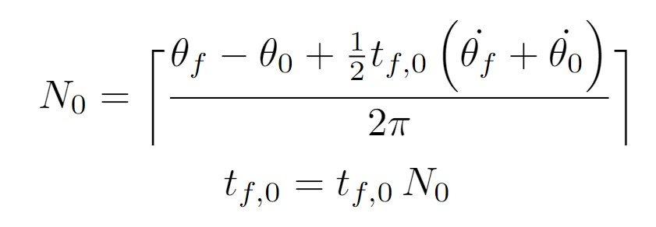
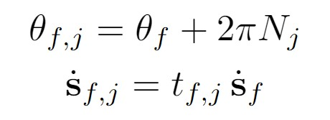
LOW-THRUST ORBITAL TRANSFERS
The initial guess is crucial for the convergence of the algorithm
Direct transfers are usually infeasible. This work focuses on multi-revolution trajectories
If the number of revolutions N is optimized, boundary conditions shall be recomputed at each iteration of the algorithm
Both the time of flight and the number of revolutions can be subject to the optimization process

Slide 15
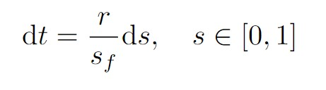
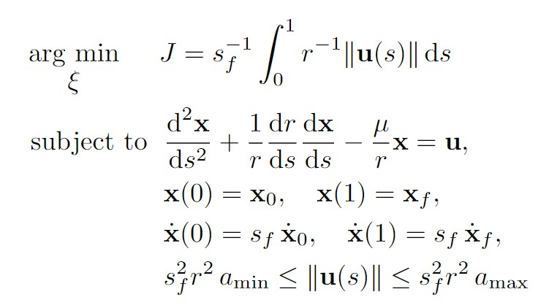
LOW-THRUST ORBITAL TRANSFERS: REGULARIZED GRID
Regularized coordinates can be used to construct a constant sampling grid which intrinsically adapts to the spacecraft trajectory at each iteration
The algorithm capacity to capture the problem’s dynamics and geometry is enhanced, together with obtaining an adaptative mesh
The problem can be completely solved in the fictitious time space after the initial guess is transformed

Slide 16
ORBIT DETERMINATION

Slide 17
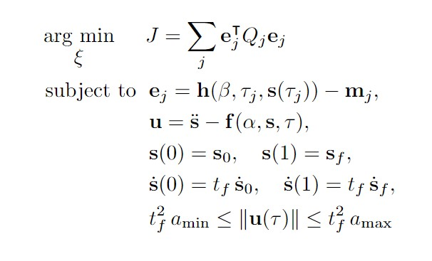
ORBIT DETERMINATION FOR THRUSTED OBJECTS
The algorithm can be also used for navigation purposes: given a set of measurements, the methodology can be used to solve for an object’s trajectory and control law. Applications for low-thrust maneuver-detection
Several OD problems can be well-posed, including minimization of dynamics residual

Slide 18
MISSION CASES AND DISCUSSION

Slide 19
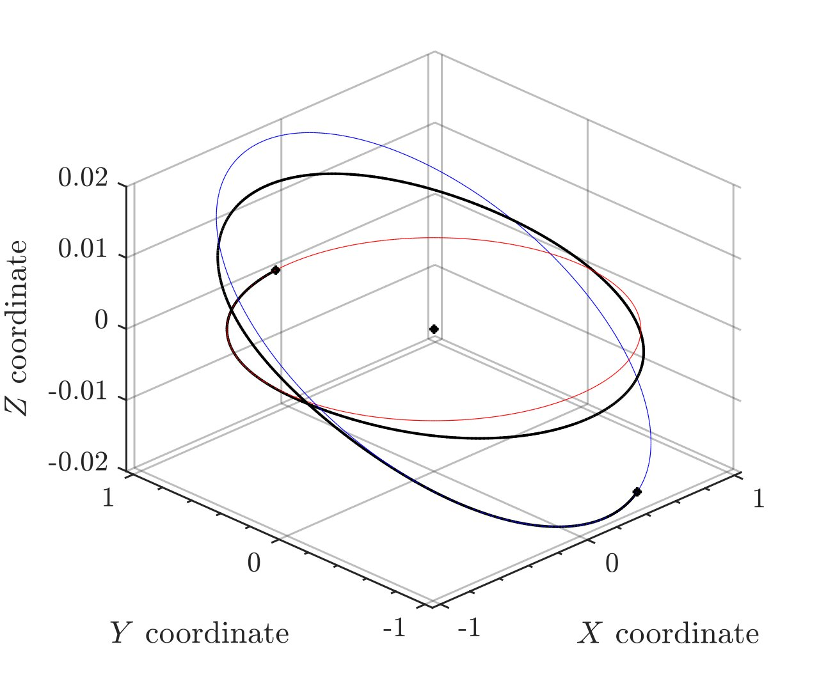
Low-thrust leo transfer example
A LEO transfer is solved using the proposed algorithm in various of its constructions. The baseline trajectory is computed using 500 nodes and 60-th order expansion
The main differences between algorithms are:
Computational cost, mainly given by the polynomial family in use and the sampling grid topology
Numerical performance and properties. Approximation error distribution
3sigma errors to the baseline solution estimation are of 30% for the delta-V (dependent on numerical performance) and 3% for the TOF (not-dependent on the exact construction)

Slide 20
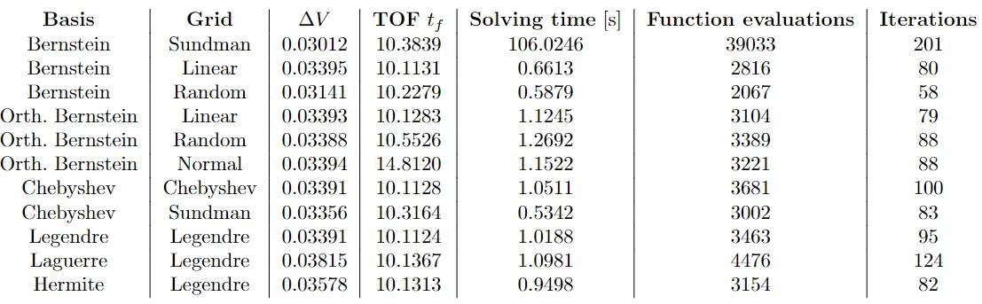
Low-thrust leo transfer example

Slide 21
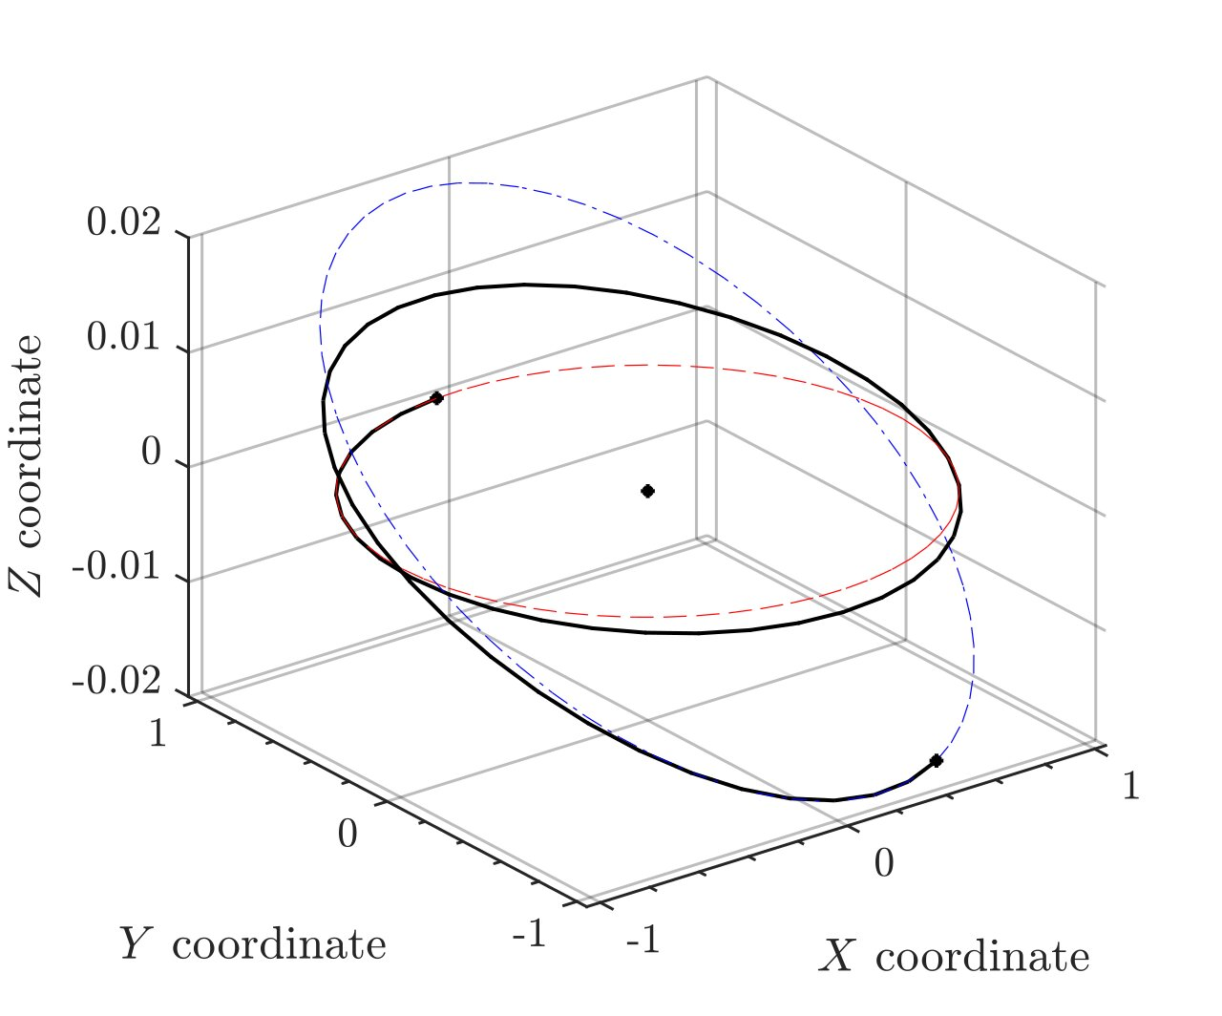
Low-thrust leo transfer example
Baseline solution
Computationally cheap solution

Slide 22
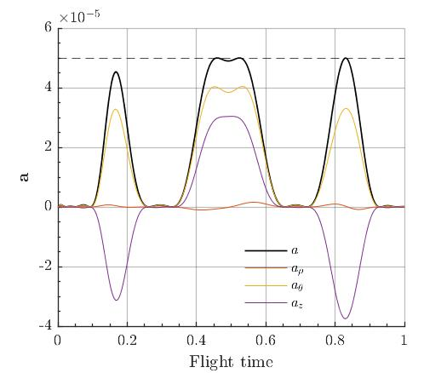
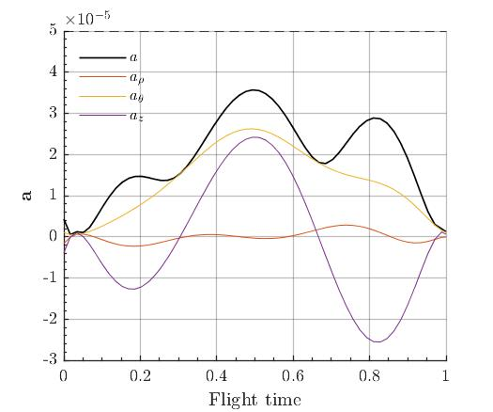
Low-thrust leo transfer example
Baseline acceleration solution
Computationally cheap acceleration solution

Slide 23
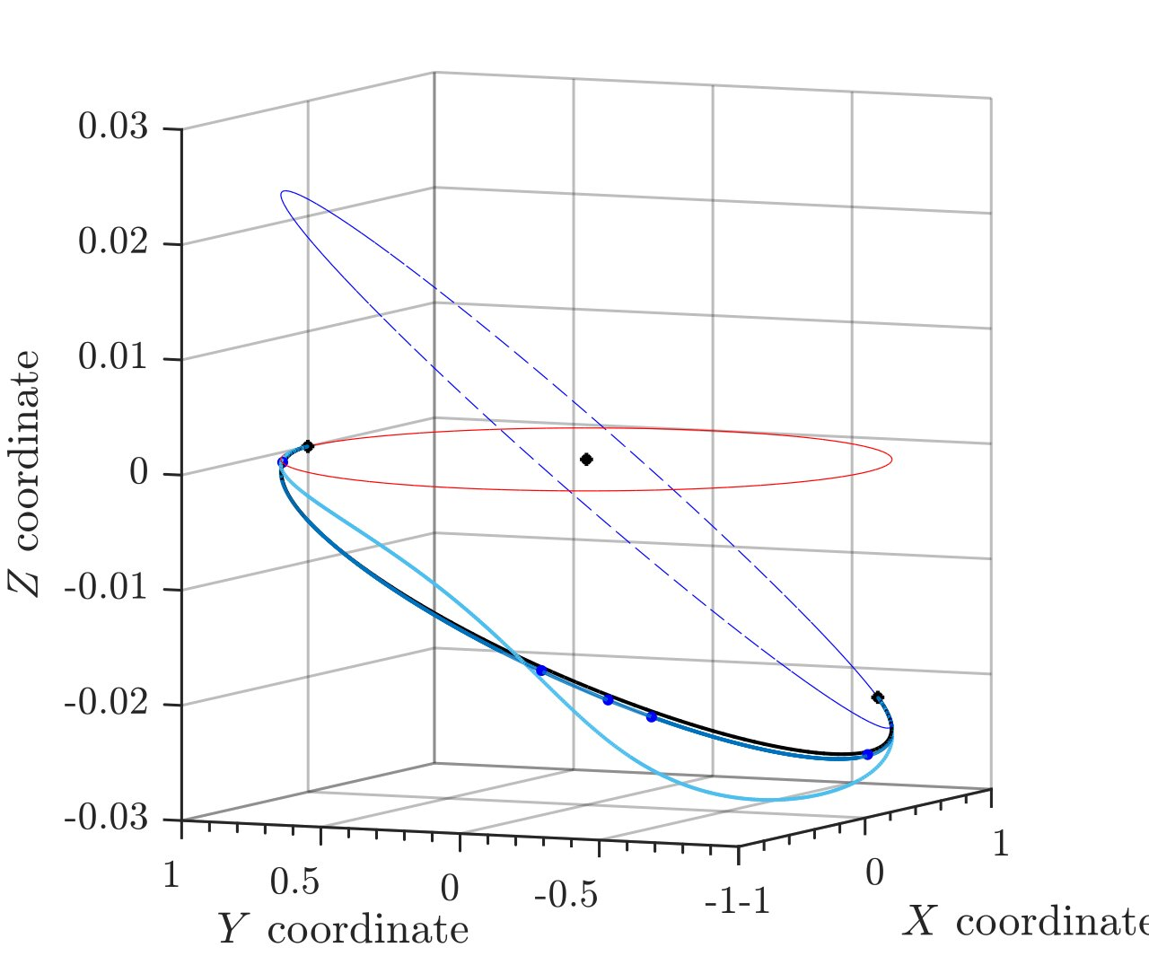
Low-thrust leo transfer determination example
A thrusted LEO transfer is determined using 10 noisy observations (10 km sigma error). Acceleration is constant (0.1 m/s2) in ECI Z direction
3sigma errors to the true, thrusted solution in the acceleration profile are in the order of 8%, standard deviation of 0.1% (see next slide)
The problem is a TVBP. Stiffness can be relaxed by letting the a priori flight time or observation span to vary as a decision variable

Slide 24
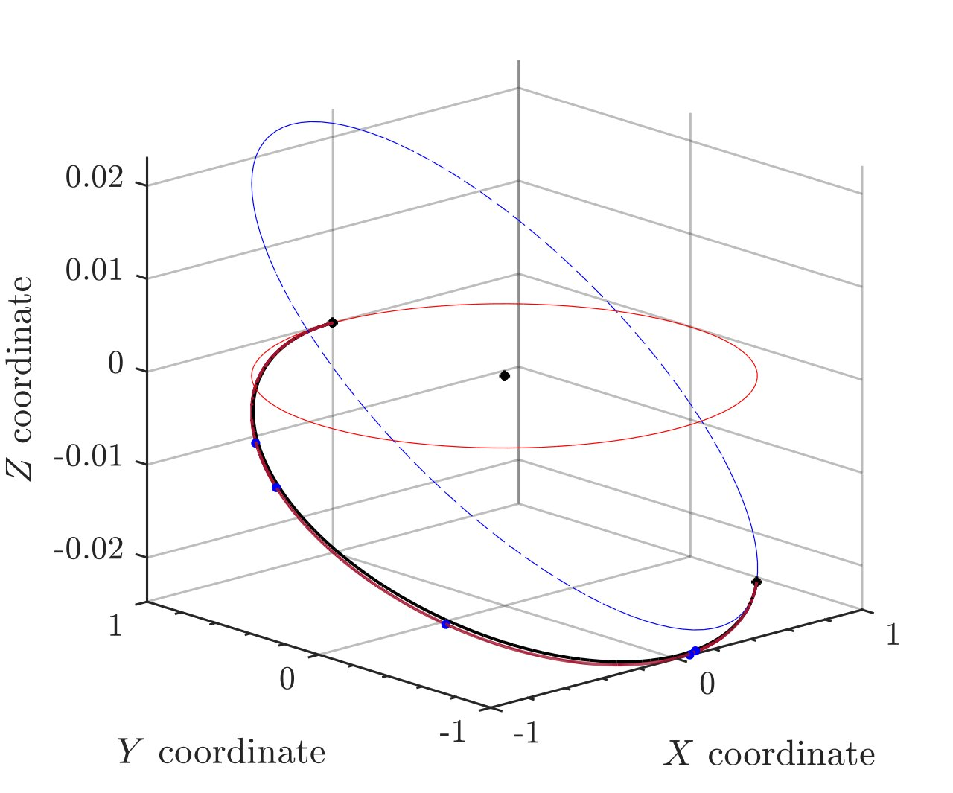
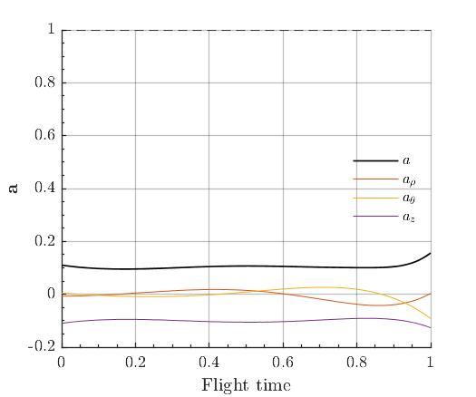
Low-thrust leo transfer determination example
Orbit-determination thrusted arc
Determined acceleration law

Slide 25
CONCLUSIONS

Slide 26
cONCLUSIONS and future research
A extended formulation of classical shape-based methods has been presented
The algorithm allows to solve TBV Bolza problems in a quick, cheap and efficient way when compared to traditional methods
New functional bases and collocation grids distributions haven been explored, showing additional computational and numerical performance
The method is currently being extended for IVPs, Model Predictive Control and other optimization problems in astrodynamics and attitude control
The effect of the grid and the boundary conditions on the results is still to be objectively assessed
An multi-segment adaptative algorithm is currently under development

Slide 27
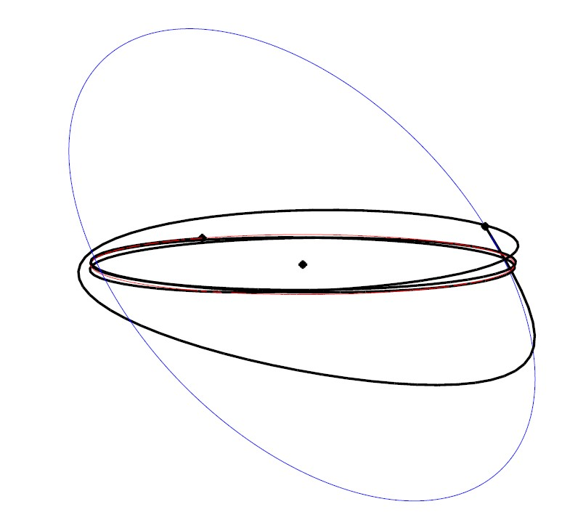
thank you verY much
Contact info:
s.cuevas.2017@alumnos.urjc.es
hodei.urrutxua@urjc.es
pablo.solano@urjc.es

Slide 28
extra slides

Slide 29
Low-thrust leo transfer determination example
The example transfer was solved using a 9-th order expansion and a 60-node sampling grid. Acceleration available onboard: 0.05 mm/s2
Boundary conditions of the transfer:

