Slide 1
Mechanistic Interpretability
A Brief and Incomplete History
Sergio Estan Ruiz

Slide 2
What is Mechanistic Interpretability?

Slide 3
What is MechInterp?
(That’s how the cool kids call it nowadays)
“Mechanistic interpretability, narrowly, means trying to reverse-engineer the internal computation of a trained neural network: features, circuits, algorithms, and causal pathways inside the model.”
- ChatGPT
Notes:
*Naomi Saphra and Sarah Wiegreffe, “Mechanistic?” (2024) – distinguishes between technical and cultural, and narrow and broad.
Technical narrow: internals through causal mechanisms
Technical broad: any research looking at internals (weight or activations valid)
Cultural narrow: emerging from MI community
Cultural broad: any research in the broad AI community
Causal pathways : mechanisms or paths in a NN which relate a specific input to a specific outcome

Slide 4
A 4-stage history of the MechInterp hype
Stage 1:
Visual Models and CNNs
(2013-2020)
Stage 2:
Transformers and LLMs
(2020-2022)
Stage 3:
From Neurons to Features
(2022-2024)
Stage 4:
Scalable Interpretability
(2023- )

Slide 5
Stage 1: The Rise of Deep Learning, CNNs and Vision Models*
Notes:
*Recall that there was actually some interpretability research being done in NLP before this- for a more accurate account look at Saphra
In fact, things like word2vec were already looking at some broad questions like the geometry of activation vectors since the mid-2010s.

Slide 6
The Beginning of Deep Learning
2007
Fei-Fei Li develops ImageNet – not hugely popular but very impressive
2008
ImageNet Challenge created
2012
AlexNet surprises and outperforms everyone at ImageNet Challenge*
2015
ResNet wins the ImageNet Challenge
Notes:
CNNs become dominant: before human engineers mathematically programmed specific rules to extract features, which were then fed into classifiers.
* AlexNet presents the start of the deep learning boom, characterised by:
Architecture: Deep learning and black box models
Hardware: Models trained on GPU for efficiency (AlexNet was huge and distributed across two GPUs)
Huge datasets: ImageNet contained 12 million labelled images

Slide 7
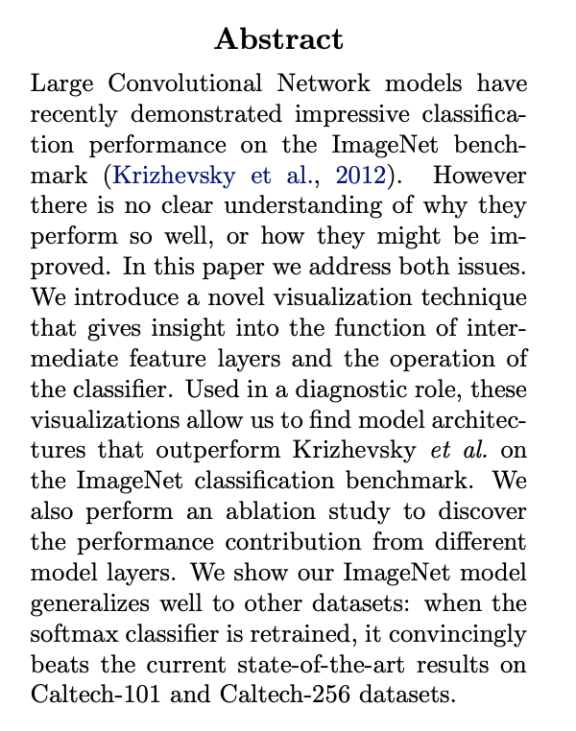
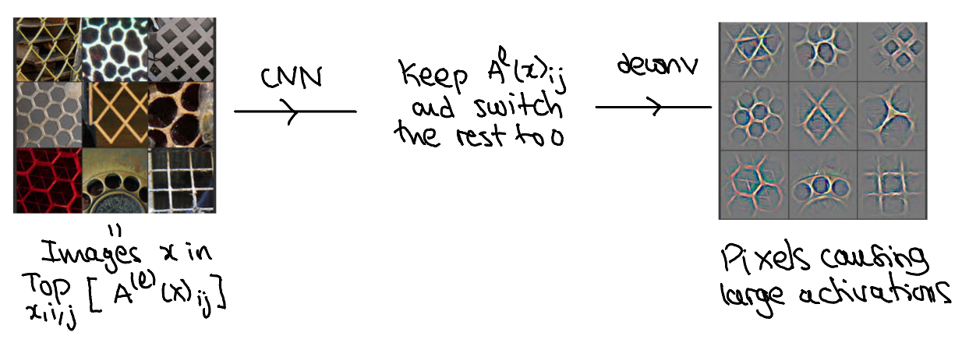
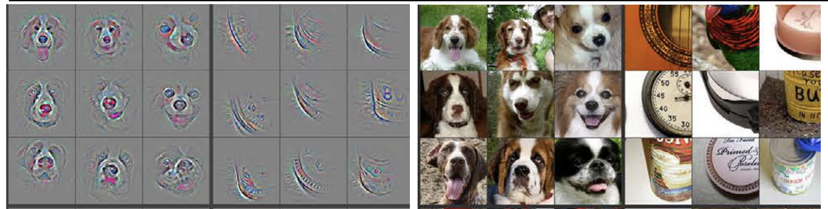
Visualising and Understanding Convolutional Networks (2013)
Matthew D. Zeiler and Rob Fergus
Notes:
Lower layers pick up patters like edges, these are learned early
Deeper layers pick up more complex patterns, these are learned later
Deconv is not the inverse of the CNN

Slide 8
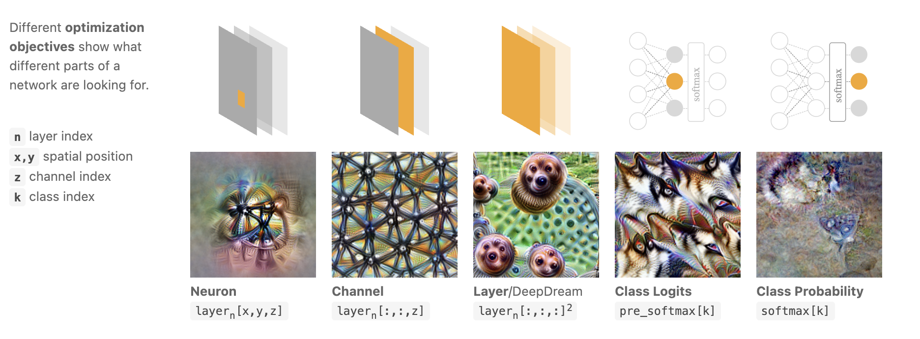
Feature Visualisation
Chris Olah, Alexander Mordvintsev and Ludwig Schubert
Notes:
https://distill.pub/2017/feature-visualization/

Slide 9
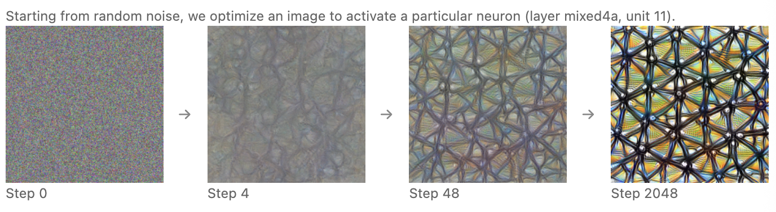
Feature Visualisation
Chris Olah, Alexander Mordvintsev and Ludwig Schubert
Regularisation
Frequency penalisation, e.g. total variation
Learned priors
Transformation Robustness
Notes:
https://distill.pub/2017/feature-visualization/
If you do this without any regularisation you just get noisy images → adversarial examples

Slide 10
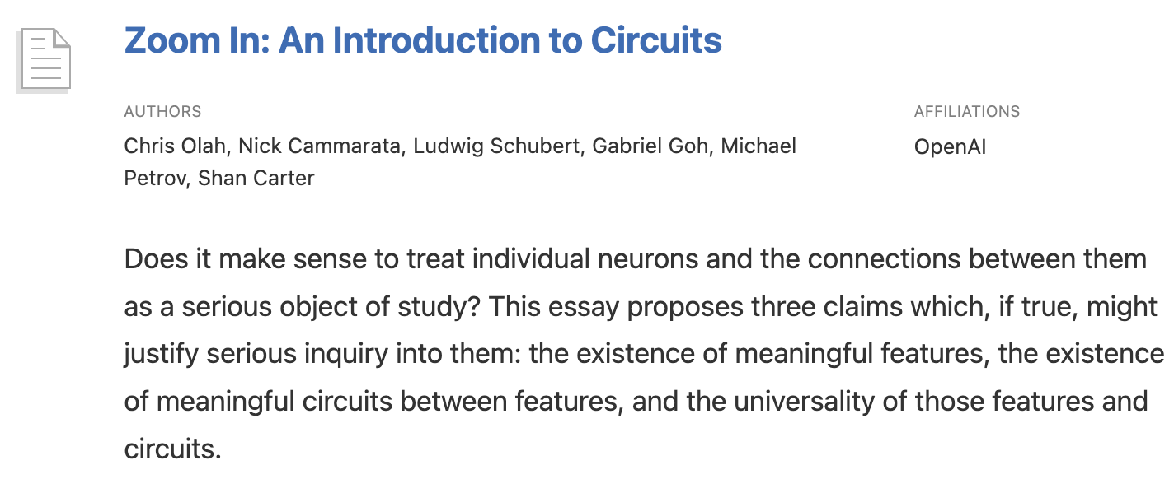
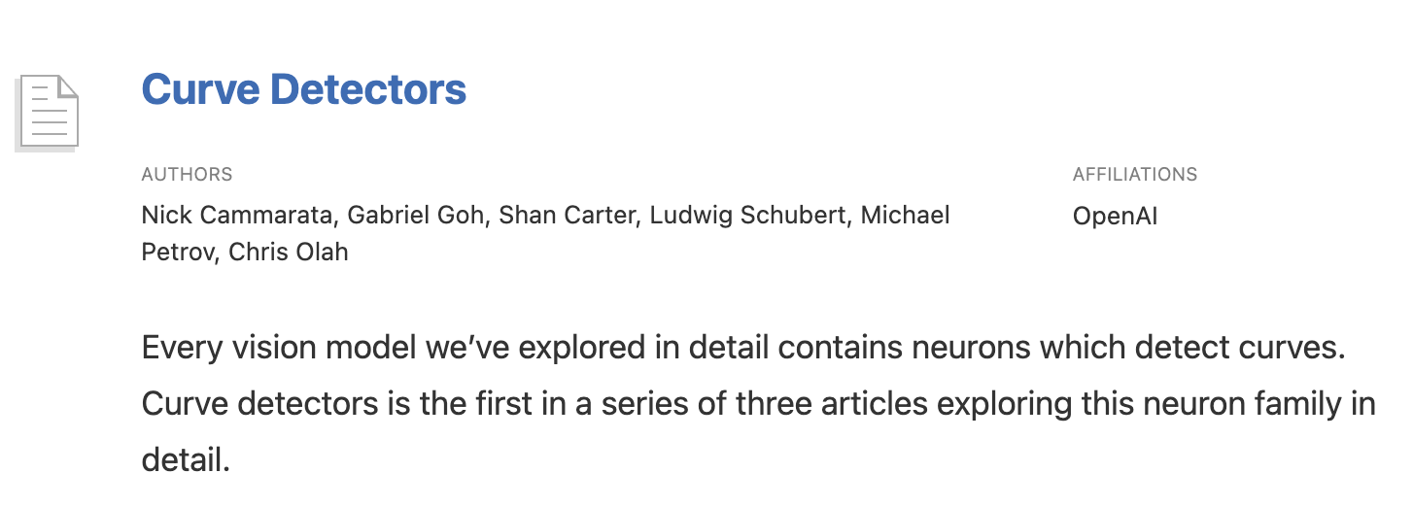
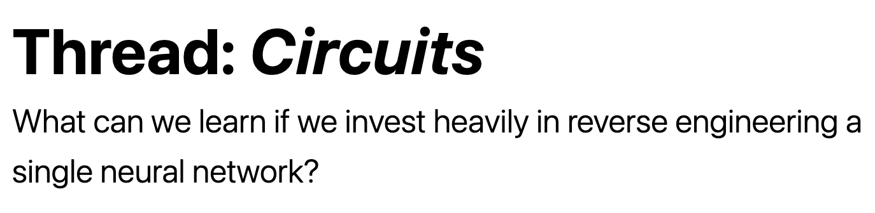
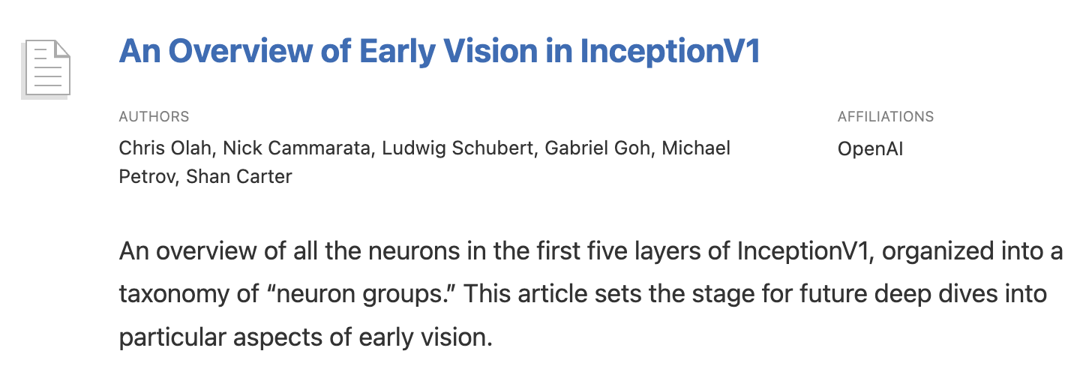
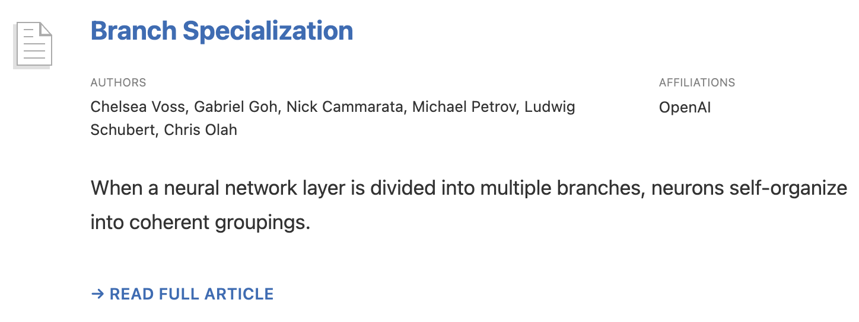
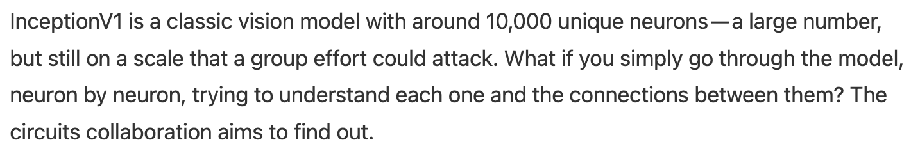
Circuits Thread
From neurons to circuits
Notes:
We start talking about things like:
Circuits
Polysemanticity of neurons, ie. Some neurons get excited with both dogs and cars.

Slide 11
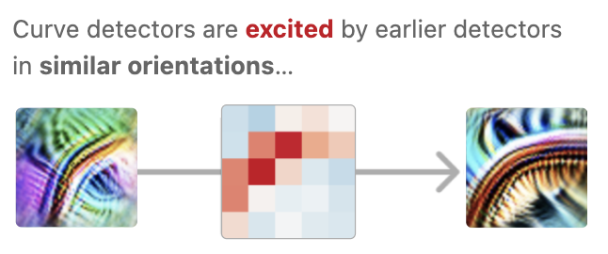
Circuits Thread
From neurons to circuits
Notes:
We start talking about things like:
Circuits
Polysemanticity of neurons, ie. Some neurons get excited with both dogs and cars.

Slide 12
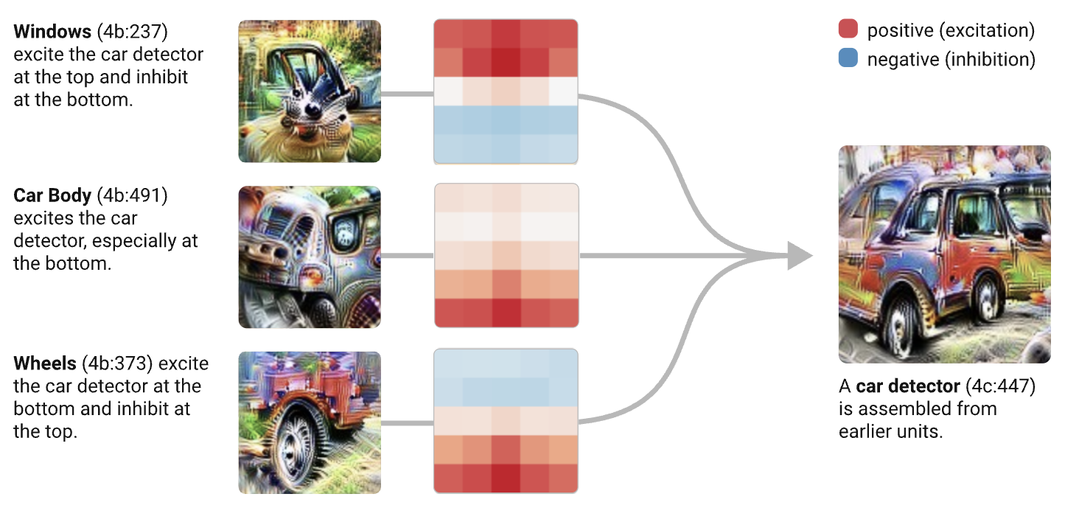
Circuits Thread
From neurons to circuits
Notes:
- All of the images are “feature visualisations”, ie. Images which have been optimised to fire that specific channel (in a CNN layer you have C channels, so that layer has W x H x C).

Slide 13
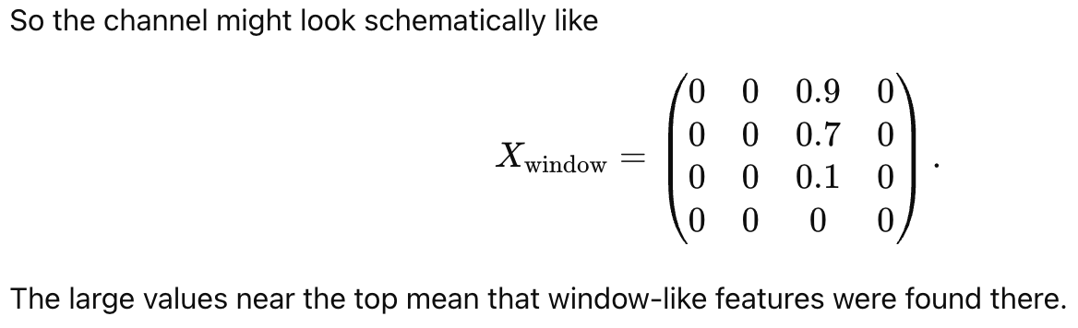
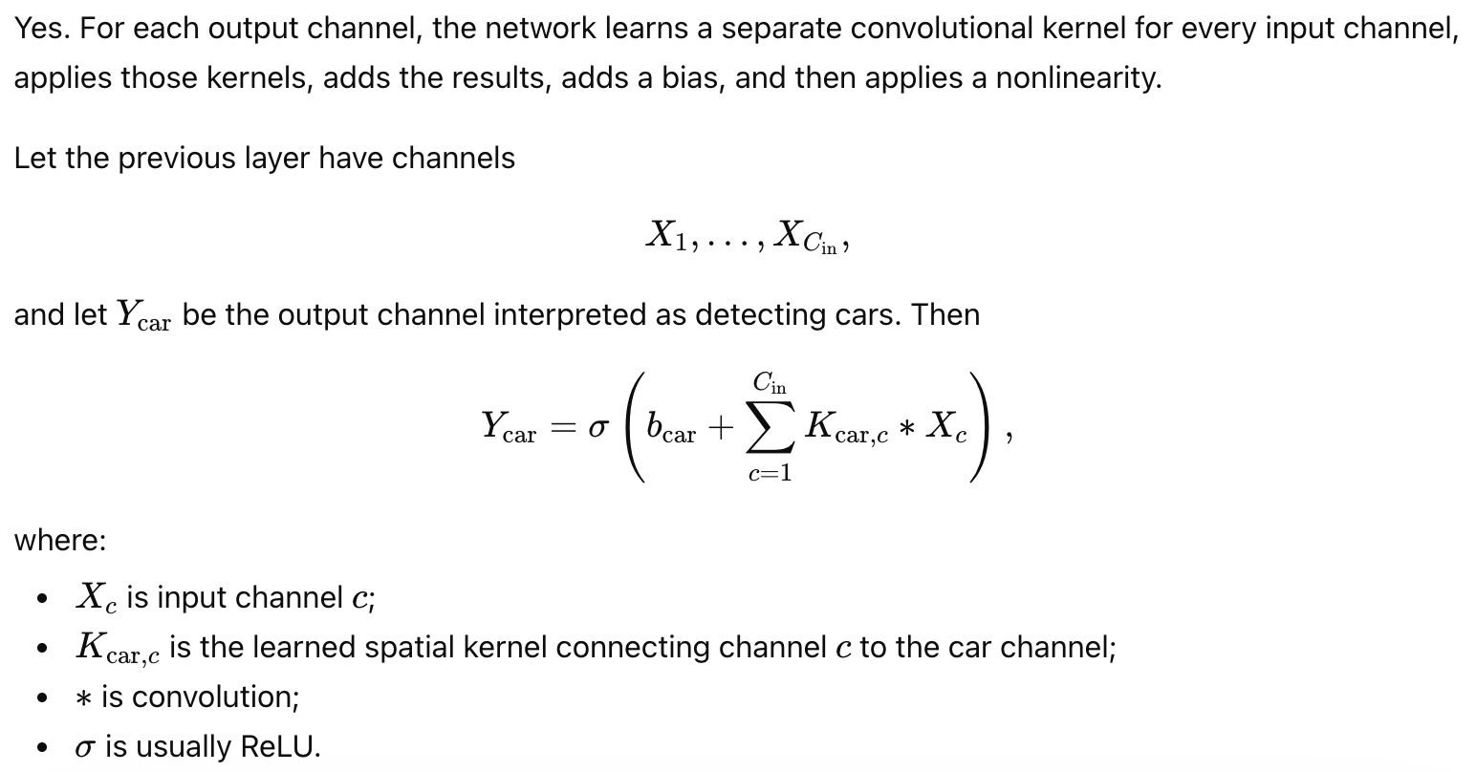
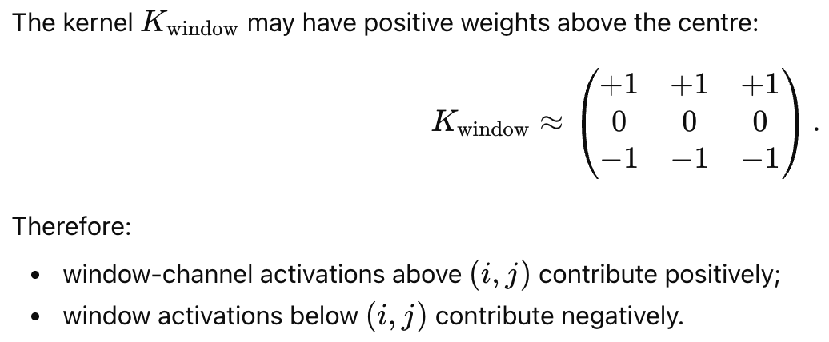
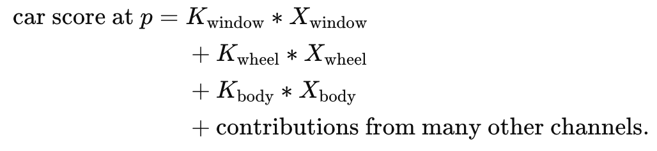
Circuits Thread
From neurons to circuits
Notes:
- All of the images are “feature visualisations”, ie. Images which have been optimised to fire that specific channel (in a CNN layer you have C channels, so that layer has W x H x C).

Slide 14
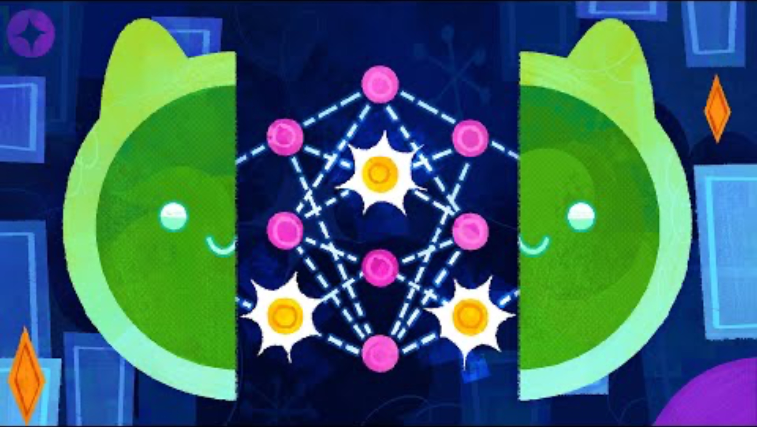
A YouTube video you should watch in your spare time

Slide 15
Stage 2: The arrival of Transformers and LLMs

Slide 16
How LLMs and NLP became popular
Pre-2013
Statistical models like n-grams
2013-2016
Word embeddings like word2vec and neural models like LSTMs and GRUs
2017
Transformers- Attention is All You Need
2018-2020
2018: GPT-1, 2019: GPT-2, 1.5b model, 2020: GPT-3, 175b model.
2021-2022
From language models to assistants via RL, e.g. InstructGPT. ChatGPT released in Nov 2022.

Slide 17
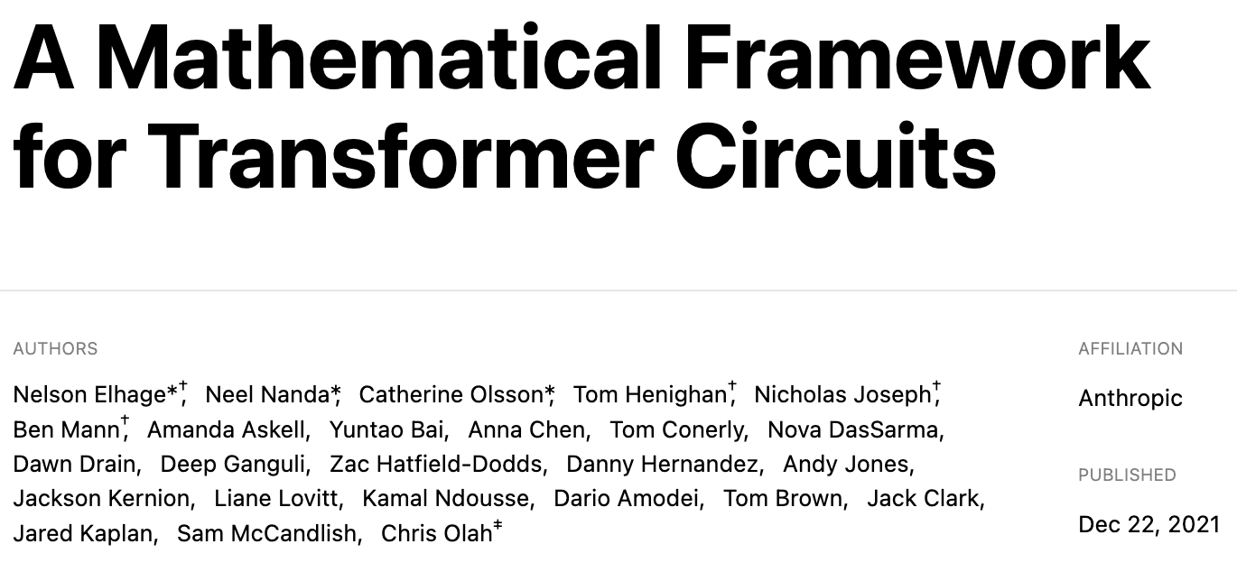
A Mathematical Framework for Transformer Circuits
Notes:
Neel Nanda: runs MechInterp team at Deepmind
Dario Amodei: CEO of anthropic
Chris Olah: cofounder of anthropic, and key developer of many of these ideas. In fact he came up with MechInterp term

Slide 18
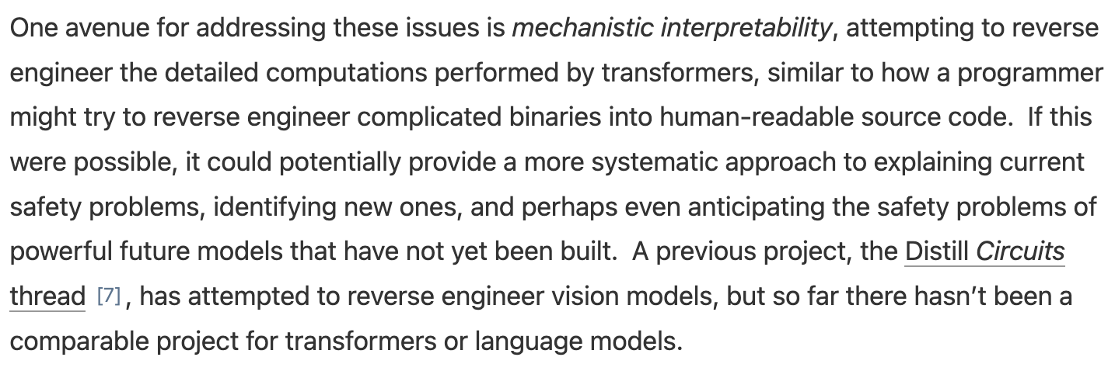
A Mathematical Framework for Transformer Circuits
Notes:
- Like in Threads: Circuits, they look at toy examples to make it more amenable. Specifically, one- and two-layer attention-only transformers.

Slide 19
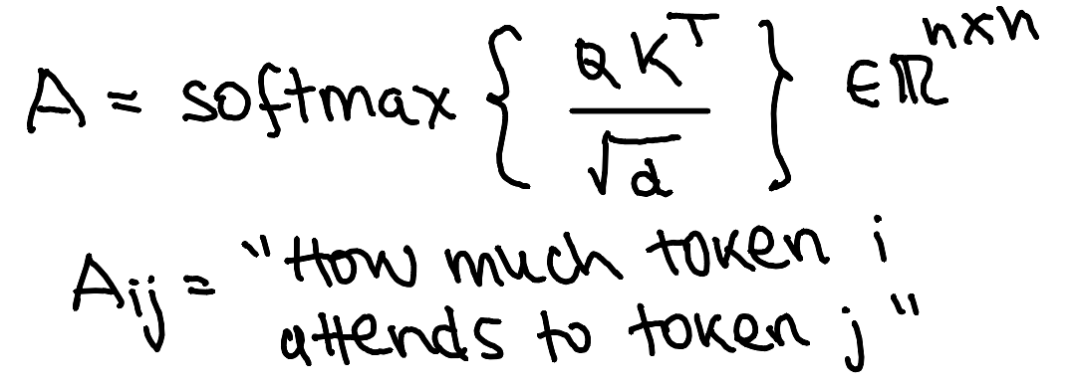
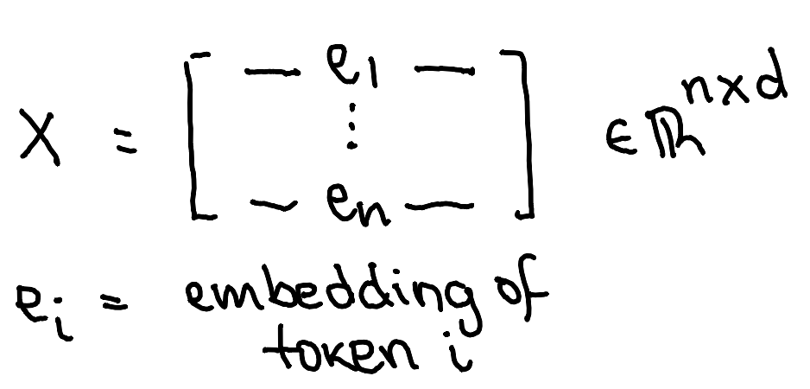
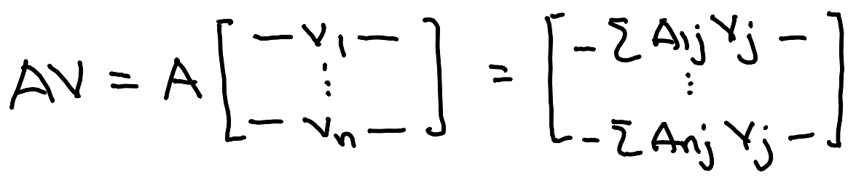
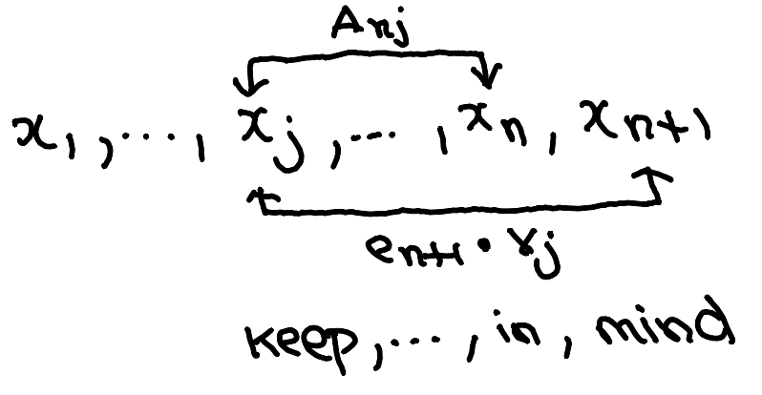
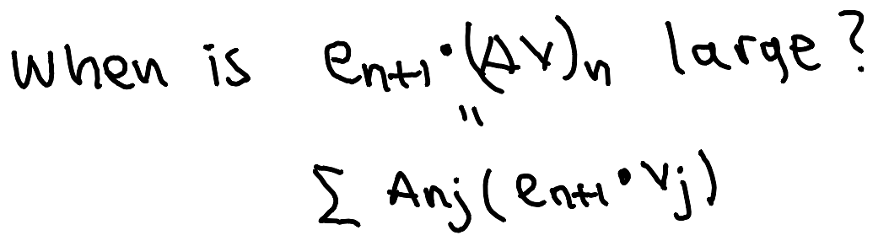
A Mathematical Framework for Transformer Circuits
Circuits in one-layer transformers
Notes:
The d values are actually difference as d_embed >> d_atten . But let’s simplify notation.
We are also omitting the fact that W_O is a matrix used to go from the attention stream to the residual (background) stream

Slide 20
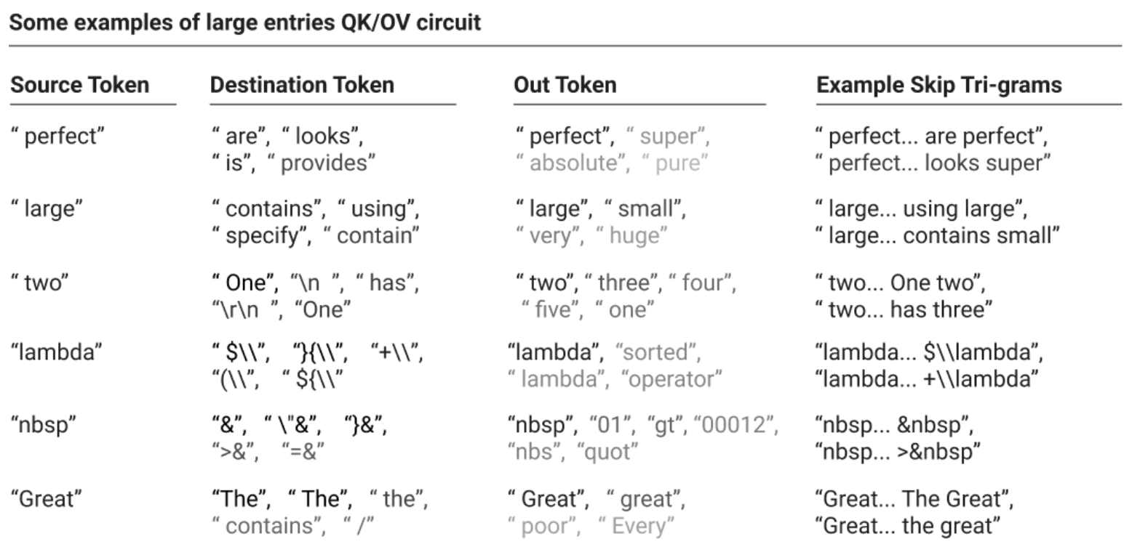
A Mathematical Framework for Transformer Circuits
Circuits in one-layer transformers

Slide 21
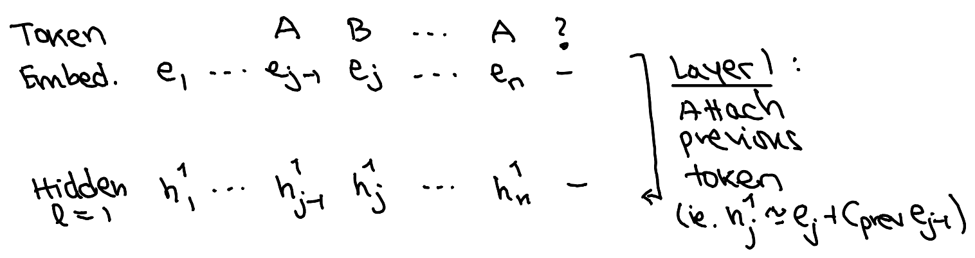
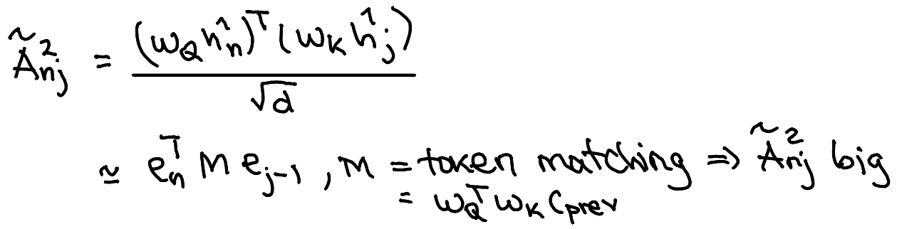
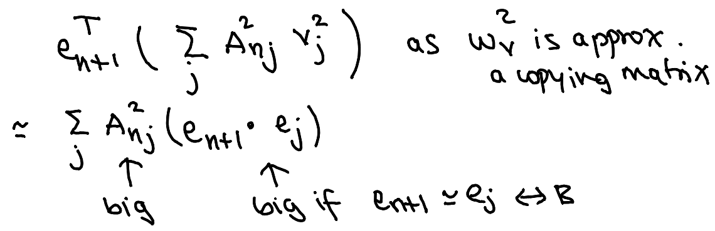
A Mathematical Framework for Transformer Circuits
Induction Circuits in Two-layer transformers
Notes:
The punchline is that they are trying to apply the manual techniques which worked for the Threads: Circuits program.
It’s manual inspection of things to try to find circuits or algorithms.

Slide 22
Stage 3: Dealing with huge models

Slide 23
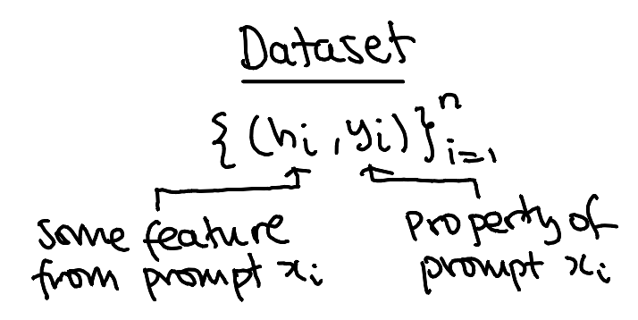
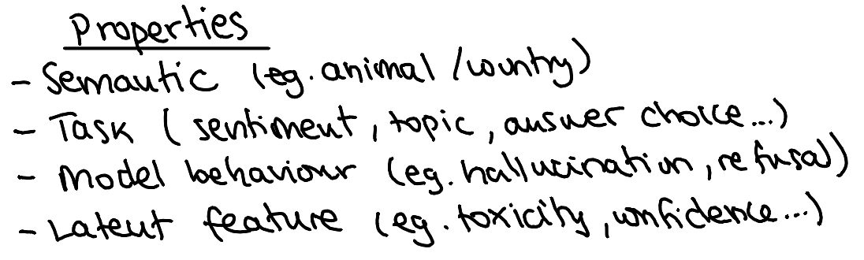
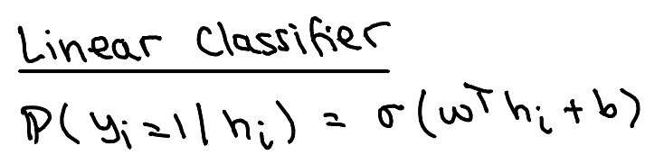
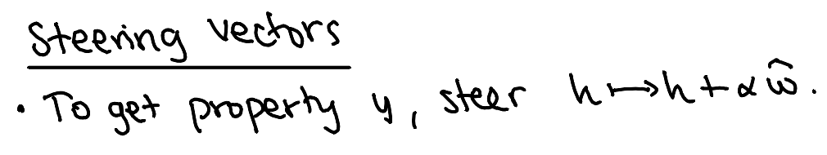
Linear Probes
Notes:
We do so to try to understand, for example, where knowledge is located.
A hidden representation could be the activation vector in a specific later corresponding to the last token of a prompt
We use linear probes because they work, but also because complex models might learn stuff that the actual LLM at that point doesn’t yet

Slide 24
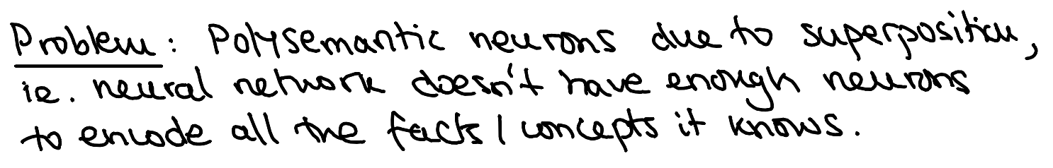
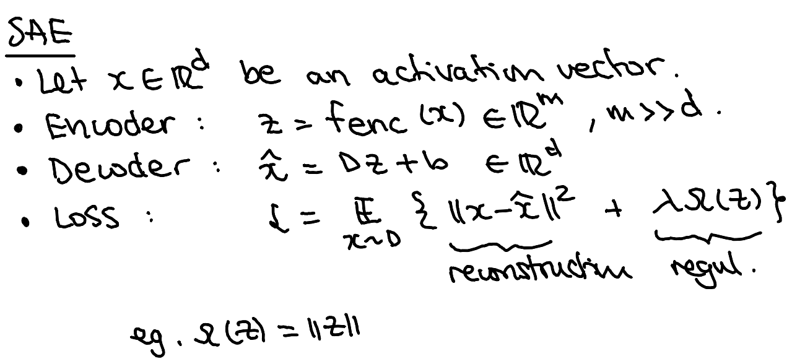
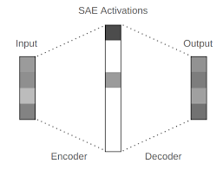
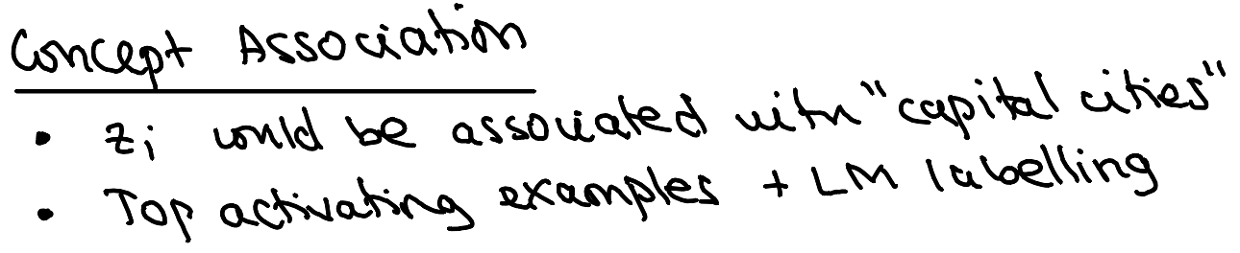
Sparse Autoencoders

Slide 25
Stage 4: Scalable Interpretability

Slide 26
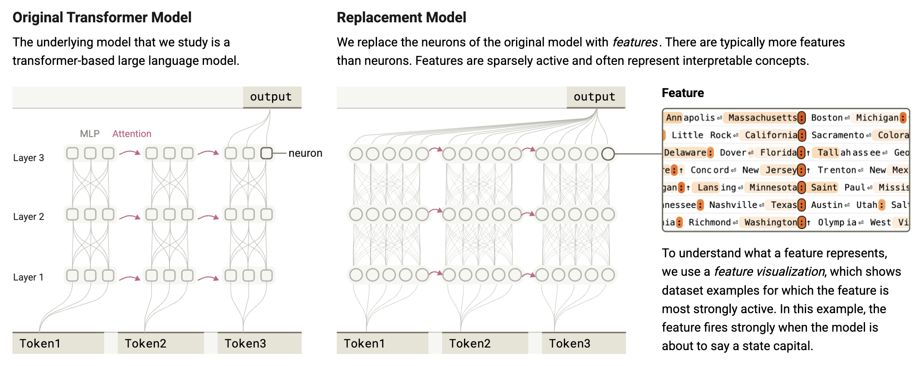
On the Biology of a Large Language Model
Anthropic

Slide 27
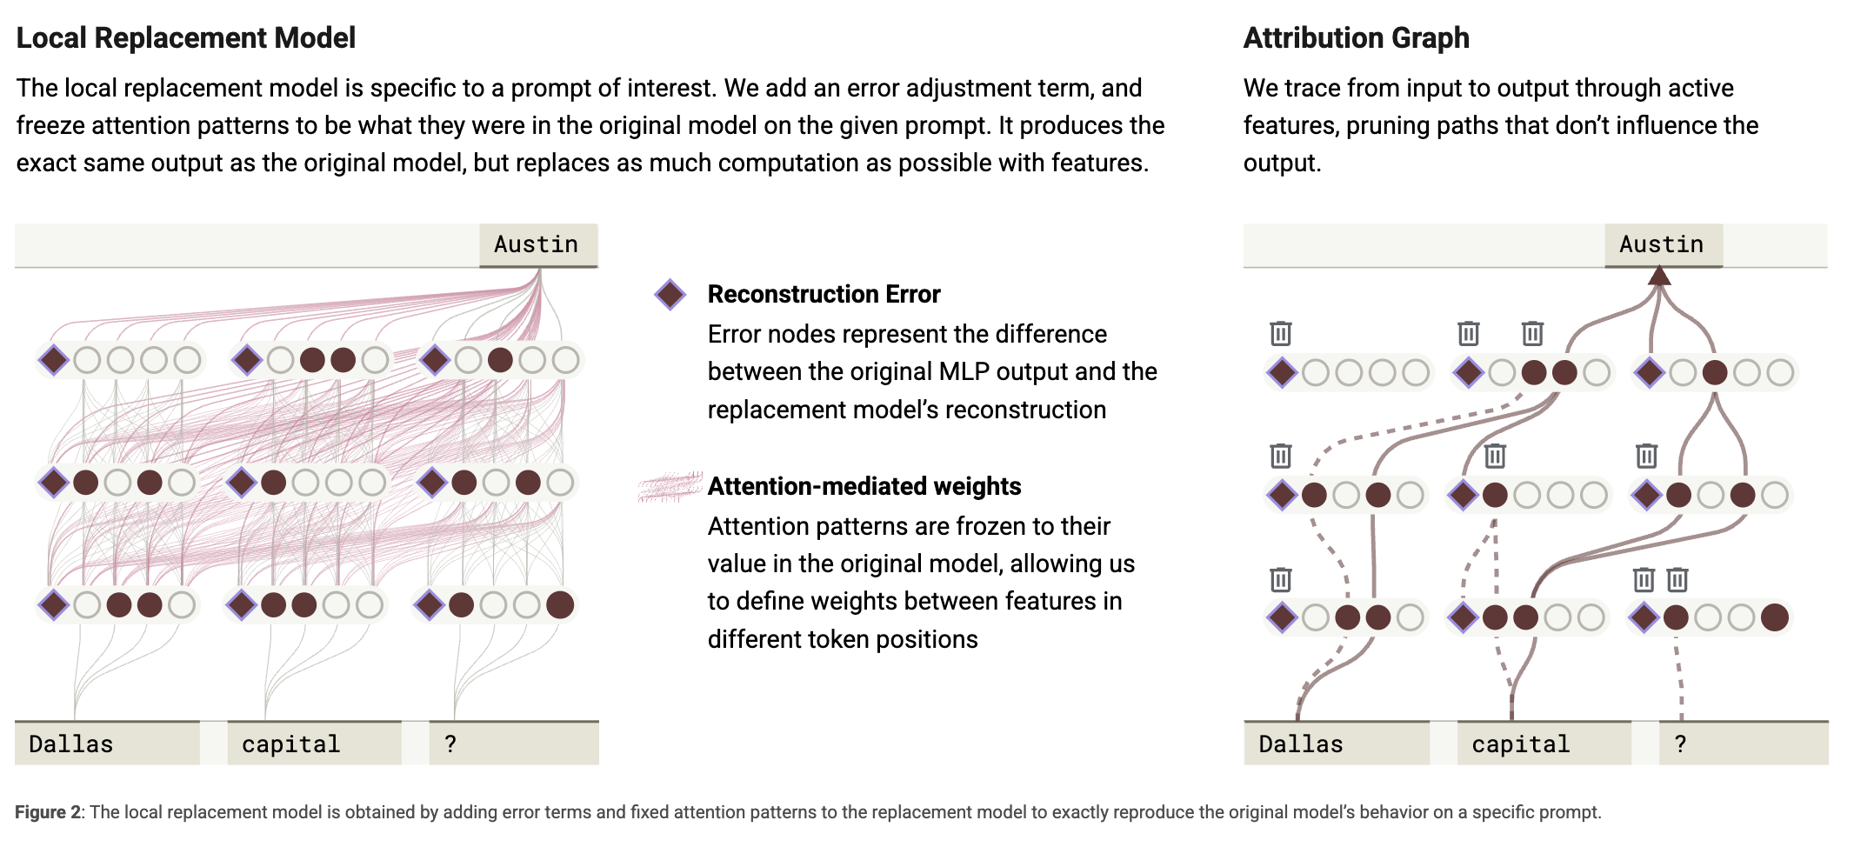
On the Biology of a Large Language Model
Anthropic

Slide 28
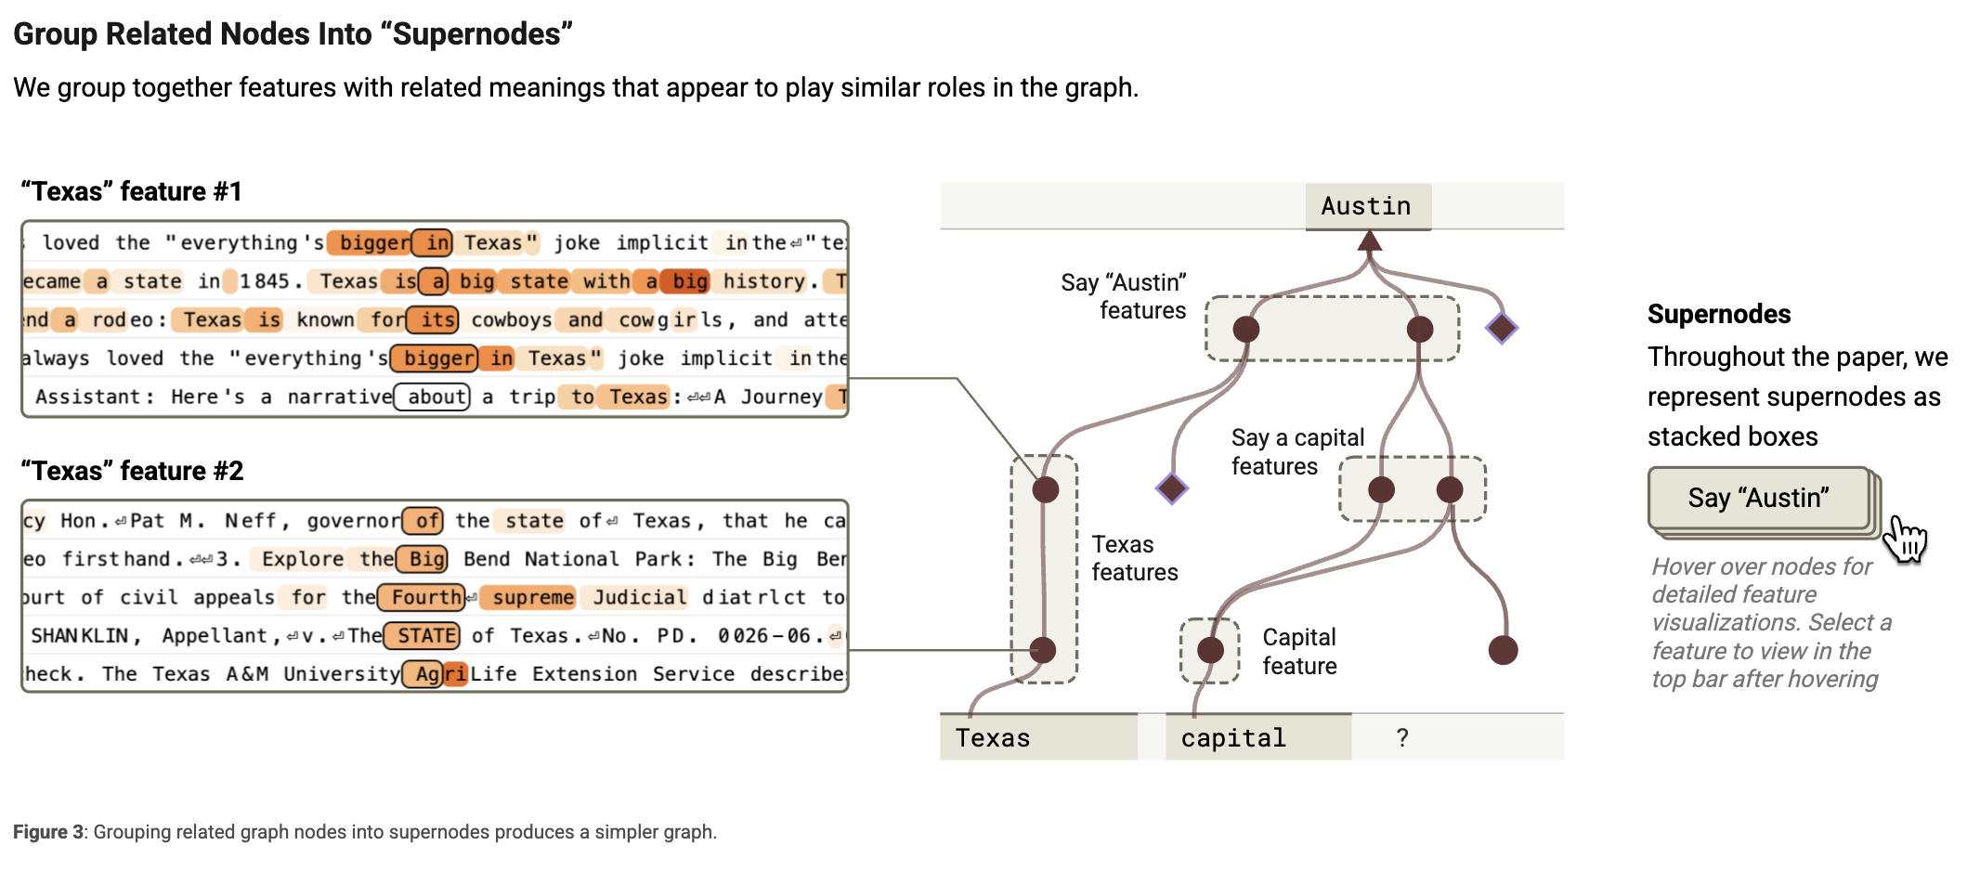
On the Biology of a Large Language Model
Anthropic

Slide 29
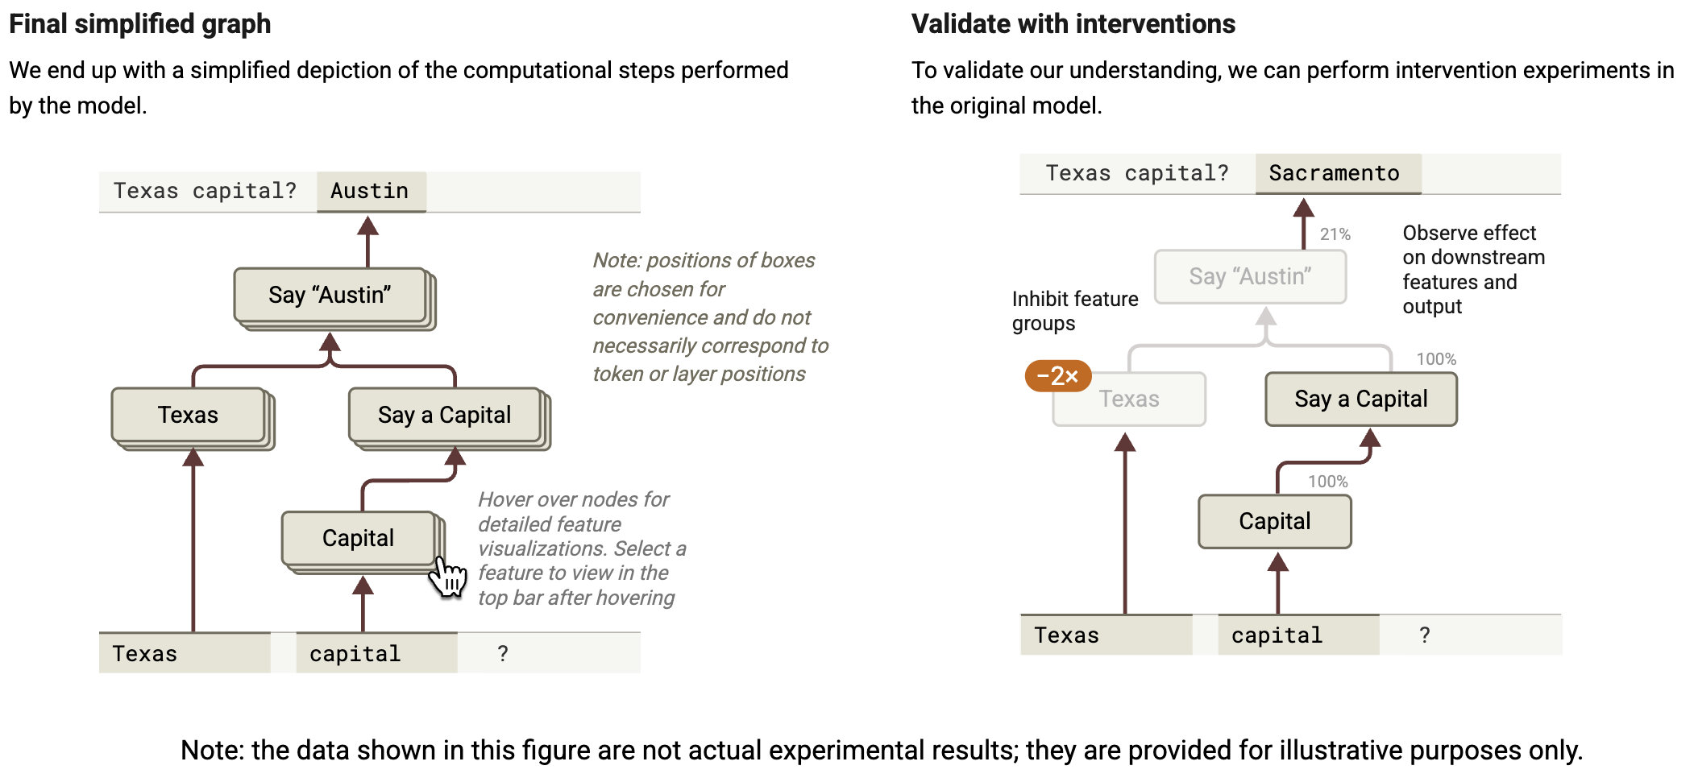
On the Biology of a Large Language Model
Anthropic

Slide 30
Thank you for listening!

Slide 31
Some resources for you to have a look
80,000 hours podcast: leading experts (eg. Head of AI Safety at GDM) have loooong interviews.

Slide 32
A brief history of mechanistic interpretability
Early 2010s
NLPI: NLP researchers start getting interested interp. Probing hidden representations.
MI: Emphasis on CNNs as black box models
2020
2019
GPT 2 gets released
Chris Olah introduces the term "Mechanistic Interpretability" in the thread Circuits → MI community
Popularised terms like features and circuits
The context is still visualisation
Early 2020s
GPT-3 gets released → MI migration starts
Some frustration from NLPI community but gradual merging: from blogs to papers
Mid 2020s
Merging of communities
Anthropic work often becomes the focus
Notes:
Inspired by Saphra et al (2024), which gives rise to the narrow/broad and technical/cultural definitions.
2010-2020: it is important to understand that ML meant mostly vision models based on CNNs. NLP worked on statistical models like bag of words, and then slowly
Nanda tweets in 2023: “We're currently refining my grokking work to better fit academic interests and language and are submitting it to a peer-reviewed AI venue. This was a bunch of effort, but I'm really hoping this can get more awareness and interest in mech interp from academic communities!”
Distill.pub : a journal which operated 2016-2021 and included the Thread called Circuit. Here Chris Olah (among others) contributed to mechinterp techniques in the area of visualisation.

